Slide 1
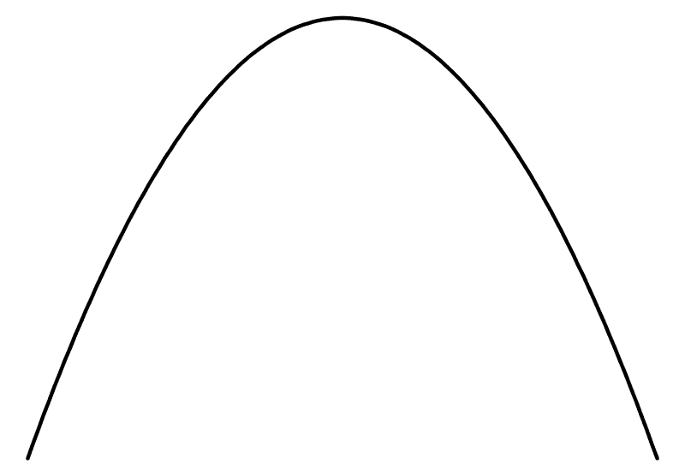
det(A - Λ 1) = Λ² + 1
Λ

