Slide 1
How to: Lightweight material pipeline
Using a Khronos SPIR-V Toolchain

Slide 2

What to expect:
  Introduction into SPIR-V toolchain
  SPIR-V toolchain by example
  SPIR-V cross reflection
  ShirabeEngine Material System

Slide 3
Introduction - the SPIR-V toolchain:
Q: What is the SPIR-V toolchain?
A: A collection of standalone tools linked together:
    glslang
    SPIR-V tools
    SPIR-V cross

Slide 4
glslang – the GLSL reference compiler
Repository: https://github.com/KhronosGroup/glslang
Project Home: https://www.khronos.org/opengles/sdk/tools/Reference-Compiler/
glslang is a OpenGL and OpenGL ES shader front end and validator.
There are several components:
  A GLSL/ESSL front-end for reference validation and translation of
  GLSL/ESSL into an AST.
  An HLSL front-end for translation of a broad generic HLL into the AST.
  A SPIR-V back end for translating the AST to SPIR-V.
  A standalone wrapper, glslangValidator, that can be used as a command-
  line tool for the above.

Slide 5
SPIR-V tools - Overview
Repository: https://github.com/KhronosGroup/SPIRV-Tools
The SPIR-V Tools project provides an API and commands for processing SPIR-V modules.
The project includes:
    dis/assembler (spirv-as/spirv-dis)
    validator (spirv-val)
    dot-graph generator (spirv-cfg)
    optimizer (spirv-opt)
    module statistics dumper (spirv-stats)

Slide 6
SPIR-V cross – shader reflection
Repository: https://github.com/KhronosGroup/SPIRV-Cross
SPIRV-Cross is a tool designed for parsing and converting SPIR-V to other shader languages.
Features:
    Convert SPIR-V to readable, usable and efficient GLSL, MSL &HLSL
    Convert SPIR-V to a JSON reflection format [EXPERIMENTAL]
    Reflection API to simplify the creation of Vulkan pipeline layouts
    Reflection API to modify and tweak OpDecorations
    Supports "all" of vertex, fragment, tessellation, geometry and compute
    shaders.

Slide 7
SPIR-V cross – shader reflection
Reflection API: https://github.com/KhronosGroup/SPIRV-Cross/wiki/Reflection-API-user-guide
We can use the SPIR-V cross shader reflection module to extract all sorts of interfaces to the material shaders.
    Stages & stage inputs/outputs and their locations & types
    Uniform buffers & their set/binding indices
    Uniform buffer members, their bindings, types, ...
    Sampled Images & their set/binding indices
    Subpass inputs and their locations
    So much more, we’d possibly still be here tomorrow...

Slide 8
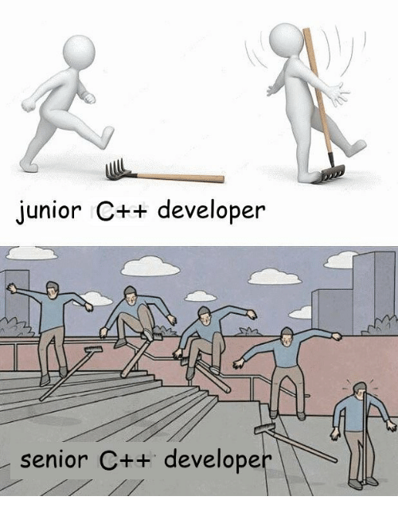
ShirabeEngine
(調べ – [Shirabe] jap. → research )
→ My neverending hobby & life-time project.
→ Basically my training playground to go
crazy in graphics, C++ and dev. in general.
→ Is currently being extended by:
The Material-System

Slide 9
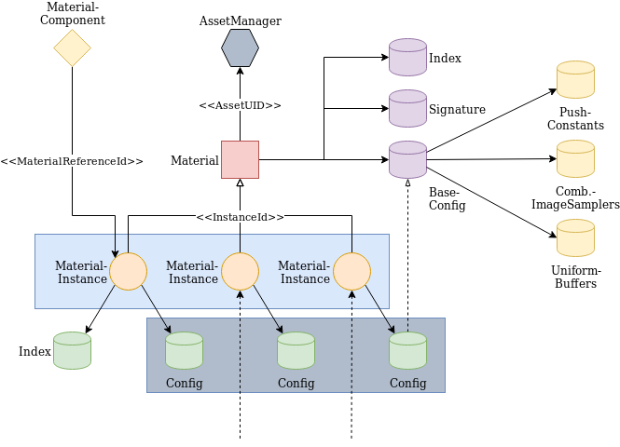
The Material-System – an overview:

Slide 10
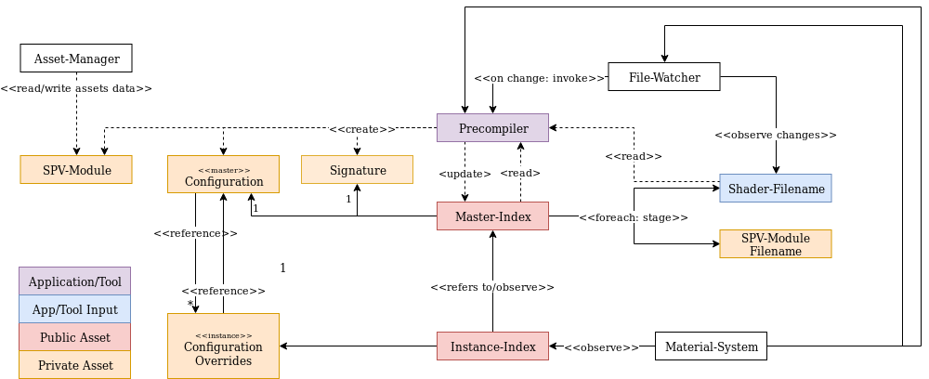
The Material-System – integration:

Slide 11
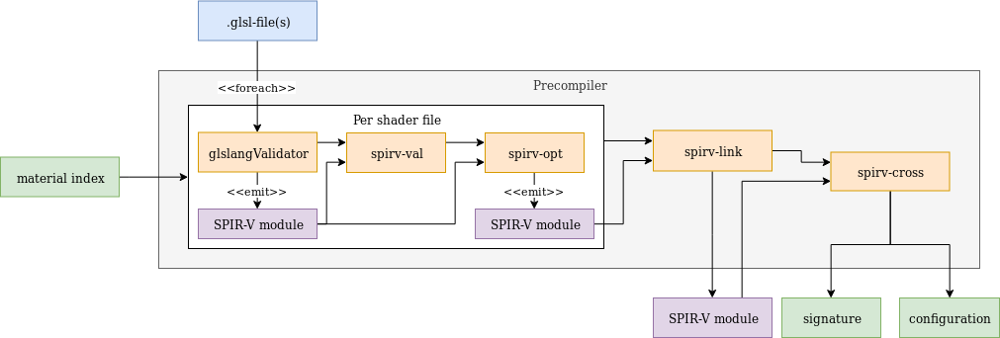
The Material-System – Precompiler:

Slide 12

Questions?
Blog: craft-deploy.it @DottiDeveloper
(new born, more to come soon… :P)

