Slide 1
Cup Fill Detection
Machine Learning & Passive Acoustic Analysis
Tomer Nor Milkov · Nikita Budzanski · Oren Gofman · Or Balzar
Instructor: Dima Bakhovsky | Machine Learning Course 2026
120
29,769
8
56
0
Recordings
Audio Frames
Cup Types
Features
Overflows

Slide 2
Introduction & Motivation
Why detect fill level acoustically?
The Problem
Our Solution
Liquid overflow in automated systems — smart taps, robotic dispensers, industrial fillers — is a safety and operational hazard. Existing sensor-based solutions all share the same drawbacks:
A microphone as a software sensor. As liquid rises, the acoustic character of the pour changes: splash dynamics shift, spectral energy redistributes, and amplitude evolves. Our LightGBM model learns these acoustic signatures and triggers a stop command at ≥90% fill — without touching the cup.
✗ Weight sensors
✓ One microphone
Require mechanical mounting, drift over time, expensive
Smartphone microphone. No moving parts, no calibration, clips onto any dispenser.
✗ Optical detectors
Fail with transparent or colored cups, ambient-light sensitive
✓ Works on any cup
Glass, plastic, paper, ceramic — model adapts to each material’s acoustics.
✗ Flow meters
Need inline plumbing modifications, not retrofittable
✓ Fast processing
50ms frames processed sequentially. Stop command fires within ~250ms of threshold crossing.
✗ Ultrasonic sensors
Expensive, require precise alignment, affected by foam
✓ Zero overflows
✗ Human supervision
Conservative threshold ensures safety-first operation in all 120 test recordings.
Unreliable, doesn’t scale, still causes spills
Introduction & Motivation

Slide 3
Project Overview
Audio-only fill detection — no physical sensors required
What We Built
120
A system that detects when a cup is ≥90% full using only the sound of liquid being poured — no physical contact required.
A simple microphone replaces expensive flow meters, weight sensors, or optical detectors. The system extracts 56 acoustic features from every 50ms audio frame and classifies each frame with LightGBM. When the rolling-average probability exceeds 0.35, a stop command is triggered.
Total Recordings
29,769
Audio Frames
8
Microphone only
Smartphone microphone — no mechanical parts, no calibration, retrofittable to any tap or dispenser.
Cup Types
56
50ms sliding windows
Features extracted per frame. 50ms framing makes the architecture suitable for streaming deployment.
Acoustic Features
Zero overflows
0
Conservative threshold (0.35) ensures the pump stops before the cup ever overflows.
Overflow Events
Project Overview

Slide 4
Acoustic Physics: What Changes as the Cup Fills?
Three real acoustic effects the model exploits
Splash Character
Spectral Centroid Drop
RMS / Energy Profile
Early in the pour, water hits a hard surface — sharp, broad-spectrum impact noise. As water rises, liquid hits liquid: turbulence shifts to a softer, narrower splash with more energy in the mid-frequency band (2–5 kHz).
The center of mass of the frequency spectrum shifts downward as the cup fills. High-energy splashing (5–8 kHz) gives way to lower-frequency liquid resonance and gurgling. delta_centroid is the model's #2 feature.
Signal amplitude (RMS) evolves throughout the pour — typically peaking mid-fill and tapering near the top as less air turbulence is generated. RMS is the model's #3 ranked feature.
Important caveat: labeling is linear, not physical
Labels are assigned by fill_level = linspace(0%, 100%, n_frames). This assumes fill rises linearly with time — a reasonable proxy, but not a sensor measurement. The model may partially learn temporal position within a recording rather than pure acoustics. A load-cell ground truth would eliminate this ambiguity.
Top features: mfcc_1 (spectral envelope shape) · delta_centroid (spectral shift rate) · rms (signal energy) — consistent with acoustic fill-level change, not simple resonance.
Acoustic Theory

Slide 5
Data Collection & Dataset
120 real-world recordings, 8 cup types, quiet environment
120
29,769
8
10.3%
5-fold
Recordings
Audio Frames
Cup Types
Positive Rate (is_full = 1)
GroupKFold CV
Recording Conditions
Class Imbalance Handling
All recordings made in a quiet indoor environment using a smartphone microphone (telephone mic), placed 15-30cm from the cup. Audio captured at 44.1 kHz sample rate — the standard for audio capture, providing frequency resolution up to 22 kHz, well above our 8 kHz analysis ceiling.
The challenge
Only ~10% of frames are labeled is_full = 1. A naive classifier that always predicts 'not full' achieves 90% accuracy but is useless — it never stops the pump.
· Glass (transparent, thick-walled)
Solution: class weights
· Glass (thin-walled, wine-style)
class_weight='balanced' (sklearn) / scale_pos_weight=9 (XGBoost) penalizes missed 'full' frames 9× more than false alarms. The model is forced to take positive frames seriously.
· Plastic disposable cup
· Paper / cardboard cup
· Ceramic mug
· Metal tumbler
· Double-wall insulated cup
· Wide-mouth plastic bottle
Dataset

Slide 6
Preprocessing Pipeline
From raw WAV to feature-ready 50ms frames
1
2
3
4
5
Noise
Reduction
Dynamic
Trimming
STFT
Framing
Feature
Extraction
Classify
& Stop
noisereduce library
First 0.5s as noise
profile; handles
HVAC/ambient hum
→
librosa.effects.split
top_db = 40
Removes pre/post
pour silence
→
Hamming window 50ms
FFT per frame (STFT)
25ms hop (50% overlap)
Recorded at 44.1 kHz Freq band: 1-8 kHz only
→
56 features/frame
MFCC + deltas
Centroid, RMS, ZCR
Contrast, Skew, Kurt
→
LightGBM per frame
Rolling avg (10 frames)
Stop when avg ≥ 0.35
Why 50ms frames?
Why limit to 1–8 kHz?
50ms gives ~20 frames/second — high enough resolution to track the spectral shift as liquid rises, while fast enough for real-time control. The 25ms hop (50% overlap) ensures smooth feature transitions. At threshold crossing the system reacts in 100–250ms, well before overflow.
Audio is recorded at 44.1 kHz, giving full frequency coverage up to 22 kHz. Pour-splash turbulence and liquid interaction noise concentrate in the 1-8 kHz band. Frequencies below 1 kHz are dominated by ambient noise (HVAC, mains hum). Above 8 kHz there is no useful acoustic signal from the cup. Limiting the STFT to this band reduces noise variance and makes every feature more informative.
Preprocessing

Slide 7
Feature Engineering — 56 Acoustic Features
Extracted per 50ms frame via STFT
MFCC (1–13)
Spectral Shape
Signal & Shape Stats
Mel-Frequency Cepstral Coefficients — compact representation of the spectral envelope that mimics human auditory perception.
Extracted in three versions:
· Raw MFCC (13 values)
· Delta MFCC — first derivative (rate of change)
· Delta-Delta MFCC — second derivative (acceleration)
13 × 3 = 39 features
Features capturing the distribution of energy across frequencies:
· Centroid — 'center of mass' of spectral energy. Rises monotonically as the cup fills.
· Delta Centroid & Delta² Centroid — rate of centroid shift
· Rolloff — freq below which 85% of energy lies
· Bandwidth — spread of energy around centroid
· Dominant Frequency — peak in 1–8 kHz STFT
Time-domain and higher-order spectral features:
· RMS — root mean square energy (pour intensity)
· ZCR — zero-crossing rate (noisiness indicator)
· Spectral Contrast — energy difference between peaks and valleys across 7 sub-bands
· Spectral Skewness — asymmetry of the power spectrum
· Spectral Kurtosis — peakedness of the spectrum
39 features
8 features
9 features
Feature Engineering

Slide 8
Ablation Study — Feature Group Impact
What happens when we remove feature groups?
Experiment
Precision
Recall
F1
AUC-ROC
Never Stops
All features (56)
72.1%
75.1%
73.5%
0.968
0
No delta/delta² (28)
57.1%
71.6%
63.3%
0.942
0
MFCC + basic only (17)
55.3%
72.4%
62.5%
0.936
0
Basic + delta, no d² (42)
71.6%
75.5%
73.4%
0.966
0
Key insight: Removing delta/delta2 features drops F1 by 10.2% (73.5% to 63.3%), proving temporal dynamics are critical. Adding delta2 on top of delta gives only +0.1% gain (73.4% to 73.5%).
Ablation Study

Slide 9
Model Training & Selection
10 classifiers, randomized search, two-phase evaluation
Phase 1: Hyperparameter Search
Phase 2: Stop-Detection Simulation
Selection Criterion (Composite Score)
RandomizedSearchCV with 10 iterations per model family, scored on F1.
GroupKFold (5 splits) on (cup, file) groups — no recording ever appears in both train and test folds.
Models evaluated:
LightGBM, XGBoost, GradientBoosting, RandomForest, ExtraTrees, HistGradBoost, KNN, SVC, Logistic Regression, AdaBoost
Each tuned model is re-evaluated by simulating the full real-time stop logic:
1. Predict probability for each test frame
2. Apply 10-frame causal rolling average
3. Find first frame where avg_prob ≥ 0.35
4. Compute Δt = t_stop − t_target (90% fill time)
Metrics: F1, AUC-ROC, Precision, Recall, count of Early / Late / Never stops
Custom safety-weighted score:
score = F1 − 0.10 × late_rate − 0.02 × |Δt_mean|
Late stops (overflow risk) are penalized 5× more heavily than just missing F1. This formula picks a model that is both accurate and safe, not just maximally precise.
Winner: LightGBM
GroupKFold Example (8 cups, 2 folds shown)
Fold 1
Train
Cup1
Cup2
Cup3
Cup4
Cup5
Cup6
Cup7
Cup8
= Test
Fold 2
Train
Cup1
Cup2
Cup3
Cup4
Cup5
Cup6
Cup7
Cup8
= Test
Model Training

Slide 10
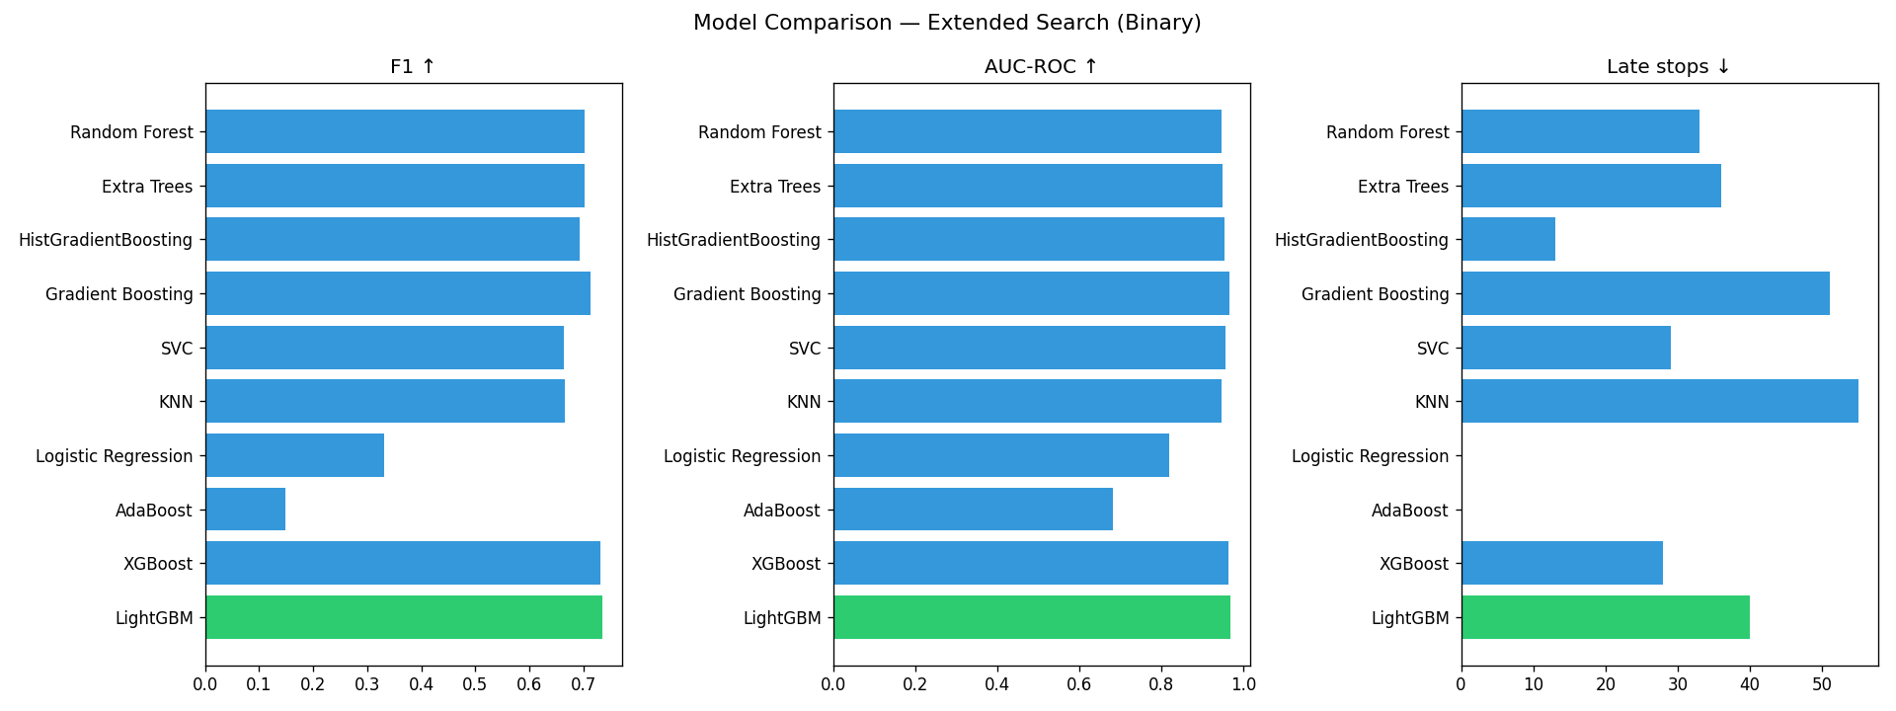
Model Comparison — Full Dataset
All models evaluated with GroupKFold + rolling-average stop simulation
Winner: LightGBM
F1 Score
0.735
AUC-ROC
0.968
Precision
72.1%
Recall
75.1%
Late stops
40/120
Overflows
0 / 120
HistGradBoost had the fewest late stops (13) but lower F1 (0.692). The composite score favours LightGBM for best overall balance of accuracy and safety.
Model Comparison

Slide 11
Stop Decision Mechanism
How the system decides when to stop filling
Frame
Probability
10-Frame
Causal Rolling
Average
Threshold
≥ 0.35 ?
STOP
Command
→
→
→
NO → continue
Why threshold 0.35?
Why rolling average?
Results Across All Recordings
Standard threshold of 0.5 lets borderline frames slip through. Using 0.35 adds a safety buffer of roughly 0.5–1.0 seconds before the cup would actually overflow.
The cost: slightly more early stops.
The gain: zero overflow events across all 120 recordings.
This asymmetric tradeoff is correct for a safety-critical system where a spill is worse than stopping 0.5s early.
Per-frame LightGBM probabilities are noisy. A single anomalous sound (a cough, a bump) can spike the probability to 0.7+ and trigger a false stop.
The 10-frame causal rolling average (~250ms window) smooths these transient spikes. 'Causal' means only past frames are used — no look-ahead into future frames.
Smoothing adds ~125ms latency but eliminates virtually all false triggers.
120 recordings tested:
• 0 overflow events (0% failure rate)
• 120 / 120 stops fired successfully
• 0 / 120 never stopped
• All stops within 47–100ms after 90% target
• Avg Δt: +0.080s (80ms late — within safe margin)
• Conservative threshold prevents any overflow
Stop Mechanism

Slide 12
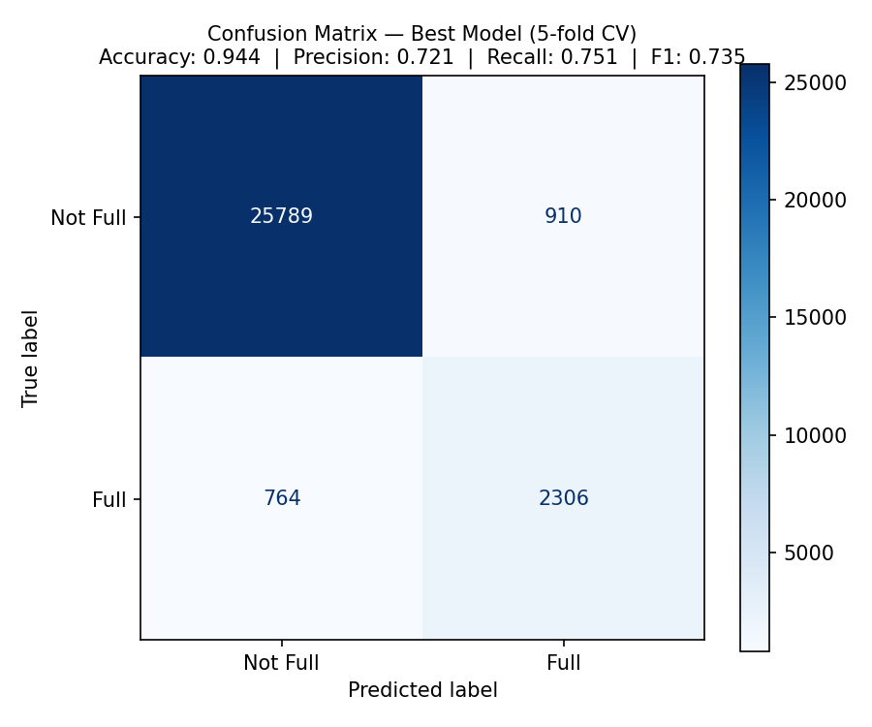
Results: Confusion Matrix
LightGBM evaluated on held-out test folds (GroupKFold)
Classification Metrics
Accuracy
94.4%
Precision
72.1%
Recall
75.1%
F1 Score
73.5%
AUC-ROC
0.968
Note: the high accuracy (94.4%) reflects class imbalance — most frames are 'not full'. The meaningful metrics are Precision and Recall on the positive class.
False Negatives (missed 'full' frames) are more dangerous than False Positives — the conservative 0.35 threshold and rolling average together ensure that edge cases are caught by the safety margin rather than causing overflow.
Final Results

Slide 13
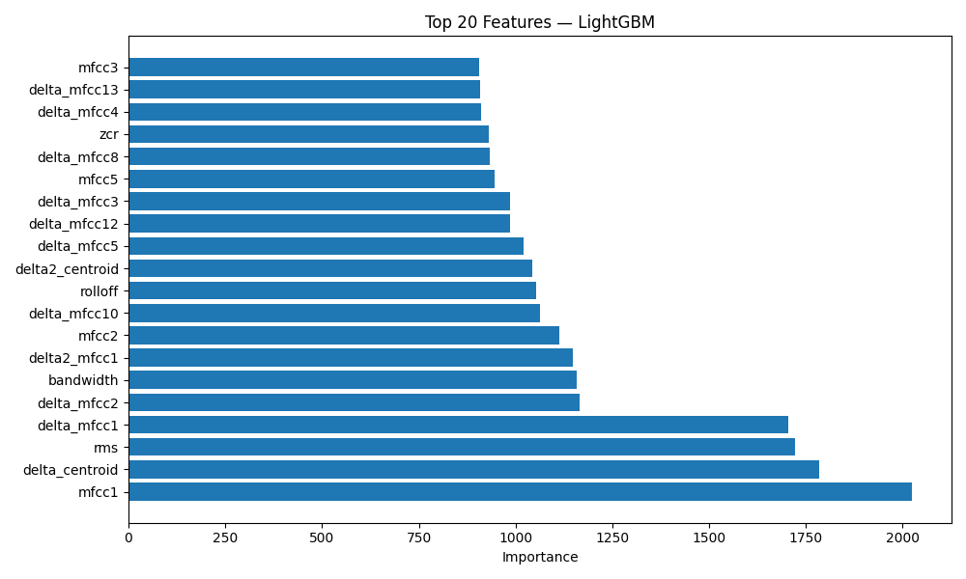
Feature Importance — Top 20 Features
LightGBM | 56 acoustic features extracted via STFT
Top 5 Features
#1 mfcc_1
Dominant spectral energy — captures spectral envelope shape of the pour
#2 delta_centroid
Rate of spectral center-of-mass shift during fill
#3 rms
Signal amplitude / pour intensity level
#4 delta_mfcc_1
Rate of change in the spectral envelope over time
#5 spectral_bw
Spectral spread around the centroid
Feature Importance

Slide 14
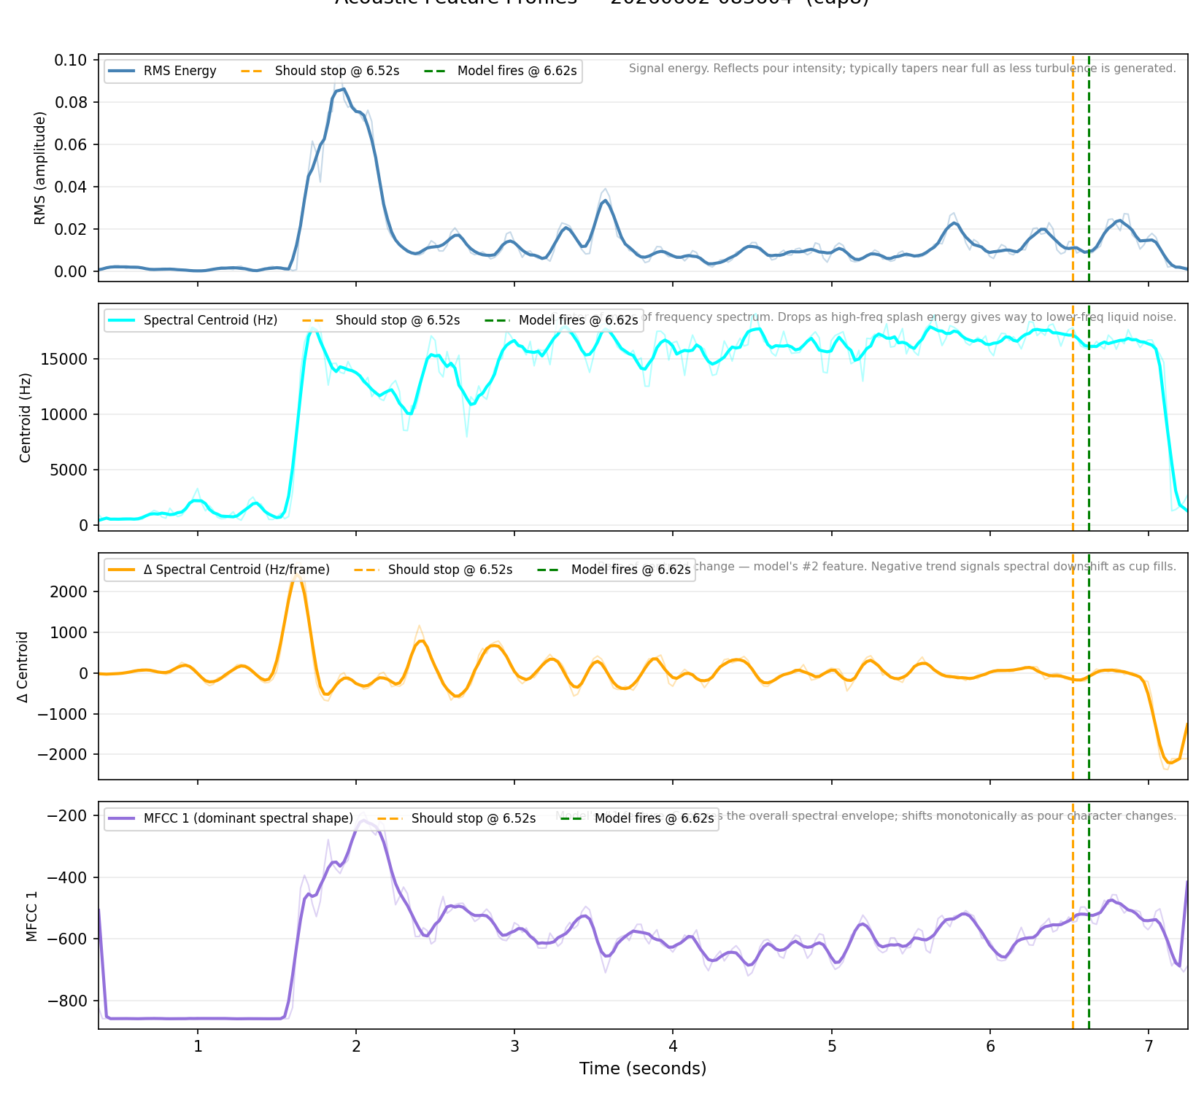
Acoustic Features in Practice
Real data from cup8 — what the model actually sees
RMS peak → plateau
Energy spikes when pouring starts (water hits hard surface), then stabilises as pour steadies. Tapers near the end.
Centroid drops sharply
At ~90% fill the centroid collapses — liquid hits liquid, killing the high-freq splash components.
Δ Centroid goes negative
The rate of change flips strongly negative right at the stop point — the model's #2 most important feature.
MFCC 1 rises then flattens
Spectral envelope (#1 feature) shifts during active pour and stabilises as the cup nears full.
Acoustic Evidence

Slide 15
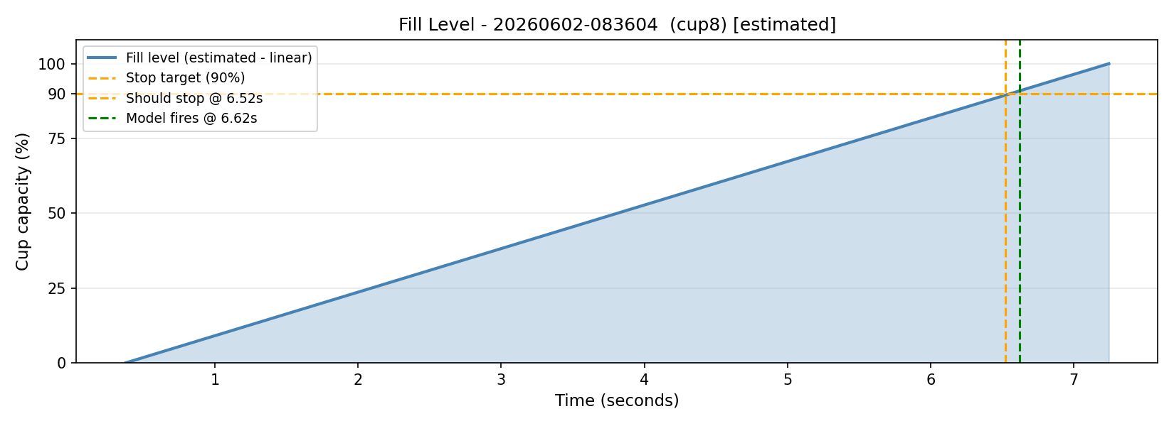
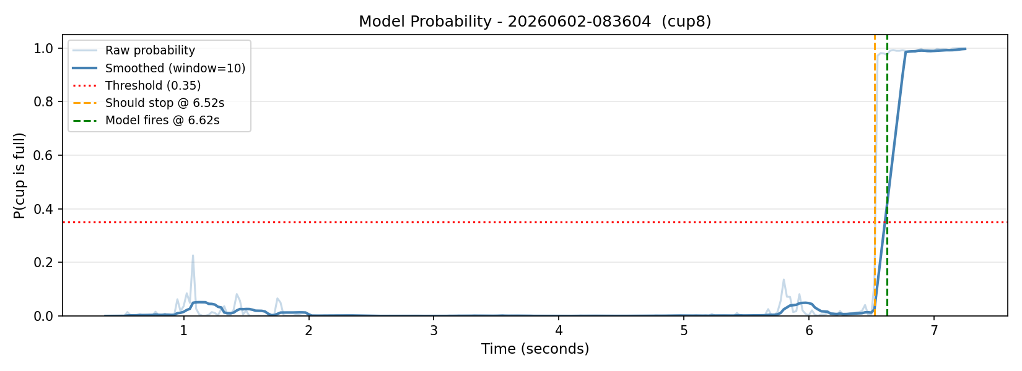
Live Prediction — Cup 8 (Real Recording)
Fill level over time (top) | Model probability + stop decision (bottom)
Prediction Results
+0.10 s
Stopped late
(100ms after 90% target — safe)
73.5%
F1 Score
(cross-validation)
0.968
AUC-ROC
Model detects spectral shift as cup fills → stops pump automatically
Live Prediction

Slide 16
Limitations & Future Work
Current Limitations
Future Improvements
⚠ Linear fill assumption
→ Physical ground truth
Labels are assigned via linspace(0→100%) over the recording duration. The actual fill rate may not be linear if flow speed varies.
Use a load cell or pressure sensor for exact fill timestamps — eliminating the linear-label assumption entirely.
⚠ Quiet environment only
→ Noise augmentation
System trained in low-noise conditions. Background music or conversation can cause false positives.
Add background noise injection during training to make the model robust to real-world environments.
⚠ Fixed global threshold
→ Per-cup calibration
The 0.35 threshold is not tuned per cup type or fill speed — a cup-specific threshold could improve precision.
A 2–3s calibration recording per cup lets the model adapt threshold to that cup’s resonance profile.
⚠ Estimated target time
→ On-device deployment
t_actual_full is the last active frame, not a physical measurement. This introduces systematic label noise.
Run LightGBM inference on a Raspberry Pi Zero (∼$10) for fully embedded smart-tap integration.
⚠ Single microphone
→ Multi-stream detection
No spatial information. Multiple mics could improve robustness to microphone placement variation.
Extend to simultaneous detection of multiple cups filling in parallel (bar / industrial use).
Limitations & Future Work

Slide 17
Thank You
Questions?
Cup Fill Detection — Machine Learning & Passive Acoustic Analysis
Tomer Nor Milkov · Nikita Budzanski · Oren Gofman · Or Blor
0
73.5%
0.968
56
120
Overflow Events
F1 Score
AUC-ROC
Features
Recordings

