Slide 1
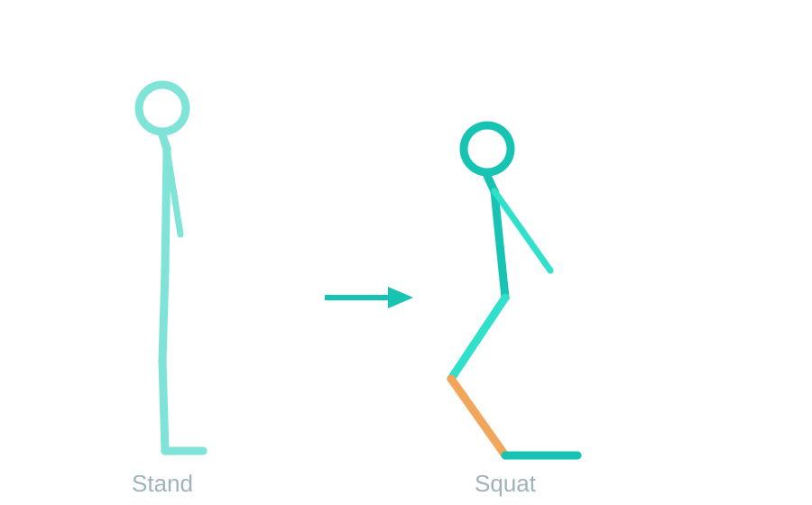
TEAM BONEJAMS
GymPoser
AI Squat Form Checker on Raspberry Pi 4
Real-time squat posture analysis using MediaPipe Pose and a Camera Module v3 — fully on-device, no cloud.
Nguyen Thanh Tai
Nguyen Hoang Anh Duy
Do Viet Bach
1 / 5
Notes:
Intro: who we are and the one-line idea. Affordable device that checks squat form in real time using only a camera and a Raspberry Pi.

Slide 2




What GymPoser Does
Poor squat form risks knee and back injury, and most people train without a coach. GymPoser watches your form from a side-view camera and gives instant feedback.
Detect posture
Recognise the squat
33 body landmarks from one side-view camera, in real time.
A state machine tracks each phase of the movement.
Count & judge reps
Run on the edge
Separates correct reps from incorrect ones.
Everything on a Raspberry Pi 4 — no internet needed.
2 / 5
Notes:
Four objectives. Emphasise the on-device constraint: no cloud, all processing on the Pi itself.

Slide 3
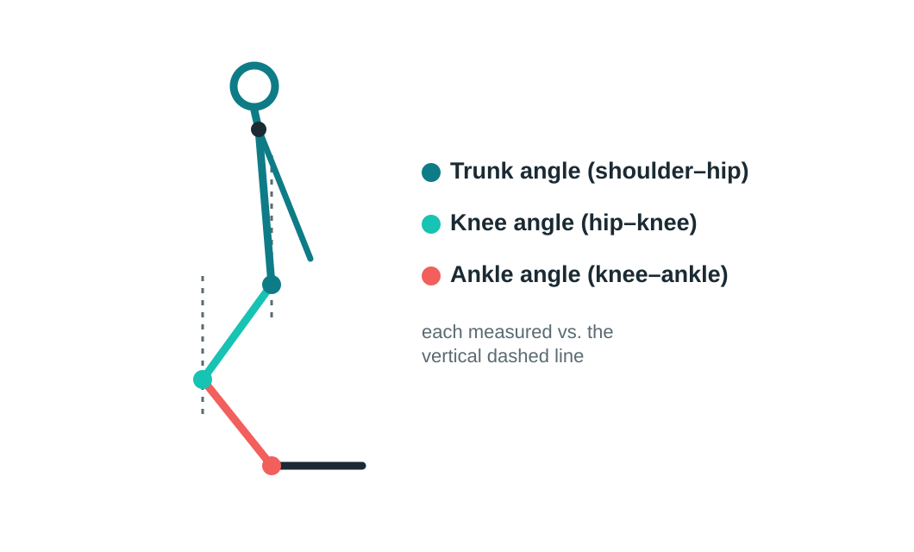
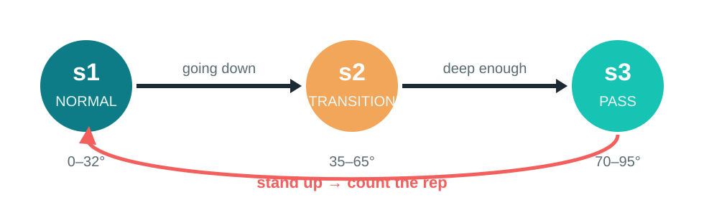
How It Works
Three joint angles, measured against the vertical, drive a three-state machine.
Squat finite-state machine
A valid rep = s1 → s2 → s3 → s2 → s1, performed without a form error.
Live feedback at the bottom of the squat:
leaning too far forward · knees past the toes · not deep enough
3 / 5
Notes:
Core technical slide. Walk through the three angles, then the s1/s2/s3 states and what a valid rep looks like. Slow down here.

Slide 4
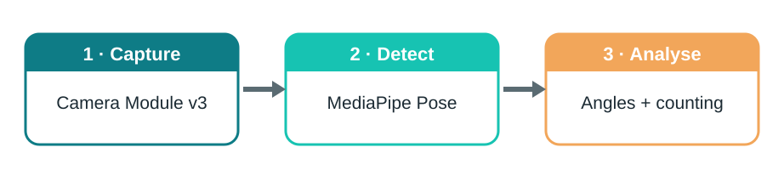

Hardware & Platform
Processing pipeline
OS requirement
MediaPipe needs 64-bit Bookworm. The newer Trixie (Python 3.13) is not yet supported.
↓ Generates the form feedback and the correct / incorrect rep count.
Raspberry Pi 4
Camera Module v3
64 GB microSD
5V / 3A power
8 GB RAM model
Sony IMX708 sensor
Class 10 / A1
+ heat sink / fan
4 / 5
Notes:
Hardware list and the data pipeline. Stress the OS lesson: must be 64-bit Bookworm, not Trixie.

Slide 5
Challenges & Project Status
Engineering hurdles we solved
Last-minute hardware failure
OS compatibility — re-imaged to 64-bit Bookworm
Headless SSH access set up over a phone hotspot
Network isolation between Pi and laptop diagnosed
Lag traced to power / thermal throttling
The software was complete and ready. Shortly before this talk, the Pi’s microSD card became corrupted — the OS stopped responding and the screen went black.
Root cause: repeated power interruptions during testing damaged the card — a hardware fault, not a logic flaw.
Lesson & next steps
Reliable power and graceful shutdown matter as much as good code. Next: restore the device, stream annotated video to a laptop, and extend to more exercises. Full design and methodology are documented in our report.
5 / 5
Notes:
Be calm and confident. Frame the SD-card failure as a lesson learned, not an apology. Pivot quickly to next steps and the report.

