Slide 1
QUEUELESS SA
Give people back the time they lose waiting.
A working citizen and service-centre queue operating system
Notes:
Imagine waking up at 4 a.m. just to queue at Home Affairs, only to find hundreds of people already waiting. Some spend half the day there just to renew an ID or collect a document. QueueLess SA gives people back their time by allowing them to join a virtual queue, track their position in real time, and arrive only when they are about to be served.
[Sources]
- QueueLess SA project-authored concept and prototype.

Slide 2
The queue starts costing people before service begins
LOST INCOME
Hours away from work, family, or school.
CROWDING
Too many people arrive at the same time.
UNCERTAINTY
People travel without knowing the wait or outcome.
2
Notes:
Connect the problem to the lack of visibility before a person travels.
[Sources]
- QueueLess SA hackathon problem statement supplied by the project team.

Slide 3
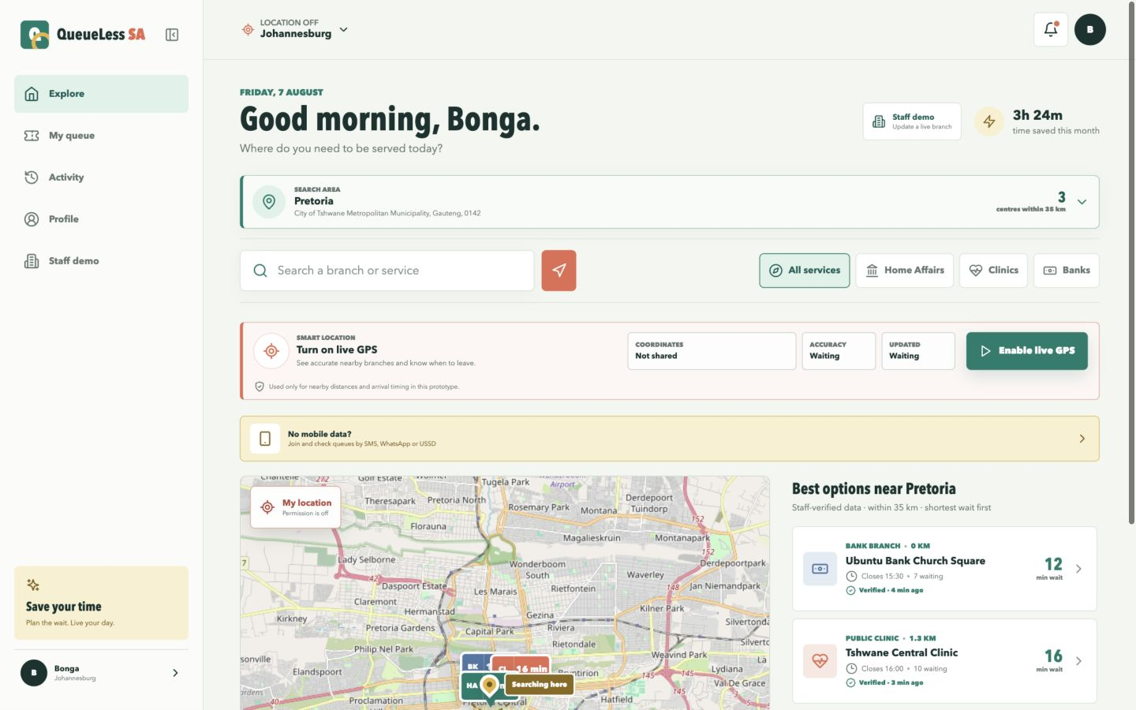
The queue becomes visible
Citizens plan with trusted information
Compare verified waits, capacity, services, distance and travel time before leaving. Staff updates and citizen decisions use the same branch state.
3
Notes:
Point to the verified queue list, selected search area, service map, GPS state, and direct Staff demo entry.
[Sources]
- QueueLess SA working prototype screenshot, captured 7 August 2026.
- OpenStreetMap contributors: https://www.openstreetmap.org/copyright

Slide 4
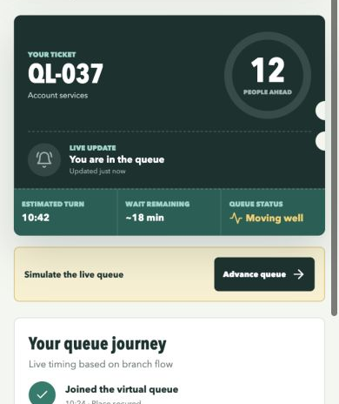
Citizens wait remotely and complete the visit
01
Join remotely
02
Hear the leave-now alert
03
Navigate and check in
04
Complete service; Activity updates
4
Notes:
Use the live prototype to join, advance the queue, hear leave-now and next alerts, check in, mark the service complete, and show the updated Activity totals.
[Sources]
- QueueLess SA working prototype screenshot, captured 7 August 2026.

Slide 5
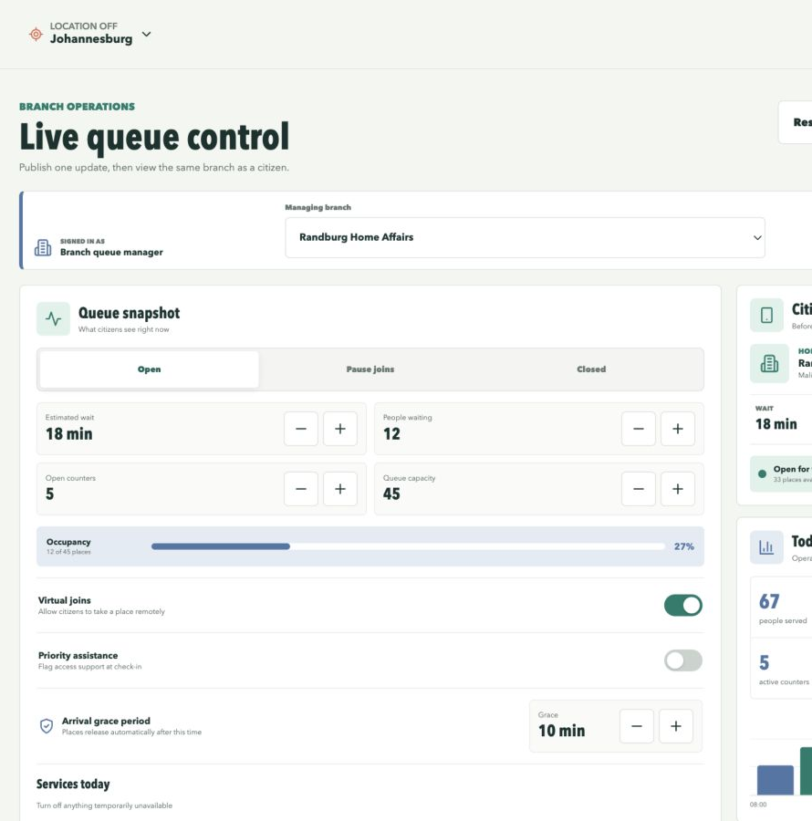
Staff publish live conditions
A visible source of queue data
Staff publish wait, people, counters, capacity, closures and service availability. Citizen screens update immediately with a verification time.
5
Notes:
In the live demo, close Pretoria Home Affairs, publish, and return to the citizen app to show the fresh status.
Explain that synthetic conditions prove the operating model; a pilot would connect a ticketing feed or authenticated staff account.
[Sources]
- QueueLess SA working prototype screenshot and project-authored operating model, captured 7 August 2026.

Slide 6
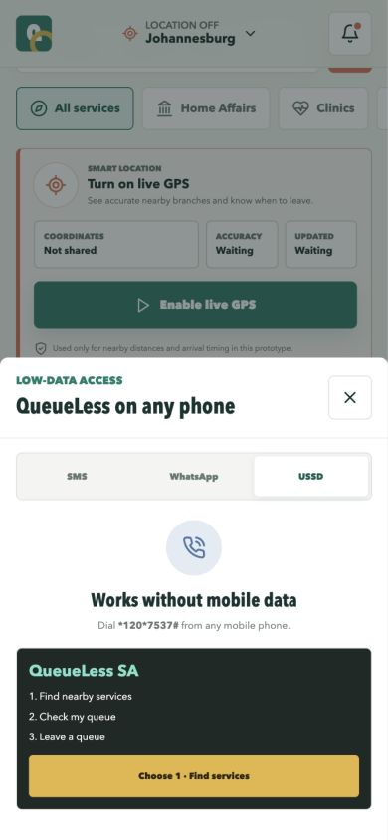
QueueLess works without data
One service, three access channels
The same queue journey is demonstrated through SMS, WhatsApp and USSD. Full queues also offer appointments or distance-ranked alternatives.
6
Notes:
Demonstrate the USSD menu and say clearly that production messaging providers are not connected in the prototype.
The creative angle is inclusion: QueueLess is designed for any phone, not only a smartphone with data.
[Sources]
- QueueLess SA working prototype screenshot and project-authored access concept, captured 7 August 2026.

Slide 7
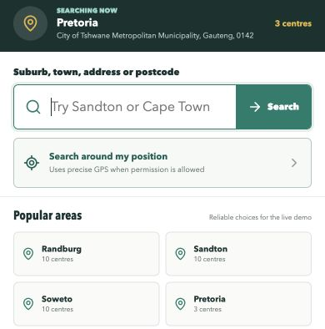
Search areas update live
Live search with proof
Search a real South African place. QueueLess recentres the map, recalculates nearby services and distances, notifies the user, and records the source and time in Activity.
7
Notes:
Use Pretoria as the live demo. The explicit Search button keeps API usage controlled.
[Sources]
- QueueLess SA working prototype screenshot, captured 7 August 2026.
- Nominatim Search API: https://nominatim.org/release-docs/latest/api/Search/
- Nominatim Usage Policy: https://operations.osmfoundation.org/policies/nominatim/
- OpenStreetMap contributors: https://www.openstreetmap.org/copyright

Slide 8
Every tool supports something visible in the demo
NEXT.JS + REACT
App and interactions
LEAFLET
Map and markers
OPENSTREETMAP
Tiles and place data
NOMINATIM API
Live place search
GEOLOCATION
Precise position
WEB AUDIO
Sound alerts
LOCALSTORAGE
Device persistence
GOOGLE MAPS
Turn-by-turn directions
8
Notes:
Keep this slide quick: every technology supports a feature visible in the demo.
[Sources]
- QueueLess SA package.json and application source code.
- Nominatim Search API: https://nominatim.org/release-docs/latest/api/Search/
- OpenStreetMap copyright and attribution: https://www.openstreetmap.org/copyright

Slide 9
One pilot can prove how much time QueueLess returns
CONNECT
PILOT
PROVE
One trusted queue feed
Link ticketing data or authenticated staff updates.
One high-volume branch
Train staff and launch citizen and low-data access.
One measurable result
Track waits, crowding, no-shows and hours returned.
9
Notes:
Close with a concrete ask: approve one high-volume branch and one pilot period.
Our goal isn't just to reduce queues; it's to give South Africans back their time.
[Sources]
- QueueLess SA project-authored pilot recommendation.

