Slide 1
Project Presentation

Slide 2
Intro

Slide 3
Lattices

Slide 4
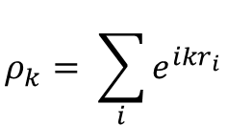
Ewald Summation – Coulomb Long Range Forces
Since we are dealing with Li-ions in an external electric field we need coulomb forces
Split coulomb potential/force into k-space and real-space segments
$$V_{Ewald}= \frac{1}{2V}\sum_{i≠j}{q_{i}q_{j}\sum_{\vec{k}≠0}{\frac{4π}{k^{2}}{\left|ρ(\vec{k})\right|}^{2}e^{{−k^{2}}/{4α}}}} −{\left(\frac{α}{π}\right)}^{1/2}\sum_{i=1}^{N}{q_{i}^{2}}+ \frac{1}{2}\sum_{i≠j}{\frac{q_{i}q_{j}∙erfc\left(\sqrt{α}r_{ij}\right)}{r_{ij}}}$$
$${\vec{F}}_{Ewald}= q_{i}\sum_{j}{q_{j}\frac{1}{V}\sum_{\vec{k}≠0}{\frac{4π∙\vec{k}}{k^{2}}e^{{−k^{2}}/{4α}}∙Sin\left(\vec{k}∙{\vec{r}}_{ij}\right)}}+ q_{i}\sum_{j}{q_{j}}\left[2\sqrt{\frac{α}{π}}e^{−αr_{ij}^{2}}+ \frac{1}{r_{ij}}∙erfc\left(\sqrt{α}r_{ij}\right)\right]\frac{{\vec{r}}_{ij}}{r_{ij}^{2}}$$
$$ρ_{k}= \sum_{i}{e^{ikr_{i}}}$$

Slide 5
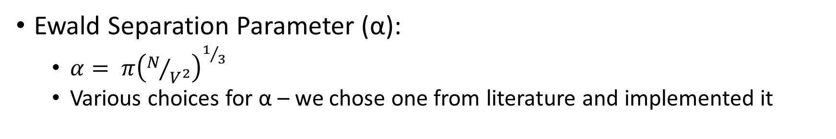
Parameters for Ewald Summation
Ewald Separation Parameter (α):
  $α= π{\left(N/{V^{2}}\right)}^{1/3}$
  Various choices for α – we chose one from literature and implemented it
Density of K-Space:
  For more complex systems → density of grid should be higher
  Used K-grid used in HW3
  Nmax = 4 → did not see major difference with increase in grid density
  Exponentially increased calculation time
K-grid Nmax number | Time to complete 100 steps (sec)
2 | 306 (6 mins)
4 | 1208 (20 mins)
6 | 4062 (1.13 hours)
8 | 8541 (2.3 hours)

Slide 6
Implementation

Slide 7
Graphs

Slide 8
Tables / trends we find

Slide 9
Conclusions

Slide 10
References

