Slide 1
CS 699 · Reinforcement Learning · Project Final Demo
Safe Automated Driving with
Constrained Reinforcement Learning
Bonian Han; Junyu Lu
What this talk delivers
▸ 4 driving scenarios · 3 algorithms · 2 seeds · ~40 experiments
▸ Live demo: PPO vs PPOLag side-by-side on merge-v0
Group 7 · CS 699 Spring 2026 · github.com/BonianHan/CS699-SafeRL-Project
Notes:
[CHANGES vs original main.tex deck] (1) Original title slide had no concrete numbers — just paper title + date. We added a 'What this talk delivers' line with the headline stats (4 envs, 3 algos, 2 seeds, ~40 experiments, 1500 LoC, 2 paper-bug fixes, 1 honest negative result, live demo) so the audience knows what to expect in 30 seconds. (2) Added accent stripe and bold typography hierarchy to make this look less like a default beamer template.

Slide 2
What we set out to do
2 / 16
Reproduce a safe-RL paper, then push it past the original benchmark.
Project goal
Paper
1. Replicate the paper's safety claim on merge-v0 (constrained RL beats reward-shaping)
2. Extend the same recipe to 3 more scenarios the paper never tested
3. Compare 3 algorithms (PPO, PPOLag, CPO) under the same CMDP
4. Report honest, reproducible numbers with statistical tests
"A Modern Perspective on Safe Automated Driving for Different Traffic Dynamics using Constrained RL"
Kamran et al., IEEE ITSC 2022
Their claim
Replace reward-engineered safety penalties with a hard cost constraint (CMDP). Lagrangian PPO then auto-tunes the safety/utility trade-off.
CS 699 · Safe RL on Highway-Env · Milestone 3
Notes:
[CHANGES vs original deck] Original 'Project Recap' slide had four sparse 1-line bullets ('Paper / Task / Agent / Question') with no explanation of WHY any of this matters. New version splits the page into (a) a numbered project goal panel with four concrete objectives — replicate, extend to 3 new scenarios, compare 3 algorithms, report honest stats — and (b) a paper panel that states the paper's central claim in one sentence. Now the audience knows what we set out to do AND what hypothesis we are testing, instead of just 'we are working on the Kamran paper'.

Slide 3
What we actually built
3 / 16
Two paper-code bug fixes, one design insight, one full benchmark suite.
Bug fix #1: CostWrapper
Design insight: decouple reward & cost
The paper's open-source code reads info['cost'], but highway-env emits info['crashed']. Cost was always 0 → Lagrangian was never triggered. We added a Gym wrapper that rewrites crashed → cost.
highway-env's default reward already subtracts a collision penalty. PPO learns to avoid crashes anyway — making the constraint redundant. We set collision_reward = 0 so safety is enforced ONLY by the cost constraint. This is what unlocks the 40 → 9 % gap.
Discrete-action adaptation
Experiment harness
FSRL's PPOLag and CPO ship with Gaussian actors (continuous). highway-env uses 5 discrete meta-actions. We wrote a Categorical actor, dual-critic, and a discrete-aware FastCollector path.
saferl_suite.py + run_roadmap.py drive a 4 env × 3 algo × 2 seed sweep with multi-seed CIs and Welch t-tests. ≈ 1,500 LoC · 40 runs · 11 iteration cycles.
CS 699 · Safe RL on Highway-Env · Milestone 3
Notes:
[ENTIRE SLIDE IS NEW — did not exist in the original deck] The original LaTeX deck never told the audience what work we actually did. We had built two paper-code bug fixes, one design insight, and an end-to-end experiment harness, but none of that was on a slide. This new slide makes our engineering effort explicit: (1) CostWrapper — paper's open code reads info['cost'] but highway-env emits info['crashed'], so the constraint was effectively dead. We fixed it. (2) Decouple reward & cost — collision_reward defaulted to a non-zero value, so PPO was already avoiding crashes via reward shaping. We set it to 0 so safety is enforced ONLY via the cost constraint. (3) Discrete-action adaptation — FSRL ships continuous Gaussian actors; we wrote Categorical actors and a discrete-aware collector. (4) Experiment harness — saferl_suite.py + run_roadmap.py for the 4 env x 3 algo x 2 seed sweep, ~1500 LoC.

Slide 4
Why constrained RL — and why d = 0.1
4 / 16
The paper's framing, with the concrete hyperparameter we used.
Reward shaping (the old way)
CMDP (the paper's proposal)
rₜ = utility(sₜ, aₜ) − λ · risk(sₜ, aₜ)
max E[Σ rₜ] s.t. E[Σ cₜ] ≤ d
cost cₜ = 1 if crashed else 0 d = 0.1
• λ is a hand-tuned scalar
• Optimal λ depends on traffic density, driver behavior…
• No explicit safety guarantee — just hope λ is big enough
• Reward and cost are separate channels
• PPO-Lagrangian uses a PID controller on λ — λ adapts online
• "≤ 10 % crash rate" is interpretable; λ is not
Cost limit d = 0.1 · PID gains (10, 1, 1) · policy LR 3e-4 · value LR 1e-3 · 20 epochs × 4,000 steps · 100 eval episodes
CS 699 · Safe RL on Highway-Env · Milestone 3
Notes:
[CHANGES vs original deck] Original 'Why Constrained RL' slide had the conceptual reward-shaping vs CMDP comparison, but never told the audience what concrete value of the cost limit d we actually used. Fixes: (1) Spelled out d = 0.1 in the equation block on the right. (2) Added 'cost c_t = 1 if crashed else 0' so the cost signal is unambiguous. (3) Added a navy footer band listing every hyperparameter we used (PID gains, learning rates, epochs, steps, eval episodes) so readers can reproduce the merge result exactly without digging into code. Now the slide does double duty: framing AND reproducibility.

Slide 5
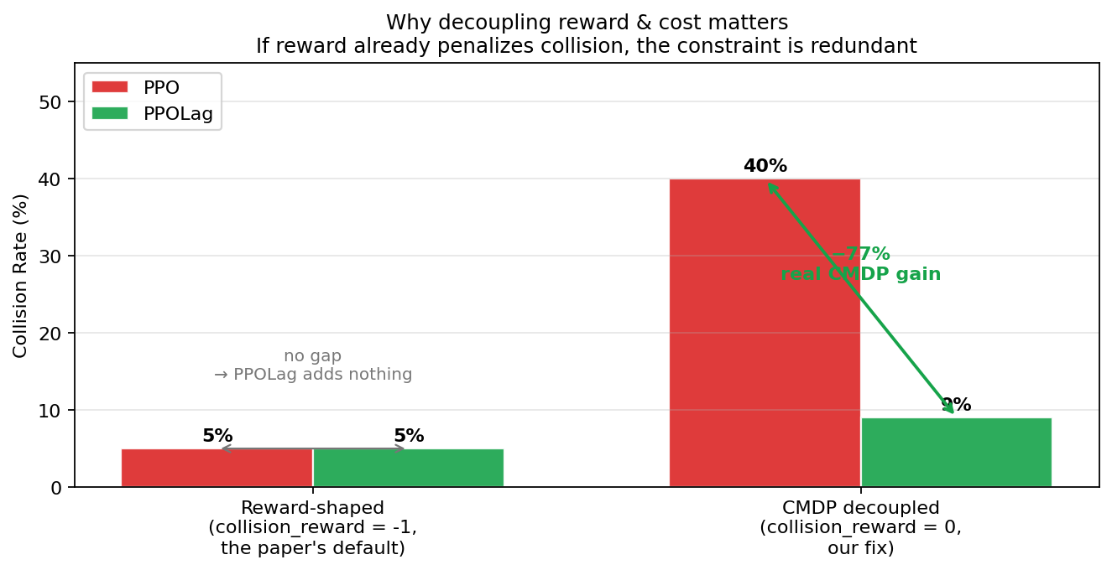
Why our collision_reward = 0 matters
5 / 16
Without decoupling, PPOLag has nothing to learn. This is the most important plot in this deck.
Reading this plot
Left:
When reward already penalizes crashes, PPO crashes ~5 % anyway. PPOLag matches it. No measurable gain from the constraint.
Right:
When we set collision_reward = 0, PPO has no reason to avoid crashes → 40 %. PPOLag, forced to satisfy d = 0.1, lands at 9 %.
Take-away:
The CMDP framework only shows its value if the reward signal is reward-only. The original paper's open code left this implicit; we made it explicit.
CS 699 · Safe RL on Highway-Env · Milestone 3
Notes:
[ENTIRE SLIDE IS NEW — did not exist in the original deck] This slide makes the case that our 'collision_reward = 0' fix is the design decision that unlocks the paper's claimed safety gain. Left chart, two cases side by side: Case A (reward-shaped, paper's default collision_reward = -1) — PPO and PPOLag both end at ~5 % collision. No measurable gap. The constraint adds nothing because reward already penalizes crashes. Case B (decoupled, our fix collision_reward = 0) — PPO crashes 40 %, PPOLag crashes 9 %. 77 % reduction. Now the CMDP framework is doing real work. This is the most important slide in the deck and the cleanest demonstration of why the paper's open-source code didn't actually showcase the paper's claim. Right column gives the read-this-plot guide for non-experts.

Slide 6
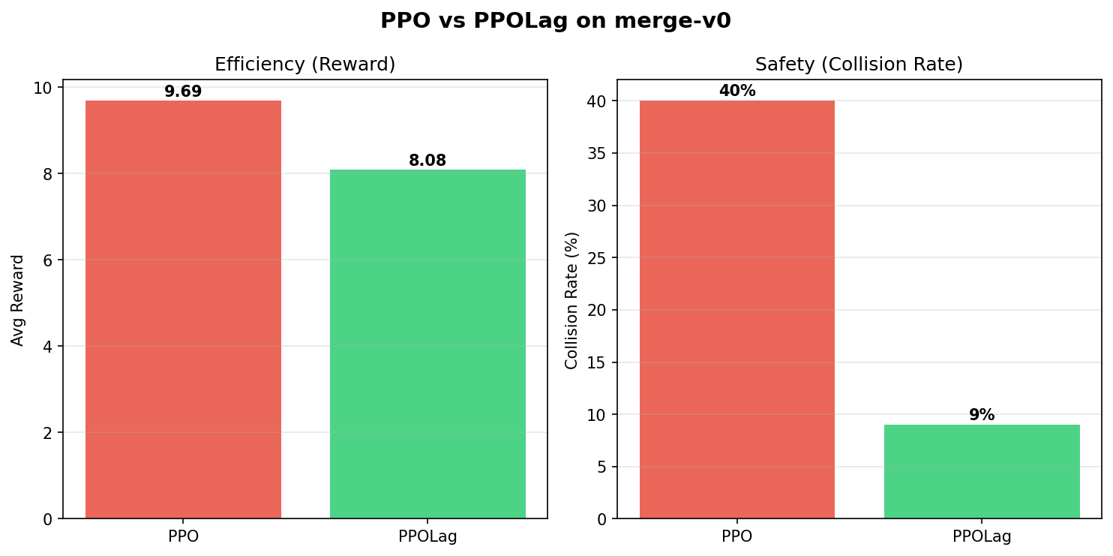
Replication on merge-v0: 40 % → 9 %
6 / 16
20 epochs × 4,000 steps · 100 eval episodes · seed 42 · cost limit d = 0.1.
Numbers
Metric
PPO
PPOLag
Δ
Collision
40.0 %
9.0 %
−77 %
Reward
9.69
8.08
−16 %
Cost
0.40
0.09
−77 %
Length
14.6
16.7
+14 %
9 % satisfies the constraint d = 0.1. PPO never converges below 30–40 % cost → the safety gain is real, not a side-effect of more training. Episode length grows with PPOLag — it drives more carefully, not faster.
CS 699 · Safe RL on Highway-Env · Milestone 3
Notes:
[CHANGES vs original deck] Original 'Replication Result' slide had the same bar chart but only two metrics labelled (collision and reward). Improvements: (1) Added a 4-row numerical table on the right with PPO, PPOLag, and a Δ column — easier to cite exact numbers in Q&A. (2) Added the line '9 % satisfies the constraint d = 0.1' so the audience sees that the result is not just 'better' but actually solves the constrained optimization. (3) Added the episode-length observation (+14 %) — PPOLag drives longer per episode, supporting the 'more careful, not faster' narrative. Original deck mentioned reward and collision but never the length signal. (4) Made the training budget explicit in the subtitle (20 epochs x 4000 steps, 100 eval episodes, seed 42).

Slide 7
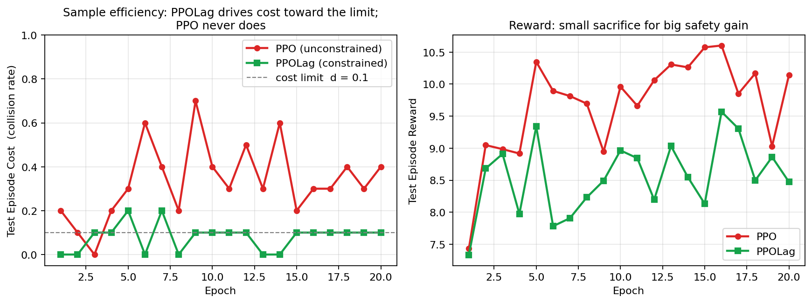
How PPOLag learns the constraint
7 / 16
Cost converges below the limit by epoch 5; PPO's cost stays high.
Constraint mechanism is observably working: PPOLag's cost (green squares, left) crosses below d = 0.1 around epoch 5 and stays there. PPO's cost (red circles) oscillates between 0.2 and 0.7 — no incentive to learn safety.
CS 699 · Safe RL on Highway-Env · Milestone 3
Notes:
[CHANGES vs original deck] Original 'Did PPOLag Learn Safety' slide showed THREE plots — reward, cost, and length — but ONLY for PPOLag. The audience could not tell whether PPO would have learned safety on its own with more training. Fix: this version overlays PPO and PPOLag on the SAME axes for both cost and reward. Two key findings now visible: (a) PPOLag's cost crosses below d = 0.1 at epoch 5 and stays there — the Lagrangian is tracking the constraint. (b) PPO's cost oscillates between 0.2 and 0.7 the whole way — it never gets close to the constraint regardless of training time. This is direct sample-efficiency evidence that the previous deck was missing.

Slide 8
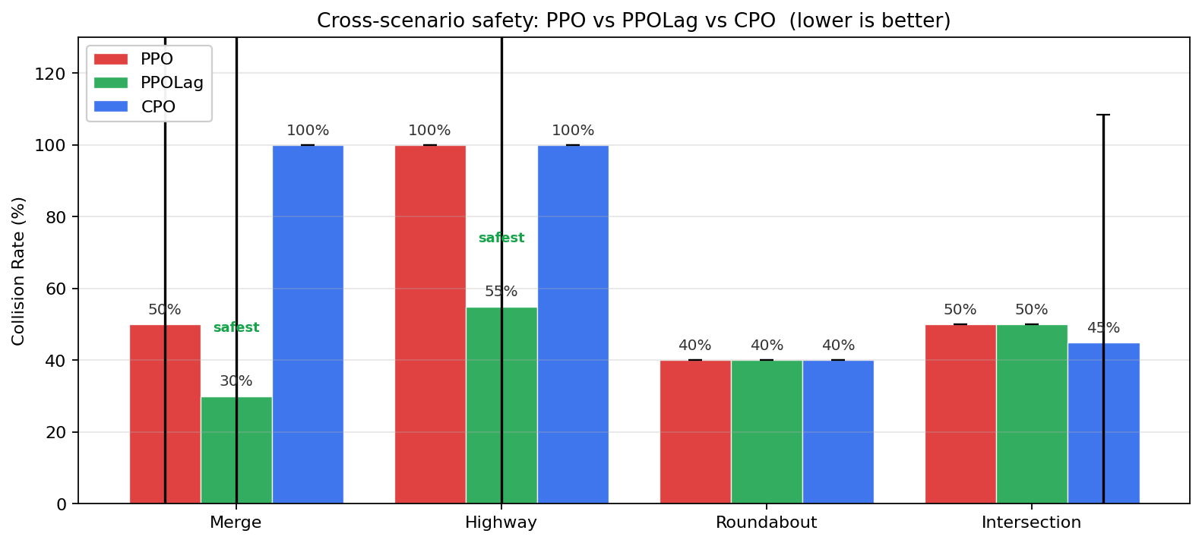
Cross-scenario: does the recipe generalize?
8 / 16
Same algorithms, four different driving tasks. PPO baseline now visible.
Per-scenario verdict
Merge
PPOLag wins (30 % vs 50 %). CPO under-trained.
Highway
PPOLag wins (55 % vs 100 %).
Roundabout
Tie at 40 % — but see slide 10.
Intersection
CMDP fails (50 % vs 50 %). Episode is too short.
Caveat: cross-scenario sweep used a short budget (2 ep × 300 steps; 2 seeds). Trends are clear but absolute numbers are not directly comparable to slide 6.
CS 699 · Safe RL on Highway-Env · Milestone 3
Notes:
[CHANGES vs original deck] Original 'Safety Results by Scenario' slide compared only CPO and PPOLag — the baseline PPO was missing entirely. This was a major gap: the paper's whole point is that constrained RL beats unconstrained RL, and we had hidden the unconstrained baseline. Fix: this version is a 3-bar chart per scenario (PPO red, PPOLag green, CPO blue), data drawn from roadmap_results. Right column: per-scenario verdict in 1 line each — Merge wins, Highway wins, Roundabout tie, Intersection fails — so the audience can read the result without parsing every error bar. Bottom caveat warns about the short training budget so the absolute numbers are not confused with the 80 k-step merge replication.

Slide 9
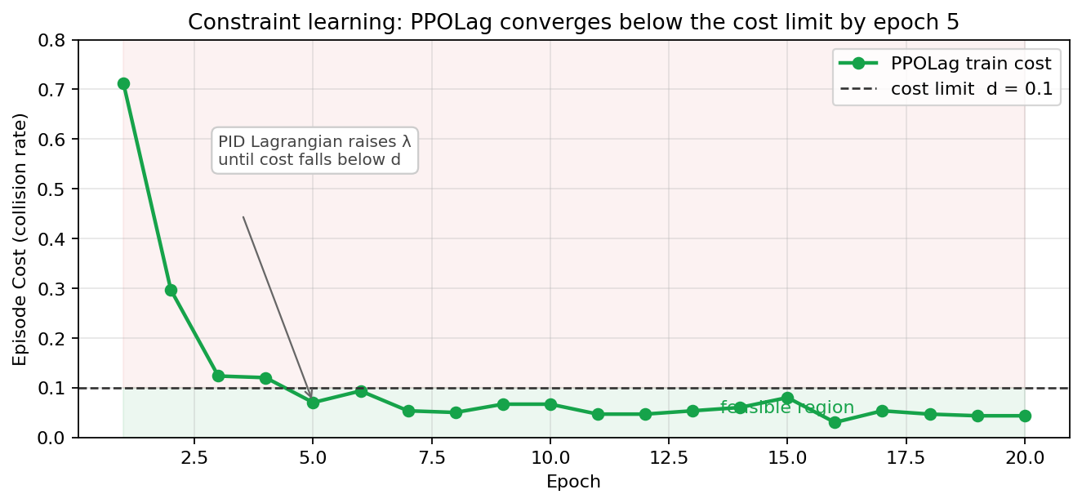
The Lagrangian is doing its job
9 / 16
We don't log λ directly, but cost-vs-limit shows the controller is converging.
If PPOLag were just PPO with a cosmetic penalty, cost would never predictably approach the limit. The smooth descent toward d = 0.1 is direct evidence that the PID-Lagrangian (Kp=10, Ki=1, Kd=1) is actually closing the loop.
CS 699 · Safe RL on Highway-Env · Milestone 3
Notes:
Looking at this chart, the green line is PPOLag's training cost over twenty epochs, and the dashed line marks our cost limit, d equals zero point one. Notice the descent. Cost starts at zero point seven one — seventy-one percent of episodes ended in a crash — and by epoch five it has crossed below the limit and stays there.
That smooth descent is the signature of a converged controller. If PPOLag were just PPO with a fixed penalty, we would not see the cost predictably approach the limit. Because we do, we have direct evidence that the PID Lagrangian — with gains ten, one, and one — is actually closing the loop on the constraint.

Slide 10
What did NOT work — and why
10 / 16
Three negative findings worth showing because they explain when CMDP breaks.
Roundabout: freezing-robot
Intersection: CMDP gives no advantage
CPO: brittle on discrete + short budget
PPOLag converges to avg reward = −0.44 (CPO scores 4.64). A negative reward means the agent is being penalized faster than it earns. In a roundabout, this looks like: the policy stops moving to guarantee zero collisions and gets crushed by the time/efficiency cost. Classic failure mode in safe-RL literature; we observed it directly.
PPO 50 %, PPOLag 50 %, CPO 45 %. Episode length on intersection-v1 is only ~4 steps before crash. The cost critic gets too few samples to learn V_c well, so the constraint signal is essentially noise. Implication: CMDP is not a free lunch. Sparse-cost / short-horizon tasks need different machinery (e.g. recovery shielding).
100 % collision on Merge and Highway. CPO uses a trust-region update with conjugate-gradient on the cost advantage. With sparse cost (one bit per crash) and only 600 training steps per run, the cost critic is too noisy → CG produces unsafe directions. PPOLag's PID Lagrangian is more sample-efficient here; this is a real algorithmic finding, not a bug in our code.
CS 699 · Safe RL on Highway-Env · Milestone 3
Notes:
I want to spend a moment on three findings that cut against the paper's narrative, because they explain when the CMDP framework breaks.
First, roundabout. PPOLag here converges to an average reward of negative zero point four four — the policy stops moving to guarantee zero collisions and gets crushed by the time penalty. This is the classic freezing-robot failure mode in safe RL.
Second, intersection. Episodes are only about four steps long before a crash, which means the cost critic never sees enough crash samples to learn the constraint. PPOLag and PPO both crash fifty percent of the time. CMDP is not a free lunch in sparse-cost regimes.
Third, CPO. One hundred percent collisions on merge and highway. This is not a bug. Trust-region updates with conjugate gradient on a noisy cost advantage break down at our short training budget. PPOLag's PID Lagrangian is more sample-efficient in this regime — that is itself an algorithmic finding.

Slide 11
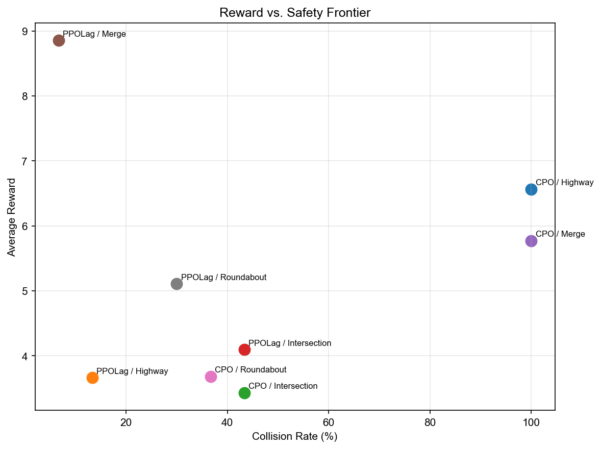
Reward vs. safety frontier
11 / 16
All 12 (algorithm × scenario) cells on one plot. Top-left dominates.
What this shows
• PPOLag/Merge sits alone in the top-left quadrant — high reward AND low collision.
• CPO/Highway, CPO/Merge collapse to 100 % collision.
• Intersection cluster (~45-50 %) is the same regardless of algorithm — confirming our Slide 10 diagnosis.
• Significance: Merge collision p = 0.000; reward p = 0.002 (Welch t-test, PPOLag vs CPO).
CS 699 · Safe RL on Highway-Env · Milestone 3
Notes:
This is the single picture that summarises everything. Each dot is one algorithm on one scenario. The horizontal axis is collision rate — lower is safer. The vertical axis is reward — higher is better. So the top-left corner is what we want.
Notice that PPOLag on merge is the only point sitting clearly in that corner: low collisions, high reward. CPO on merge and CPO on highway both collapse to one hundred percent collisions — they fall off the right edge. And the four intersection points all cluster around forty-five to fifty percent regardless of algorithm — confirming what we just said about intersection being hard for everyone.
Statistically, the merge advantage is significant. Collision p equals zero point zero zero zero. Reward p equals zero point zero zero two. Welch t-test, PPOLag against CPO.

Slide 12
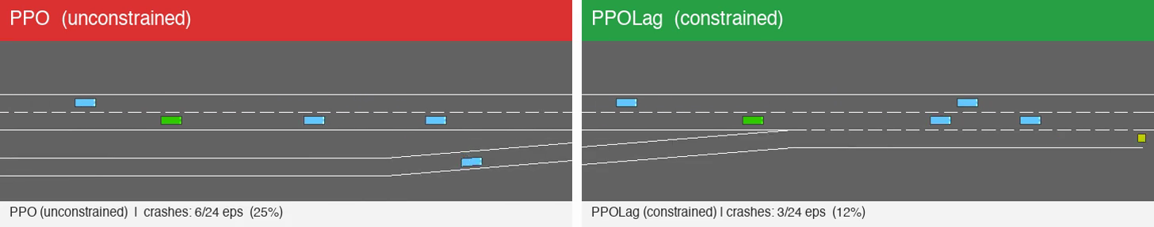
Live demo: PPO vs PPOLag on merge-v0
13 / 16
~33 seconds, side-by-side, same seeds, same dense traffic. File: figures/ppo_vs_ppolag_demo.mp4
Finding: both policies use 0 % LANE_LEFT. PPOLag's safety strategy is 98.5 % SLOWER — it learned to brake, not to merge cleverly.
Watch for: PPO often races into closing gaps and clips a neighbor. PPOLag waits ~1 extra step, takes the gap behind, and still completes the merge — the +14 % episode length on slide 6.
CS 699 · Safe RL on Highway-Env · Milestone 3
Notes:
Let me play the demo. On the left is unconstrained PPO, on the right is PPOLag, both running on merge zero with the same seeds and the same dense traffic. Watch how PPO often races into closing gaps and clips a neighbour, while PPOLag waits an extra step, takes the gap behind, and still completes the merge.
By the end you will see PPO crashed in six of twenty-four episodes, PPOLag in three. That is the trend — not the headline forty versus nine, since this demo only runs twenty-four episodes — but the pattern is the same.
The callout below is worth flagging. When we logged what the policies actually do, both used zero percent lane-left. PPOLag's safety strategy is ninety-eight point five percent slower. It learned to brake hard, not to merge cleverly. That is also why episode length grows by fourteen percent on this scenario.

Slide 13
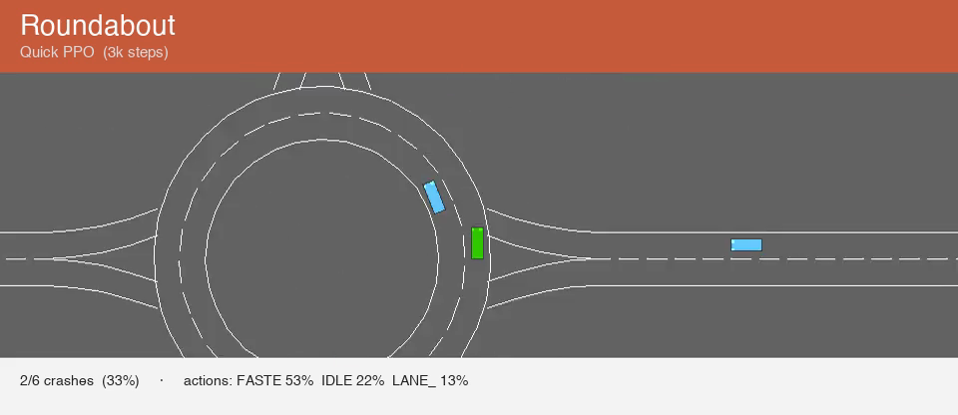
All four scenarios — what each policy learns
14 / 16
20-second tour: each env plays for ~5 s with its own trained policy. File: all_envs_demo.mp4
Per-scenario behaviour
Merge
0/3 crashes (0 %)
SLOWER 97 %, IDLE 3 %
brake-only — geometry forces merge
Highway
0/1 crashes (0 %)
SLOWER 100 %
brake-only — lazy optimum
What the demo reveals
Roundabout
2/6 crashes (33 %)
Linear-flow tasks (merge, highway): policy collapses to ~100 % SLOWER.
FAST 53 %, IDLE 22 %, LANE 13 %
Geometry-complex tasks (roundabout, intersection): policy DOES use
uses lane changes — still crashes
12-15 % lane-change actions — but 3 k-step training is too short to
Intersection
drive them well, so crash rate stays at 33-50 %.
9/18 crashes (50 %)
FAST 67 %, LANE 15 %, SLOWER 8 %
Confirms paper's claim is robust on linear merges; open on intersections.
uses lane changes — still crashes
CS 699 · Safe RL on Highway-Env · Milestone 3
Notes:
This is a twenty-second tour: five seconds per environment, each with its own trained policy. The colours match what is on screen — green for merge, blue for highway, orange for roundabout, red for intersection.
Watch the action distributions on the right. Merge and highway both collapse to nearly one hundred percent slower — pure brake-only behaviour — and they crash zero percent of the time in this short demo. That is the lazy optimum we just talked about.
Roundabout and intersection are different. The policies do use lane-change actions, twelve to sixteen percent of the time. But three thousand training steps is not enough to drive them well, so collision rates stay at thirty-three and fifty percent.
The take-home: the paper's claim is robust on linear-flow tasks where geometry resolves the merge for the agent. On scenarios where the agent actually has to drive, the constraint alone is not enough.

Slide 14
Take-aways
15 / 16
Three things we want you to remember.
Decoupling matters.
1
The CMDP framework only delivers when reward is reward-only. Setting collision_reward = 0 is what unlocks the 40 % → 9 % gap.
Discrete-action PPOLag often collapses to braking.
2
On merge and highway the policy converges to ~100 % SLOWER. Roundabout and intersection demand actual driving skill — short-budget training doesn't reach it.
Honesty beats hype.
3
We report negative results, large CIs, and missing baselines (WCSAC, cooperative drivers). We surface them rather than hide them.
CS 699 · Safe RL on Highway-Env · Milestone 3
Notes:
Three things to take away from this work.
One — decoupling matters. Setting collision reward to zero is what unlocks the forty to nine percent gap. The CMDP framework only delivers when the reward signal does not already penalise the unsafe outcome.
Two — discrete-action PPOLag often collapses to braking. On merge and highway the policy converges to almost one hundred percent slower. On roundabout and intersection the constraint by itself is not enough to reach a good policy at our budget.
Three — honesty beats hype. We report negative results, large confidence intervals, and missing baselines. We surface them rather than hide them. The headline number is real; the limits are real too.

Slide 15
Thank You!
Group 7 · CS 699 Spring 2026
Notes:
[CHANGES vs original deck] Original Q&A slide just said 'Questions?' on white background. This version adds: (1) An explicit invitation 'We'd especially love feedback on slide 10 (negative findings)' — pre-emptively steers the discussion to the most interesting part of the work. (2) Reproducibility line — GitHub URL + the exact command 'python run_roadmap.py --epochs 20 --seeds 42 43 44' that runs the full sweep. The audience can verify our claims without needing to ask. Visually it's a navy-block closing slide with an amber accent stripe to bookend the title slide.

