Slide 1

REST API CONTEXT

Slide 2

What is the Rest Api Context?
Contract and Context
In a task, Dave (Process Designer) explicitly gives what to be updated (this is the contract) : this is the OUT.
Idea is to give to Dave what can be visible: this is the IN
Second idea for Dave is to control the permission on data
Then, idea is to give to the Form Designer the simplicity
All information is given in one REST API. Even in a task, a overview, a archived overview, a process instance.
Context Contract

Slide 3
How to install it?
Install the Rest Context
You are done
Even if the process change, the BDM change : Nothing to update, the code is 100% dynamic
Maybe one day in standard ?

Slide 4
Advantages
1. Simplicity
Access Data (process variables, BDM, parameters) in one Rest Api
2. Powerful
Access BDM (Lazy ? Eager ? Don’t care)
Access variables (Process ? Task ? Parameter ? Don’t care)
Access Java variable (List, HashMap, Enum, even your class)
3. General
Same URL for Instantiation, Tasks, Overview, Archived Overview
4. Protection
Control who can access the data based on location and/or users
Control the Document access too in the process
5. Extension
Extend the REST API by give a Java plugin

Slide 5
1. Simplicity
One URL in the designer:
../API/extension/context?taskId={{taskId}}
Or
../API/extension/context?caseId={{caseId}}
Or
../API/extension/context?caseId={{id}}&taskId={{id}}&processid={{id}}&url={{url}}
url: Javascript : return window.location.href
Sorry, UI Designer use the same parameters id for all
How to | Standard | Rest Api Context
Access 4 process variables ? | 5 call | 1 call
Access 4 variables in a overview and a Archive Overview | 8 call + JavaScript | 1 call
Access BDM with a Eager child list | 2 call + Jquery + Javascript | 1 call
Oups, you change the Eager to Lazy (or opposite ? ) | Re-design your form | Do Nothing
Protect the comment manager ? | Impossible | Yes

Slide 6
2. Powerful
Context allow:
To Access Process Variables, Activity variable
2 different Standard REST API
Access Active or Archive
2 different Standard REST API : impossible to build an overview
JSON access (on Map, List, Datatype)
Standard REST API access only String, Long, Date.
One call from a task
Standard REST API need one call per variable
Protect the process variable
Process Designer can describe which variable can be accessible

Slide 7
3. General
Process designer manage:
Which variable will be updated by the contract
Which variable will be exposed by the context
UI Designer have a simple work
By the contract, he know what he must provide
By the context, he know what he must/should display
And this is only one REST call
Overview form is now possible
UI Designer can create a overview form for Active and Archived case (try it without this REST API !)
BDM can be use
Without be afraid if one person change the EAGER load to a LAZY load ! Else, all forms are broken…

Slide 8
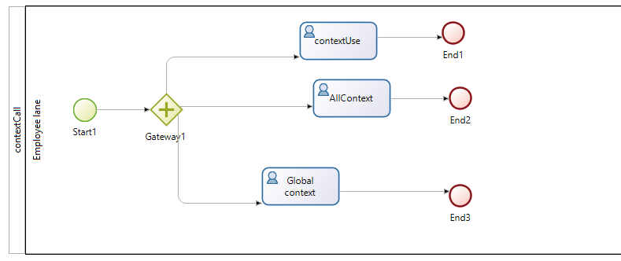
4. Protection
If there are no “REST Context Distribution”:
Process Variable, BDM, Activity Variable (if you give a taskId)
OR a “REST Context Distribution” can be define
At the process level :
this distribution is used in Overview, Tasks
For each task
If a distribution context is given, it is used
{ "validateExpense":"data",
"DateExpense":"data",
"listOfLines":"data",
"decisionManager":data,
"decisionFinancial:"data,
"Amount":"data"}
Task Rest Context Distribution
{ "validateExpense":"data",
"DateExpense":"data",
"listOfLines":"data",
"Amount":"data"}
{ "validateExpense":"data"}
Process Rest Context Distribution

Slide 9
REST Context Distribution for Variables
The “Rest context distribution” is a JSON (store on the SERVER)
Remember, Dave describe the distribution and the contract
Just give the name of variable(s) (process or activity)
Rest Context give the result in one answser, JSON
{ "validateExpense": true,
"AmountExpense": 5453.23
"LineExpense" : [
{ "linenum" : 10,
"datedelivery" : "2016-05-12T15:46:10.399Z",
"shortdesc":"New Car" },
{ "linenum" : 20,
"datedelivery" : "2016-08-08T15:46:10.399Z",
"shortdesc":"Light" },
{ "linenum" : 30,
"datedelivery" : "2016-09-10T15:46:10.399Z",
"shortdesc":"bus" }
]
};
{
"validateExpense":"data",
"AmountExpense" :"data",
"LineExpense" : "data«
}
../API/extension/context?taskId={{taskId}}
Rest Context Distribution

Slide 10
Context for BDM
Ask the BDM variable, and then control the information you want in term of attributes / child
REST Context will manage the Complete / Lazy mode for you (ouf !)
So now you can use the BDM in a UIDesigner, no worry if one guy change the mode
{ "summerOrder" :
{ "name":"Special offer",
"ticket" : { "solicitante":"Banco", "city":"El paso","country":"Mexico" },
"lines" : [
{ "linename": 10,
"ticket" : { "socilitante":"Bruno" },
"price" : 344.33
},
{ "linename": 20,
"ticket" : { "socilitante":"Jhon" },
"price" : 12.00
},
{ "linename": 30,
"ticket" : { "socilitante":"Helen" },
"price" : 982.00
}
]
}
}
{
"summerOrder" : {
"name": "data",
"ticket": "*" ,
"lines" : {
"linename" : "data",
"ticket" : {
"solicitante" : "data"
},
"price":"data"
}
}
../API/extension/context?taskId={{taskId}}

Slide 11
Secure the Data (need)
How to secure the data ? We wants
In a process, user can see only what the designer allow
In a task,
In the process
One difference : on the Overview Page, Helen.Kelly should see the decision of the Manager, when Walter.Bates must not access it.
On the BDM :
BDM is a global information, the Security must apply

Slide 12
2.0: Secure the data
With 2.0, you can secure the data:
Deny REST access to BDM, to Process Variable
Then use only REST Context : only process variable and BDM use in the process are accessible
BDM / Find must not be deny to access in Page
You want to go deeper ?
Create a Rest Distribution on the process / on a task
Then, you can protect the information, to not send the process variable “DecisionOfManager” or the attribute “myExpense.DecisionOfManager” in the BDM

Slide 13
Secure Process Variable (need)
On the access:
First level : process / task access
If the user can access the task, or to a case, he can get an answer
Answer is piloted by the Rest Context Distribution information
Second level : Who you are
For example, Helen.Kelly can access the process variable « DecisionManager »
Anecdotic in a task, interesting in the Overview

Slide 14
3.0: Secure Process Variable : in the distribution
The Rest Context Distribution can describe the security
Keep in mind the BDM is secure by the Security Access Control
In the Rest Context Distribution, use all artefact define in the Secure Access Control concept
You can Use Right concept
Add the « security » in place of Data
{"validateExpense":"data",
"AmountExpense" : "security: User|Walter.Bates, Right|Pentagone, Profile|Administrator",
"LineExpense" : "data"}

Slide 15
Next steps

Slide 16

Objective 1.0
Give a simple access to process variable and activity variables in REST
Manage complexes variables : HashMap and List
Be symmetric with Contract
Concept : Process Designer (Dave) control which variables will be updated, so Dave decide which variable are available
Technical : One RESTCALL to send variable, one REST CALL to get them
Form
Rest Context
Contract
Process variable

Slide 17
Objective 2.0 (current)
Extend
BDM, and don’t manage “lazy” or “eager” !
accept caseId (for overview),
retrieve archive process variable data
Form
Overview
Rest Context
Contract
Rest Context
Process variable BDM
Process variable BDM

Slide 18
Objective 3.0
Extend the mechanism (Custom Page)
Implement a Security Access Control
Ui Designer (Fred)
Form
Page
Process Designer (Anna)
Rest Context Distribution
Rest Context
Contract
Rest Context
Security Designer (Sofia)
Security Access Control
AccessControl Description
Process variable BDM

Slide 19
Secure the BDM
The BDM is global, security must be global
If Walter.Bates can’t access the Invoice, he can’t whatever the access
Form
Page
Rest Context
Rest Context
Security Access Control
InvoiceHeader
Invoice Lines

Slide 20

How to manage Security in BDM ? A matrix
Walter Bates can access some data, and some not. Then, if Walter Bates has the accreditation « Public » and « Confidential defense »,he can access the invoice 245 and 563
In the data, he may be not allow to access the attributes Decision
Of course, the same mechanism apply on Lines in the BDM => All objects should have a AccessData

Slide 21

Security access : principle
Data has an accessData
Table have col
Via the SecurityMapping, user get access.
Security Access Control
InvoiceHeader:Decision
InvoiceHeader:Number
SecurityMapping
Public
Secret Defense
Confidential Defense

Slide 22
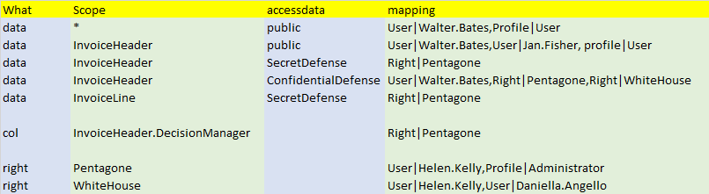
How to implement it ?
Each data contains a column « accessdata », a String
A SecurityMapping give the access control
Data : manage by the Access data
Col : access to a column
Right : alias

Slide 23
Use case
Leave request :
Users create a leave Request if they have enough in the bank
During the validation, only the users and managers can see the request
After validation, process waits the end of the physical vacation, to update the payroll.
User access
William.Jobs can access all leave Request (this is the manager)
Helen.Kelly is the manager of the R&D team, he can see / modify all requests of its team
Walter.Bates can modify only its request during the validation, after he can only SEE it and he can see the validated request of the person in the same team

Slide 24
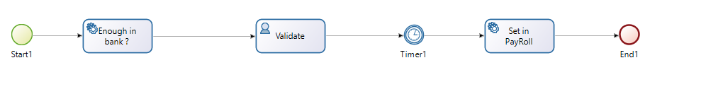
Process / Data / Security
Process / Life cycle / Security : 3 independents concept
Process can modify the life cycle,
Security may change too during
All changes may be pilot by the process
Data live after the end of the process
Create Leave Request
Creation
Process
Data(BDM)
Security
Validate
Done
In validation
Planned
Complete
Private
Public team

Slide 25
Implementation 1
Pure “accessData”
One accessData per user
leaveRequestWalter.Bates (Walter, Helen, Williams)
LeaveRequestDanielaAngelo (Daniela, Helen, Williams)
One access data per team
LeaveRequestR&D (Walter,Daniela,Helen,Williams)
LeaveRequestSales (Jan.Fisher,Williams)

Slide 26
Implementation 2
AccessData + Distribution
One private accessData per team
Leave Private R&D (Helen.Kelly,William.Bates)
Walter Bates access the information via the process
Save the reduce information in a Local Variable, and send the variable on the Distribution
One public access data per team
LeaveRequestR&D
LeaveRequestSales

Slide 27
Context Contract

Slide 28






Thank you, and…
STAY CONNECTED WITH US!
CORPORATE WEBSITE
Product & Services descriptions,
References, Webinars, White papers
OPEN SOURCE COMMUNITY
Forums, Contributions, Source Code
youtube.com/ bonitasoft
twitter.com/ bonitasoft
linkedin.com/groups?gid=3182097
facebook.com/ bonitasoftbpm

