Slide 1
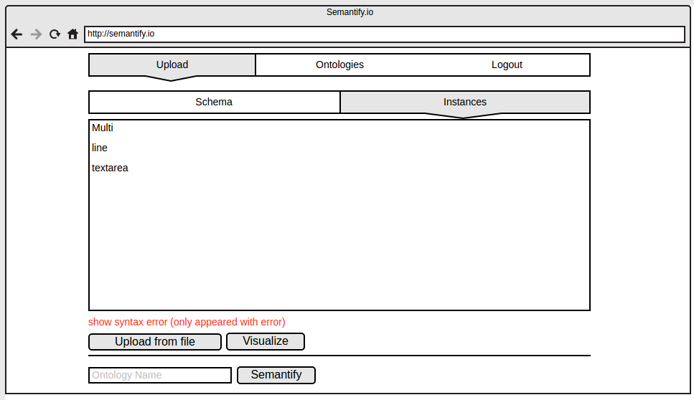
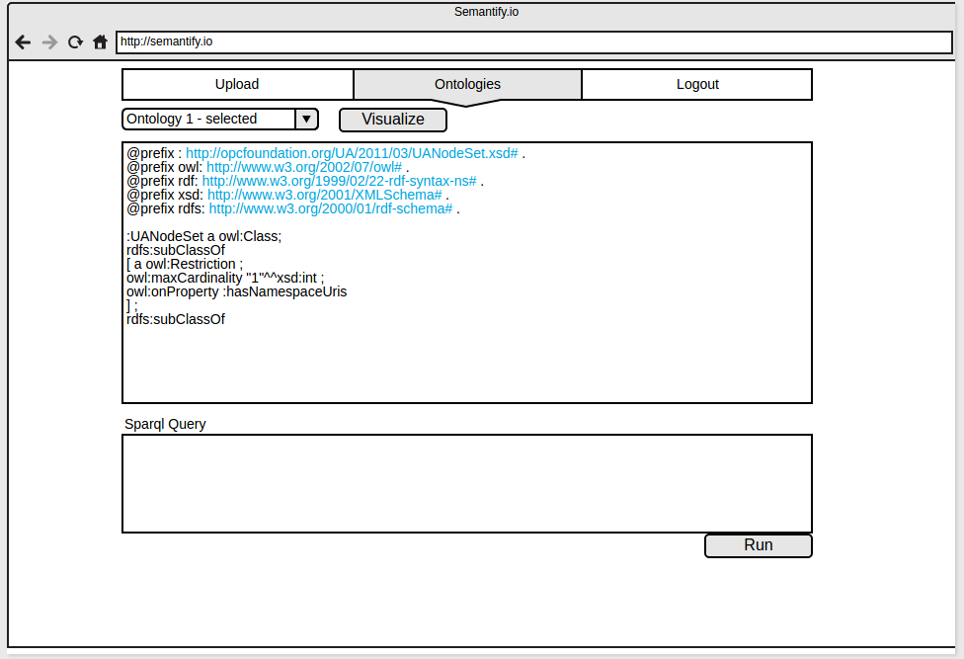
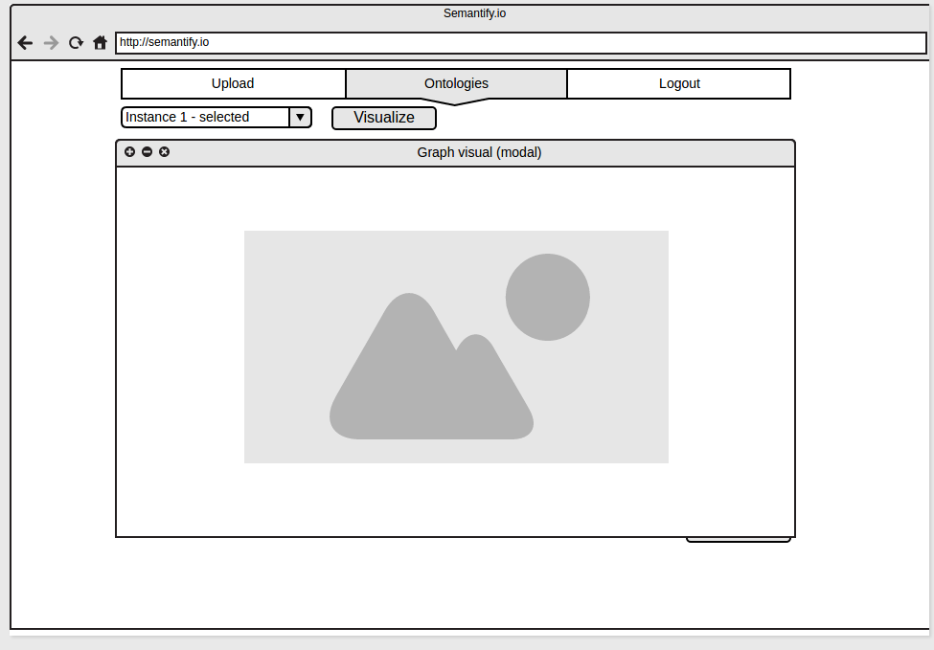
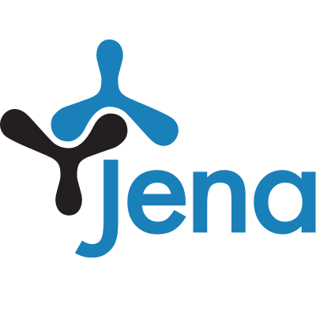
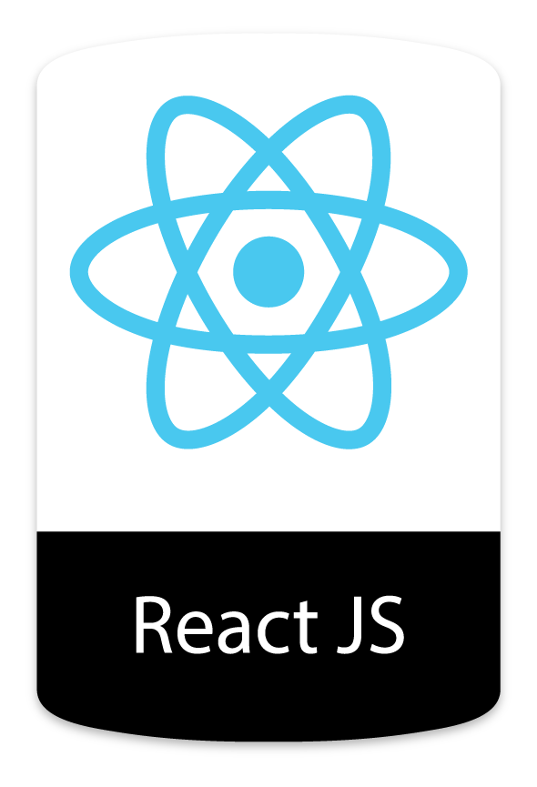
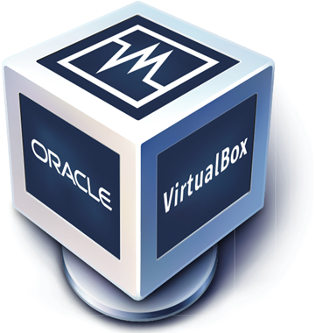



Semantify.IO
Logo/Icon
A web-based tool to semantify the knowledge of standards
Motivation
Challenges
Industry 4.0 (I4.0) is a term coined in Germany to refer to the fourth industrial revolution. Under this concept we find another one, Machine to Machine (M2M), which refers to the communication between devices using a specific channel. One of the protocols implementing the interoperability is OPC Unified Architecture (OPC UA). This standard is implemented with XML.
We are proposing a web tool to translate the schema and instance files from XML into OWL vocabularies.
We faced the next challenges:
Few relevant works managing similar problems. That forced us to consult the documentation.
Few (although enough) material to work with. Because the access to the original files was restricted and private.
From OPC UA to Ontology
To accomplish this we used a modified version of Ontmalizer… (add more info and images here)
Results
We built a web-tool where is possible to upload, validate, transform, and visualize schema and instances of OPC UA standard into OPC ontologies.
Parsing
Conclusions and open problems
In this work we deal with the OPC UA standards, however, it is not the only M2M protocol that exists. We think it is possible to extend the current implementation to different M2M solutions, for example, AML. Given the increasing popularity of IoT, we think that is possible to build new things over our project.
Tools
<Virtual Machine Description>
Hostname: vm-<???>
Software installed:
Installed on: EISX, Java EE X.X.X,
Local Access:
OS User: eis-user
Password: <INCLUDE HERE>
Remote Access:
Partner ID: 51220xxxx Password: <INCLUDE HERE>
EIS
Enterprise
Information Systems

