Slide 1
Vocabulary based-integration Web tool for Industry 4.0 Standards
Mentor:
Irlán Grangel-González
Group members:
Aleksandr Korovin
Shinho kang
Alexey karpov
Omar Trinidad Gutiérrez Méndez

Slide 2
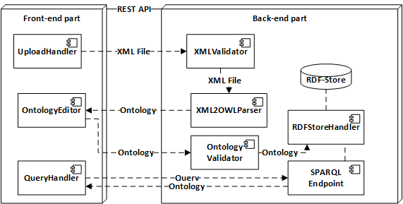




Architecture

