Slide 1
Web-based tool to semantify
the knowledge of a standards
with semantic technologies
Mentor:
Irlán Grangel-González
Group members:
Aleksandr Korovin
Shinho Kang
Alexey Karpov
Omar Gutiérrez

Slide 2
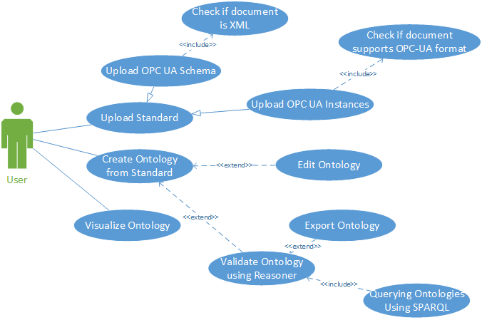

Slide 3
Functional requirements
Upload OPC UA files
    Schema and Instances
Validate XSD/XML files
Validate ontologies
  Using a reasoner
Create ontologies from standard

Slide 4
Functional requirements (ii)
Visualize ontologies
Edit ontologies
Management and storage of ontologies
SPARQL query support

Slide 5
Non-functional requirements
Handle different format files:
  OWL (.owl, .owx, .rdf)
  RDF/XML (.xml)
  Turtle (.ttl)
Handle large files
Responsive interface

