Slide 1

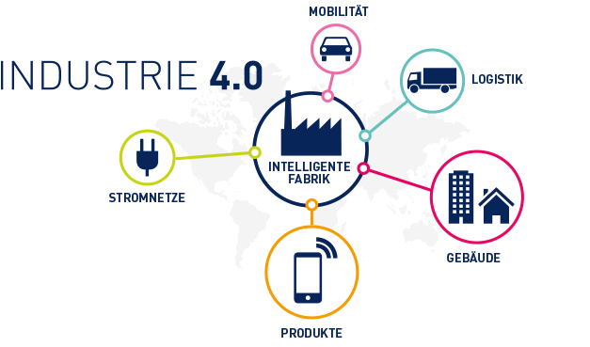


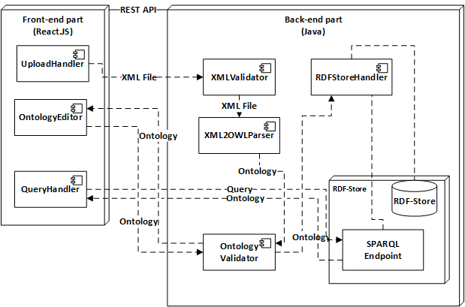







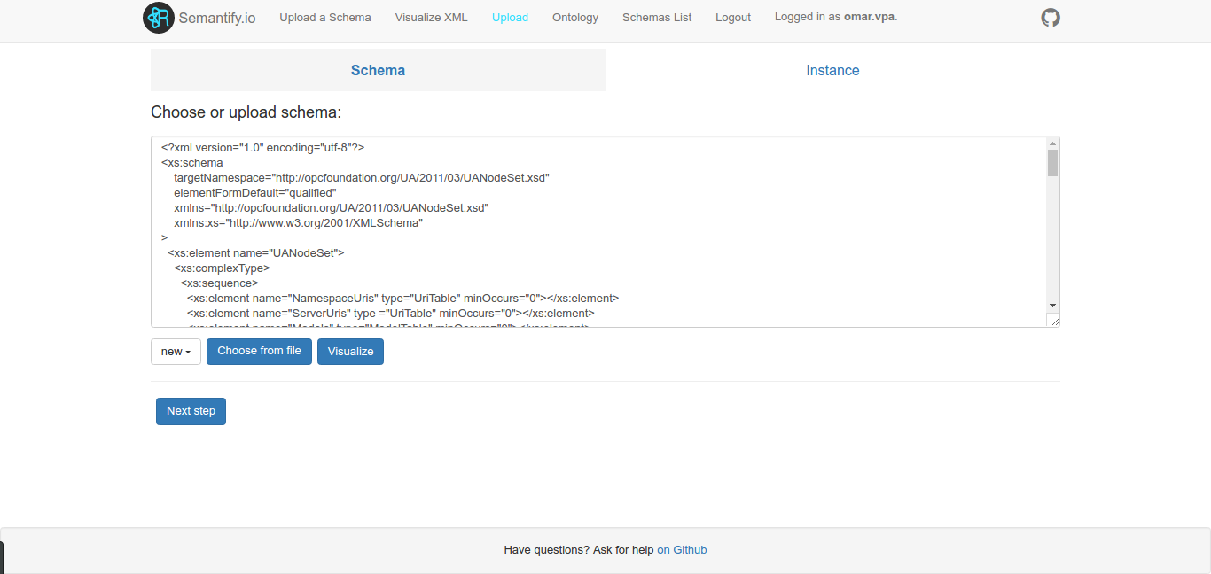
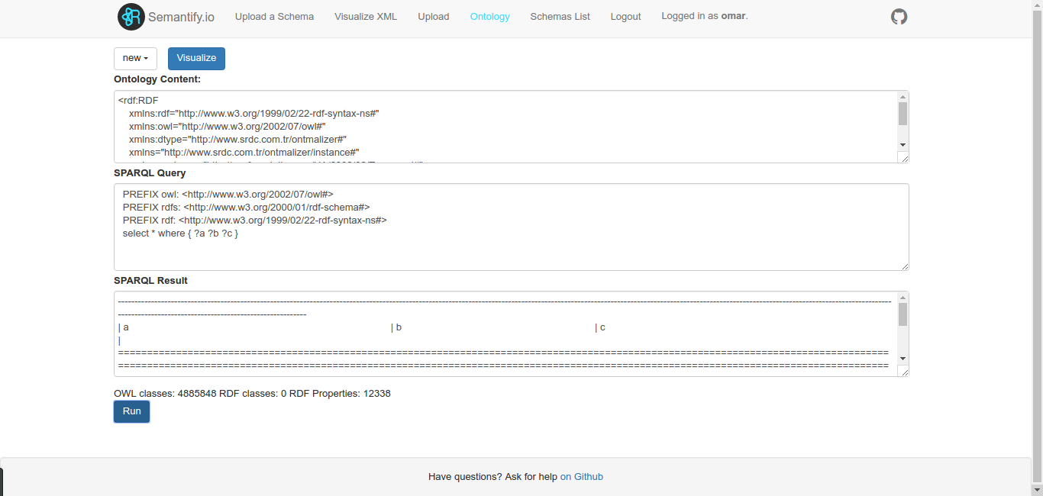

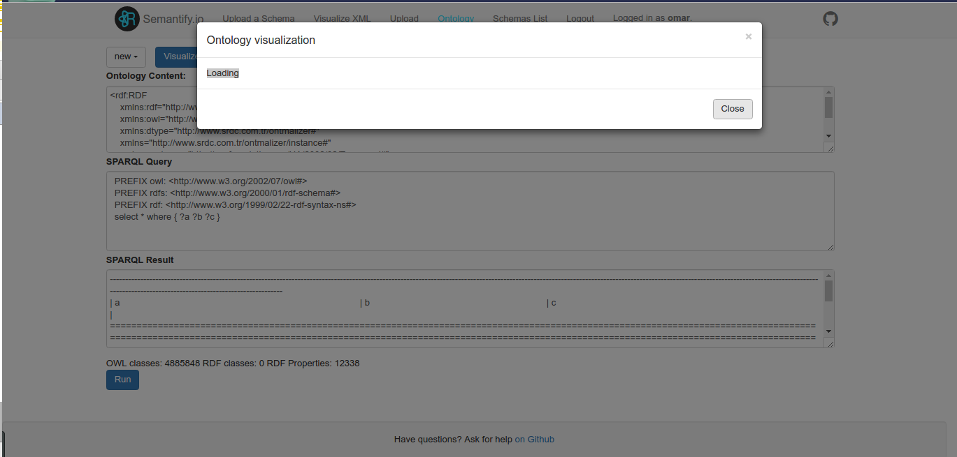


Semantify.IO
A web-based tool to semantify the knowledge of standards
Shinho Kang, Aleksandr Korovin, Omar Gutiérrez, Alexey Karpov
The role of OPC UA
What we did
OPC UA is playing a key role the Industry 4.0 (i4.0), the so called fourth industrial revolution whose purpose is to make reality the vision of smart factories
It is the leading standard for interoperability and data exchange
Even more, OPC UA is becoming popular in other markets like the Internet of Things (IoT)
We build a web tool to transform the schema and instance XML files from OPC UA into semantic ontologies.
The architecture of our solution was implemented in two parts:
Web Service to access the features of Apache Jena and other Java libraries.
A Web application developed in Node.js to interact with the web service above.
Architecture
Challenges we faced
We found few relevant works managing similar problems.
Understand some details from OPC UA documentation.
The access to the original files was restricted and private. We had few (but enough) material to work with.
Plug different technologies in the front-end and back-end.
Results and conclusions
A modified version of the tool Ontmalizer was created to transform the XML Schemas and XML data was created.
Those changes were done taking in account the OPC UA standard.
Tests were implemented in server and client application.
A production deployment was done with Docker.
The project is ready to be improved in later stages.
Upload and transformation
Virtual Machine Settings
Hostname: EIS03
Software installed: Apache Tomcat 7.0, Node.js, Java 8, Docker.
RAM: 2GB
SPARQL queries
Local Access:
OS User: semantifyio
Password: 15team}
Remote Access:
Partner ID: 905 399 395 Password: 15team}
Github links:
Webpage: https://bonnwestcoast.github.io/ontologize-standards
Back-end: https://github.com/BonnWestCoast/Semantify.io-jena
Front-end: https://github.com/BonnWestCoast/Semantify.io
Docs: https://github.com/BonnWestCoast/Semantify.io-docs
Visualisation
EIS
Enterprise
Information Systems

