Slide 1
Web-based tool to semantify the knowledge of a standards with semantic technologies
Mentor:
Irlán Grangel-González
Group members:
Aleksandr Korovin
Shinho kang
Alexey karpov
Omar Trinidad Gutiérrez Méndez

Slide 2
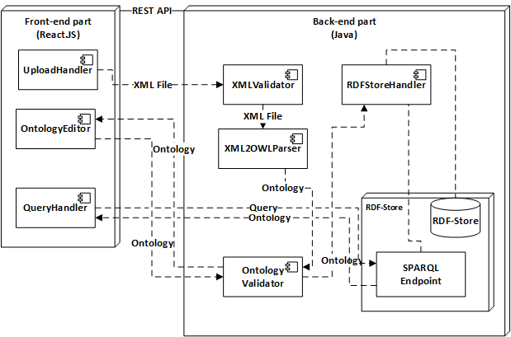






Architecture

Slide 3
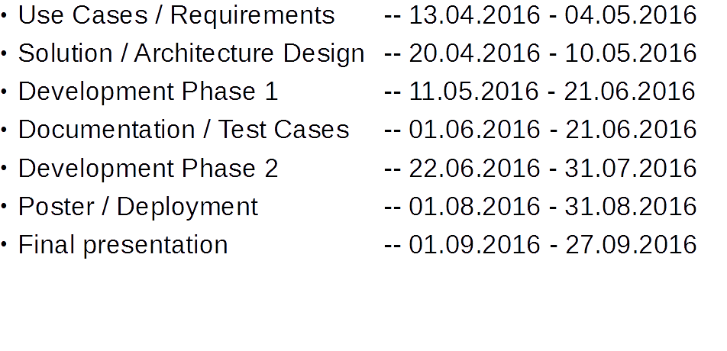
Work Plan

Slide 4
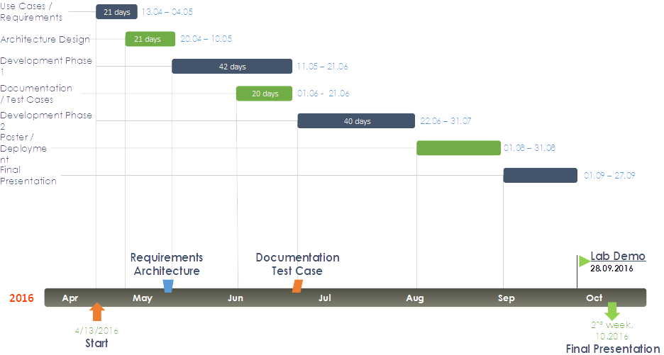
Work Plan

