Slide 1



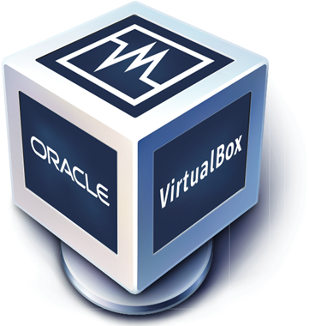



Semantify.IO
A web-based tool to semantify the knowledge of standards
Shinho Kang, Aleksandr Korovin, Omar Gutiérrez, Alexey Karpov
The role of OPC UA
What we are doing
OPC Unified Architecture (OPC UA) is the leading standard for data exchange and interoperability between products of different manufacturers and operating systems. Because of that, OPC UA is playing a key role in what we call Industry 4.0 (I4.0).
I4.0 is a term coined in Germany to refer to the fourth industrial revolution whose purpose is to make reality the vision of smart factories. Even more, OPC UA is becoming popular in other markets like the Internet of Things (IoT).
OPC UA relies on SOAP architecture, that is, the communication is done using XML. We build a web tool to translate the schema and instance XML files from OPC UA into semantic formats.
Our challenges
We found few relevant works managing similar problems. That forced us to consult the documentation to understand how OPC UA works. Because the access to the original files was restricted and private. We had few –although enough– material to work with. Plug different technologies in the server (Java EE) and client side (Node.js).
From OPC UA to Ontology
To accomplish this we used a modified version of Ontmalizer… (add more info and images here)
Results
We built a web-tool where is possible to upload, validate, transform, and visualize schema and instances of OPC UA standard into OPC ontologies. We implement this in two parts:
a) A Java API where we use Apache Tomcat and we implement endpoints
Parsing
Conclusions and open problems
In this work we deal with the OPC UA standards, however, it is not the only M2M protocol that exists. We think it is possible to extend the current implementation to different M2M solutions, for example, AML. Given the increasing popularity of IoT, we think that is possible to build new things over our project.
Tools
<Virtual Machine Description>
Hostname: vm-<???>
Software installed:
Installed on: EISX, Java EE X.X.X,
Local Access:
OS User: eis-user
Password: <INCLUDE HERE>
Remote Access:
Partner ID: 51220xxxx Password: <INCLUDE HERE>
EIS
Enterprise
Information Systems

