Slide 1

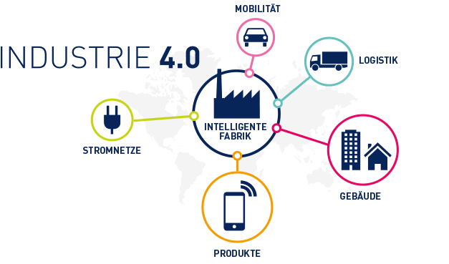


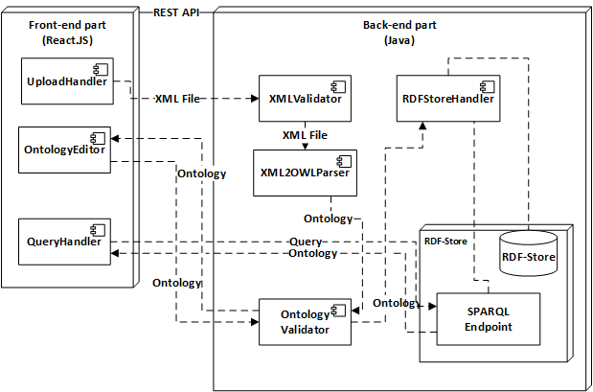





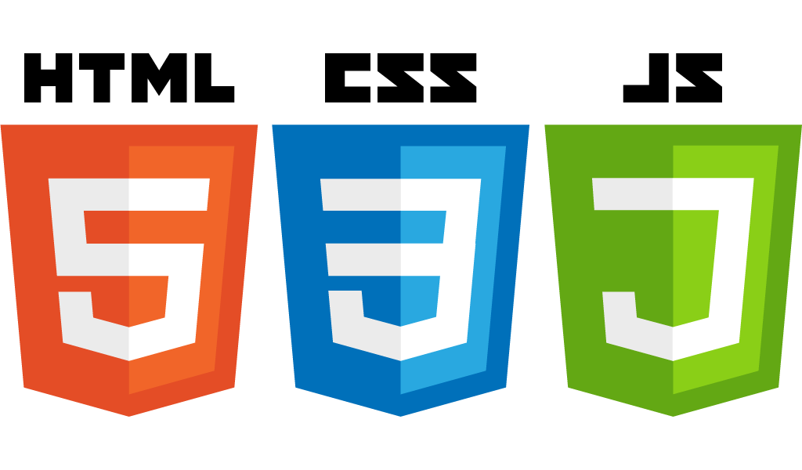

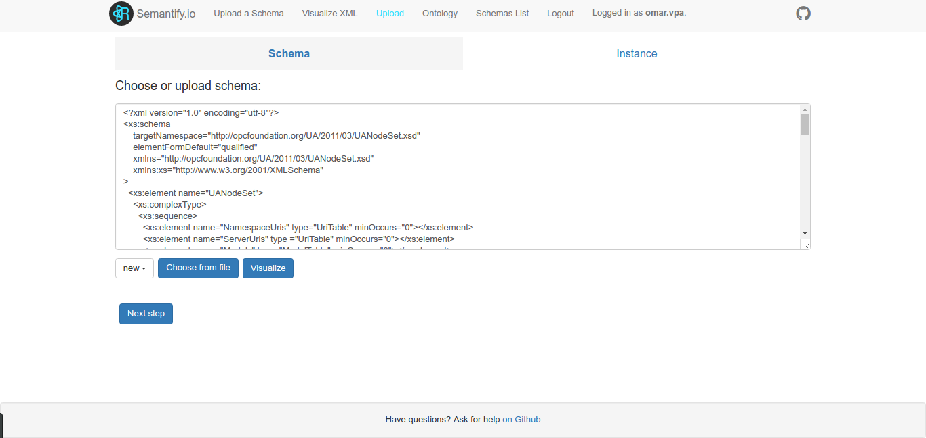
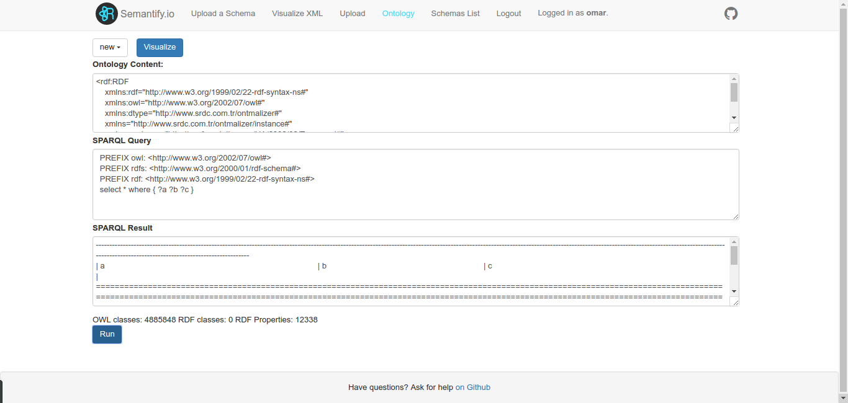
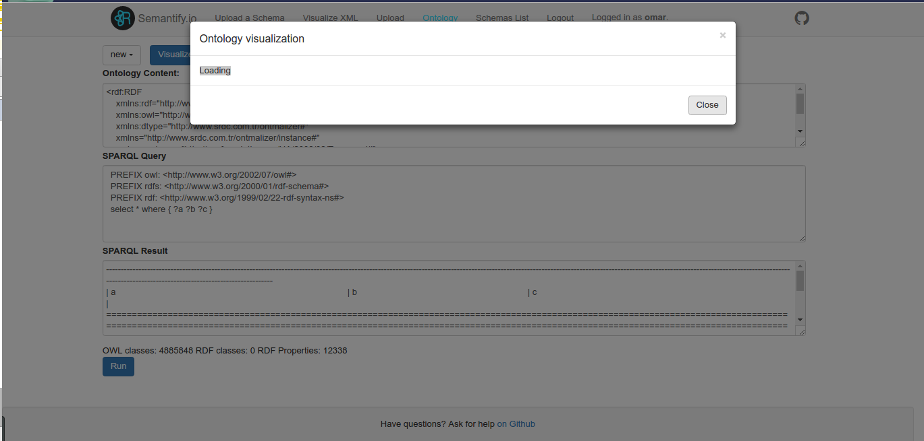



Semantify.IO
A web-based tool to semantify the knowledge of standards
Shinho Kang, Aleksandr Korovin, Omar Gutiérrez, Alexey Karpov
The role of OPC UA
What we did...
OPC UA is playing a key role the Industry 4.0 (i4.0), the so called fourth industrial revolution whose purpose is to make reality the vision of smart factories.
It is the leading standard for interoperability and data exchange.
Even more, OPC UA is becoming popular in other markets like the Internet of Things (IoT).
A web tool to transform the schema and instance XML files from OPC UA into semantic ontologies.
This translation matters because adds the ability to express not only data but also the meaning of this data. It is a key piece in the quest to make a system more intelligent.
Architecture
Web Service to access the features of Apache Jena and other Java libraries.
A Web application developed in Node.js to interact with the web service above.
Challenges we faced
Few relevant works managing the conversion from the standard into semantic formats.
Understand some details from OPC UA documentation.
The access to the original files was restricted and private. We had few (but enough) material to work with.
Plug different technologies in the front-end and back-end.
Results and conclusions
A method to transform OPC UA schemas and instances into ontologies.
The above method was created taking advantage of the tool Ontmalizer (http://github.com/srdc/ontmalizer ). A modified version was created.
To ensure the compliance of requirements tests of the main methods were implemented in server and client application.
A production deployment was done using Docker.
It is possible to improve the current product in later stages.
Upload and transformation
Virtual Machine Settings
Hostname: EIS03
Software installed: Apache Tomcat 7.0, Java 8.0, Node.js.
RAM: 2GB
How to access to the app? Open the browser and go the address: http://localhost:3000
SPARQL queries
Local Access:
OS User: semantifyio
Password: 15team}
Remote Access:
Partner ID: 905 399 395 Password: 15team}
Github links:
Webpage: https://bonnwestcoast.github.io/ontologize-standards
Back-end: https://github.com/BonnWestCoast/Semantify.io-jena
Front-end: https://github.com/BonnWestCoast/Semantify.io
Docs: https://github.com/BonnWestCoast/Semantify.io-docs
Visualisation
EIS
Enterprise
Information Systems

