Slide 1
Reinforcement Learning for Optimizing Public Transportation
Bonnie Hu – 260556970
Andrei Chubarau – 260581375
Haydar Talib – 119829250
April 26, 2018

Slide 2

A Bus Route Simulation – Why?
Its MDP Form and the Reinforcement Algorithm to ~Solve it
I am tired of waiting for the 80 North on avenue Du Parc!
Existing scheduling techniques are inadequate – need for better scheduler, and one that can operate online
A game-y real world problem suitable for RL
Extensible to various urban (transport) planning problems
In RL? Route-finding, route-creation, multi-agent systems
Notes:
Schedule has a variable, static component, but other dynamics introduce additional variability
Including some work by Justin Boyan

Slide 3
Building a Shareable Environment
System assigns negative rewards for
Each person waiting at a bus stop
Each bus circulating
State representation – # of buses on the route & whether there are people at each bus stop
One day = 1 episode
# of time steps
General passenger trends, e.g. “rush hour”
Model traffic conditions
Time for bus to move from one station to next
Rush hour – fixed values at specific times of day
Notes:
Actions are to add buses, or send a rescue bus

Slide 4
General Results
Dyna-Q Implementation
Major traffic incident at episode 250!

Slide 5
Finding an “Optimal” Policy
Comparing Episode 30 to Episode 200
Passengers appear at stops

Slide 6
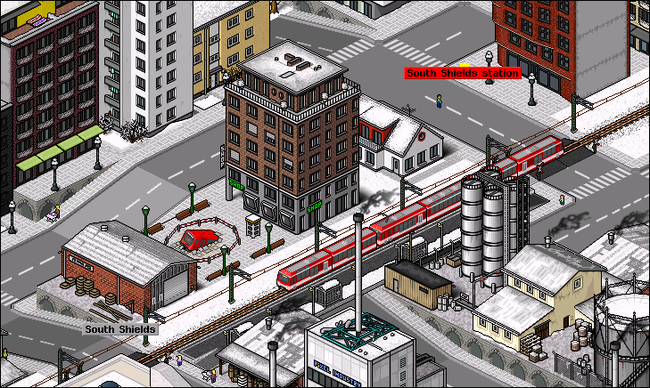
Currently a Challenging Environment
But What’s Next?
Share on Gym
Increase complexity – multiple routes (multi-agent systems?)
Integrate with Open Data initiatives in public transport
https://www.transitwiki.org
Relationship to “sims” – visual elements
https://www.simutrans.com

