Slide 1
VolterraDSPPredictor
Teaching a radio amplifier to stay clean, using software that learns
A real-time simulator for adaptive digital predistortion on Apple Silicon
Boniface Mundia · October 2026 · github.com/BonnieMundia/VolterraDSPPredictor
Notes:
Introduce yourself. One-sentence summary: this project shows, live, how software can clean up the distortion that radio amplifiers create, so they can run more efficiently.

Slide 2
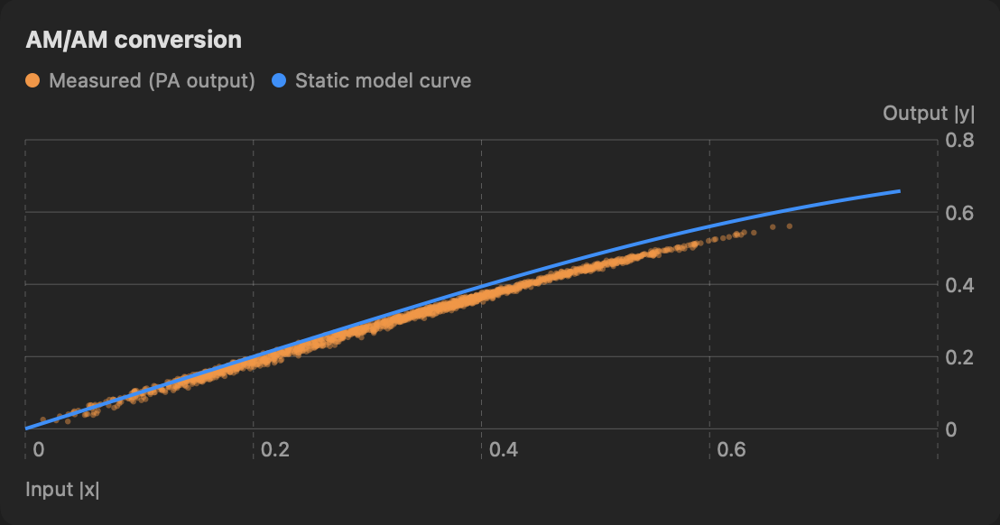
The problem: amplifiers distort when pushed hard
Every phone mast, Wi-Fi router and phone has a power amplifier that boosts the signal before the antenna
Like a speaker turned up too loud, it distorts near its limit: the loudest moments get squashed and twisted
It also has memory: what it does now depends on what it just did
Result: errors in our own signal and noise that spills into other people's channels
Measured output (orange) falls below the ideal straight line as the input gets louder
VolterraDSPPredictor
2
Notes:
Use the speaker analogy. On the chart, a perfect amplifier would be a straight line. The orange dots bend down at high input: that is compression. The spread of dots is the memory effect.

Slide 3
Why it matters
Energy
The amplifier is the biggest power user in a radio. It is most efficient near its limit, which is exactly where it distorts.
Neighbours
Distortion leaks into neighbouring frequency channels. Regulators set strict limits on this leakage.
Quality
A distorted signal causes bit errors, so users get slower, less reliable data.
Today's common fix is to turn the volume down ("back-off"). It works, but it wastes energy and money on every transmitter.
VolterraDSPPredictor
3
Notes:
Three reasons: energy bills and battery life, legal limits on interference, and user experience. Back-off is like never driving above second gear: safe but wasteful.

Slide 4
The idea: pre-distort the signal on purpose
Clean signal
what we want to send
Predistorter (DPD)
bends it the opposite way
Amplifier
bends it back
Clean, strong output
distortions cancel
Measure & learn
compare output with the ideal
Like glasses: the lens bends light the opposite way your eye does, so you end up seeing clearly
The amplifier changes with heat and age, so the predistorter keeps learning while it works
VolterraDSPPredictor
4
Notes:
This is the core idea of digital predistortion. The feedback loop is what makes it adaptive: we listen to the amplifier's output and keep adjusting the correction.

Slide 5
The gap this project addresses
Most research is done offline: record data, compute, plot. You can't watch the learning happen or change things live.
The most accurate model (the full Volterra series) is often dismissed as too slow. Few tools measure what it really costs.
Modern chips where the CPU and GPU share memory, like Apple Silicon, are rarely studied for this job.
Learning methods are compared in different papers with different setups, so the comparison isn't fair.
Few open, reproducible tools exist for teaching: commercial toolboxes are closed and lab hardware is expensive.
VolterraDSPPredictor
5
Notes:
These five gaps are the motivation. Each one maps to a feature of the app: live loop, full Volterra model, CPU+GPU, same setup for every algorithm, and open source with tests.

Slide 6
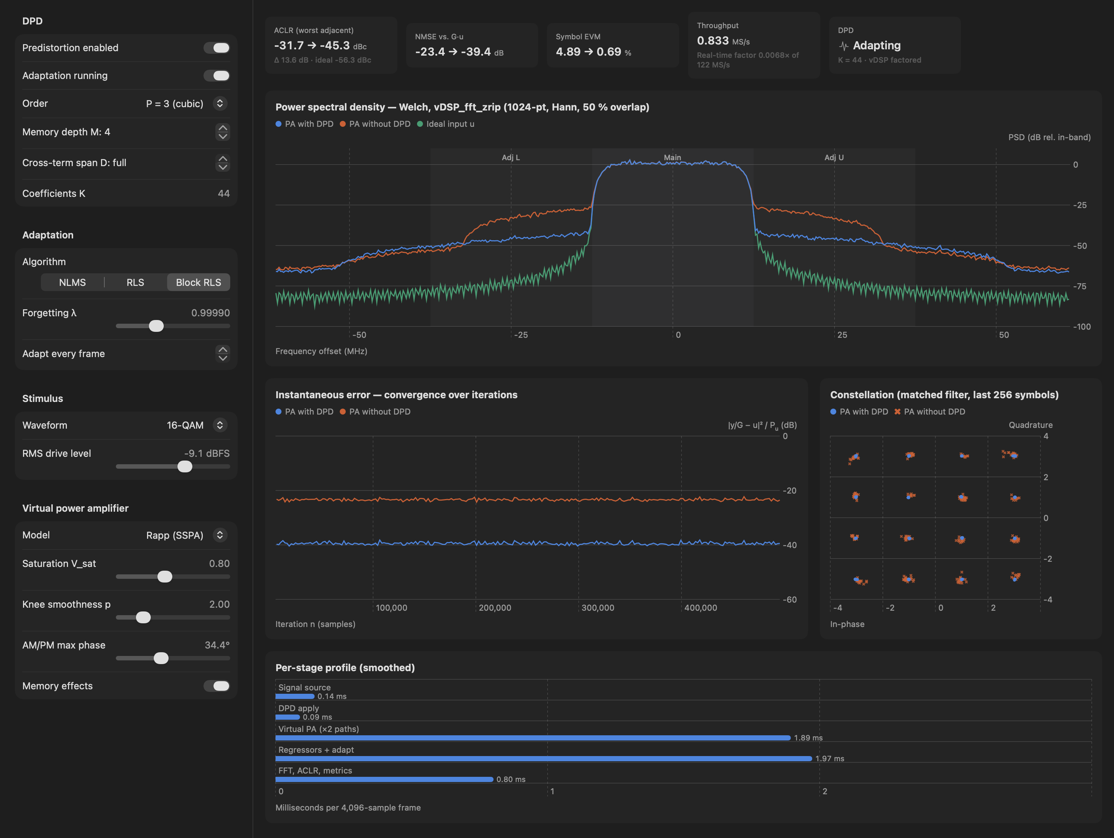
What we built
A Mac app that simulates the whole loop live: signal, predistorter, amplifier, learning, measurement
Change any setting while it runs and see the effect instantly
Four tabs: signal & amplifier, model engine, learning lab, live dashboard
Written in Swift on Apple's Accelerate and Metal, with no external libraries and a 66-case test suite
The Live Dashboard updates ten times a second
VolterraDSPPredictor
6
Notes:
Give a quick tour of the screenshot: tiles at the top, spectrum in the middle, error trace and constellation below, per-stage timing at the bottom. If possible, show the app live here.

Slide 7
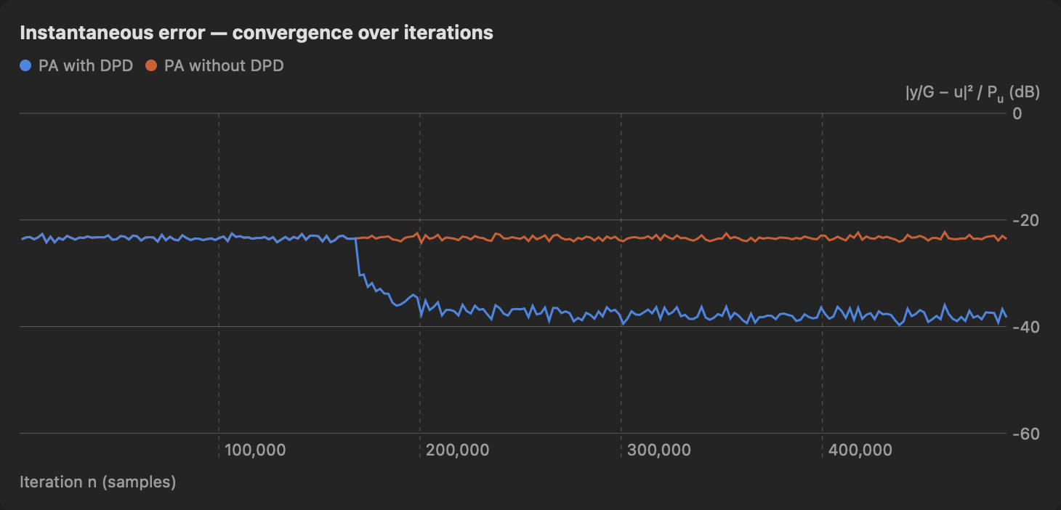
How it learns
A model with memory
The Volterra model looks at the last few samples and how they combine, not just the current one.
Three ways to learn its settings
NLMS: small, cheap steps. Simple, but slow to settle.
RLS: smart steps. Fast to settle, but heavy maths on every sample.
Block RLS: the same smart answer, computed in batches. Fast and accurate, and the default.
Switching the predistorter on: the error (blue) drops about 15 dB below the uncorrected amplifier (orange) and stays there
VolterraDSPPredictor
7
Notes:
Memory depth M is how many past samples the model looks at. The chart shows the moment adaptation starts: the blue line falls and settles within a few frames of signal.

Slide 8
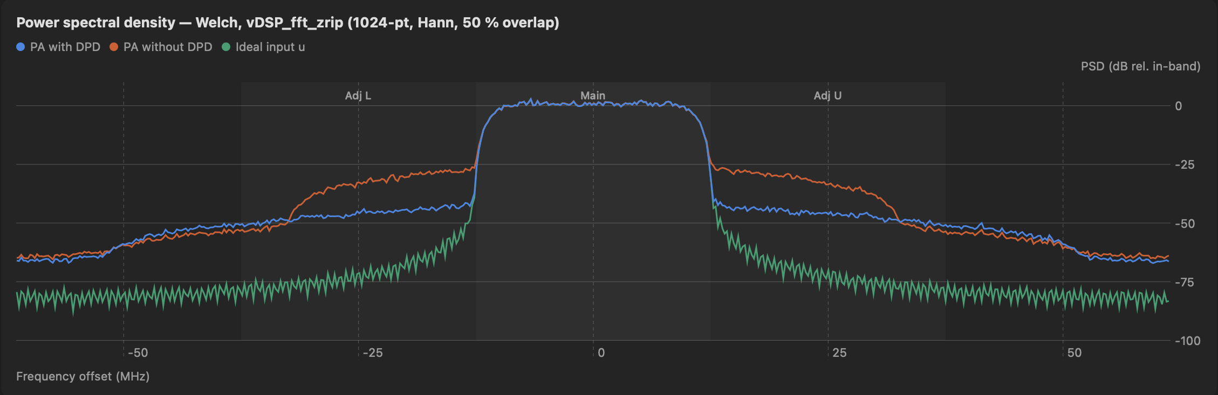
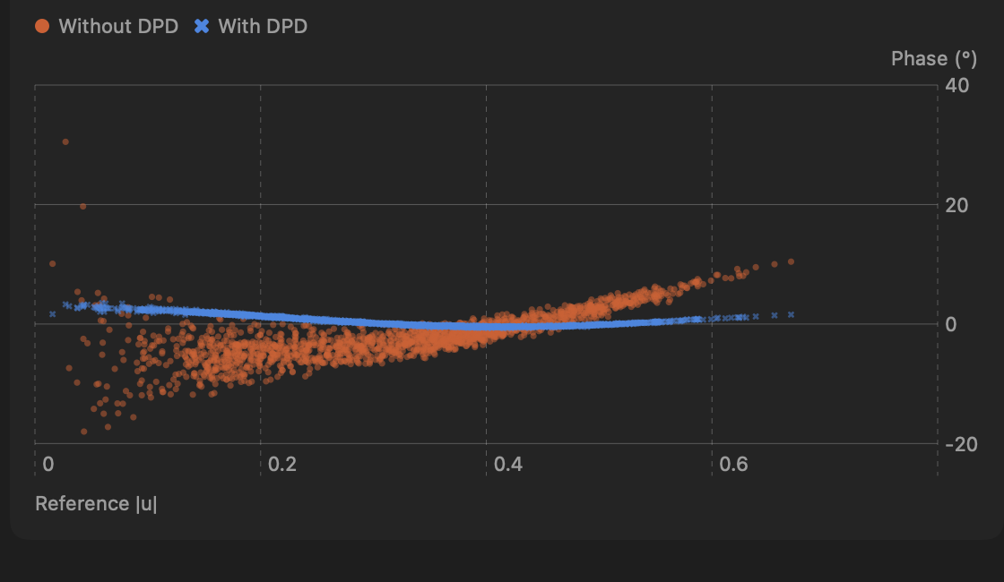
Results: a much cleaner signal
23× less
leakage to neighbours
−31.7 → −45.3 dBc
40× less
error in our own signal
−23.4 → −39.4 dB
Spectrum: orange = amplifier alone, blue = with predistortion, green = ideal
The twist is gone too: with predistortion the amplifier's phase error (blue) stays flat at 0°. Without it (orange) it wanders by 10–15°.
7× lower
symbol error (EVM)
4.9 % → 0.7 %
VolterraDSPPredictor
8
Notes:
Point at the shoulders either side of the main channel: they drop sharply. Default scenario: 16-QAM, 25 MHz wide, Rapp amplifier with memory, 44 model coefficients. 23× is 13.6 dB and 40× is 16 dB.

Slide 9
Making it fast
23× faster
Block RLS versus classic RLS (M = 8), with exactly the same result
26× faster
Keep only the important model terms and learn on 1 frame in 8. Same leakage result.
Auto CPU / GPU
The app times both processors while it runs and picks the faster one. The GPU wins for big models.
All numbers measured on an Apple M5 laptop chip (Release build, 4,096-sample frames)
Lesson: the "too slow" full model becomes practical with smart maths, not just faster hardware
VolterraDSPPredictor
9
Notes:
Classic RLS needs about 349 ms per frame at memory depth 8; Block RLS needs 15 ms. Pruning plus adapting every 8th frame brings it to 0.58 ms. The GPU takes over at memory depth 12 and above.

Slide 10
Limits, next steps, and try it yourself
Honest limits
Simulated amplifier, not real hardware yet
Third-order model only (no 5th/7th order)
Not yet at full radio speed (122.88 MS/s)
Next steps
Test on a real amplifier with a software radio
Higher-order and neural-network models
Try it
github.com/BonnieMundia/VolterraDSPPredictor
Open in Xcode 27 on an Apple Silicon Mac, then press ⌘R
Thank you. Questions?
VolterraDSPPredictor
10
Notes:
Be upfront about limits; they are also the roadmap. Invite people to clone the repo and try the scenarios from the documentation.

