Slide 1
RcppArmadillo and Parallelism in Rcpp
Let’s boost R with C++

Slide 2
Outline
00
Env. Settings
03
Rcpp
Prepare for Rcpp
Integration of R and C++
01
Reviews of C++
04
RcppArmadillo
Class, Pointer and Why use C++
Rcpp with Armadillo
02
R Interface to C
05
Parallelism in Rcpp
What is SEXP
OpenMP and RcppParallel

Slide 3



About Me
Current Status: Unemployed 宅宅
Work Experiences:
Senior Engineer, TSMC, 2018.09-2018.12
Engineer, TSMC, 2016.07-2018.09
RA, Academia Sinica, 2015.09-2016.07
Education:
Master, Department of Statistics, NCKU, 2012.09-2014.09
Bachelor, Department of Economics, NCKU, 2008.09-2012.07
Miscellaneous:
Board Manager, R_Language, Ptt.cc
You can find me at…

Slide 4
EnV. Settings
Windows – Rtools
Linux – Installation of R Tool Chain

Slide 5
Environmental Settings
0
Linux
RHEL: yum install gcc gcc-c++ make
Debian: apt-get install build-essential
Windows
Go to https://cran.r-project.org/bin/windows/Rtools/
Download Rtools.exe and Install

Slide 6

Environmental Settings
0
Linux
RHEL: yum install gcc gcc-c++ make
Debian: apt-get install build-essential
Windows
Go to https://cran.r-project.org/bin/windows/Rtools/
Download Rtools.exe and Install

Slide 7
Windows - RTools
0
Recommend to Install with R package installr
# R
install.packages("installr", repos = "https://cran.rstudio.com/")
library(installr)
install.Rtools()

Slide 8
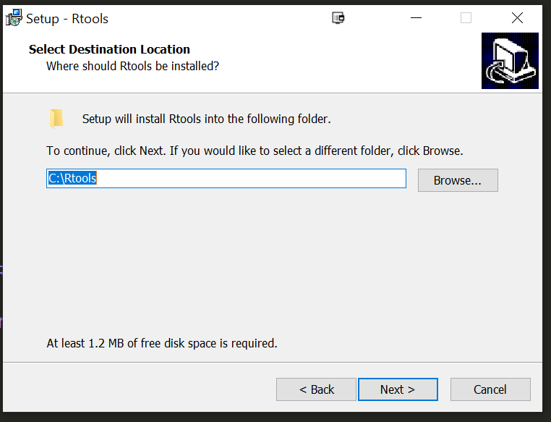
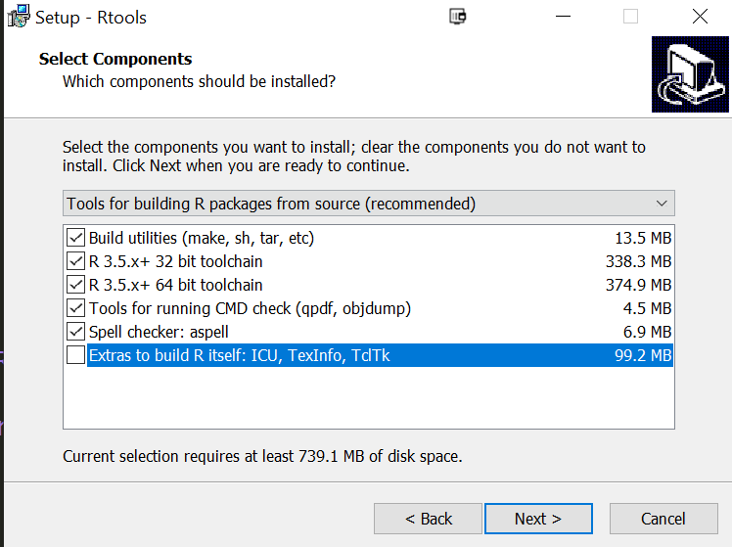
Windows - RTools
0
Recommend to install under C:\

Slide 9
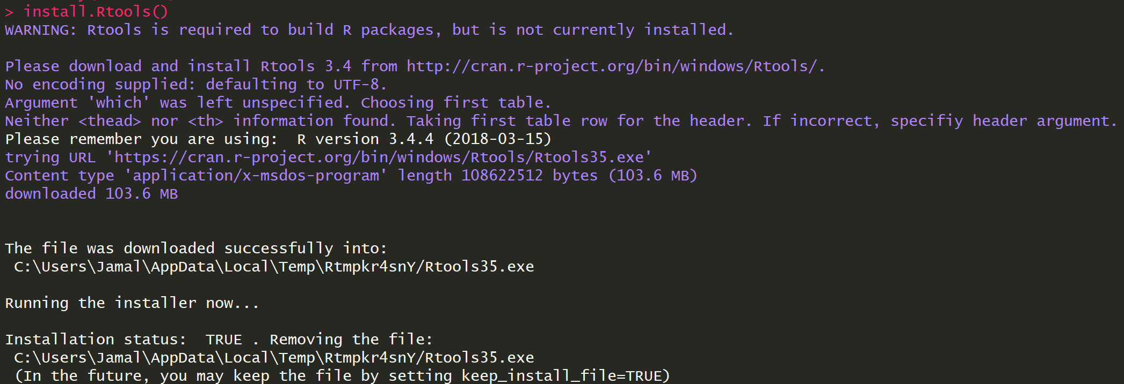
Windows - RTools
0

Slide 10
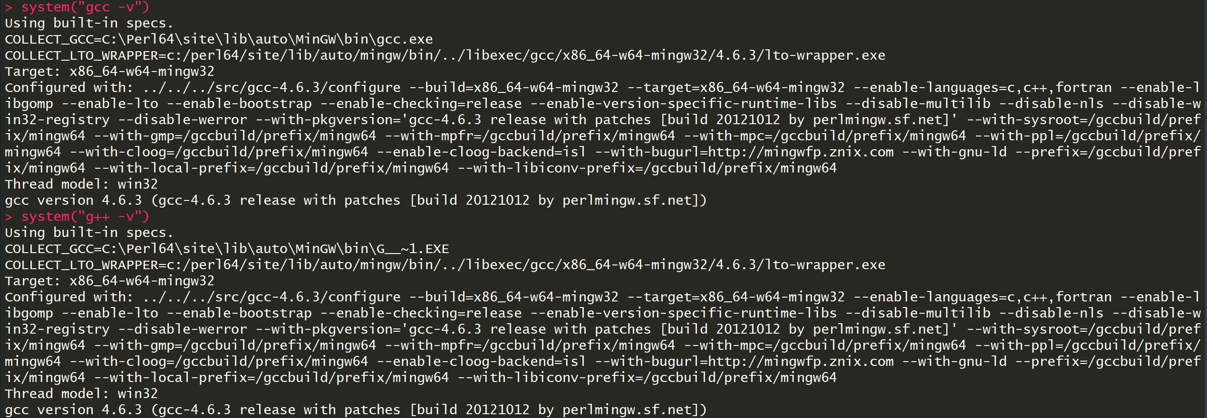
Windows - RTools
0
Test

Slide 11
Reviews of C++
Class, Pointer and Why use C++

Slide 12
Reviews of C++
1
First question, why we use C++?
It outperforms R in most cases.
C and Fortran are more difficult to use for most people.
There are many libraries in C++ to accelerate computing with matrices like Armadillo, Eigen, boost, MLPACK.
You can find more libraries at https://en.cppreference.com/w/cpp/links/libs

Slide 13
Reviews of C++
1
Object Oriented (OO) is the prime purpose of C++ programing.
We will see a lot of classes in following lessons.

Slide 14
Reviews of C++
1
What is class?
Simply speaking, it is a blueprint of object.
Wait… What is Object?
Object is a basic unit of OOP. It consists data and functions.

Slide 15
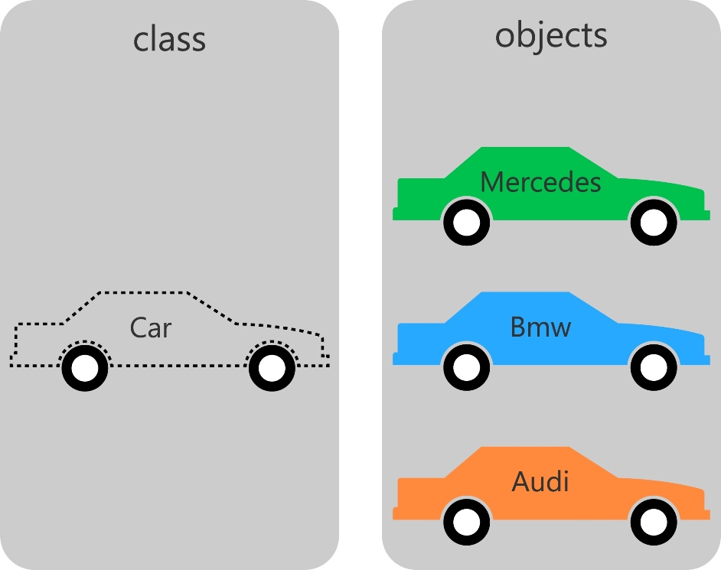
Reviews of C++
Class and Objects

Slide 16
Reviews of C++
C++ namespace
A scope to distinguish the classes and functions.
We have two classes with same name, but we need to differentiate them with additional information.
i.e. 兩個人都叫怡君，但一個姓林，一個姓陳，這樣我們就能區別這兩個怡君了。(同名同姓不在討論範圍內)

Slide 17
Reviews of C++
1
Because C++ is strongly typed language, so how can we write a function for integer, float, double, long and so on?
The answer is C++ Template.
We can define a Template on classes or functions.

Slide 18
Reviews of C++
1
Example of Template:
As Is (functions overloading):
To Be (Template)
int add(int x, int y) {
return x + y;
}
double add(double x, double y) {
return x + y;
}
template <typename T>
T add(T x, T y) {
return x + y;
}

Slide 19
Reviews of C++
1
Example of Template:
template <class T>
class Stack {
private:
vector<T> elems;
public:
void push(T const&);
void pop();
T top() const;
bool empty() const {
return elems.empty();
}
};
But not this.
Usage:
Stack<int> intStack;
Stack<std::string> stringStack;
You can ignore this.

Slide 20
R Interface to C
What is SEXP

Slide 21
R Interface to C
2
Basically, this section is refer to Hadley’s Advanced R
It is a excellent book, I recommend you to read and review from time to time.
Also refer to Statistical Computering in C++ and R
If you are really interested in integration of R and C++…

Slide 22
R Interface to C
2
There are 2 APIs for R interfacing to C
.C (old)
You can find details in Statistical Computering in C++ and R
.Call (new)
You can find details in Advanced R
Example code: https://github.com/ChingChuan-Chen/Rcpp_RcppArmadillo_tutorial

Slide 23
R Interface to C
2
Examples to use .C in R
First Example - Hello world and input from R
Second Example - Generate normal random numbers and output to R
Examples to use .Call in R
Same as .C

Slide 24
R Interface to C
2
What is SEXP
SEXP or S-expression
All R objects are stored in SEXP at C-level.
You must return a SEXP as output and take SEXPs as inputs.
There are a lot of types of SEXP:
You can find them in R.home()/include/Rinternals.h

Slide 25
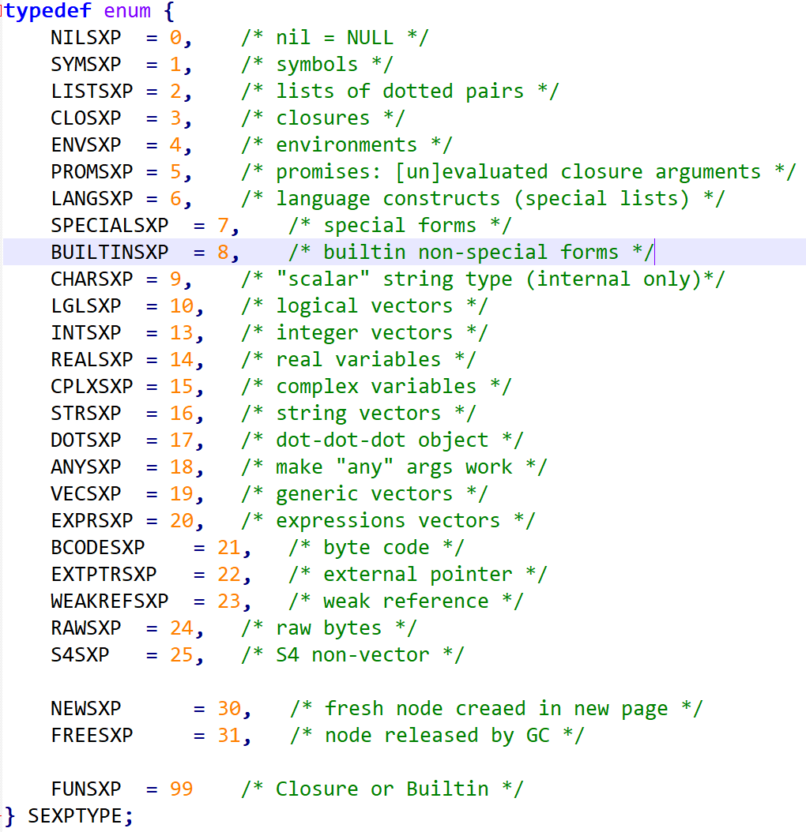
R Interface to C
2
SEXPs

Slide 26
R Interface to C
2
Why PROTECT?
You need to PROTEXT all R objects in declaration. PROTEXT keeps objects from being deleted by garbage collector.
Conversion between R objects and C.
You can find them in R.home()/include/Rinternals.h
i.e. asChar, asComplex, asInteger, asLogical, asReal…
Allocate R Objects
Also in Rinternals.h
i.e. allocArray, allocList, allocMatrix, allocVector…

Slide 27
R Interface to C
2
Conclusion
SEXP makes us dizzy and hard to use them.
We need to get used to those functions of conversion, allocation, utilities of objects.
Compilation is also complicated although we have not discussed here.

Slide 28
Rcpp
Integration of R and C++

Slide 29
Rcpp
3
History
Dominick Samperi want to make R access a quantitative finance library named QuantLib and develop a prototype of Rcpp.
No further releases at 2007 to 2008 and stop developing at 2009. Then withdrawn from CRAN.
Dirk decided to revitalize it in Nov. 2008 and redesign of code in 2009 with Francois. Those added features forms current Rcpp.
You can find more details in Rcpp’s introduction.

Slide 30
When to Use Rcpp
3
A number of for loops.
A number of iterations with dependencies.
Recursion, i.e. Fibonacci sequence.
Bottlenecks in your R program and it don’t have to spend much time to rewrite in C++.

Slide 31
Rcpp
3
Major features of Rcpp
Mapping all R objects into C++ objects.
Rcpp Attributes - Provide a high-level syntax for declaring C++ functions as callable from R and automatically generating the code required to invoke them. Also are the dependencies and plugins. Details goes here.
Rcpp Modules - Exposing C++ classes in R. Details goes here.
Rcpp Sugar – Bring a high-level of abstraction to C++ code written using the Rcpp API. Details goes here.

Slide 32
Mapping between R objects and Rcpp objects
3
Example of R Object | R Object | Rcpp Object | SEXP Type
c(TRUE, FALSE) | logical vector | LogicalVector | LGLSXP
c(1L, 5L) | integer vector | IntegerVector | INTSXP
c(1, 5) | double vector | NumericVector | REALSXP
c(“A”, “B”) | character vector | CharacterVector | STRSXP
matrix(c(TRUE, FALSE), 2L) | logical matrix | LogicalMatrix | LGLSXP
matrix(c(1L,5L), 2L) | integer matrix | IntegerMatrix | INTSXP
matrix(c(1,5), 2L) | double matrix | NumericMatrix | REALSXP
matrix(c(“A”, “B”), 2L) | character matrix | CharacterMatrix | STRSXP
list(a = 1:5) | list | List | VECSXP
data.frame(V1 = 1:5) | data.frame | DataFrame | VECSXP
function(x) x^2 | function | Function | CLOSXP
new.env(parent = baseenv()) | environment | Environment | ENVSXP
Quick Ref: https://cran.r-project.org/web/packages/Rcpp/vignettes/Rcpp-quickref.pdf

Slide 33
Rcpp Attributes
3
Example to exposing C++ function to R.
Rcpp::sourceCpp("hello.cpp")
Example of importing dependencies will be seen in RcppArmadillo.
Example of importing plugins will be seen in Parallelism in Rcpp.

Slide 34
Rcpp Sugar
3
Functions related to distribution, i.e. rnorm.
Operators and mathematical functions
i.e. vectorized +-*/, logical operators >/</==/!
Some useful functions in R
i.e. is_na, seq_along, pmin/pmax, ifelse, sapply/lapply

Slide 35
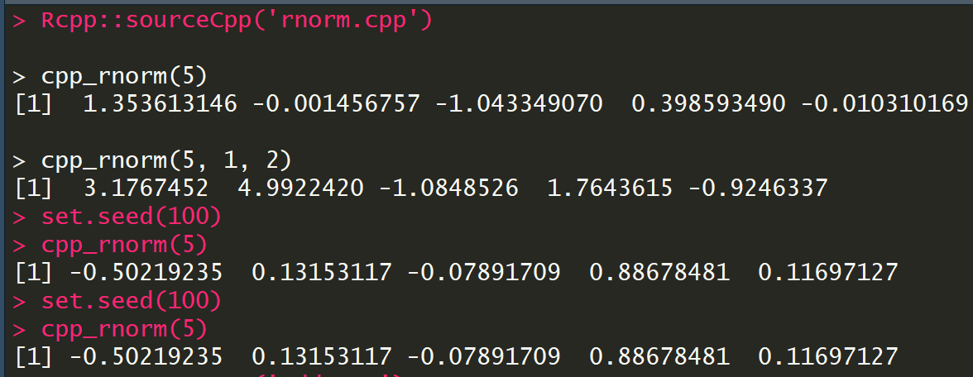
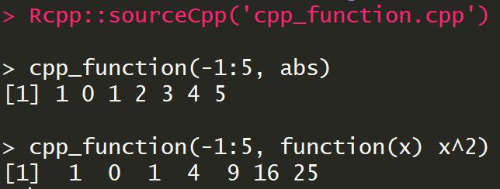
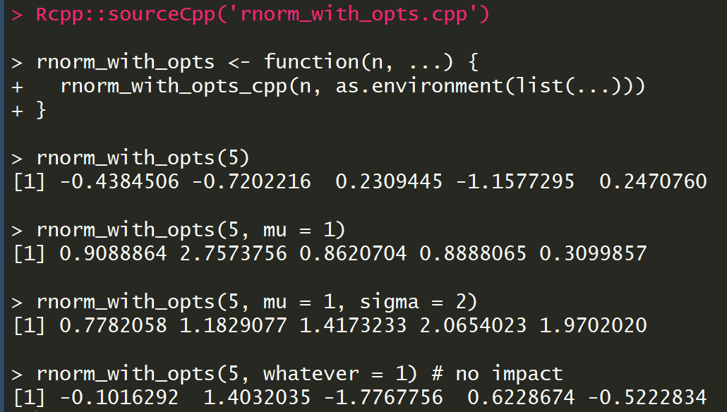
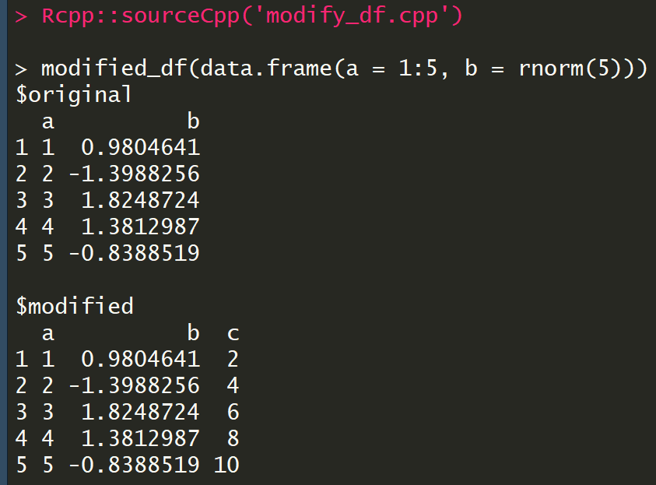
Rcpp Sugar
3
Examples:
Random
Vectorized Func.
Function
Environment
List/DataFrame

