Slide 1
RcppArmadillo and Parallelism in Rcpp
Let’s boost R with C++

Slide 2
Outline
00
Env. Settings
03
Rcpp
Prepare for Rcpp
Integration of R and C++
01
Reviews of C++
04
RcppArmadillo
Class, Pointer and Why use C++
Rcpp with Armadillo
02
R Interface to C
05
Parallelism in Rcpp
What is SEXP
OpenMP and RcppParallel

Slide 3
RcppARMADILLO
Rcpp with Armadillo

Slide 4
RcppArmadillo
4
What is Armadillo?
It provides vector and matrix classes with linear algebra support. Also it is able to link external BLAS and LAPACK to improve performance such as Intel MKL, OpenBLAS, ACML and CUDA BLAS etc.
It provides efficient classes for vectors, matrices and cubes. And dense and sparse matrices are supported.
There are many matrix libraries, why Armadillo?
It provides more APIs than Eigen, GSL and others.
Its syntax is like MatLab. (To me, it is advantage.)

Slide 5
BLAS and LAPACK
4
BLAS - Basic Linear Algebra Subprograms which performs vector addition, scalar multiplication, dot products, linear combinations, and matrix multiplication.
LAPACK - Linear Algebra PACKage which provides routine for solving systems of linear equations and linear least squares, eigenvalue problems, and singular value decomposition.

Slide 6
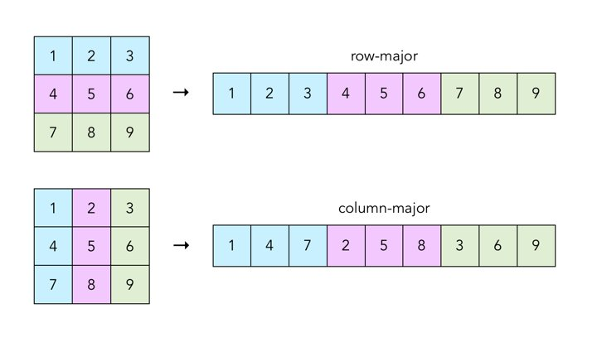
Column-Major v.s. Row-Major
4
Column-major order and row-major order are methods to store values in linear storage.
Basically, C, C++ and Python NumPy are row-major.
Fortran, R, MatLab are column-major.

Slide 7
Classes in RcppArmadillo
4
Type can be one of following:
float
ouble
std::complex<float>
std::complex<double>
(unsigned) short
(unsigned) int
(unsigned) long
Basic Types:
Mat<Type> - Class for dense matrices (column-major ordering)
Col <Type> - derived from Mat<Type> with one column.
Row <Type> - derived from Mat<Type> with one row.
Cube<Type> - Class for 3D arrays or 3rd order tensors.
SpMat<type> - Class for sparse matrices
field<Object_Type>
It is like a vector of objects.
Object_Type can be matrices,
Cube or other classes.

Slide 8
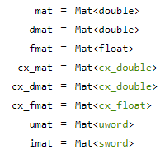
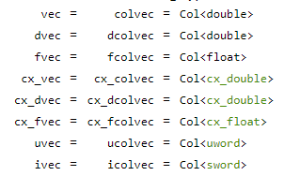
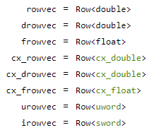
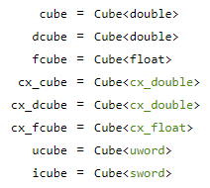
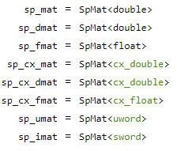
Aliases in Armadillo
4
Dense
Matrix
Column
Vector
Row
Vector
Sparse
Matrix
Cube

Slide 9
Mapping between R objects and Rcpp objects
3
Example of R Object | R Object | RcppArmadillo Object
c(TRUE, FALSE) | logical vector | uvec (ucolvec) / urowvec
c(1L, 5L) | integer vector | ivec (icolvec) / irowvec uvec (ucolvec) / urowvec
c(1, 5) | double vector | vec (colvec) / rowvec
c(“A”, “B”) | character vector | No such type in Armadillo I used to use vector<string>
matrix(c(TRUE, FALSE), 2L) | logical matrix | umat
matrix(c(1L,5L), 2L) | integer matrix | imat / imat
matrix(c(1,5), 2L) | double matrix | mat
matrix(c(“A”, “B”), 2L) | character matrix | No such type in Armadillo
Please use corresponding Rcpp types for other R objects.

Slide 10
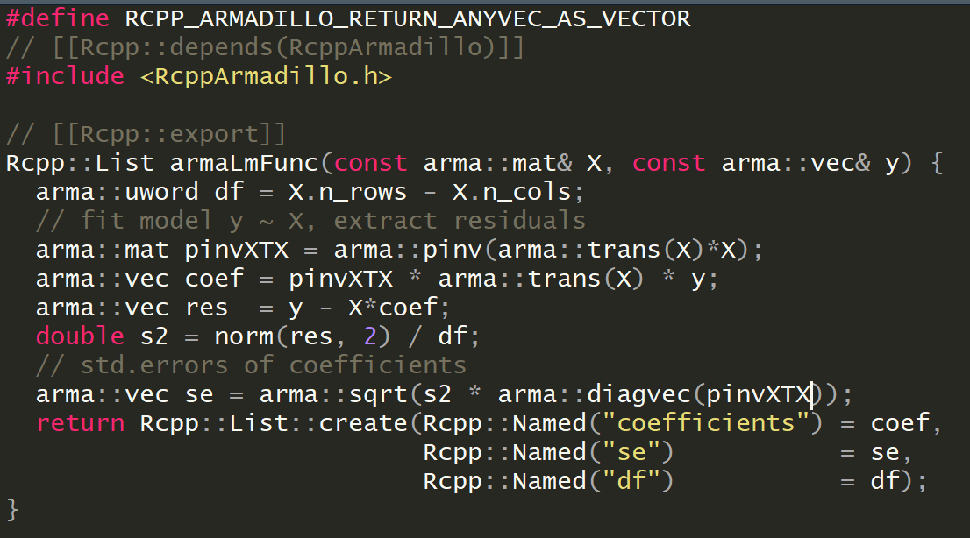
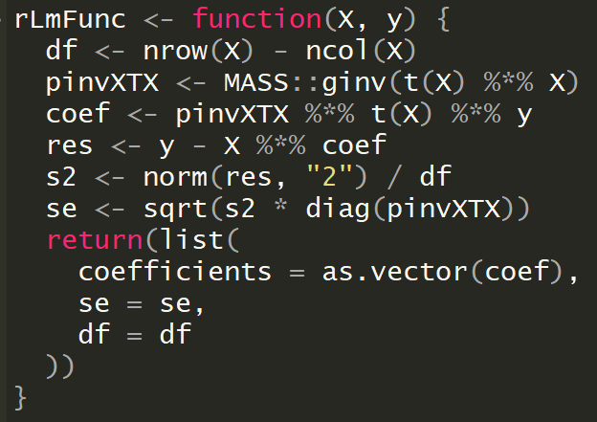
First Example – Linear Regression
4
Make Aramdillo vectors returning to R is vector instead matrix
Attributes
We can compare this two syntax,
they are very similar except that C++ need type declaration.

Slide 11
Preprocessors
4
RcppArmadillo provides 3 preprocessors for casting arma::Col <Type> or arma::Row<Type> into R vector
RCPP_ARMADILLO_RETURN_COLVEC_AS_VECTOR – cast arma::Col<Type> to R vector
RCPP_ARMADILLO_RETURN_ROWVEC_AS_VECTOR – cast arma:: Row<Type> to R vector
RCPP_ARMADILLO_RETURN_ANYVEC_AS_VECTOR – cast arma::Col<Type> and arma:: Row<Type> to R vector

Slide 12
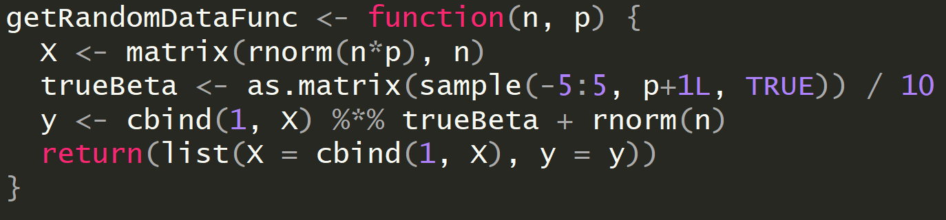
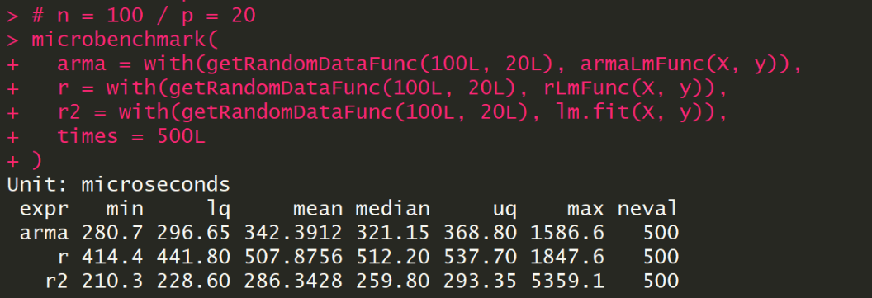
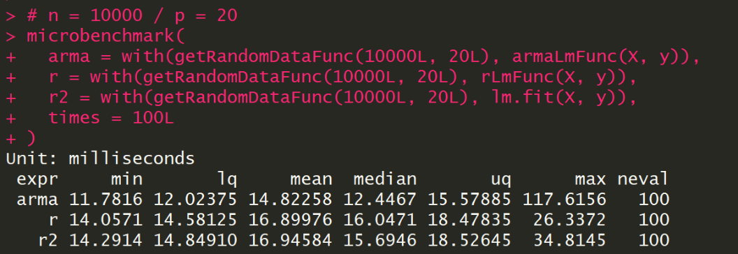
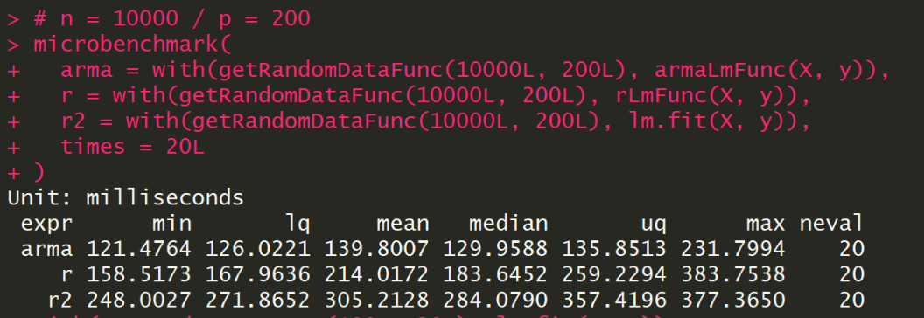
Performance
4
N = 100
P = 20
These benchmarks is under MRO-3.4.4
with AMD ThreadRipper X1950@3.85GHz
The official R is slower than MRO.
See next slide.
N = 10000
P = 20
N = 10000
P = 200

Slide 13
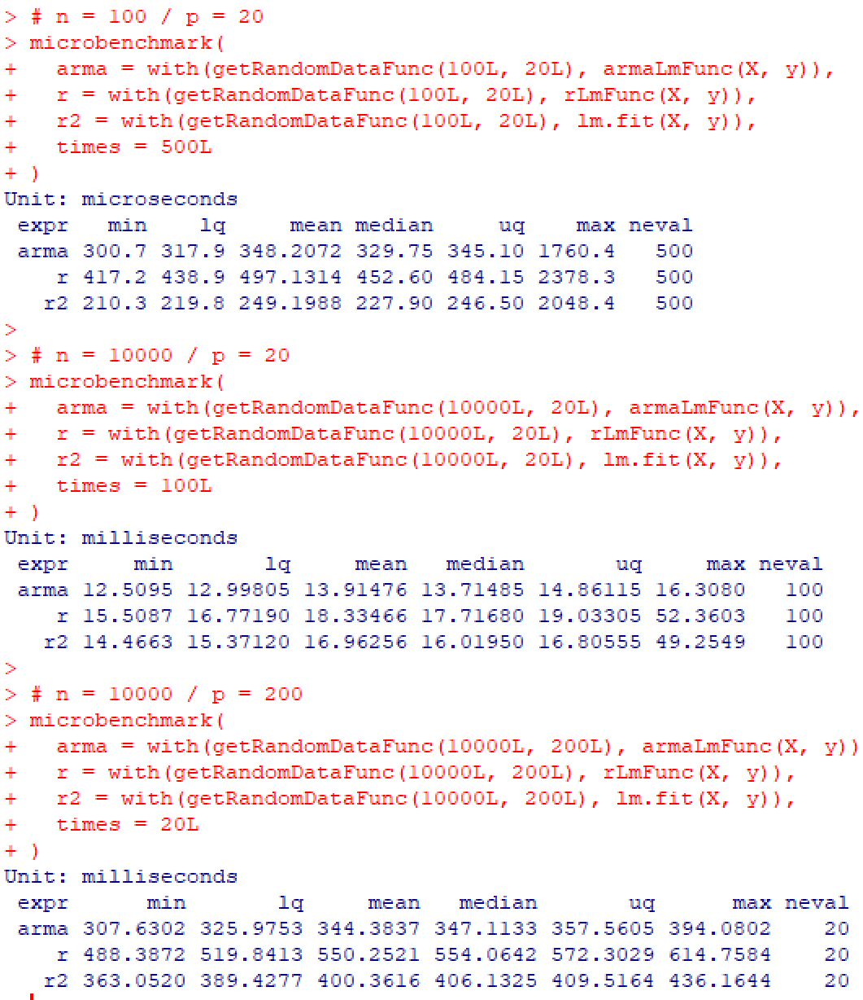
Performance in Official R
4

Slide 14
Second Example – Logistic Regression
4

Slide 15
ParallELism in Rcpp
OpenMP and RcppParallel

Slide 16
Parallelism in Rcpp
5
First question, why we use C++?
It outperforms R in most cases.
C and Fortran are more difficult to use for most people.
There are many libraries in C++ to accelerate computing with matrices like Armadillo, Eigen, boost, MLPACK.
You can find more libraries at https://en.cppreference.com/w/cpp/links/libs

Slide 17
After this lesson…
6
There are a lot of R packages under Rcpp framework, i.e.
BH – Provides boost header
RcppMLPACK – Integrate MLPACK library
RcppNumerical – Integrate Numerical Computing Libraries

Slide 18
Thank You !
Hope you like this tutorial

Slide 19
References
https://www.geeksforgeeks.org/c-classes-and-objects/
https://www.tutorialspoint.com/cplusplus/cpp_classes_objects.htm
https://www.tutorialspoint.com/cplusplus/cpp_namespaces.htm
https://www.tutorialspoint.com/cplusplus/cpp_overloading.htm
https://www.tutorialspoint.com/cplusplus/cpp_templates.htm
http://adv-r.had.co.nz/C-interface.html
http://arma.sourceforge.net/docs.html
https://github.com/ChingChuan-Chen/milr/blob/master/src/milr.cpp
https://github.com/RcppCore/RcppArmadillo/blob/master/inst/examples/fastLm.r
https://thelaziestprogrammer.com/sharrington/math-of-machine-learning/solving-logreg-newtons-method
https://www.statlect.com/fundamentals-of-statistics/logistic-model-maximum-likelihood

Slide 20
MRO vs Official R
MRO (Microsoft R Open) is the enhanced distribution of R from Microsoft Corporation.
It includes multi-threaded math libraries (Intel MKL) to improve the performance of R.
Official R uses single-threaded BLAS/LAPACK libraries (ATLAS), so its performance on matrix multiply/inverse, matrix decomposition, and some higher-level matrix operations is slow.

Slide 21
MRO vs Official R
install.packages("SuppDist") source("https://raw.githubusercontent.com/jtalbot/riposte/master/benchmarks/other/R-benchmark-25.R")
MRO-3.4.4
Official R-3.4.4

Slide 22
Eigen vs Armadillo
Eigen has own BLAS/LAPACK functions, so if you use official R, you will find that RcppEigen outperforms RcppArmadillo in matrix operations. That is because RcppArmadillo share the same BLAS/LAPACK with R.
However, if you use MRO, you will see that RcppArmadillo outperforms RcppEigen since the performance of MKL is better than Eigen.

