Slide 1
RcppArmadillo and Parallelism in Rcpp
Let’s boost R with C++

Slide 2
Supplementary
A case study for logistic regression with L1 regularization

Slide 3
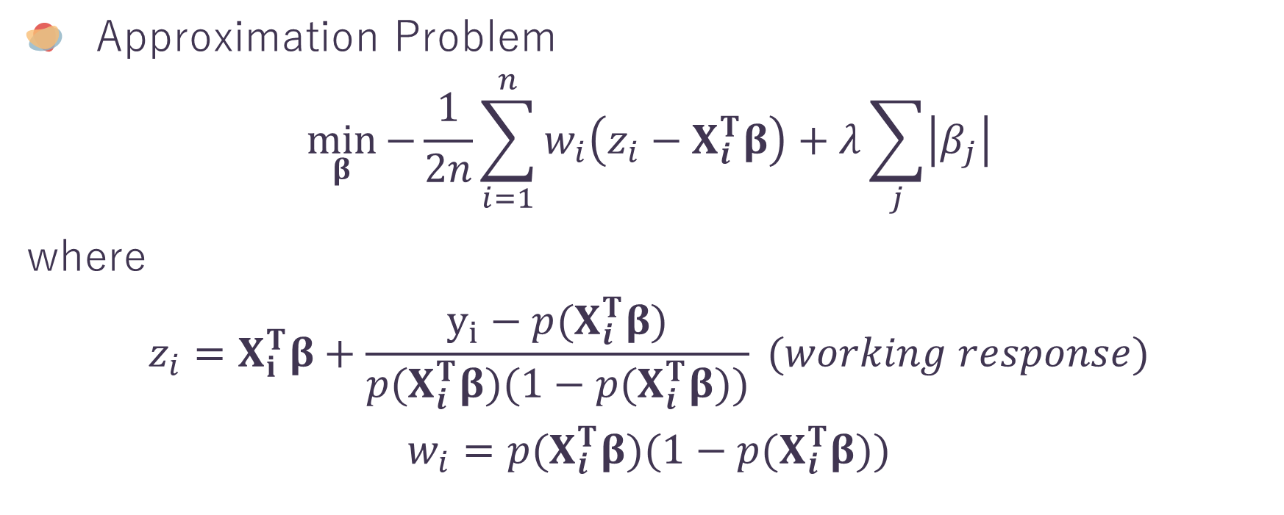

$L_{1}$-Penalized Logistic Regression
S
Approximation Problem
$$\min_{β}{−\frac{1}{2n}\sum_{i=1}^{n}{w_{i}\left(z_{i}−X_{i}^{T}β\right)}+λ\sum_{j}{\left|β_{j}\right|}}$$
where
$$z_{i}=X_{i}^{T}β+\frac{y_{i}−p(X_{i}^{T}β)}{p(X_{i}^{T}β)(1−p(X_{i}^{T}β))} (working response)$$
$$w_{i}=p(X_{i}^{T}β)(1−p(X_{i}^{T}β))$$

Slide 4
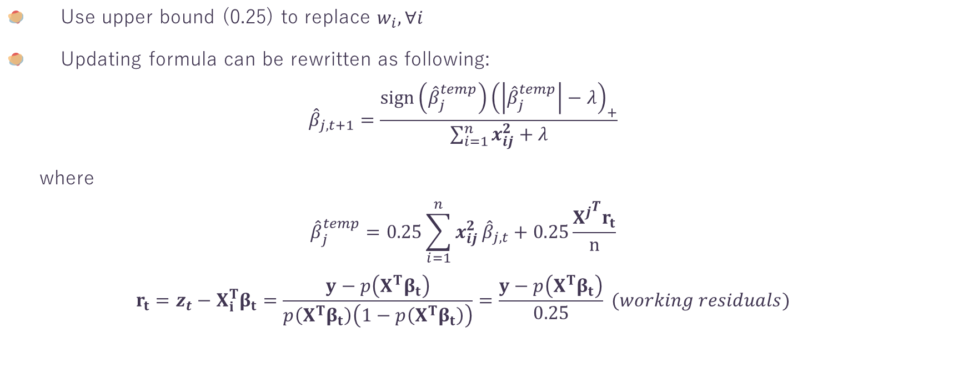
$L_{1}$-Penalized Logistic Regression
S
Use upper bound (0.25) to replace $w_{i}, ∀i$
Updating formula can be rewritten as following:
$${\hat{β}}_{j, t+1}=\frac{sign\left({\hat{β}}_{j}^{temp}\right){\left(\left|{\hat{β}}_{j}^{temp}\right|−λ\right)}_{+}}{\sum_{i=1}^{n}{x_{ij}^{2}}+λ}$$
where
$${\hat{β}}_{j}^{temp}=0.25\sum_{i=1}^{n}{x_{ij}^{2}}{\hat{β}}_{j, t}+0.25\frac{{X^{j}}^{T}r_{t}}{n}$$
$$r_{t}=z_{t}−X_{i}^{T}β_{t}=\frac{y−p\left(X^{T}β_{t}\right)}{p\left(X^{T}β_{t}\right)\left(1−p\left(X^{T}β_{t}\right)\right)}=\frac{y−p\left(X^{T}β_{t}\right)}{0.25} (working residuals)$$

Slide 5
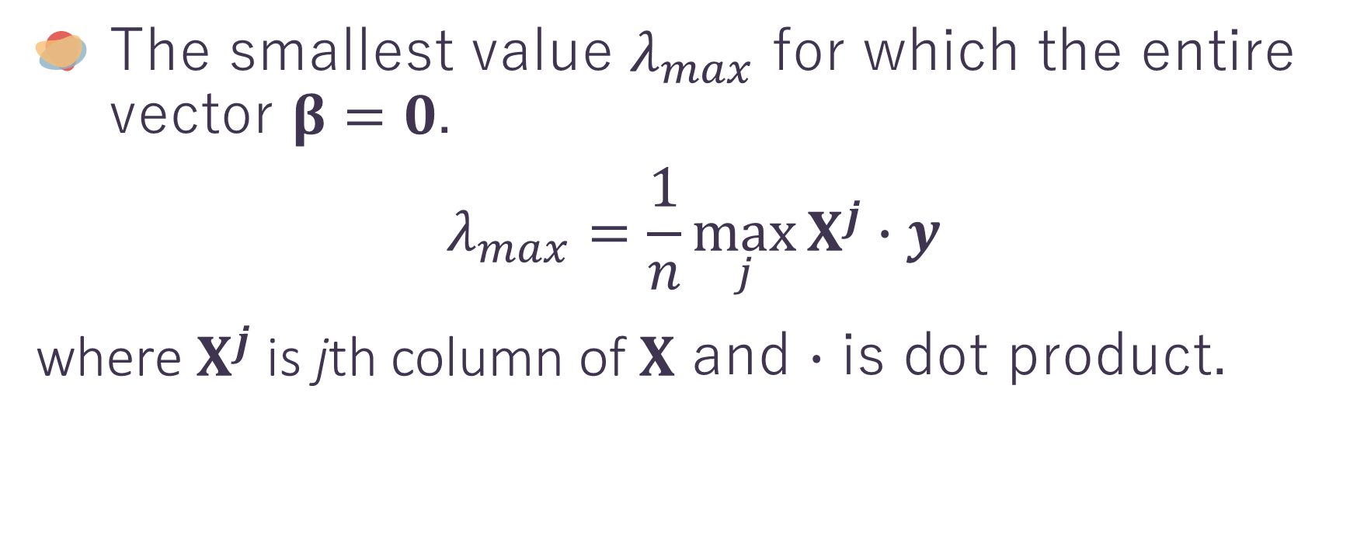
$L_{1}$-Penalized Logistic Regression
S
The smallest value $λ_{max}$ for which the entire vector $β=0$.
$$λ_{max}=\frac{1}{n}\max_{j}{X^{j}∙y}$$
where$X^{j}$is jth column of $X$ and $∙$ is dot product.

Slide 6
Performance
S

Slide 7
References
Friedman J, Hastie T, Tibshirani R. Regularization Paths for Generalized Linear Models via Coordinate Descent. J Stat Softw. 2010;33(1):1-22.

