Slide 1
RcppArmadillo and Parallelism in Rcpp
Let’s boost R with C++

Slide 2
Outline
00
Env. Settings
03
Rcpp
Prepare for Rcpp
Integration of R and C++
01
Reviews of C++
04
RcppArmadillo
Class, Pointer and Why use C++
Rcpp with Armadillo
02
R Interface to C
05
Parallelism in Rcpp
What is SEXP
OpenMP and RcppParallel

Slide 3
RcppARMADILLO
Rcpp with Armadillo

Slide 4
RcppArmadillo
4
What is Armadillo?
It provides vector and matrix classes with linear algebra support. Also it is able to link external BLAS and LAPACK to improve performance such as Intel MKL, OpenBLAS, ACML and CUDA BLAS etc.
It provides efficient classes for vectors, matrices and cubes. And dense and sparse matrices are supported.
There are many matrix libraries, why Armadillo?
It provides more APIs than Eigen, GSL and others.
Its syntax is like MatLab. (To me, it is advantage.)

Slide 5
BLAS and LAPACK
4
BLAS - Basic Linear Algebra Subprograms which performs vector addition, scalar multiplication, dot products, linear combinations, and matrix multiplication.
LAPACK - Linear Algebra PACKage which provides routine for solving systems of linear equations and linear least squares, eigenvalue problems, and singular value decomposition.

Slide 6
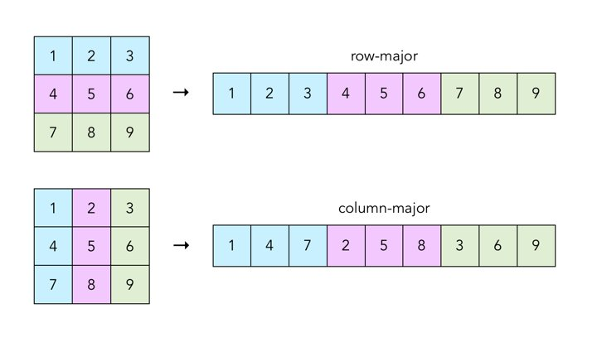
Column-Major v.s. Row-Major
4
Column-major order and row-major order are methods to store values in linear storage.
Basically, C, C++ and Python NumPy are row-major.
Fortran, R, MatLab are column-major.

Slide 7
Classes in RcppArmadillo
4
Type can be one of following:
float
ouble
std::complex<float>
std::complex<double>
(unsigned) short
(unsigned) int
(unsigned) long
Basic Types:
Mat<Type> - Class for dense matrices (column-major ordering)
Col <Type> - derived from Mat<Type> with one column.
Row <Type> - derived from Mat<Type> with one row.
Cube<Type> - Class for 3D arrays or 3rd order tensors.
SpMat<type> - Class for sparse matrices
field<Object_Type>
It is like a vector of objects.
Object_Type can be matrices,
Cube or other classes.

Slide 8
RcppArmadillo
4
Types in Armadillo
sword: signed integer
uword: unsigned integer
Its width depends on which C++ standard you use, please refer to http://arma.sourceforge.net/docs.html#uword
In Rcpp, default is C++98, their width is 32 bit.

Slide 9
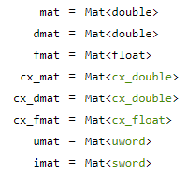
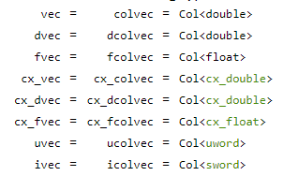
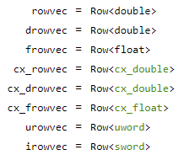
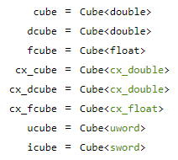
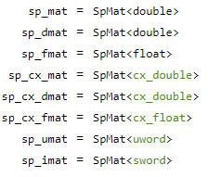
Aliases in Armadillo
4
Dense
Matrix
Column
Vector
Row
Vector
Sparse
Matrix
Cube

Slide 10
Mapping between R objects and Rcpp objects
3
Example of R Object | R Object | RcppArmadillo Object
c(TRUE, FALSE) | logical vector | uvec (ucolvec) / urowvec
c(1L, 5L) | integer vector | ivec (icolvec) / irowvec uvec (ucolvec) / urowvec
c(1, 5) | double vector | vec (colvec) / rowvec
c(“A”, “B”) | character vector | No such type in Armadillo I used to use vector<string>
matrix(c(TRUE, FALSE), 2L) | logical matrix | umat
matrix(c(1L,5L), 2L) | integer matrix | imat / imat
matrix(c(1,5), 2L) | double matrix | mat
matrix(c(“A”, “B”), 2L) | character matrix | No such type in Armadillo
Please use corresponding Rcpp types for other R objects.

Slide 11
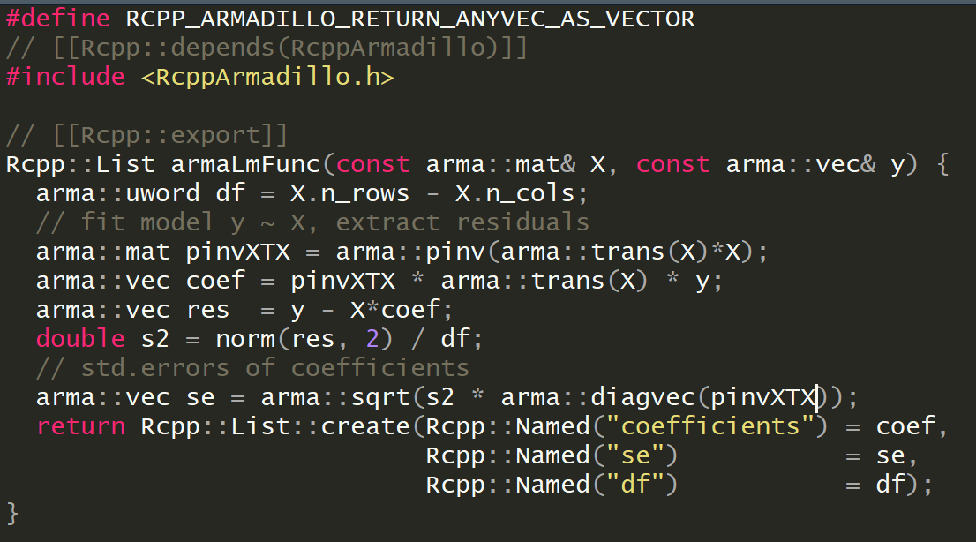
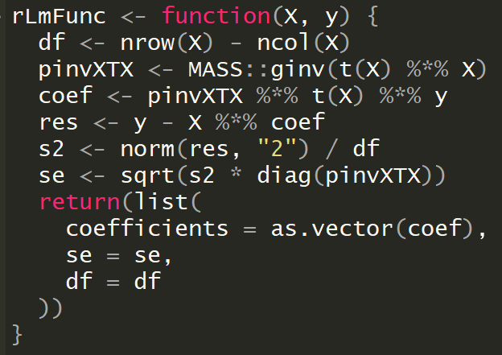
First Example – Linear Regression
4
Make Aramdillo vectors returning to R is vector instead matrix
Attributes
We can compare this two syntax,
they are very similar except that C++ need type declaration.

Slide 12
Preprocessors
4
RcppArmadillo provides 3 preprocessors for casting arma::Col <Type> or arma::Row<Type> into R vector
RCPP_ARMADILLO_RETURN_COLVEC_AS_VECTOR – cast arma::Col<Type> to R vector
RCPP_ARMADILLO_RETURN_ROWVEC_AS_VECTOR – cast arma:: Row<Type> to R vector
RCPP_ARMADILLO_RETURN_ANYVEC_AS_VECTOR – cast arma::Col<Type> and arma:: Row<Type> to R vector

Slide 13
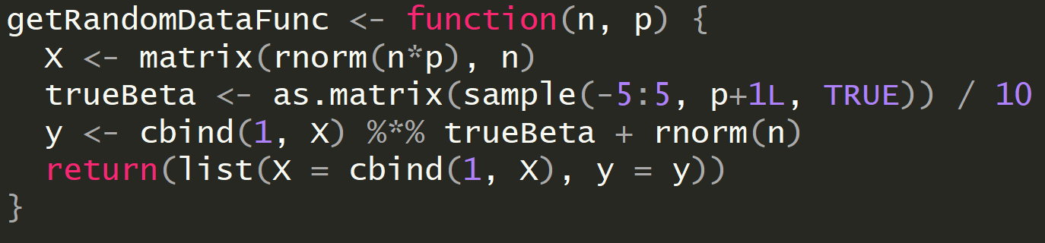
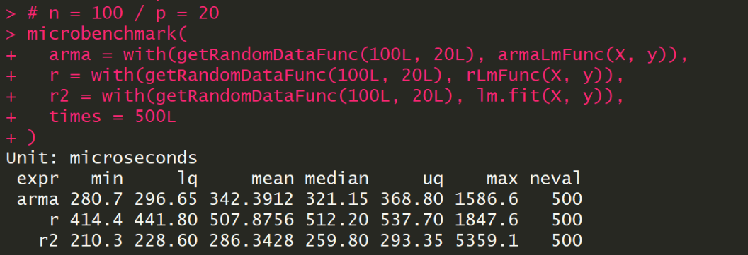
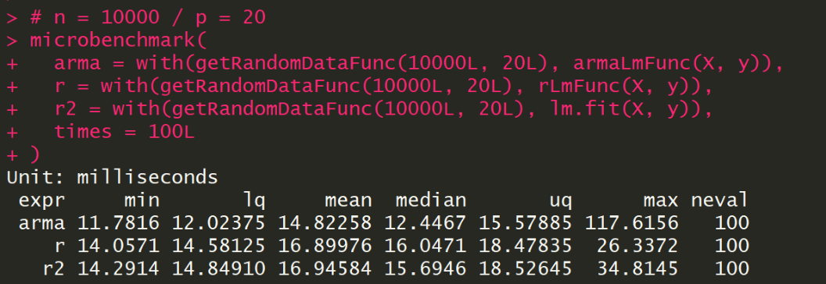
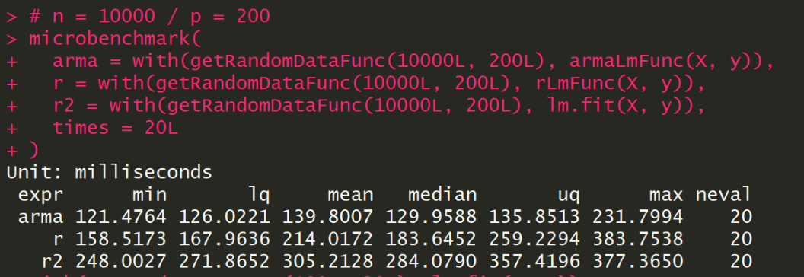
Performance
4
N = 100
P = 20
These benchmarks is under MRO-3.4.4
The official R is slower than MRO.
See next slide.
N = 10000
P = 20
N = 10000
P = 200

Slide 14
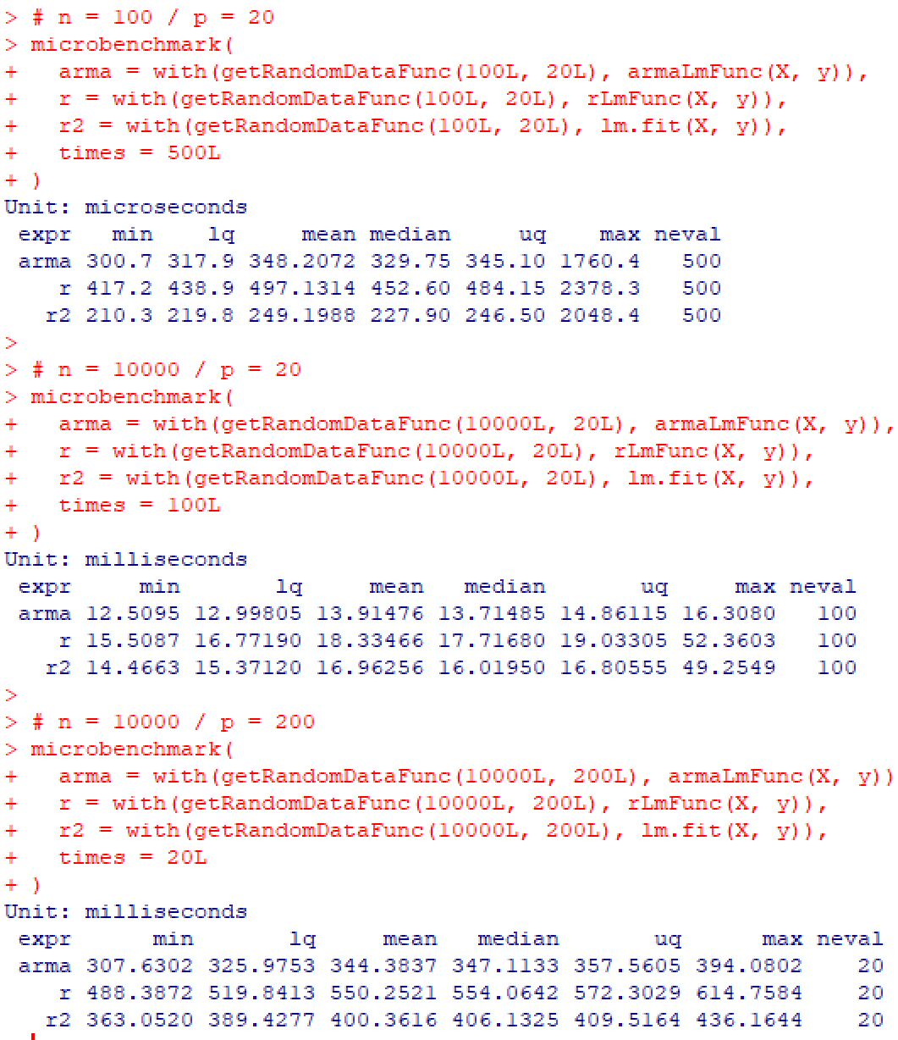
Performance in Official R
4

Slide 15
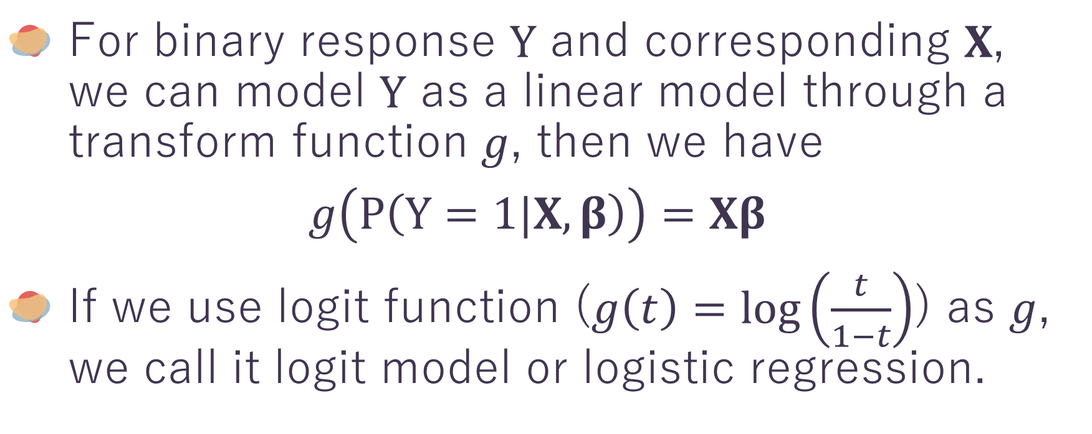
Second Example – Logistic Regression
4
For binary response $Y$ and corresponding $X$, we can model $Y$ as a linear model through a transform function $g$, then we have
$$g\left(P\left(Y=1|X, β\right)\right)=Xβ$$
If we use logit function ($g\left(t\right)=\log\left(\frac{t}{1−t}\right)$) as $g$, we call it logit model or logistic regression.

Slide 16
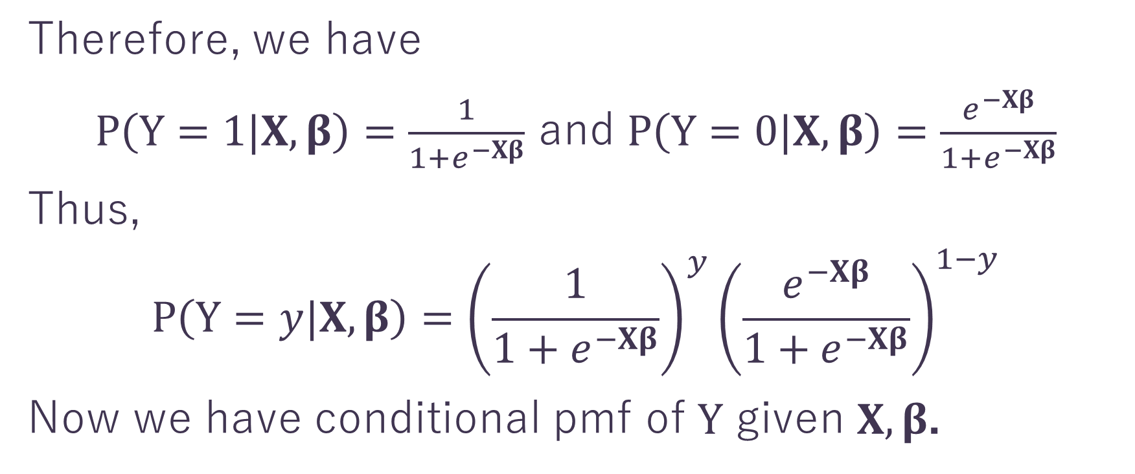
Second Example – Logistic Regression
4
Therefore, we have
$P\left(Y=1|X, β\right)=\frac{1}{1+e^{−Xβ}}$ and $P\left(Y=0|X, β\right)=\frac{e^{−Xβ}}{1+e^{−Xβ}}$
Thus,
$$P\left(Y=y|X, β\right)={\left(\frac{1}{1+e^{−Xβ}}\right)}^{y}{\left(\frac{e^{−Xβ}}{1+e^{−Xβ}}\right)}^{1−y}$$
Now we have conditional pmf of $Y$ given $X, β$.

Slide 17
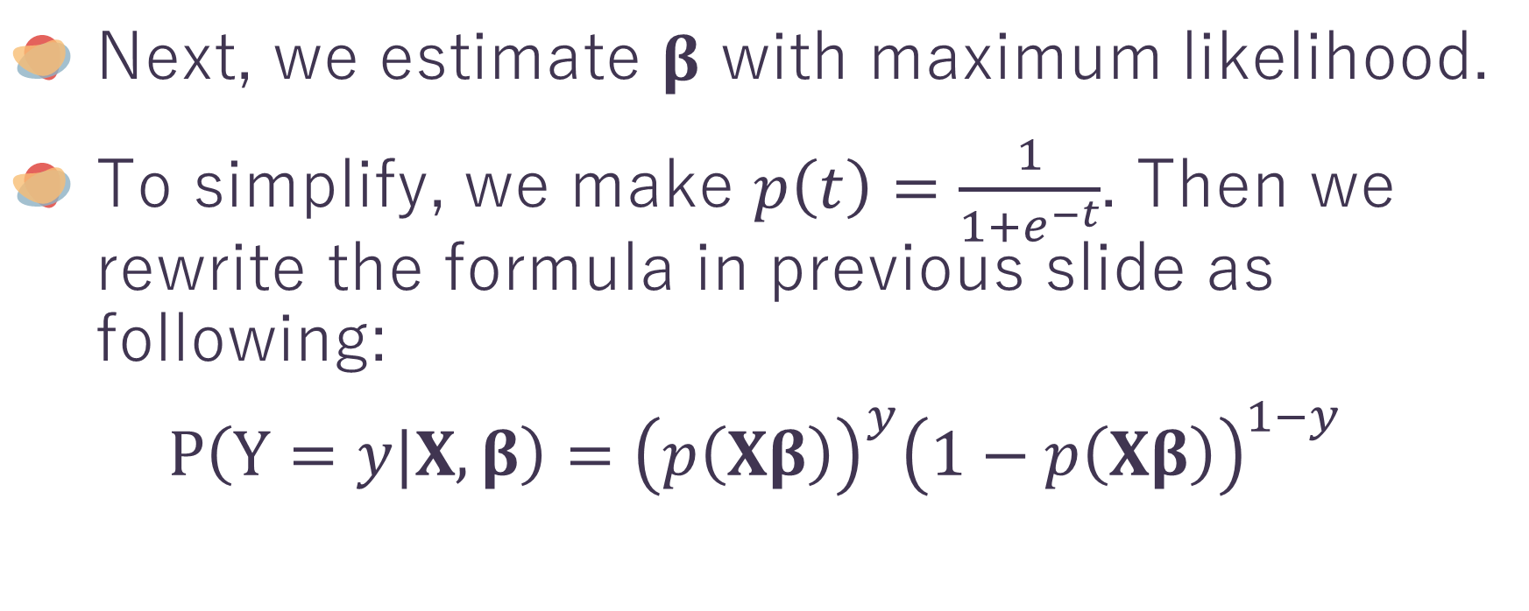
Second Example – Logistic Regression
4
Next, we estimate $β$ with maximum likelihood.
To simplify, we make $p\left(t\right)=\frac{1}{1+e^{−t}}$. Then we rewrite the formula in previous slide as following:
$$P\left(Y=y|X, β\right)={\left(p\left(Xβ\right)\right)}^{y}{\left(1−p\left(Xβ\right)\right)}^{1−y}$$

Slide 18
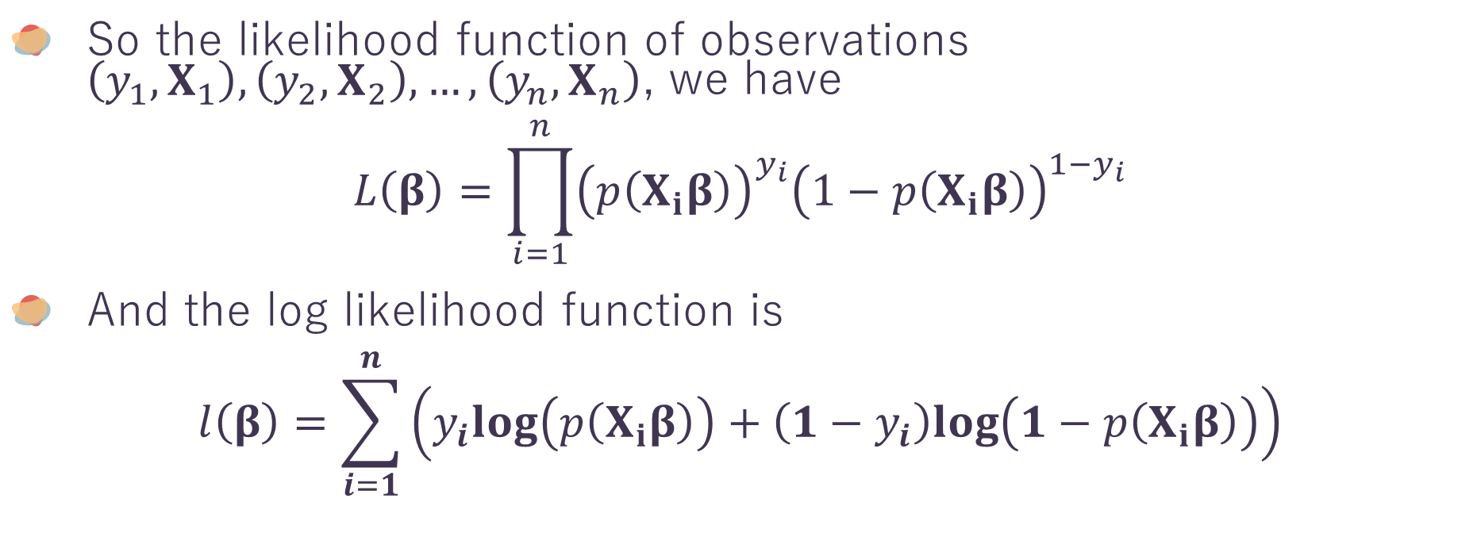
Second Example – Logistic Regression
4
So the likelihood function of observations $\left(y_{1},X_{1}\right),\left(y_{2},X_{2}\right), …,\left(y_{n},X_{n}\right)$, we have
$$L\left(β\right)=\prod_{i=1}^{n}{{\left(p\left(X_{i}β\right)\right)}^{y_{i}}{\left(1−p\left(X_{i}β\right)\right)}^{1−y_{i}}}$$
And the log likelihood function is
$$l\left(β\right)=\sum_{i=1}^{n}{\left(y_{i}log\left(p\left(X_{i}β\right)\right)+\left(1−y_{i}\right)log\left(1−p\left(X_{i}β\right)\right)\right)}$$

Slide 19
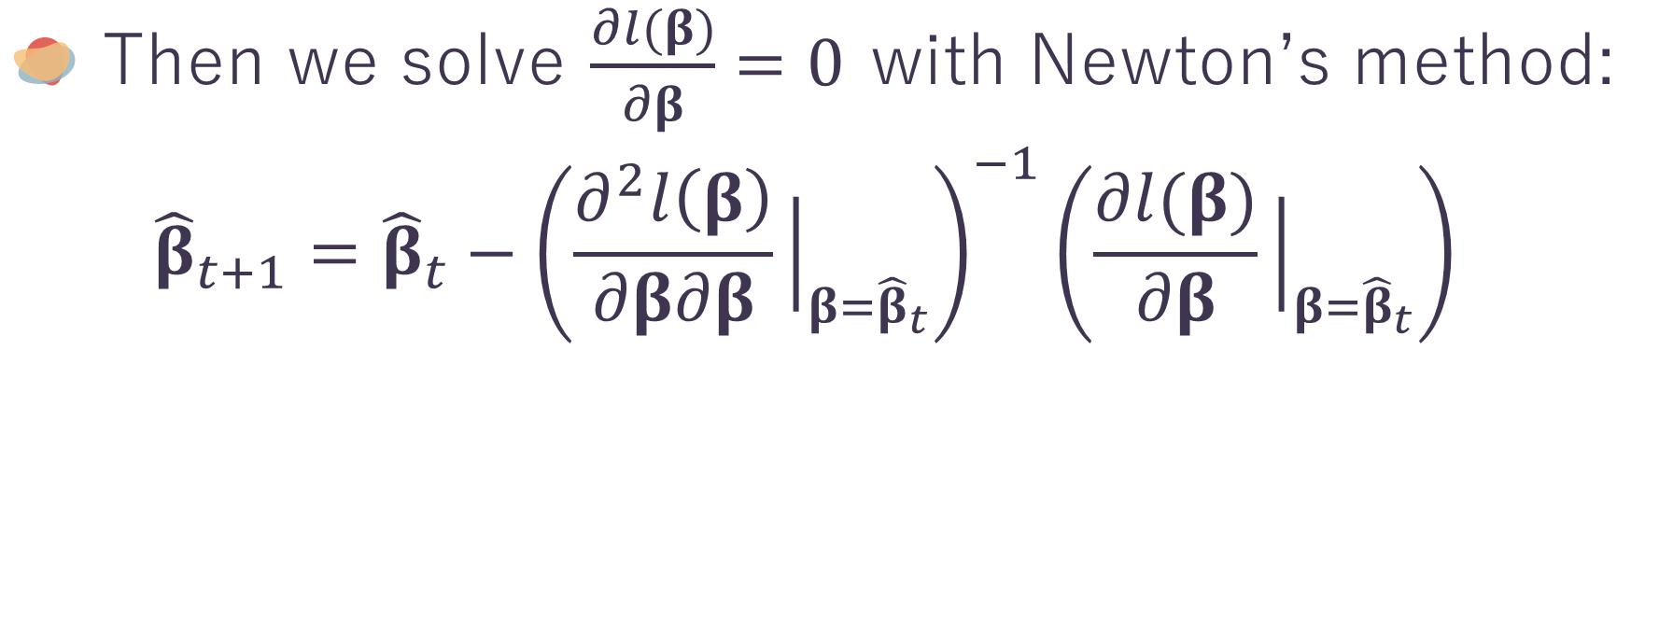
Second Example – Logistic Regression
4
Then we solve $\frac{∂l(β)}{∂β}=0$ with Newton’s method:
$${\hat{β}}_{t+1}={\hat{β}}_{t}−{\left(\frac{∂^{2}l\left(β\right)}{∂β∂β}{\left.​\right|}_{β={\hat{β}}_{t}}\right)}^{−1}\left(\frac{∂l(β)}{∂β}{\left.​\right|}_{β={\hat{β}}_{t}}\right)$$
Newton’s method is a method to approximate roots of a function $f$ with $x_{t+1}=x_{t}−\frac{f(x_{t})}{f′(x_{t})}$

Slide 20

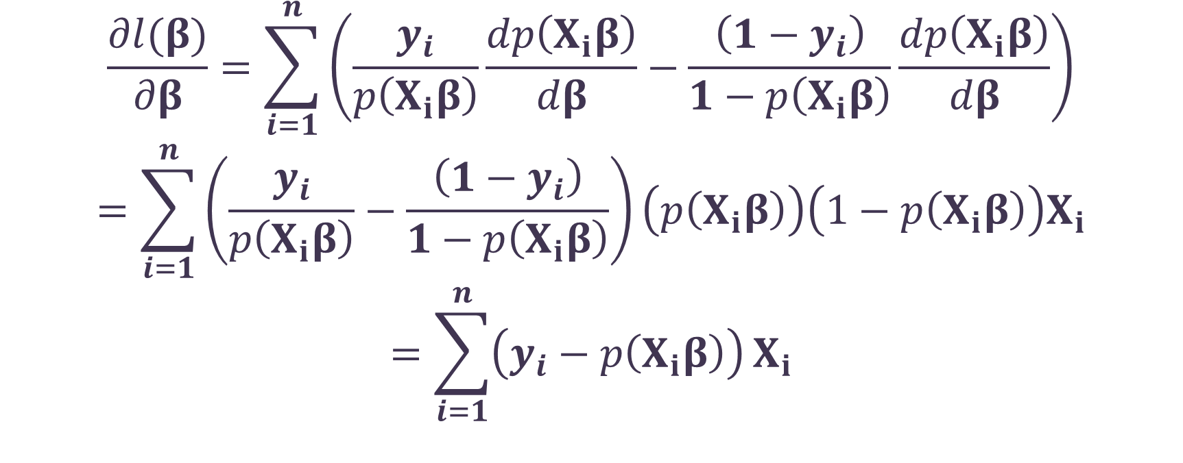
Second Example – Logistic Regression
4
$$\frac{∂l(β)}{∂β}=\sum_{i=1}^{n}{\left(\frac{y_{i}}{p\left(X_{i}β\right)}\frac{dp\left(X_{i}β\right)}{dβ}−\frac{\left(1−y_{i}\right)}{1−p\left(X_{i}β\right)}\frac{dp\left(X_{i}β\right)}{dβ}\right)}$$
$$=\sum_{i=1}^{n}{\left(\frac{y_{i}}{p\left(X_{i}β\right)}−\frac{\left(1−y_{i}\right)}{1−p\left(X_{i}β\right)}\right)}\left(p\left(X_{i}β\right)\right)\left(1−p\left(X_{i}β\right)\right)X_{i}$$
$$=\sum_{i=1}^{n}{\left(y_{i}−p\left(X_{i}β\right)\right)}X_{i}$$
$$\frac{dp(t)}{dt}=\frac{e^{−t}}{{\left(1+e^{−t}\right)}^{2}}$$
$$=\left(\frac{1}{1+e^{−t}}\right)\left(\frac{e^{−t}}{1+e^{−t}}\right)$$
$$=p\left(t\right)\left(1−p\left(t\right)\right)$$

Slide 21
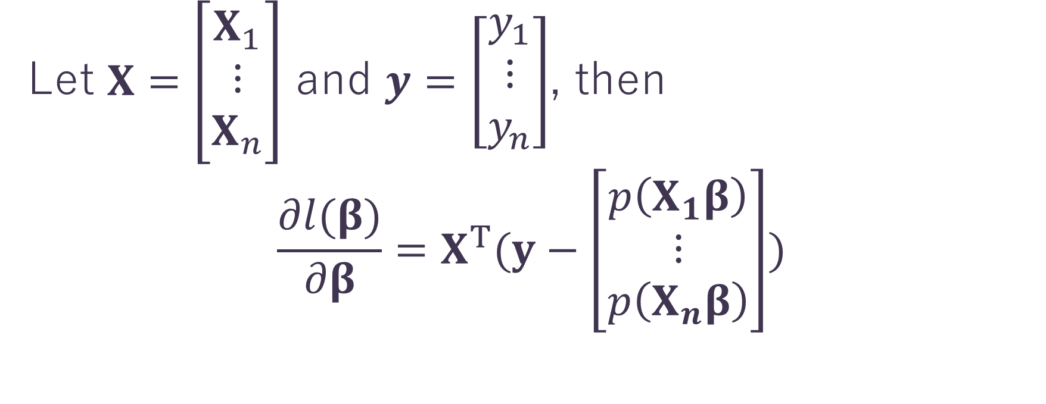
Second Example – Logistic Regression
4
Let $X=\left[\begin{aligned}X_{1} \\ ⋮ \\ X_{n}\end{aligned}\right]$ and $y=\left[\begin{aligned}y_{1} \\ ⋮ \\ y_{n}\end{aligned}\right]$, then
$$\frac{∂l(β)}{∂β}=X^{T}(y−\left[\begin{aligned}p\left(X_{1}β\right) \\ ⋮ \\ p\left(X_{n}β\right)\end{aligned}\right])$$

Slide 22
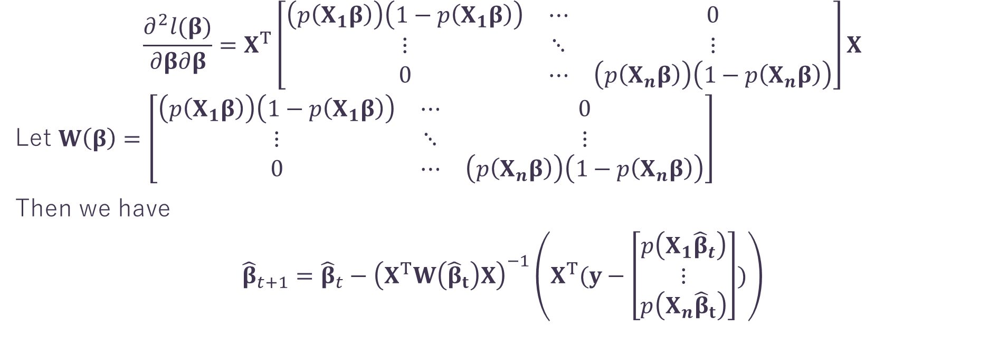
Second Example – Logistic Regression
4
$$\frac{∂^{2}l(β)}{∂β∂β}=X^{T}\left[\begin{matrix}\left(p\left(X_{1}β\right)\right)\left(1−p\left(X_{1}β\right)\right) & ⋯ & 0 \\ ⋮ & ⋱ & ⋮ \\ 0 & ⋯ & \left(p\left(X_{n}β\right)\right)\left(1−p\left(X_{n}β\right)\right)\end{matrix}\right]X$$
Let $W\left(β\right)=\left[\begin{matrix}\left(p\left(X_{1}β\right)\right)\left(1−p\left(X_{1}β\right)\right) & ⋯ & 0 \\ ⋮ & ⋱ & ⋮ \\ 0 & ⋯ & \left(p\left(X_{n}β\right)\right)\left(1−p\left(X_{n}β\right)\right)\end{matrix}\right]$
Then we have
$${\hat{β}}_{t+1}={\hat{β}}_{t}−{\left(X^{T}W\left({\hat{β}}_{t}\right)X\right)}^{−1}\left(X^{T}(y−\left[\begin{aligned}p\left(X_{1}{\hat{β}}_{t}\right) \\ ⋮ \\ p\left(X_{n}{\hat{β}}_{t}\right)\end{aligned}\right])\right)$$

Slide 23
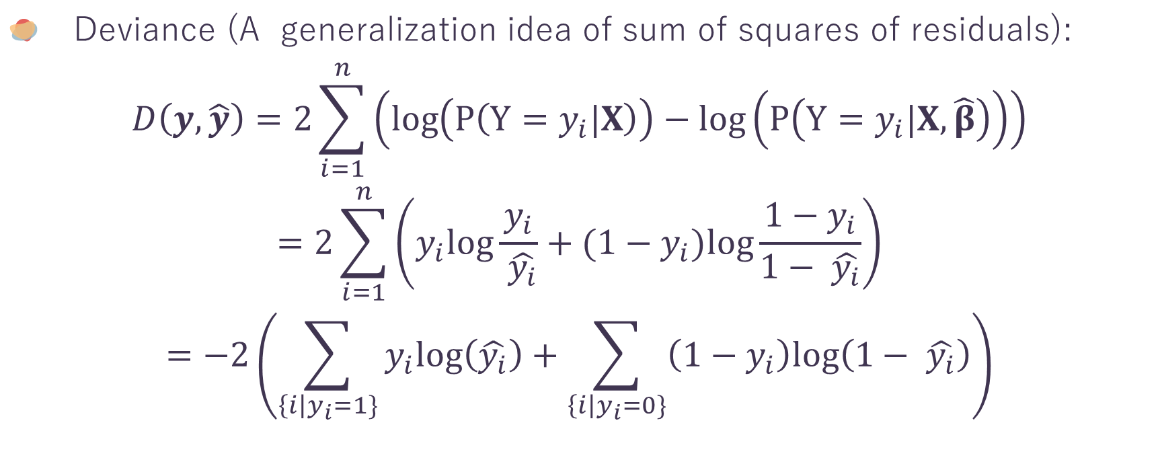
Second Example – Logistic Regression
4
Deviance (A generalization idea of sum of squares of residuals):
$$D\left(y,\hat{y}\right)=2\sum_{i=1}^{n}{\left(\log\left(P\left(Y=y_{i}|X\right)\right)−\log\left(P\left(Y=y_{i}|X, \hat{β}\right)\right)\right)}$$
$$=2\sum_{i=1}^{n}{\left(y_{i}log{\frac{y_{i}}{ \hat{y_{i}}}}+({1−y}_{i})log{\frac{1−y_{i}}{1− \hat{y_{i}}}}\right)}$$
$$=−2\left(\sum_{\left\{i\right|y_{i}=1\}}{y_{i}log\left(\hat{y_{i}}\right)}+\sum_{\left\{i\right|y_{i}=0\}}{\left({1−y}_{i}\right)log\left(1− \hat{y_{i}}\right)}\right)$$

Slide 24
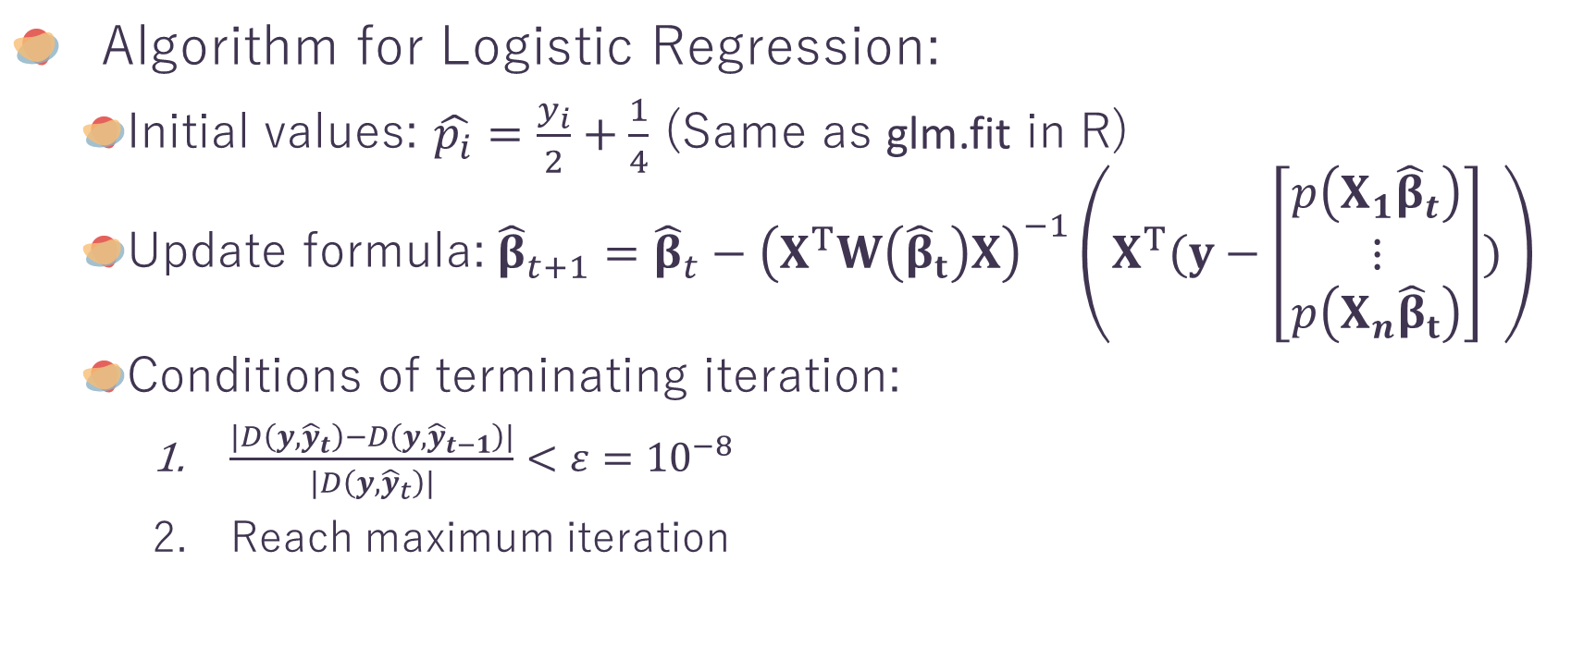
Second Example – Logistic Regression
4
Algorithm for Logistic Regression:
Initial values: $\hat{p_{i}}=\frac{y_{i}}{2}+\frac{1}{4}$ (Same as glm.fit in R)
Update formula:${\hat{β}}_{t+1}={\hat{β}}_{t}−{\left(X^{T}W\left({\hat{β}}_{t}\right)X\right)}^{−1}\left(X^{T}(y−\left[\begin{aligned}p\left(X_{1}{\hat{β}}_{t}\right) \\ ⋮ \\ p\left(X_{n}{\hat{β}}_{t}\right)\end{aligned}\right])\right)$
Conditions of terminating iteration:
$\frac{\left|D\left(y,{\hat{y}}_{t}\right)−D\left(y,{\hat{y}}_{t−1}\right)\right|}{\left|D\left(y,{\hat{y}}_{t}\right)\right|}<ε={10}^{−8}$
Reach maximum iteration

Slide 25
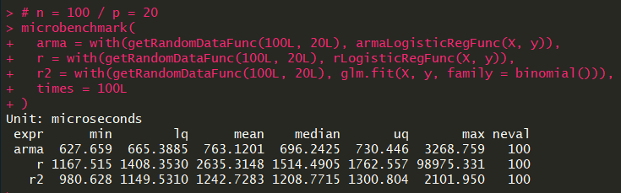
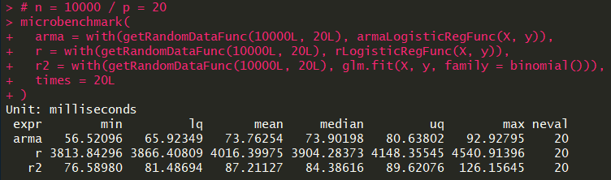
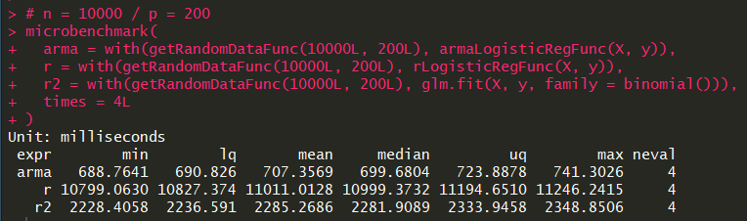
Performance
4
N = 100
P = 20
Although we use same algorithm in R and C++, the performance of C++ may be faster 50 times.
N = 10000
P = 20
N = 10000
P = 200

Slide 26
ParallELism in Rcpp
OpenMP and RcppParallel

Slide 27
First Question - Why Use Rcpp for Parallelization
5
R packages providing parallel functionalities:
parallel
snow
snowfall
Rmpi
pbdmpi
foreach
These packages almost use subprocesses to provide parallel
Implementation, they does not share memory. Thus, you may
need a lot of memories to perform parallel computation.
Note: mc*apply functions in parallel use forking instead subprocesses,
but it is the same that processes do not share memory.

Slide 28
Parallelism in Rcpp
5
With C++, you can use shared memory multiprocessing, then you don’t need too many memories for parallel implementation.
Threading Frameworks:
OpenMP (Open Multi-Processing)
TBB (Threading Building Blocks)
pthread
C++11 Threads STL (similar to Boost)
They are very hard to be used
in R with Windwos OS.

Slide 29
Parallelism in Rcpp
5
As far as I know, configuring
OpenMP in Mac OS X is annoying.
Threading Frameworks:
OpenMP (Open Multi-Processing)
TBB (Threading Building Blocks)
pthread
C++11 Threads STL (similar to Boost)
But it is simplest between these,
so I give a simple example.

Slide 30
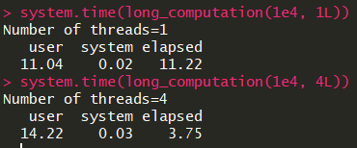
Use OpenMP in Rcpp
5
All you need to do is add following three line.
Then it works like a charm.
In the head of file:
Before for loop:
You can find more details at https://computing.llnl.gov/tutorials/openMP/

Slide 31
RcppParallel
5
2 high-level parallel functions
parallelFor
parallelReduce
2 classes for thread safety
RVector
RMatrix
Based on Intel TBB
Since we work on Armadillo objects
instead R objects, we won’t use them.

Slide 32
RcppParallel - Simple Examples
5
Simple Examples
parallelFor - Kernel Matrix Calculation
parallelReduce - Calculation of Log Likelihood of Logistic Regression

Slide 33
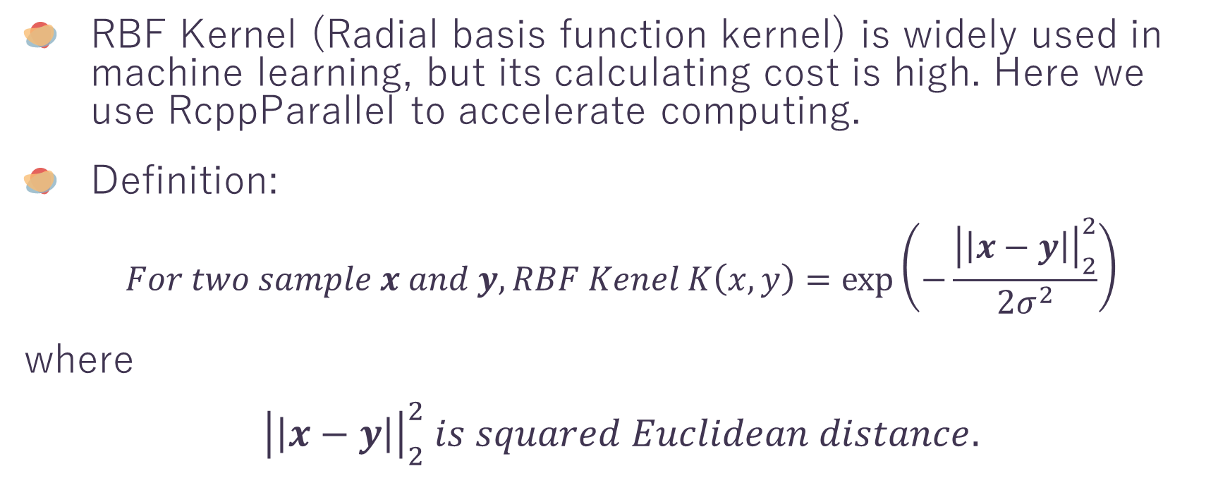
RBF Kernel Matrix Calculation
5
RBF Kernel (Radial basis function kernel) is widely used in machine learning, but its calculating cost is high. Here we use RcppParallel to accelerate computing.
Definition:
$$For two sample x and y, RBF Kenel K\left(x, y\right)=\exp\left(−\frac{{\left|\left|x−y\right|\right|}_{2}^{2}}{2σ^{2}}\right)$$
where
$${\left|\left|x−y\right|\right|}_{2}^{2} is squared Euclidean distance.$$

Slide 34
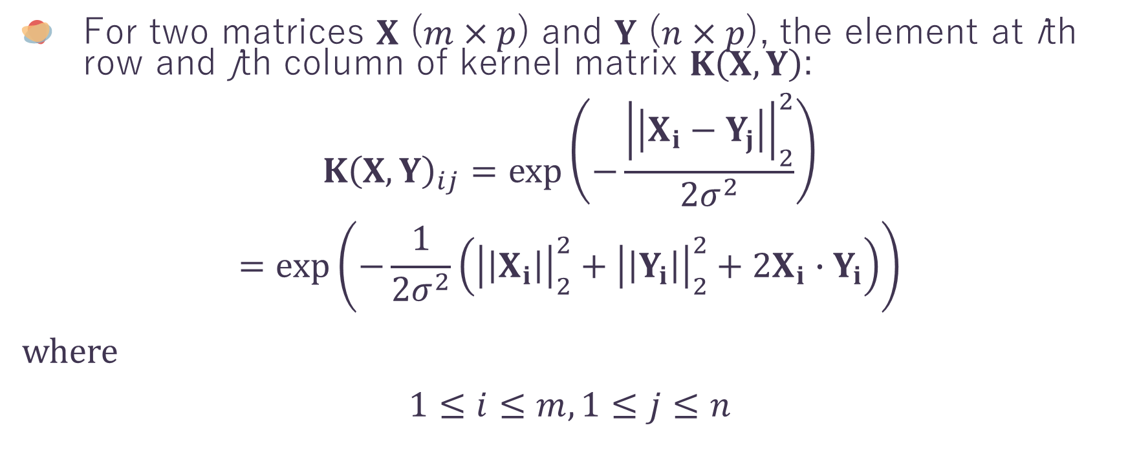
RBF Kernel Matrix Calculation
5
For two matrices $X$ ($m×p$) and $Y$ ($n×p$), the element at ith row and jth column of kernel matrix $K\left(X, Y\right)$:
$$K{\left(X, Y\right)}_{ij}=\exp\left(−\frac{{\left|\left|X_{i}−Y_{j}\right|\right|}_{2}^{2}}{2σ^{2}}\right)$$
$$=\exp\left(−\frac{1}{2σ^{2}}\left({\left|\left|X_{i}\right|\right|}_{2}^{2}+{\left|\left|Y_{i}\right|\right|}_{2}^{2}+2X_{i}∙Y_{i}\right)\right)$$
where
$$1≤i≤m, 1≤j≤n$$

Slide 35
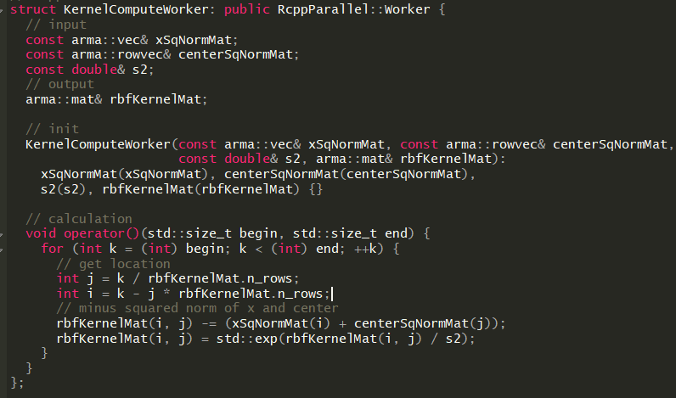
Worker in RcppParallel
5
Inheritance
Input (use const type&)
output (use type&)
Initialization
Calculation

Slide 36

Worker with parallelFor
5
Initialize worker
Use parallelFor to distribute jobs to workers

Slide 37


Performance
5
For two matrices $X$ (3000 $×$ 100) and $Y$ (500 $×$ 100), function written in RcppArmadillo and RcppParallel is 4.5 times faster than function in R package kernlab.

Slide 38
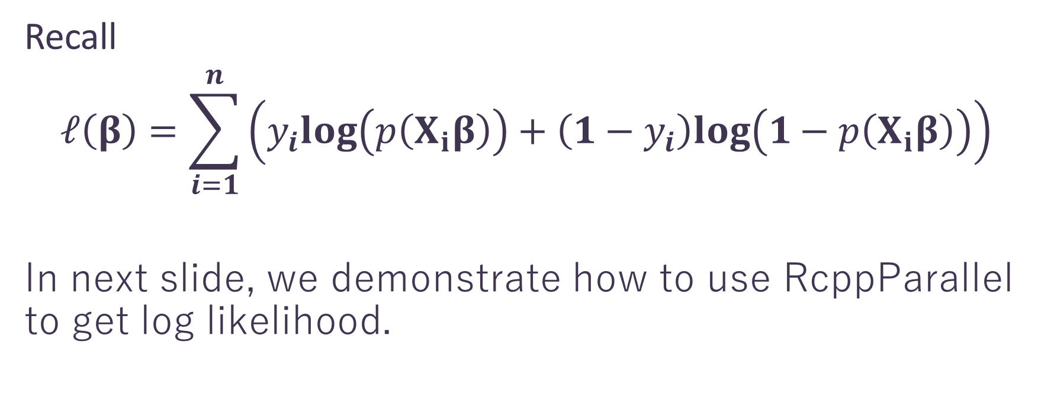
parallelReduce - Log Likelihood of Logistic Regression
5
Recall
$$ℓ\left(β\right)=\sum_{i=1}^{n}{\left(y_{i}log\left(p\left(X_{i}β\right)\right)+\left(1−y_{i}\right)log\left(1−p\left(X_{i}β\right)\right)\right)}$$
In next slide, we demonstrate how to use RcppParallel to get log likelihood.

Slide 39
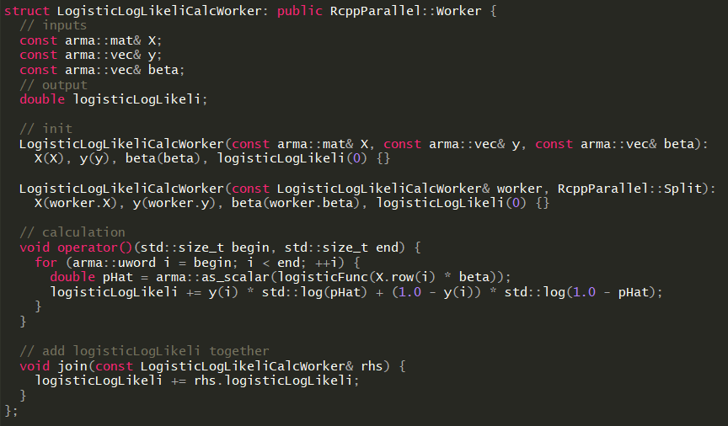
parallelReduce - Log Likelihood of Logistic Regression
5
To use parallelReduce, we need one
more initialization and one more
method (join) for reducing in worker.

Slide 40
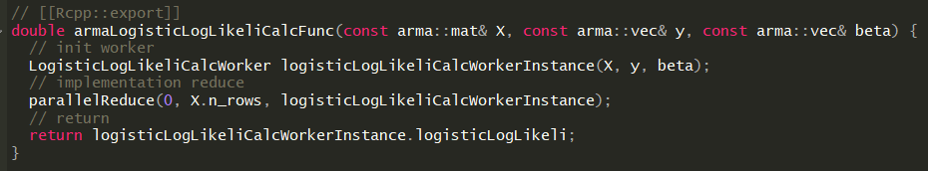
parallelReduce - Log Likelihood of Logistic Regression
5
Initialize worker
Use parallelReduce to
distribute jobs to workers

Slide 41
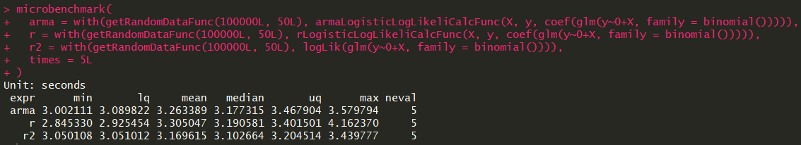
Performance
5
N=100000, p=100 on MRO-3.4.4
Note: Since computation is too simple, parallelization does not get benefit.

Slide 42
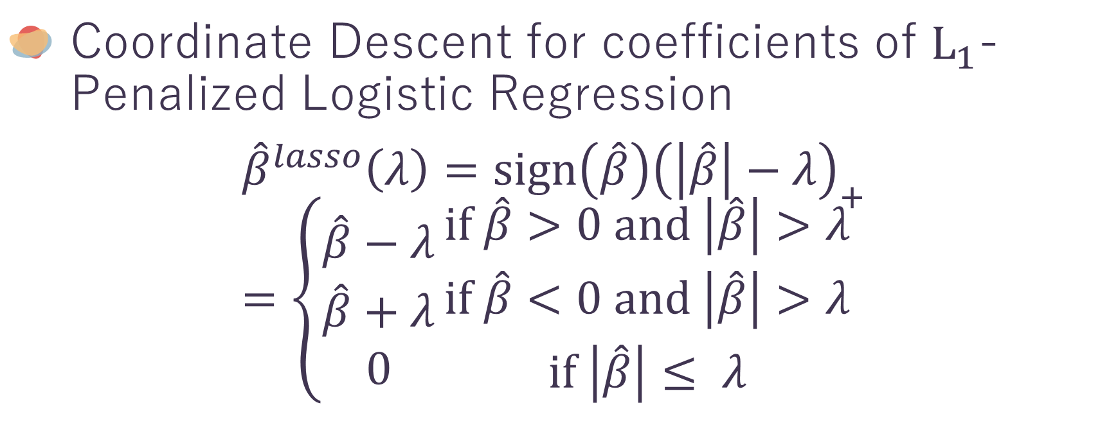

$L_{1}$-Penalized Logistic Regression
5
Coordinate Descent for coefficients of $L_{1}$-Penalized Logistic Regression
$${\hat{β}}^{lasso}\left(λ\right)=sign\left(\hat{β}\right){\left(\left|\hat{β}\right|−λ\right)}_{+}=\left\{\begin{aligned}\hat{β}−λ \\ \hat{β}+λ \\ 0\end{aligned}\right.\begin{matrix}if \hat{β}>0 and \left|\hat{β}\right|>λ \\ if \hat{β}<0 and \left|\hat{β}\right|>λ \\ if \left|\hat{β}\right|≤ λ\end{matrix}$$

Slide 43
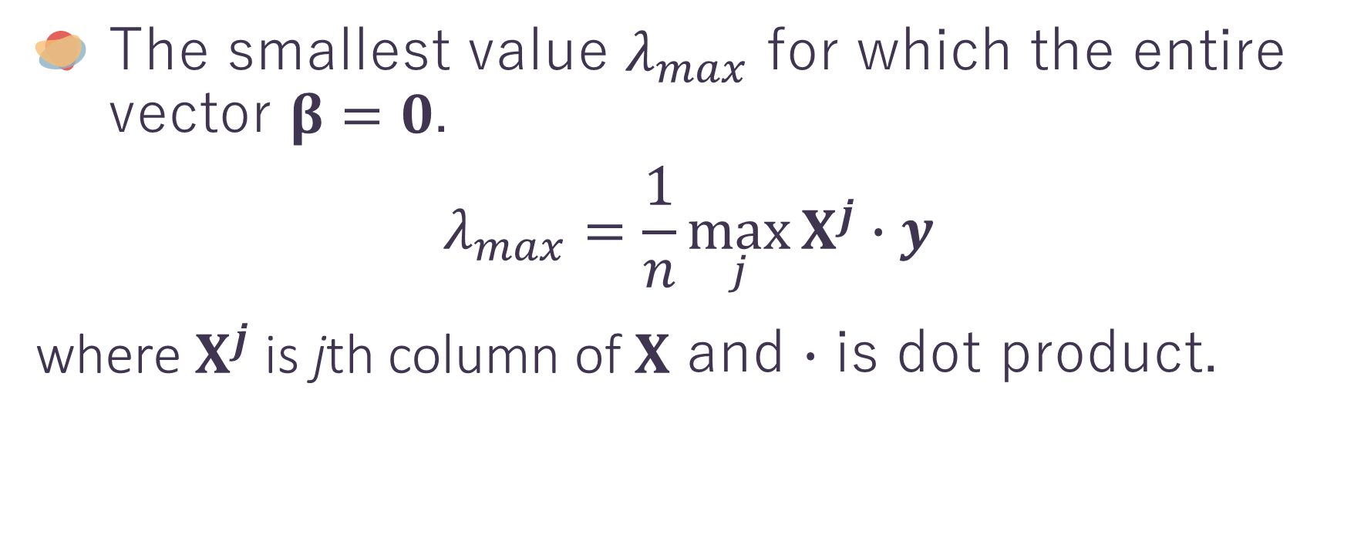
$L_{1}$-Penalized Logistic Regression
5
The smallest value $λ_{max}$ for which the entire vector $β=0$.
$$λ_{max}=\frac{1}{n}\max_{j}{X^{j}∙y}$$
where$X^{j}$is jth column of $X$ and $∙$ is dot product.

Slide 44
Performance
5

Slide 45
After this lesson…
6
There are a lot of R packages under Rcpp framework, i.e.
BH – Provides boost header
RcppMLPACK – Integrate MLPACK library
RcppNumerical – Integrate Numerical Computing Libraries

Slide 46
Thank You !
Hope you like this tutorial

Slide 47
References
https://www.geeksforgeeks.org/c-classes-and-objects/
https://www.tutorialspoint.com/cplusplus/cpp_classes_objects.htm
https://www.tutorialspoint.com/cplusplus/cpp_namespaces.htm
https://www.tutorialspoint.com/cplusplus/cpp_overloading.htm
https://www.tutorialspoint.com/cplusplus/cpp_templates.htm
http://adv-r.had.co.nz/C-interface.html
http://arma.sourceforge.net/docs.html
https://github.com/ChingChuan-Chen/milr/blob/master/src/milr.cpp
https://github.com/RcppCore/RcppArmadillo/blob/master/inst/examples/fastLm.r
https://thelaziestprogrammer.com/sharrington/math-of-machine-learning/solving-logreg-newtons-method
https://www.statlect.com/fundamentals-of-statistics/logistic-model-maximum-likelihood
Friedman J, Hastie T, Tibshirani R. Regularization Paths for Generalized Linear Models via Coordinate Descent. J Stat Softw. 2010;33(1):1-22.

Slide 48
MRO vs Official R
MRO (Microsoft R Open) is the enhanced distribution of R from Microsoft Corporation.
It includes multi-threaded math libraries (Intel MKL) to improve the performance of R.
Official R uses single-threaded BLAS/LAPACK libraries (ATLAS), so its performance on matrix multiply/inverse, matrix decomposition, and some higher-level matrix operations is slow.

Slide 49
MRO vs Official R
install.packages("SuppDist") source("https://raw.githubusercontent.com/jtalbot/riposte/master/benchmarks/other/R-benchmark-25.R")
MRO-3.4.4
Official R-3.4.4

Slide 50
Eigen vs Armadillo
Eigen has own BLAS/LAPACK functions, so if you use official R, you will find that RcppEigen outperforms RcppArmadillo in matrix operations. That is because RcppArmadillo share the same BLAS/LAPACK with R.
However, if you use MRO, you will see that RcppArmadillo outperforms RcppEigen since the performance of MKL is better than Eigen.

