Slide 1

BarBot PDDL App

Slide 2
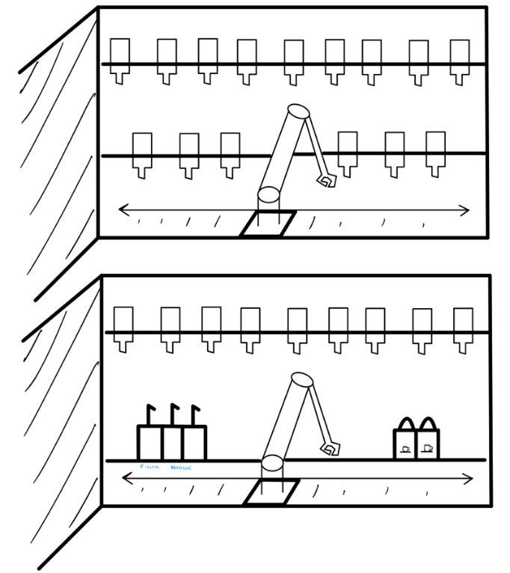
BarBot
L’implementazione “BarBot” ha come obiettivo quello di formulare un piano di azioni per un robot collaborativo all’interno di un bar. Il suo compito principale è la composizione dei drink: arrivato un ordine, prende il bicchiere, si reca in tutte le posizioni necessarie per ottenere gli ingredienti richiesti e consegna lo shaker in una posizione nota, comunicando la fine dell’ordine.
Tiene inoltre conto dello stato degli ingredienti, avvisando quando è necessario effettuare il cambio bottiglia, secondo parametri impostati.

Slide 3
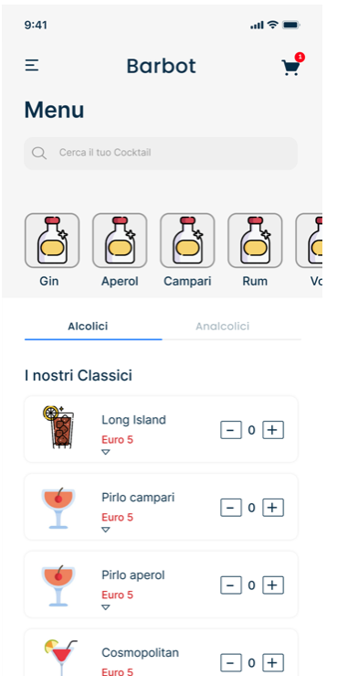
BarBot
Gli ordini che processa arrivano direttamente dai clienti, attraverso l’apposita applicazione.
I drink possono essere scelti tra I “Classici”, lista che comprende tutti i cocktail, tipici di ogni menù, o possono essere anche creati, scegliendo i sei ingredienti necessari.
In entrambi i casi, infatti, i drink risulteranno costitituiti da sei parti, composizione che permette sia di seguire la ricetta standard, sia una ampia personalizzazione.

Slide 4
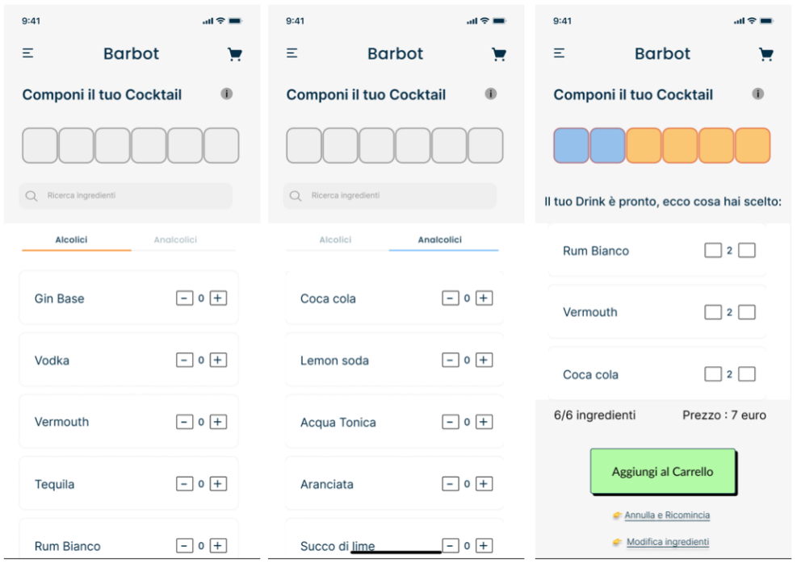
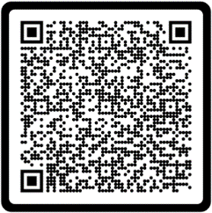
Per l’applicazione completa (mock-up):
https://www.figma.com/Barbot

Slide 5
PDDL
PDDL (Planning Domain Definition Language) è un insieme di linguaggi che permettono di definire problemi di IA planning.
I programmi PDDL sono costituiti da tre parti principali:
Dominio, in cui vengono definiti gli aspetti base, che non variano a seconda della specifica situazione.
Problema, che rappresenta l’istanza particolare, definendo oggetti e inizializzazione.
Planner, unisce i precedenti file e, seguendo le regole del dominio, decompone e risolve il problema.
L’applicazione «BarBot» gestisce tutta la parte di composizione del drink: partendo da un punto fisso e noto, in cui prende lo shaker vuoto, compone il cocktail, prelevando gli ingredienti necessari dalle relative bottiglie, e consegna il recipiente al barman, che provvederà al completamento dell’ordine, dalla guarnizione alla scelta del bicchiere adatto.
Per questa implementazione è necessario utilizzare un planner numerico, che supporta i fluents (versione 2.1 o maggiore)

Slide 6
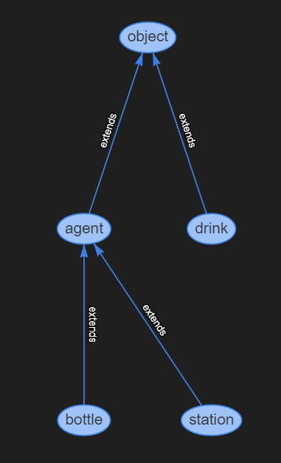
DOMINIO
Il dominio permette di definire diversi Tipi e oggetti, ognuno dei quali con le rispettive caratteristiche, definite dai predicati e dalle funzioni.
La definizione di sottotipi permette di unire proprietà specifiche ad altre generali.
Il nostro dominio definisce quattro oggetti:
bottiglie, stazioni, agenti e drink.
Bottiglie e stazioni estendono il tipo agente, e costituiscono la mappa che il robot può seguire per comporre i drink; le stazioni sono due, diversificate attraverso il predicato (BeStart).

Slide 7
(located ?x - agent)
(isnear ?x ?y - agent )
(beStart ?x - station)
(order-in-progress ?d - drink)
(served ?x - drink)
(handFree)
(warningLevel ?b - bottle)
(required-ingredient ?d - drink ?b – bottle)
(level ?b - bottle)
(used-ingredient ?d - drink)
PREDICATI
I predicati sono proprietà applicabili ad uno o più oggetti e ne definiscono delle proprietà, che possono essere imposte vere o false in qualsiasi punto del problema.
Se non esplicitamente inizializzati a vero, sono assunti essere falsi.
FUNZIONI
Le funzioni sono delle variabili numeriche applicabili ad uno o più oggetti e mantengono il valore lungo tutta la durata del piano.

Slide 8
(located ?x - agent)
(isnear ?x ?y - agent )
(beStart ?x - station)
(order-in-progress ?d - drink)
(served ?x - drink)
(handFree)
(warningLevel ?b - bottle)
(required-ingredient ?d - drink ?b – bottle)
(level ?b - bottle)
(used-ingredient ?d - drink)
AZIONI
I predicati sono proprietà applicabili ad uno o più oggetti e ne definiscono delle proprietà, che possono essere imposte vere o false in qualsiasi punto del problema.
Se non esplicitamente inizializzati a vero, sono assunti essere falsi.

Slide 9
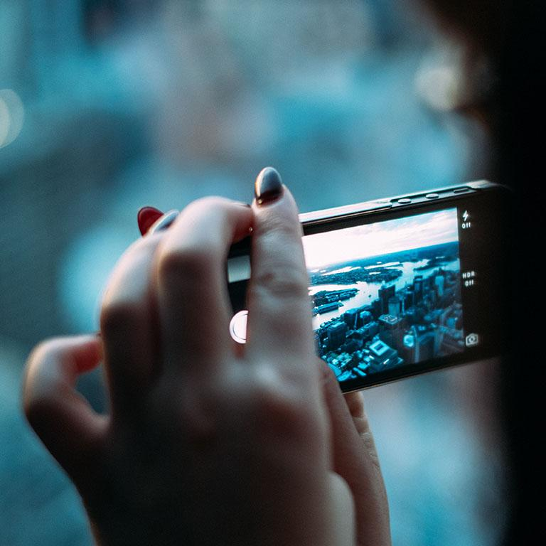
A PICTURE IS WORTH A THOUSAND WORDS
A complex idea can be conveyed with just a single still image, namely making it possible to absorb large amounts of data quickly.

Slide 10
USE CHARTS TO EXPLAIN YOUR IDEAS
White
Gray
Black

Slide 11
AND TABLES TO COMPARE DATA
 | A | B | C
Yellow | 10 | 20 | 7
Blue | 30 | 15 | 10
Orange | 5 | 24 | 16

Slide 12
MAPS
our office

Slide 13
89,526,124
Whoa! That’s a big number, aren’t you proud?

Slide 14
89,526,124$
185,244 users
100%
That’s a lot of money
And a lot of users
Total success!

Slide 15
OUR PROCESS IS EASY
First
Second
Last

Slide 16
LET’S REVIEW SOME CONCEPTS
Yellow
Is the color of gold, butter and ripe lemons. In the spectrum of visible light, yellow is found between green and orange.
Blue
Is the colour of the clear sky and the deep sea. It is located between violet and green on the optical spectrum.
Red
Is the color of blood, and because of this it has historically been associated with sacrifice, danger and courage.
Yellow
Is the color of gold, butter and ripe lemons. In the spectrum of visible light, yellow is found between green and orange.
Blue
Is the colour of the clear sky and the deep sea. It is located between violet and green on the optical spectrum.
Red
Is the color of blood, and because of this it has historically been associated with sacrifice, danger and courage.

Slide 17
4000
3000
2000
1000
0
You can copy&paste graphs from Excel or Google Sheets

Slide 18
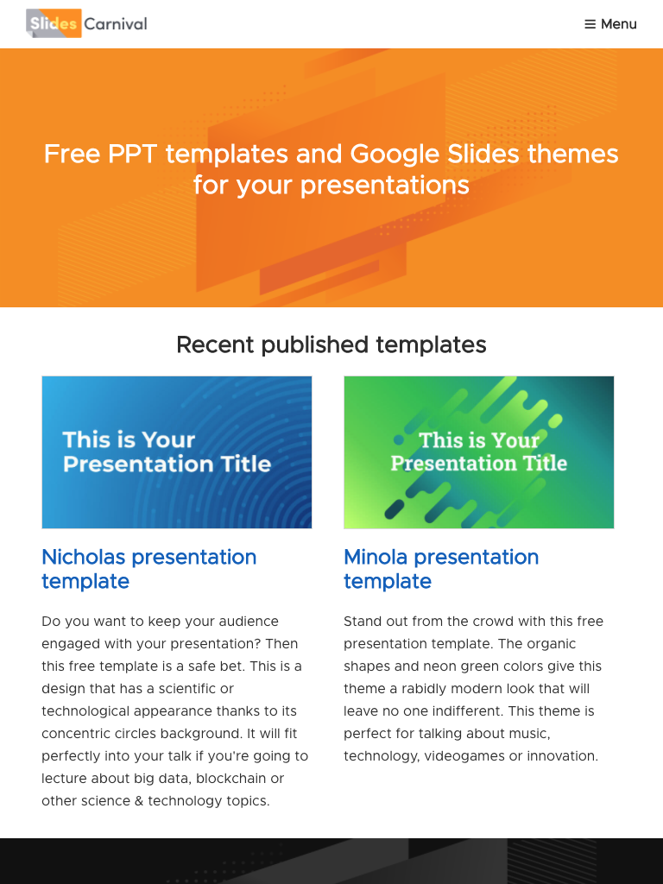
TABLET PROJECT
Show and explain your web, app or software projects using these gadget templates.

Slide 19
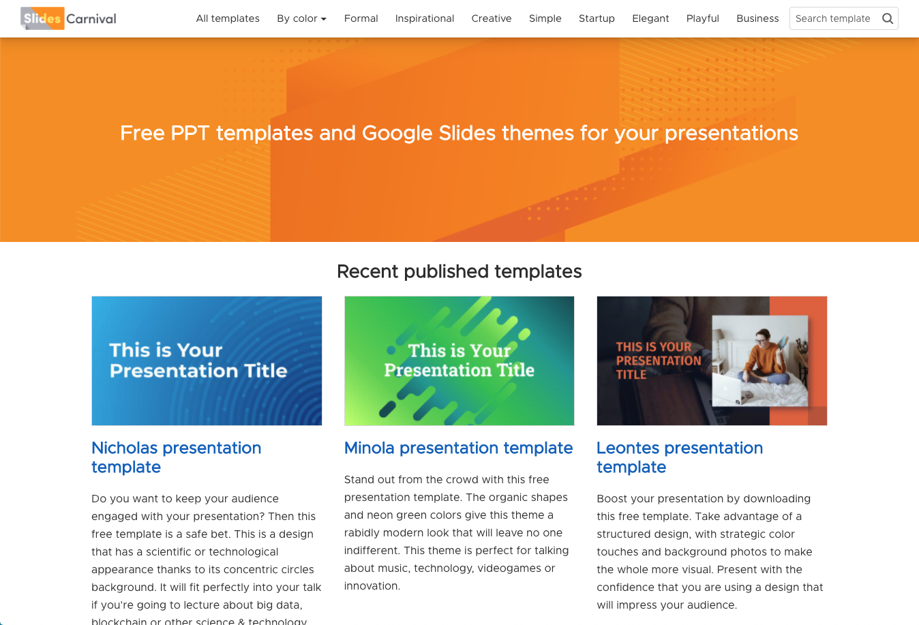
DESKTOP PROJECT
Show and explain your web, app or software projects using these gadget templates.

Slide 20
Thanks!
ANY QUESTIONS?
You can find me at
@username
user@mail.me

Slide 21
CREDITS
Special thanks to all the people who made and released these awesome resources for free:
Presentation template by SlidesCarnival
Photographs by Unsplash

Slide 22
PRESENTATION DESIGN
This presentations uses the following typographies:
Titles & body copy: Quicksand
Download for free at:
https://www.fontsquirrel.com/fonts/quicksand
You don’t need to keep this slide in your presentation. It’s only here to serve you as a design guide if you need to create new slides or download the fonts to edit the presentation in PowerPoint®

Slide 23
2. Extra Resources
For Business Plans, Marketing Plans, Project Proposals, Lessons, etc

Slide 24
Timeline
Blue is the colour of the clear sky and the deep sea
Red is the colour of danger and courage
Black is the color of ebony and of outer space
Yellow is the color of gold, butter and ripe lemons
White is the color of milk and fresh snow
Blue is the colour of the clear sky and the deep sea
JAN
FEB
MAR
APR
MAY
JUN
JUL
AUG
SEP
OCT
NOV
DEC
Yellow is the color of gold, butter and ripe lemons
White is the color of milk and fresh snow
Blue is the colour of the clear sky and the deep sea
Red is the colour of danger and courage
Black is the color of ebony and of outer space
Yellow is the color of gold, butter and ripe lemons

Slide 25
Roadmap
Blue is the colour of the clear sky and the deep sea
Red is the colour of danger and courage
Black is the color of ebony and of outer space
1
3
5
2
4
6
Yellow is the color of gold, butter and ripe lemons
White is the color of milk and fresh snow
Blue is the colour of the clear sky and the deep sea

Slide 26
Gantt chart
 | Week 1 |  |  |  |  |  |  | Week 2
 | 1 | 2 | 3 | 4 | 5 | 6 | 7 | 8 | 9 | 10 | 11 | 12 | 13 | 14
Task 1
Task 2 |  |  |  |  |  | ◆
Task 3
Task 4 |  |  |  |  |  |  |  |  |  |  | ◆
Task 5 |  |  |  |  |  |  |  |  | ◆
Task 6
Task 7
Task 8

Slide 27
SWOT Analysis
STRENGTHS
Blue is the colour of the clear sky and the deep sea
WEAKNESSES
Yellow is the color of gold, butter and ripe lemons
S
W
Black is the color of ebony and of outer space
OPPORTUNITIES
White is the color of milk and fresh snow
THREATS
O
T

Slide 28
Business Model Canvas
Key Partners
Insert your content
Key Activities
Insert your content
Value Propositions
Insert your content
Customer Relationships
Insert your content
Customer Segments
Insert your content
Key Resources
Insert your content
Channels
Insert your content
Cost Structure
Insert your content
Revenue Streams
Insert your content

Slide 29
Funnel
AWARENESS
Insert your content
DISCOVERY
Insert your content
EVALUATION
Insert your content
INTENT
Insert your content
PURCHASE
Insert your content
LOYALTY
Insert your content

Slide 30
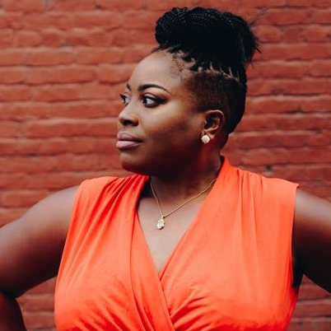

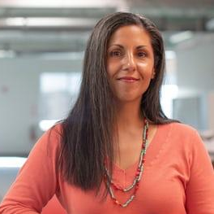
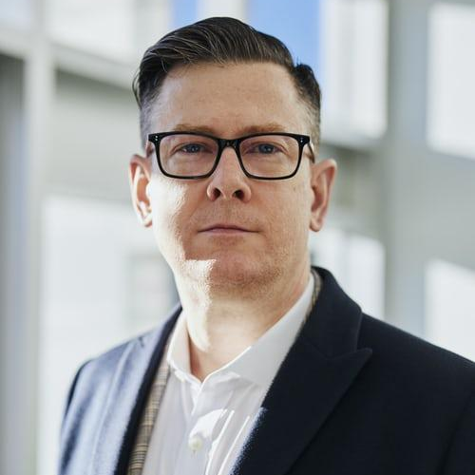
Team Presentation
Imani Jackson JOB TITLE
Blue is the colour of the clear sky and the deep sea
Marcos Galán JOB TITLE
Blue is the colour of the clear sky and the deep sea
Ixchel Valdía JOB TITLE
Blue is the colour of the clear sky and the deep sea
Nils Årud JOB TITLE
Blue is the colour of the clear sky and the deep sea

Slide 31
Competitor Matrix
HIGH VALUE 2
Competitor
Our company
Competitor
Competitor
LOW VALUE 1
HIGH VALUE 1
Competitor
Competitor
Competitor
LOW VALUE 2

Slide 32
Weekly Planner
 | SUNDAY | MONDAY | TUESDAY | WEDNESDAY | THURSDAY | FRIDAY | SATURDAY
09:00 - 09:45 | Task | Task | Task | Task | Task | Task | Task
10:00 - 10:45 | Task | Task | Task | Task | Task | Task | Task
11:00 - 11:45 | Task | Task | Task | Task | Task | Task | Task
12:00 - 13:15 | ✔ Free time | ✔ Free time | ✔ Free time | ✔ Free time | ✔ Free time | ✔ Free time | ✔ Free time
13:30 - 14:15 | Task | Task | Task | Task | Task | Task | Task
14:30 - 15:15 | Task | Task | Task | Task | Task | Task | Task
15:30 - 16:15 | Task | Task | Task | Task | Task | Task | Task

Slide 33
SlidesCarnival icons are editable shapes.
This means that you can:
Resize them without losing quality.
Change line color, width and style.
Isn’t that nice? :)
Examples:

Slide 34
Diagrams and infographics

Slide 35
Now you can use any emoji as an icon!
And of course it resizes without losing quality and you can change the color.
How? Follow Google instructions https://twitter.com/googledocs/status/730087240156643328
✋👆👉👍👤👦👧👨👩👪💃🏃💑❤😂😉😋😒😭👶😸🐟🍒🍔💣📌📖🔨🎃🎈🎨🏈🏰🌏🔌🔑 and many more...

Slide 36

Free templates for all your presentation needs
For PowerPoint and Google Slides
100% free for personal or commercial use
Ready to use, professional and customizable
Blow your audience away with attractive visuals

