Slide 1


DEPARTMENT OF ELECTRONICS AND COMMUNICATION ENGINEERING
TITLE :SMART BLOOD OXYGEN AND HEART RATE MONITORING SYSTEM
Under the guidance of
MR.SHAIK NAYAB RASOOL
Assistant Professor
AU
Presented by
Batch Number:B8
G.SAI TEJA 20EG104207
B.HARSHITHA 20EG204208
B.SHIVA KUMAR 20EG104228

Slide 2

Abstract
Development of continuous remote health monitoring is necessary, because people live longer and “baby boomers” are aging, threatening to overwhelm health-care providers.
Implementation of continuous health monitoring contributes to an increase in health-care quality and a decrease in health-care cost. Prevention of the onset of chronic disease can dramatically reduce hospitalization time and increase the quality of life.
Smart blood oxygen and heart rate monitor is a device that is used to measure heart rate i.e,. speed of the heartbeat and measures oxygen intake level of a person. The salient features include its portability, user compatibility, long battery life and durability for daily use, accurate measurement of oxygen levels and heart rate in real-time, user-friendly design and easy to understand, wireless connectivity to smart phones.
When the patient is just discharged from hospital he/she needs to be monitored for few more days based on the severity and conditions. Our device is less complex and easy to manage device , which can send alerts to guardians and doctors if there is any critical condition.
2

Slide 3
Block diagram
Switch off” Biometric Attendance on March 5th, 2020 Delhi government announced the suspension of biometric attendance in its offices via a letter written to principal secretaries, secretaries, autonomous bodies, and municipal corporations for the suspension of biometric attendance to contain the spread of coronavirus. However, it was on Feb 17th, 2020 when Maharishi Valmiki Hospital in the Capital City of India suspended biometric attendance aing it as a “precautionary measure” after many of its employees complained to the authorities that touching the biometric system is “psychological unease” on account of coronavirus scare. The need for the system is an untouchable device. And also students can't cheat with the system. Devise a secure way to take attendance of stdents and teachers in a touchless and paperless manner in order to have a sustainable way. This project aims to provide a touchless and paperless attendance system
SMS IS SENT TO GUARDIAN & DOCTOR
NODE MCU
UBIDOTS
CALLS TO GUARDIAN &DOCTOR
INPUT FROM USER
OXYGEN & HEART
RATE SENSOR
LOCATION OF PATIENT SENT TO GUARDIAN &DOCTOR

Slide 4
OBJECTIVES & METHODOLOGY
The main objective of this project
To measure and record the blood oxygen level (SpO2) and heart rate of the user in real time.
To send alerts to the user or a caregiver if the SpO2 or heart rate falls outside of a safe range.
To allow the user to view their SpO2 and heart rate data on a ubidots.
To provide the user with insights into their health by tracking their SpO2 and heart rate over time.
Methodology
Ubidots is an IoT (Internet of Things) platform that allows you to connect, manage, and analyze data from physical devices.
It is a cloud-based platform that provides a variety of features to help you build and deploy IoT applications, including:
Device connectivity
Data management
Analytics
Integrations

Slide 5
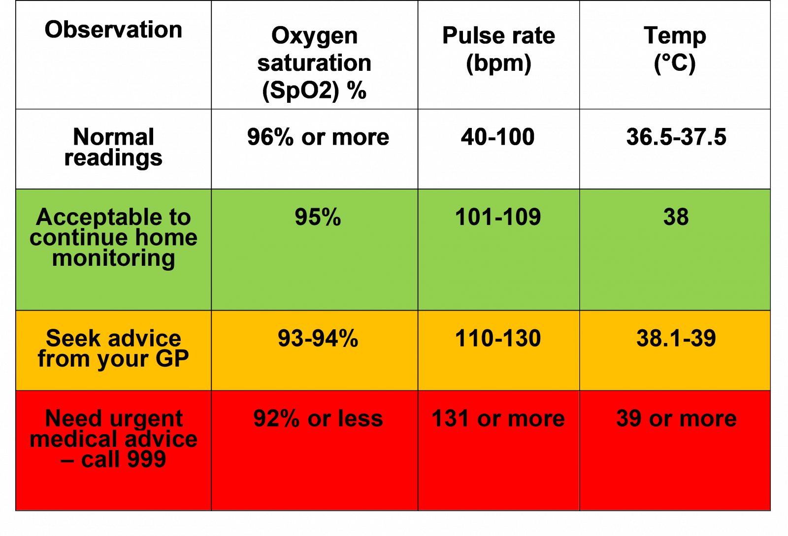
RESULTS
Studied on how the heart rate and SpO2 is measured using MAX30100 sensor.
Studied on various cloud storage platforms, IOT platforms and found ubidots.
Ubidots is an iot platform in which the heart rate and
SpO2 rate is passed to it and whenever the heart rate or SpO2 rate is abnormal then immediately alert is sent
The alert is sent via call, sms and location of the patient to the guardian, caretaker and doctor.
Once the heart rate and spo2 rate become normal then again a notification is sent.

Slide 6
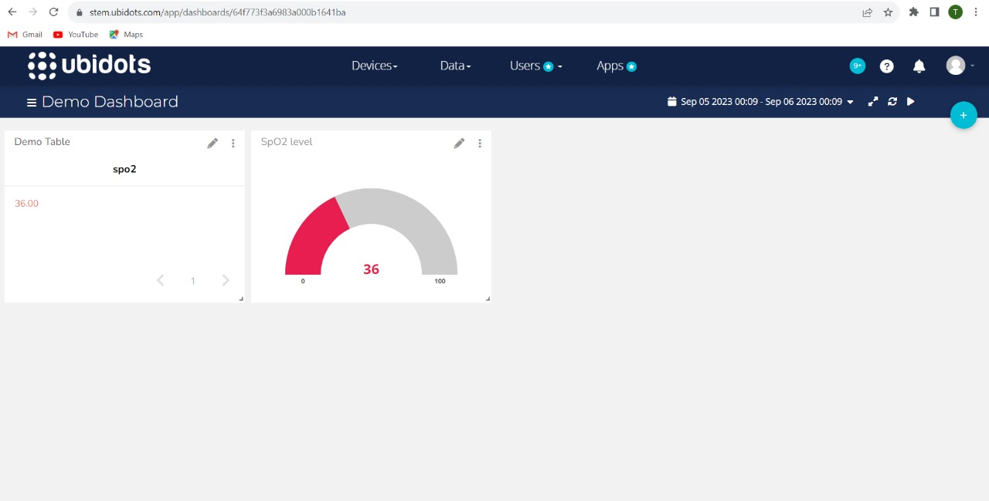
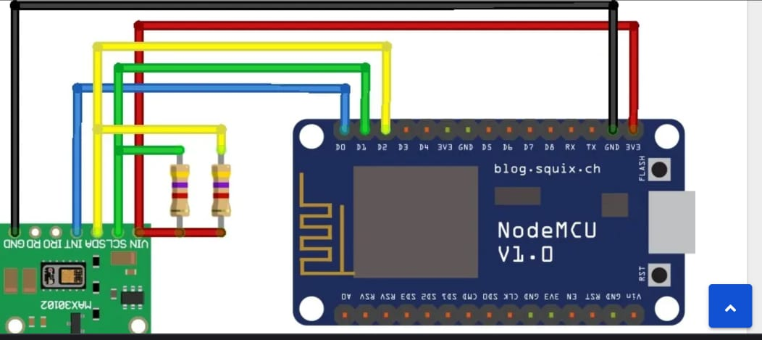
REFERENCES

Slide 7
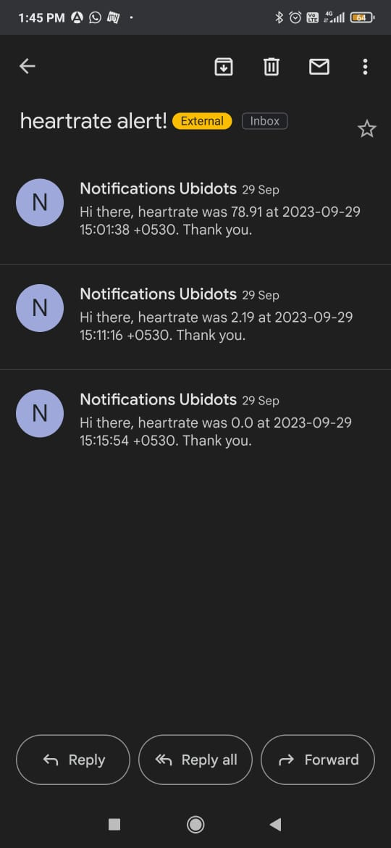
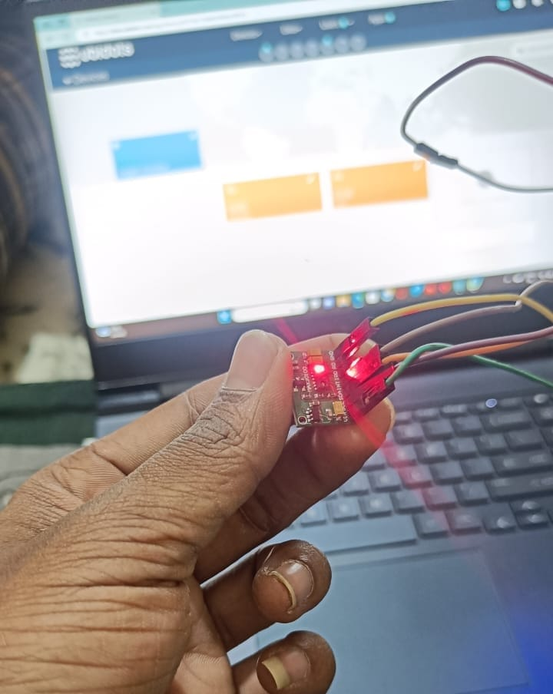

Slide 8
Thank you

