Slide 1

Customer Shopping Behavior Analysis
Uncovering insights from 3,900 transactions to guide strategic business decisions.

Slide 2
Dataset at a Glance
3,900
18
37
Transactions
Columns
Missing Values
Review Rating only
Demographics
Purchase Details
Behavior
Age, Gender, Location, Subscription
Item, Category, Amount, Season
Discount, Frequency, Reviews, Shipping

Slide 3

Data Preparation in Python
01
Load & Explore
pandas, df.info(), .describe()
02
Clean & Standardize
Impute missing ratings by category median; rename to snake_case
03
Feature Engineer
age_group bins, purchase_frequency_days
04
Load to PostgreSQL
Cleaned DataFrame ready for SQL analysis

Slide 4
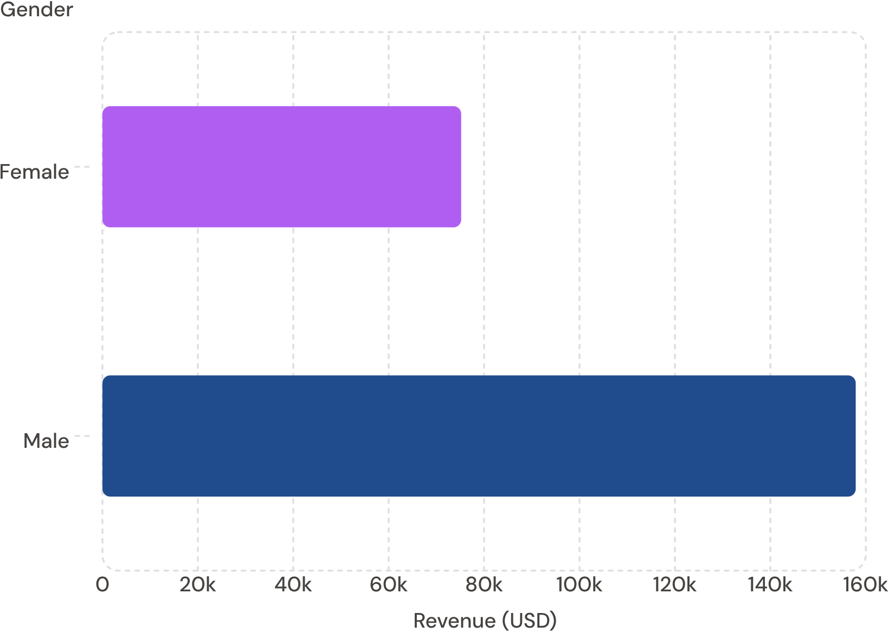

Revenue by Gender
Key Insight
Male customers generated 2× more revenue than female customers — $157,890 vs. $75,191.
Male shoppers represent 2,652 of 3,900 transactions.

Slide 5
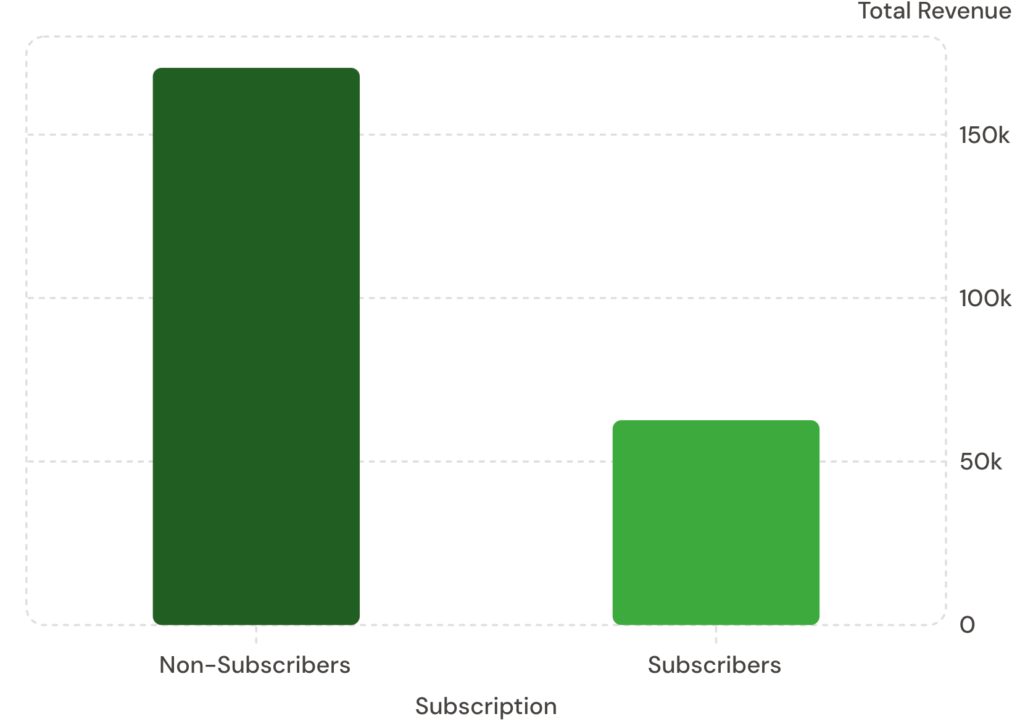
Subscribers vs. Non-Subscribers
Spending Patterns
Average spend is nearly identical: $59.87 (non-subscribers) vs. $59.49 (subscribers).
Yet 73% of customers are non-subscribers — a major growth opportunity.

Slide 6
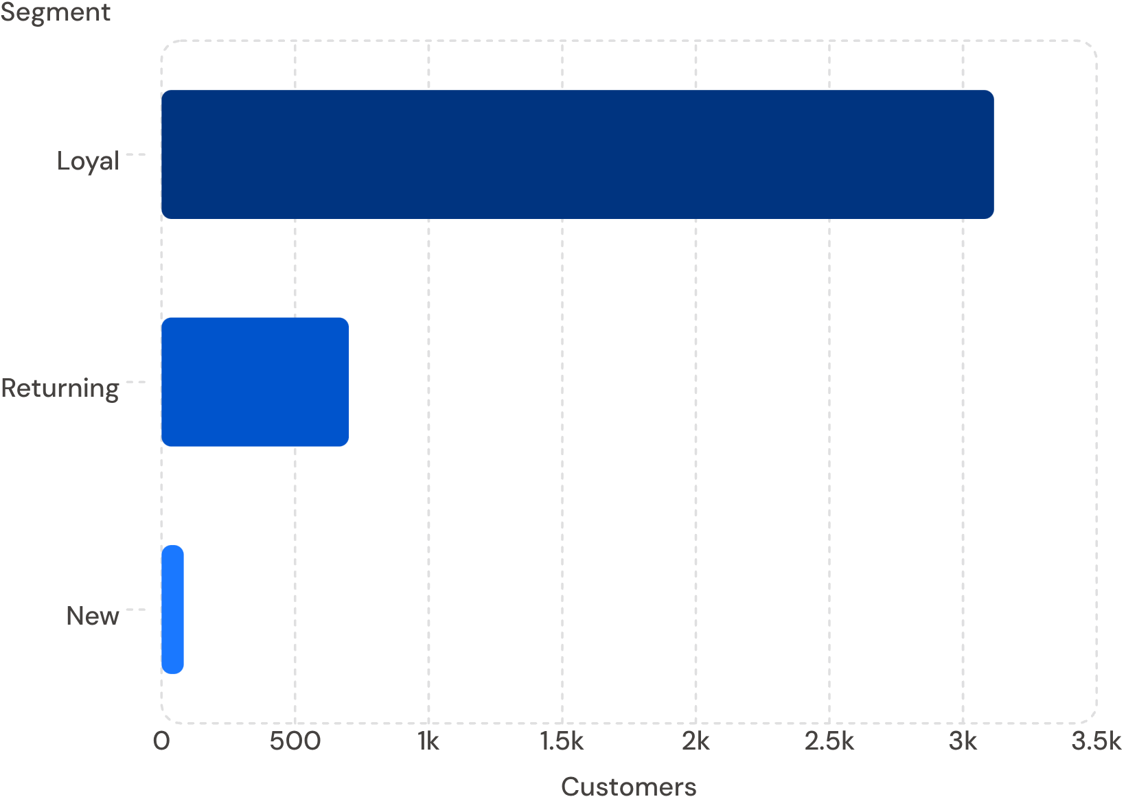

Customer Segmentation
Segment Breakdown
Loyal — 3,116
80% of base
Returning — 701
18% of base
New — 83
2% of base

Slide 7
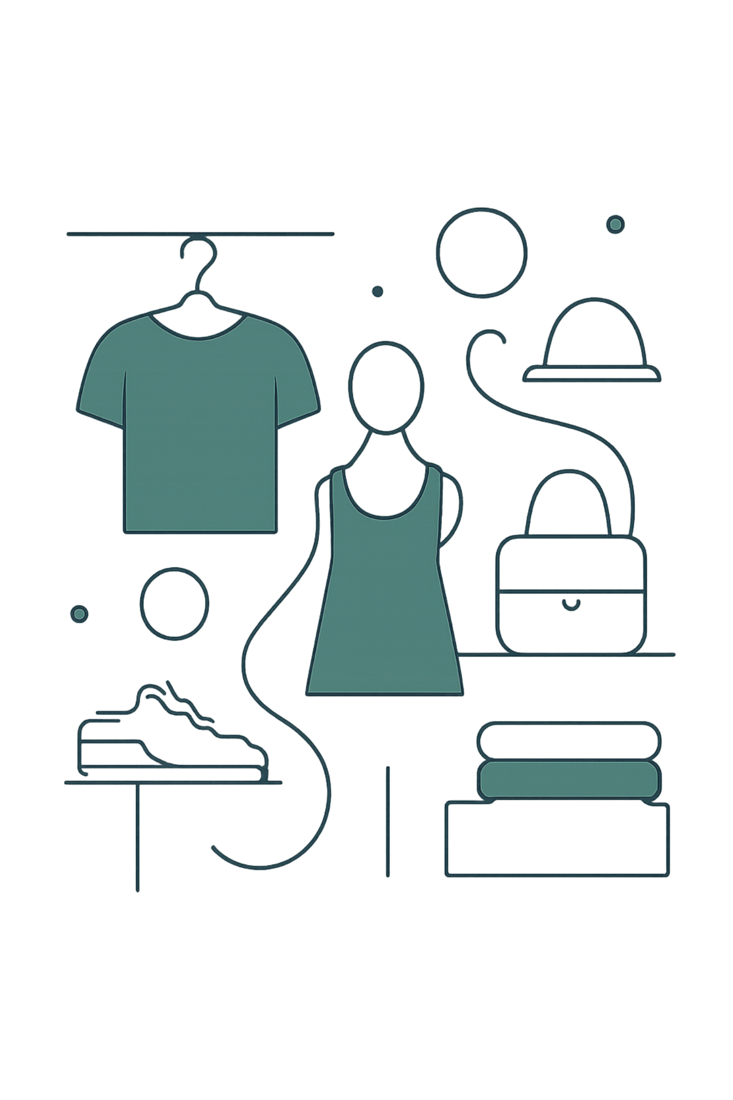
Top Products by Category
👗 Clothing
Blouse · Pants · Shirt
👟 Footwear
Sandals · Shoes · Sneakers
💍 Accessories
Jewelry · Sunglasses · Belt
🧥 Outerwear
Jacket · Coat

Slide 8
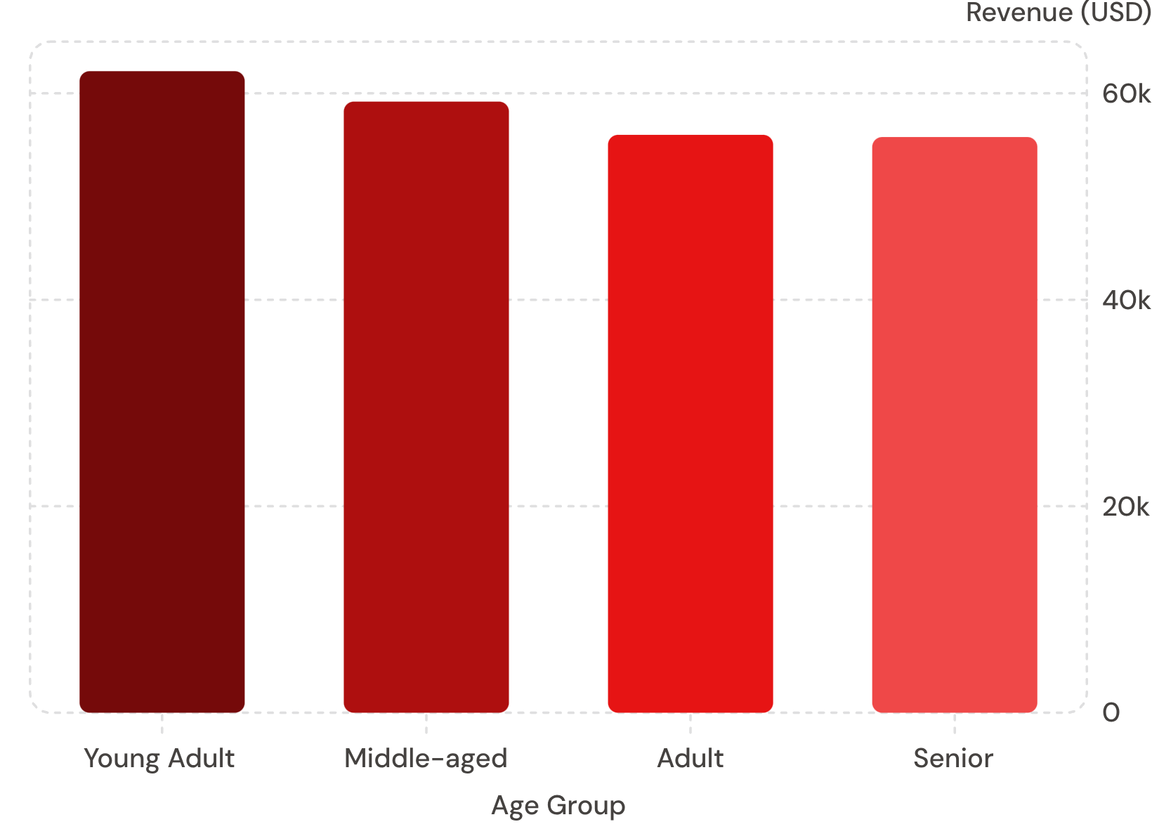
Revenue by Age Group
Key Finding
Young Adults lead in revenue at $62,143 — a prime target for marketing campaigns.
Revenue is relatively balanced across all four age groups.

Slide 9

Power BI Dashboard
3.9K
Customers
$59.76
Avg Purchase
3.75
Avg Rating
27%
Subscribers

Slide 10





Business Recommendations
Boost Subscriptions
Promote exclusive subscriber benefits
Loyalty Programs
Reward repeat buyers toward "Loyal" segment
Review Discount Policy
Balance sales lift with margin control
Targeted Marketing
Focus on Young Adults & express-shipping users

