Slide 1

Assessment System
Duke's Team Software solutions for a better life
Amrit Khadka Janardhan Bonu
Bharat Thapa Michael Saleeb

Slide 2
Assessment System
A web application that allows teachers to gives tests to students and evaluate their work
Notes:
In other words, exploratory testing is any testing to the extent that the tester actively controls the design of the tests as those tests are performed and uses information gained while testing to design new and better tests.

Slide 3
Used Technologies
Spring MVC
MySQL
AJAX
Hibernate
JSR 303 Validation
Dependency Injection
Notes:
Unfortunately, ad hoc is too often synonymous with sloppy and careless work. So, in the early 1990s a group of test methodologists (now calling themselves the Context-Driven School) began using the term “exploratory”, instead

Slide 4
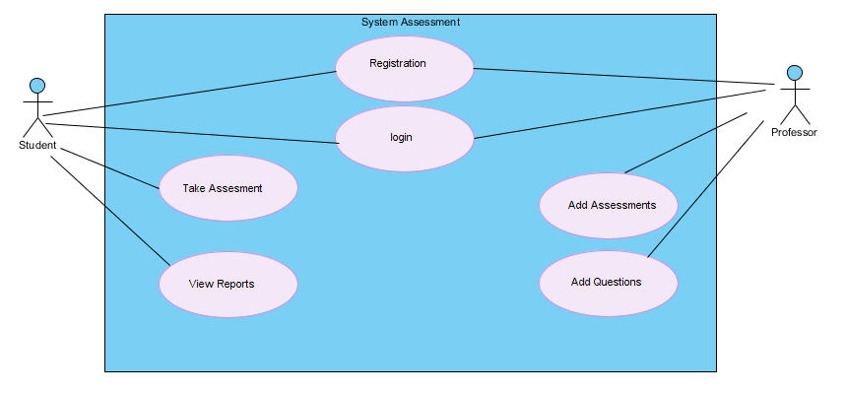
Use Case

Slide 5
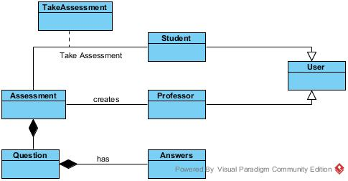
Domain object model

Slide 6
Login
Configured through servlet-context.xml
Login view has 2 text fields j_username, j_password
The login form posts to j_spring_security_check for validation
Spring framework compares credentials to data retried by the query provided in configuration and loads user roles if correct credentials
Users gets redirected to the home page with welcome message on top and option to logout
Notes:
ET fits into the middle of a test project, even when you have lots of scripted tests. Be exploratory in the sense that a tourist on a tour bus is exploratory. Let your allotted tests take you to visit different parts of the product, then improvise on the theme of those tests, briefly. Spend a few minutes working through variations of the tests, then get back on the tour bus and do the next scripted test.

Slide 7
Registration
The user provides his profile info:
Username
Password
Account type (student/teacher)
Data is validated using JSR 303 validation
In case of in correct data, error messages are displayed from resources files according to existing culture

Slide 8
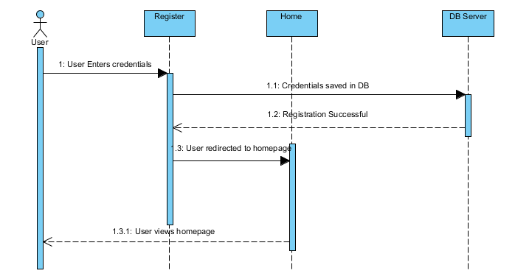
Registration Sequence Diagram

Slide 9
Registration (cont.)
In case of no errors data is passed to service layer.
Service layer passes the data to the persistence layer
User is then redirected to successful page
This is an implementation of PRG (Post/Redirect/Get) pattern

Slide 10
Create Assessment
•List existing Assessments
•Create new Assessment will validate the user inputs and persist in database
•Edit Assessment name, description and date
•Delete Assessment if not required.
Create Assessment has a functionality listing the assessments from the database.
Navigate to the actual questions to be prepared.

Slide 11
Create Assessment
•List existing Assessments
•Create new Assessment will validate the user inputs and persist in database
•Edit Assessment name, description and date
•Delete Assessment if not required.
•Create Assessment has a functionality listing the assessments from the database.
•Navigate to the actual questions to be prepared.

Slide 12
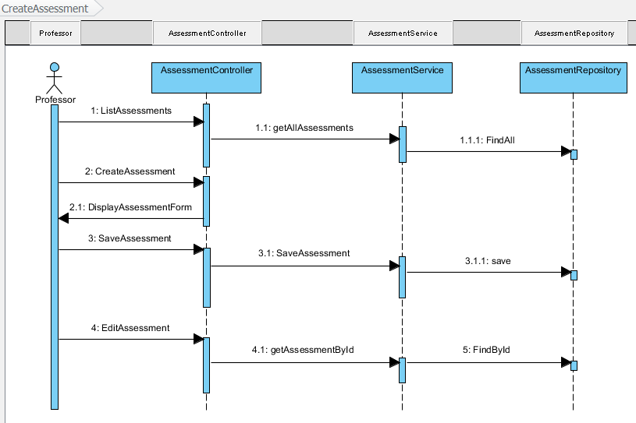
Create Assessment(Sequence Diagram)

Slide 13
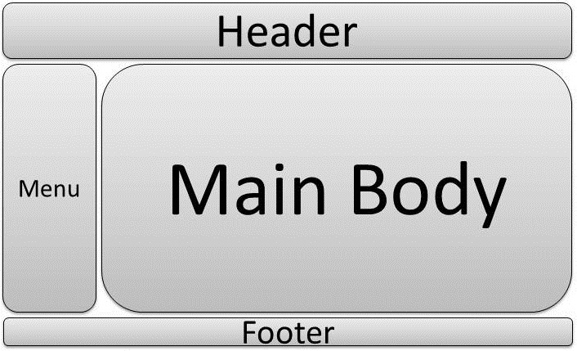
Tiles

Slide 14
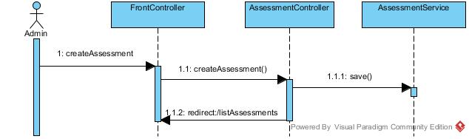
SD: Create Assessment

Slide 15
Create Question
•List existing Questions
•Validate user input
•Add question in assessment.
•Assessment is persisted, so is the Question (CascdeALL)

Slide 16
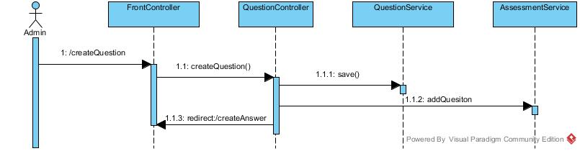
SD: Create Question

Slide 17
Create Answer
•List existing Answers
•Validate user input
•Add answer in question.
•Question is persisted, so is the Answer(CascdeALL)

Slide 18
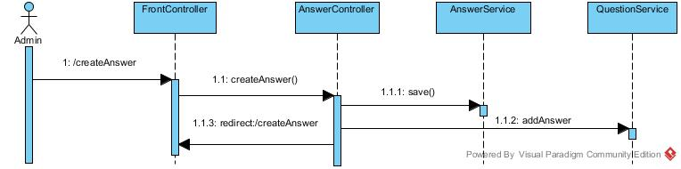
SD: Create Answer

Slide 19
Take Assessment
Display open assessments to the Student.
Student selects the assessment to take.
Student performs the assessment and submit it.
View the assessment result in next page.

Slide 20

SD: Take Assessment

Slide 21
Q & A

