Slide 1

Supervised By: Meskat Jahan Assistant Professor Dept. of CSE, Comilla University
Detection of Authentic logo using Deep Learning
Submited By:
Bonusree Datta
Id:11908039
Session:2018-19
Dept. of CSE, Comilla University

Slide 2


Agenda
Methodology
Expected Outcomes
Application
Conclusion
Introduction
Background and Motivation
Objectives
Literature review

Slide 3

Introduction
Logos are emblematic representations of companies, products, and brands. In the digital age, the misuse and counterfeiting of logos pose significant challenges for businesses, consumers, and brand integrity. The system will analyze images containing logos and classify them as either genuine or counterfeit.

Slide 4



Background and Motivation
The proliferation of counterfeit products is a global problem affecting various industries , including fashion , food , pharmaceuticals etc. Research And Markets wrote in their report on May 15, 2018, that up to 1.2 Trillion USD in 2017 of products are counterfeited goods. The report estimated this damage globally at 1.82 Trillion USD in 2020. Detecting and combating counterfeit logos is essential for these types of many problems.

Slide 5

Objectives
1. To train a deep learning model to differentiate between authenticate and counterfeit logos.
2. To develop an intuitive user interface for logo authenticity detection.
3. To evaluate the models performance using appropriate metrics.
4. To create a feedback mechanism to improve the model over time.

Slide 6
Literature Review
Author | Methods | Datasets | Accuracy | Limitations
Tanniru.et.al (2023) | AlexNet,GoogLeNet, and VGGNet | instagram API | 66% | More datasets needed for increasing accuracy
Raut.et.al (2023) | YOLO algorithm | instagram API |  | The device is quite difficult and inconvenient to use.
Li.et.al (2023) | OpenCV based on the SIFT algorithm | Flickerlogo | 24-26% | SIFT algorithm is not suitable for real-time logo recognition.
Wang.et.al (2022) | YOLOv3 | LogoDet-3K | 4% improvemnet
Zhang.et.al | PCA Strategy, KNN, Support Vector Machine(SVM) | VLDSPU(1.0) | 97.5% | System is included only vehicle logos
Zhang.et.al

Slide 7
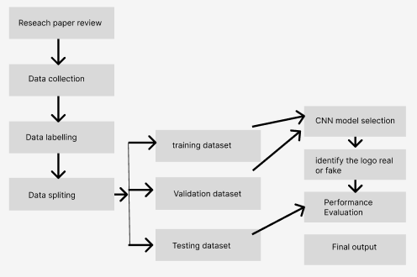
Methodology

Slide 8
Expected Outcomes
A deep learning model capable of accurately detecting authentic logos.
A user-friendly web interface for logo authenticity verification.
Comprehensive documentation detailing the project's architecture, methodology, and deployment instructions.
An evaluation report showcasing the model's performance metrics and visualizations.

Slide 9
Application
This system aims to help consumers distinguish forgeries from the original product.
This application can also be helpful for brands struggling to fight against forged products.
Besides phishing emails or messages can be identify and user can protect thyself from any kind of danger

Slide 10

Thank you
Bonusree Datta
Id:11908039
Session:2018-19

