Slide 1

Python
«Write less, do more. »
Created: Team 2

Slide 2
Contents
WHAT IS PYTHON
Key Advantages
AREAS OF PYTHON APPLICATION
CORE SYNTAX CONCEPTS
ECOSYSTEM & POPULAR LIBRARIES
LANGUAGES COMPARISON
Conclusions and Future

Slide 3
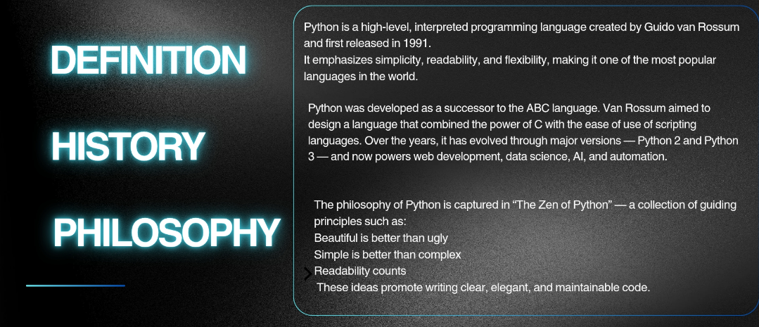
WHAT IS PYTHON

Slide 4
KEY ADVANTAGES
Simplicity and Readability: Python's syntax is clean and straightforward, resembling the English language, which drastically reduces "syntactical noise" and makes the code easy to understand and maintain.
Large Standard Library ("Batteries Included"): It comes with a vast collection of modules and packages, meaning you don't have to write code for common tasks from scratch.
Active Community and Ecosystem: A huge, helpful global community provides extensive support, documentation, tutorials, and a massive collection of third-party libraries (Ecosystem).
Versatility: Can be used across various domains: web development, data science, machine learning, scripting, and scientific computing.

Slide 5
AREAS OF PYTHON APPLICATION
Web Development: Used to build robust web applications and APIs. Key frameworks include Django (for large, complex projects) and Flask (for smaller, lightweight projects).
Data Analysis & Machine Learning (ML): Python is the industry standard for data science. Essential libraries include Pandas (data manipulation), NumPy (numerical operations), Scikit-learn (ML algorithms), and TensorFlow (deep learning).
Automation and Scripting: Ideal for automating repetitive tasks, system administration, and creating simple command-line tools.
Scientific Computing: Used in fields like physics, biology, and chemistry for complex numerical simulations and data processing.

Slide 6
CORE SYNTAX CONCEPTS
Python is a language for communicating with a computer. Like any language, Python has rules for constructing “sentences” so that the interpreter program can understand the commands and execute them. These rules are called syntax.
Key Principles:
Indentation (Structural Indentation) - Defines code blocks instead of using {}.
Comments - Explain the code and are ignored by the interpreter ( # , “””…”””).
Variables & Data Types - The type of a variable is determined automatically (name = “Ihor”)
Conditional Statements - Allow executing code based on conditions (if , elif , else).
Loops - Execute code blocks repeatedly (for , while).
Functions - Organize code into reusable blocks (def greet(name): ).
Data Collections:
list - ordered, mutable collection;
tuple - ordered, immutable collection;
set- unordered collection of unique elements;
dict - dictionary storing key-value pairs.
Modularity & Imports - Allows importing ready-made libraries to extend functionality (import math).

Slide 7
ECOSYSTEM & POPULAR LIBRARIES
Python Ecosystem — the complete set of tools, libraries, frameworks, and resources that allow developers to efficiently solve a wide range of tasks.
Python is well-known for its rich ecosystem, which includes:
Scientific and Numerical Computing
NumPy — working with multidimensional arrays and mathematical operations
Pandas — data manipulation and analysis (tables, DataFrame)
SciPy — scientific and engineering computations, statistics, integrals
Data Visualization
Matplotlib — basic plots and charts
Seaborn — enhanced visualization with attractive design
Plotly — interactive graphs and dashboards
Machine Learning & Artificial Intelligence
scikit-learn — classical machine learning algorithms
TensorFlow / Keras — deep learning and neural networks
PyTorch — another popular framework for neural networks
Web Development
Django — full-featured web framework
Flask — lightweight microframework for web applications
Automation & Utilities
Requests — working with HTTP requests
BeautifulSoup / Scrapy — web scraping and parsing
OpenCV — image and video processing

Slide 8
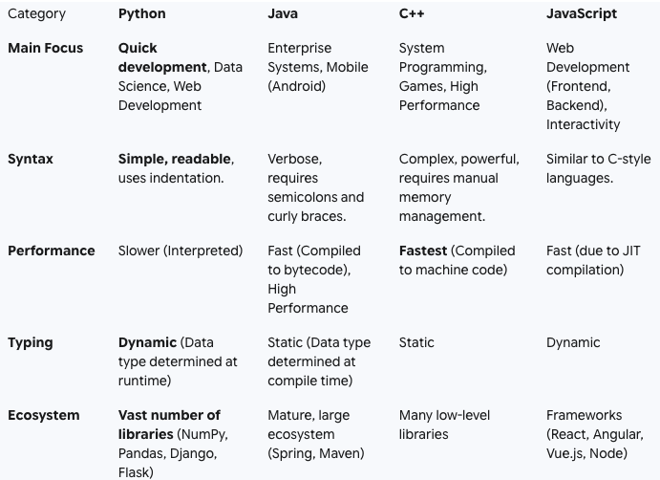
LANGUAGES COMPARISON

Slide 9
CONCLUSIONS AND FUTURE
Why Python is the Top Choice Today
Simplicity and Development Speed:
Python allows for high iteration speed due to its clean and readable syntax.
Simple syntax means faster project delivery.
Versatility (Universal Use):
It is perfect for web development, automation, and system administration.
Python works for many different tasks.
Leadership in Data Science:
Python is the de facto standard for Machine Learning (ML) and Artificial Intelligence (AI).
This is thanks to its huge ecosystem of libraries (NumPy, Pandas, TensorFlow, PyTorch).
The Future: Trends and Directions for Python
Continued ML/AI Dominance:
It will remain the primary language in this fast-growing field, supported by strong frameworks and an active community.
Performance Improvement:
The development of optimizers (like Cinder from Instagram) and tools like Mojo (an AI-focused language compatible with Python) shows we are actively working to overcome performance limits.
Asynchronous Programming:
Libraries like asyncio will strengthen Python's role in high-performance network applications and microservices.
Typing:
The growing use of type hints makes Python code more reliable and easier to maintain in large projects.

Slide 10
Thanks for attention
Bondarevskyi V.
Bodnar A.
Zhokh I.
Danylyshyn Y.

