Slide 1

INSTITUTE FOR ADVANCED
COMPUTING AND
SOFTWARE DEVELOPMENT
AKURDI, PUNE
Documentation On
“Omnipresent buddy - A chatbot which ease your life “
PG-DBDA FEB 2020
Submitted by :
Group No:07
Bony Srivastava 1310
Devender Kumar 1316

Slide 2



Do you know?
You are talking to a chatbot!
Do you know?
You are talking to a chatbot

Slide 3


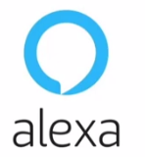
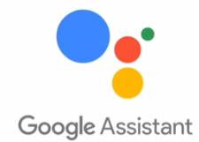
What are chatbots? chatbots?
A chatbot is an artificial intelligence-powered piece of software in a device , application, website or other networks that try to gauge consumer’s needs and then assist them to perform a particular task like a commercial transaction, hotel booking, form submission etc .
Notes:
3

Slide 4
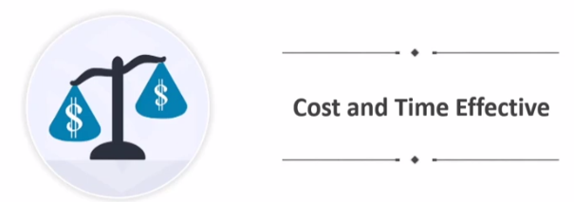

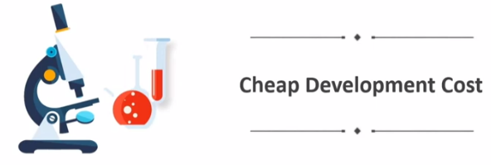

Why do we need chatbots?

Slide 5



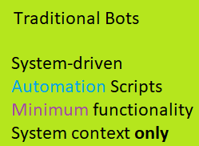
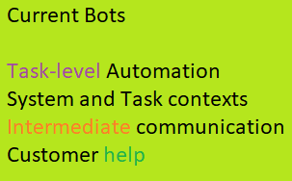
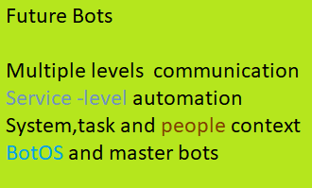
Chatbot evolution

Slide 6
How does a chatbot works?
* trained on Rules * Machine Learning
* No Complex Queries * Highly Efficient
* Simple Training * Complex Training
* Answers-Not replies always * Pre-defined Responses
* Word to Word Analysis * Context-based answers
Rule Based
Self-Learning
Generative
Retrieval based

Slide 7
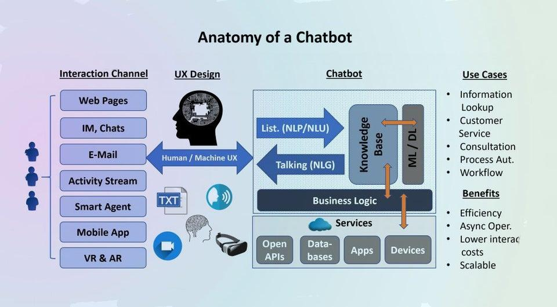
Anatomy of a Chatbot
Notes:
7

Slide 8
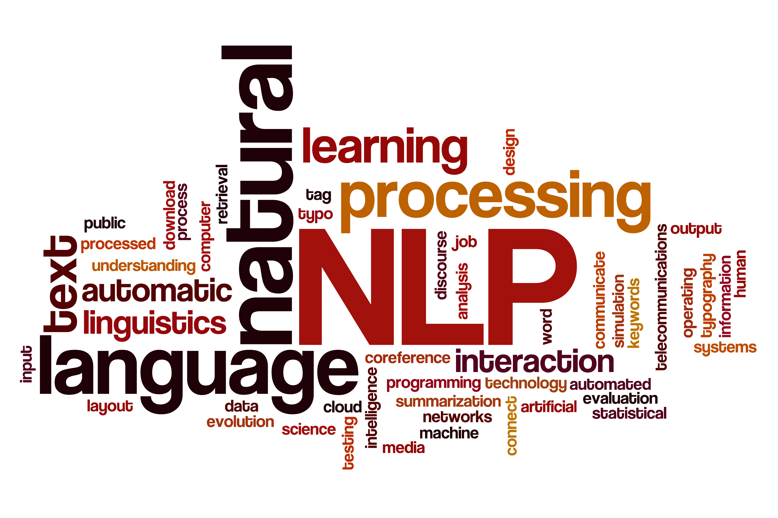
Natural Language Processing
The field of study that focuses on the interactions between human language and computers is called Natural Language Processing, or NLP for short.
It sits at the intersection of computer science, artificial intelligence, and computational linguistics.

Slide 9



Text Pre-Processing
Text Pre-processing
Case
Conversion
Tokenisation

Slide 10

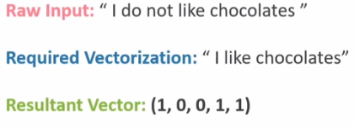
Building Bot
We need to transform the text into a meaningful vector (or array) of numbers.
The bag-of-words is a representation of text that describes the occurrence of words within a document.

Slide 11

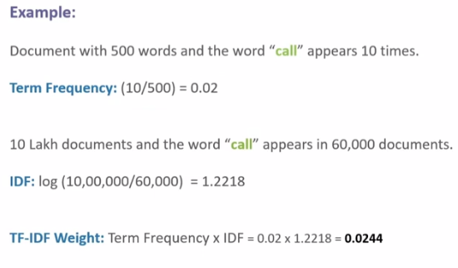
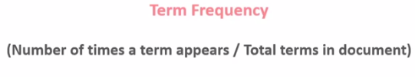
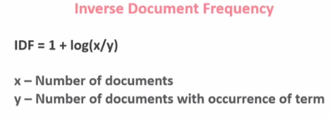
Building Bot

Slide 12
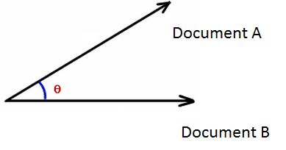

Cosine Similarity
We can then obtain the Cosine similarity of any pair of vectors by taking their dot product and dividing that by the product of their norms.
That yields the cosine of the angle between the vectors.

Slide 13
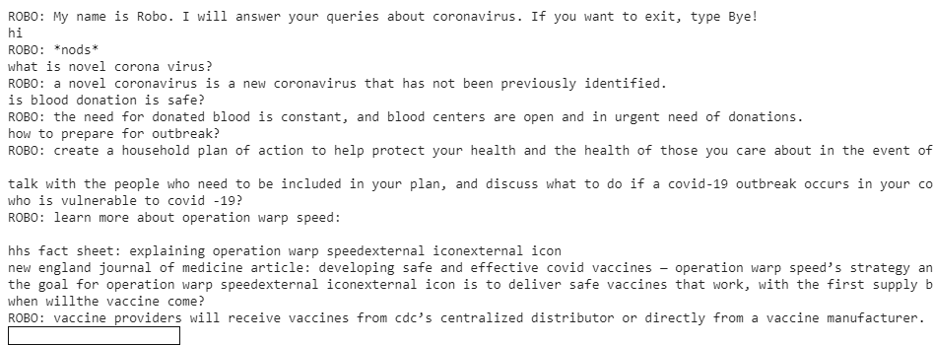
Conversation with ROBOJI

Slide 14

Rasa Framework
Rasa is a framework for developing AI powered, industrial grade chatbots. It's incredibly powerful, and is used by developers worldwide to create chatbots and contextual assistants. In this project, we are going to understand some of the most important basic aspects of the Rasa framework and chatbot development.

Slide 15
IMPORTANT CONCEPTS
INTENTS
ENTITY
The main of target f the user input.
If a user say “hey”, ”hello". Here the intent would be greeting.
The Verb in your dialog.
the information from user input that can be extracted.
I want to order a book”. Here “book” is an entity.
The Nouns are in your dialog.
ACTIONS
STORIES
These are sample interactions between the user and the bot,defined in terms of intents captured and actions performed.
As the name suggests it is an operation which can be performed by the bot.It could be replying in return,querying a database
Action could be just hard copy reply or some API response.

Slide 16
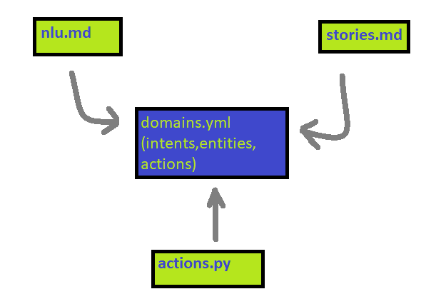
BRIDGE OF DOMAIN

Slide 17
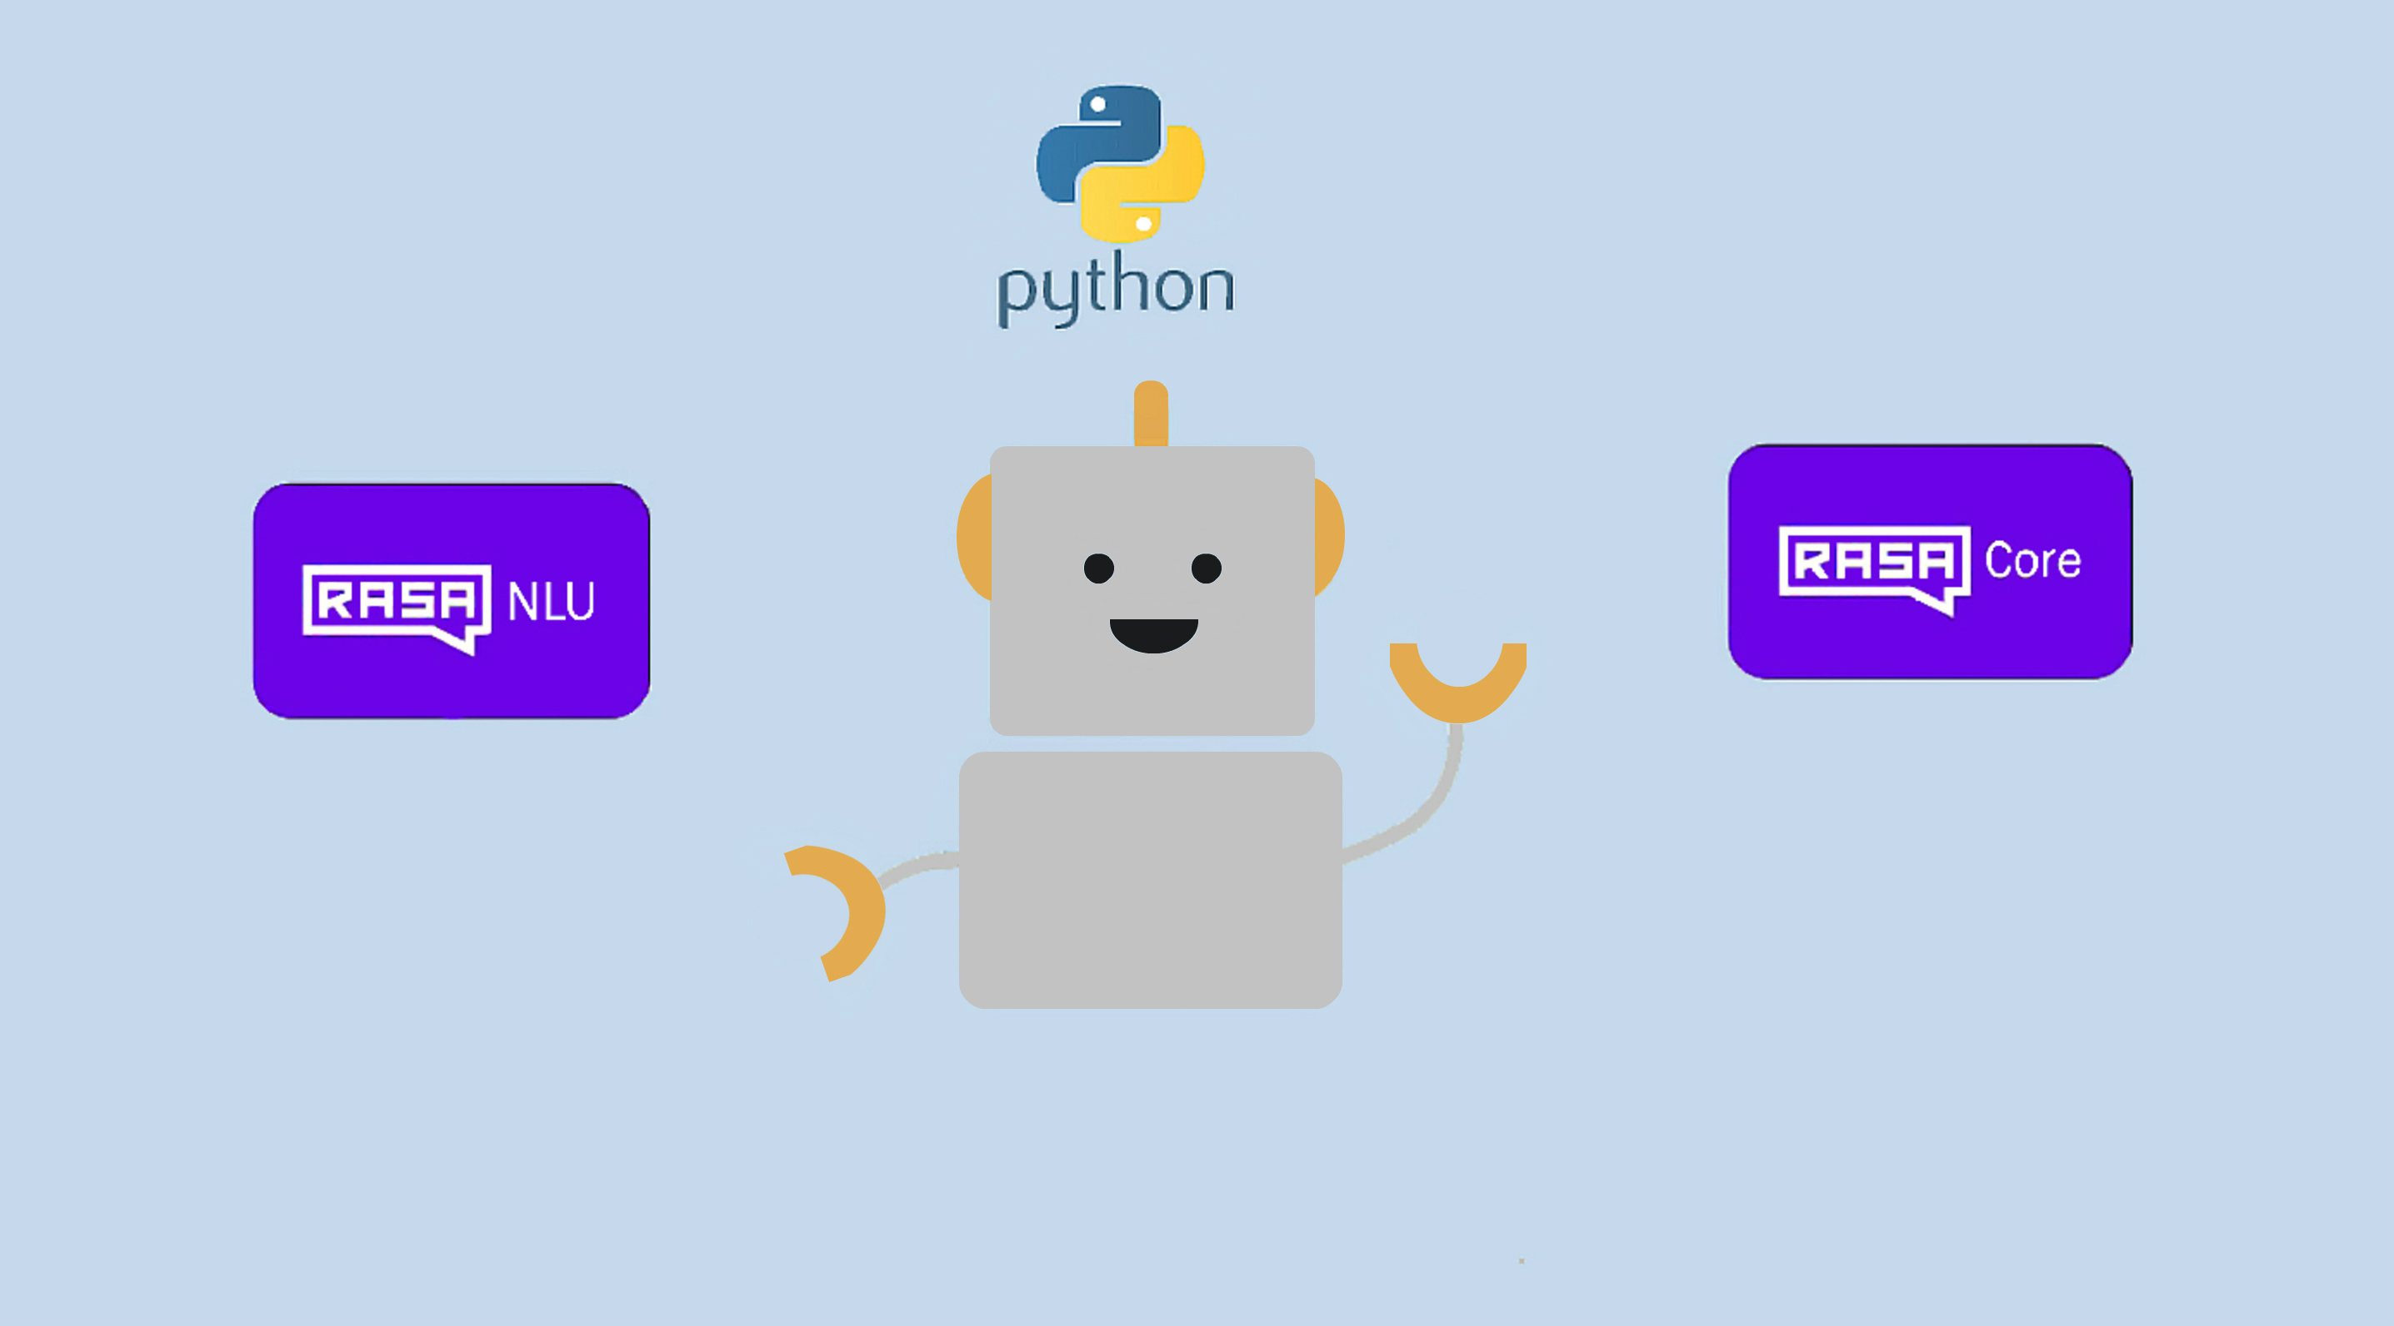
RASA Modules
RASA has two main modules:
RASA NLU for understanding messages.
RASA core for holding conversations and deciding what to do next.

Slide 18
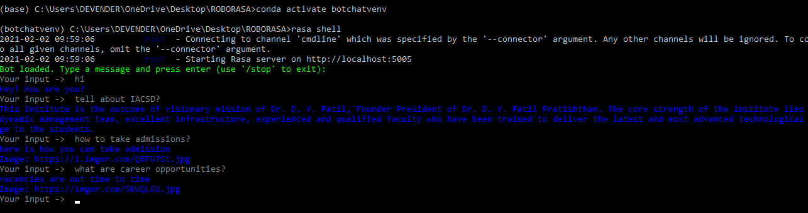
Conversation with ROBORASA

Slide 19
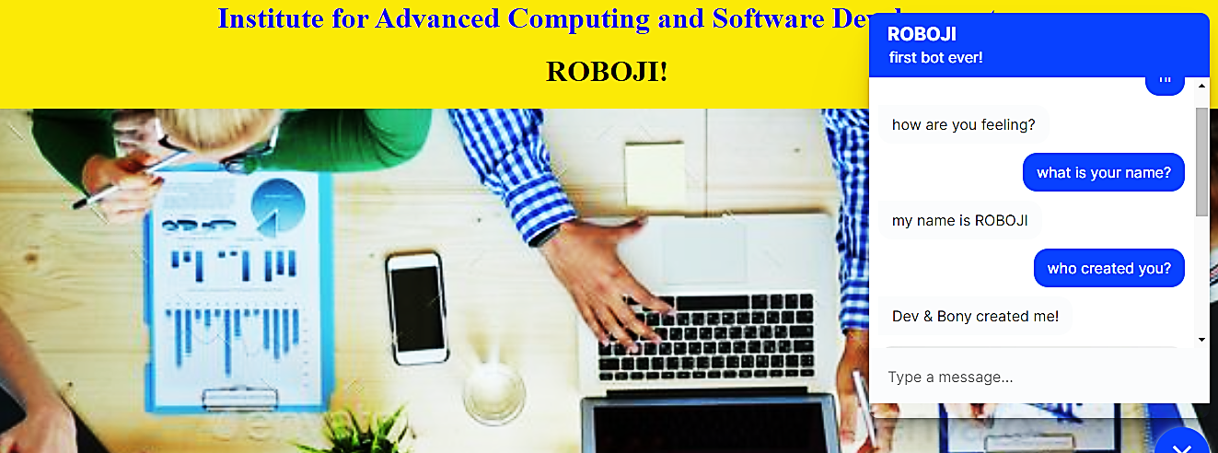
Conversation with ROBORASA

Slide 20
References
1.wikipedia
2.https://www.nltk.org/
3.https://docs.python.org/3/
4.https://towardsdatascience.com
5.ALICE. 2002. A.L.I.C.E AI Foundation, http://www.alicebot.org/
Notes:
20

