Slide 1

Wild Oat Detection
Presented By:
* Nour Bahaa
* Mai Mahmoud
* Ibrahim Fawzy
* Abanoub George
Supervised By:
* Prof. Khalid Hussein
* Eng. Hagear Sobeah
* Eng. Nour El-Huda Ashraf

Slide 2
Outline.
Introduction.
System Overview.
Expected Results.
Related Works.
Demo.

Slide 3
Introduction.
1
Problem Background.
2
Farmers’ Solution.
3
Our Solution.

Slide 4
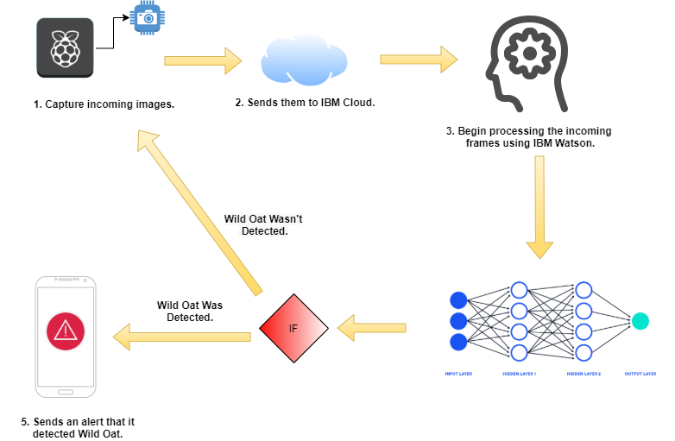
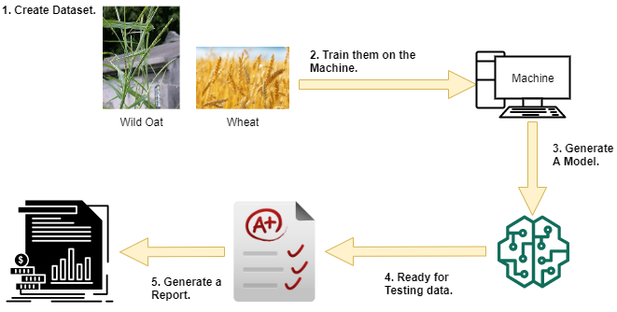
System Overview.
Model Creation.
System Overflow.
Then

Slide 5
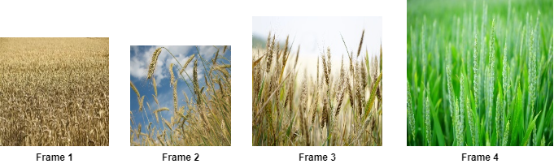
System Overview-- Dataset.
Our Dataset is divided into two main classes the Wheat class and the Wild Oat class and it consists of non normalized data of type images .
We didn’t find a data set in Kaggle for the Wild Oats ;therefore , We made an agreement with the Agriculture Research Center in Giza Government , in Cairo to collect it from them after a month. In the Agriculture Research Center , they plant Wheat earlier than any other farm

Slide 6


System Overview-- Input.
Our input will be through incoming frames from the camera module to the IBM Cloud data service.

Slide 7
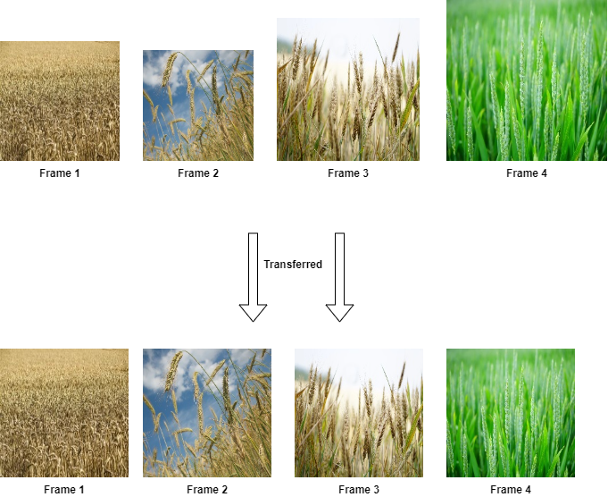
System Overview– Pre-Processing.
Normalized data makes Neural Network works better. So, in the pre-processing stage our model must normalize the incoming frames by giving them same target size for all the images and divide them into batches.

Slide 8
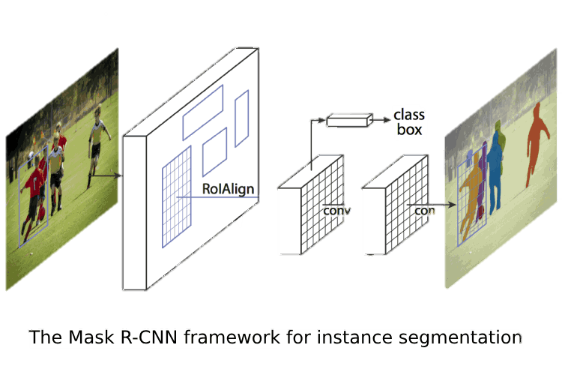
System Overview– Main Processing.
The main processing phase is where we train our model with the dataset images so it can detect our incoming frames using TensorFlow and Keras python libraries to use the Mask R-CNN for detection phase.

Slide 9
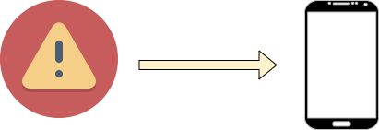
System Overview– Output.
The output of our system will end in one of the two ways either,
Our system doesn't detect a wild oat and continue capturing videos of the filed.
Our system detects a wild oat, then it will send a notification to the mobile app that their is a wild oat and the buzzer, which is connected to the Raspberry Pi will rings.

Slide 10
Expected Results.
Accuracy & Recognition Rate.
Our system shall have high accuracy and recognition rate.
Detecting & Classification.
This system shall use real-time detection to classify the wild oat from the wheat.

Slide 11
Related Work(1/2).

Slide 12
Related Work(2/2).

Slide 13
Demo.

Slide 14
Thank You.

