Slide 1
Mini Project III
Alex & Steven

Slide 2
Features Used
Steven
Alex
Banking Information
Income
Savings Balance
Checking Balance
Credit Balance
Number of Transactions
Demographics
Income
Age
Years with Bank
Number of Children

Slide 3
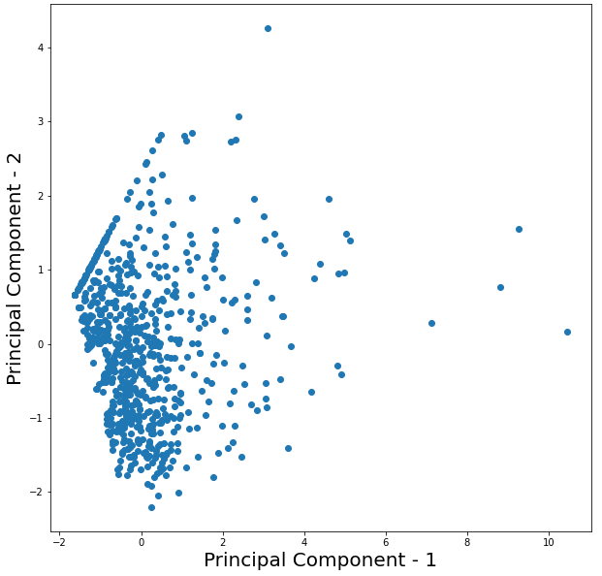
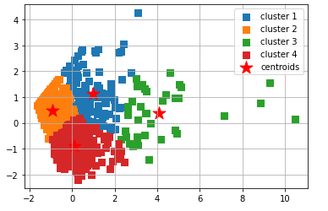
PCA Dimension Reduction
KC Means Clustering

Slide 4
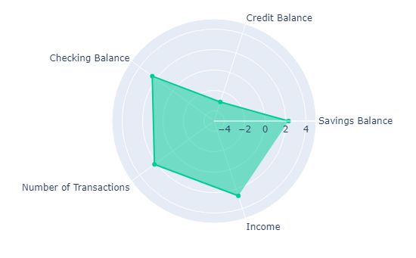
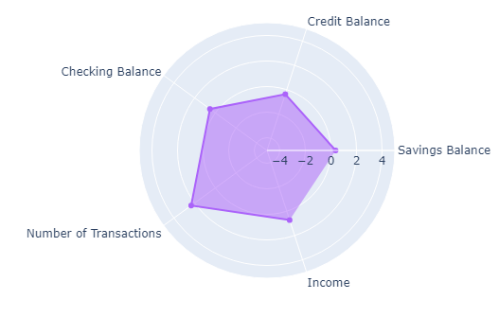
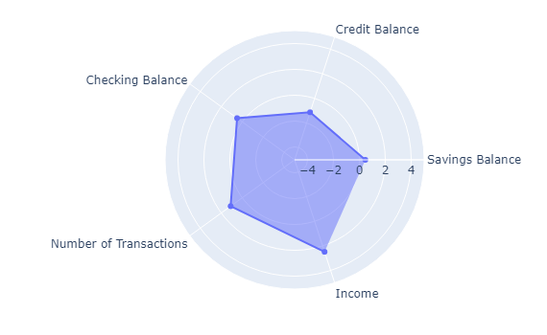
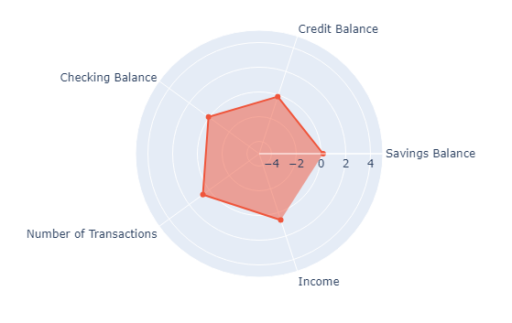
Cluster 1
Cluster 2
Cluster 3
Cluster 4

Slide 5
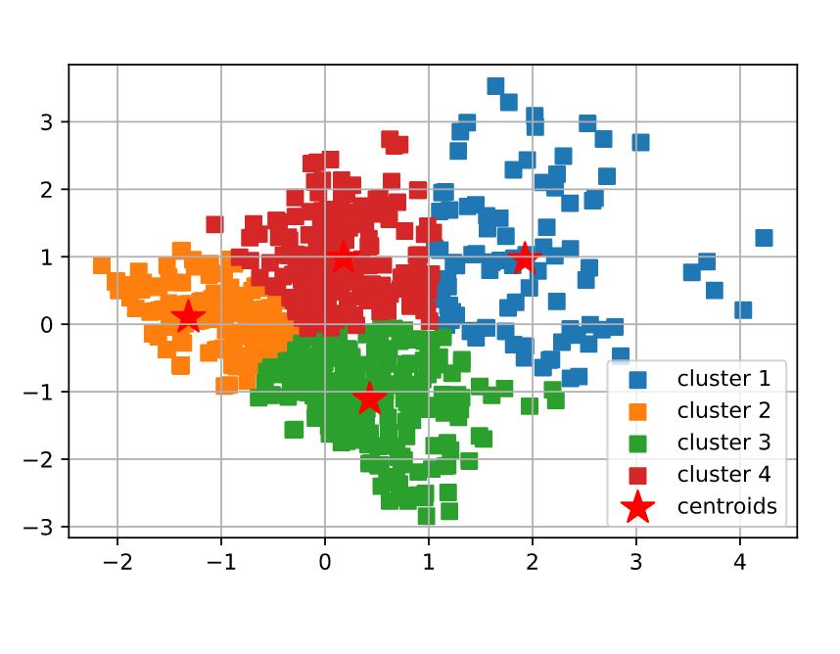
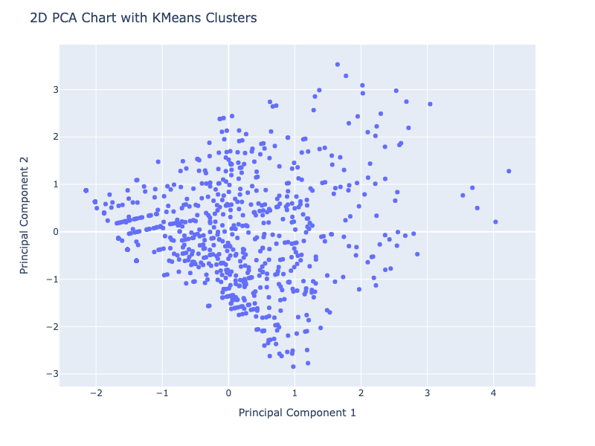
PCA Dimension Reduction
KC Means Clustering

Slide 6
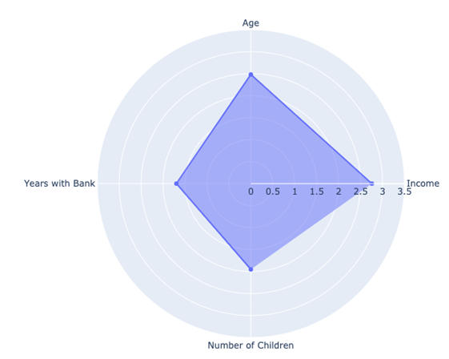
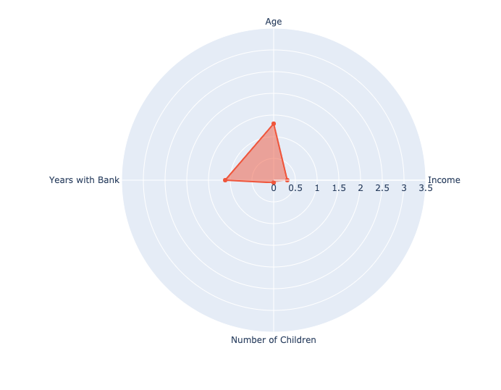
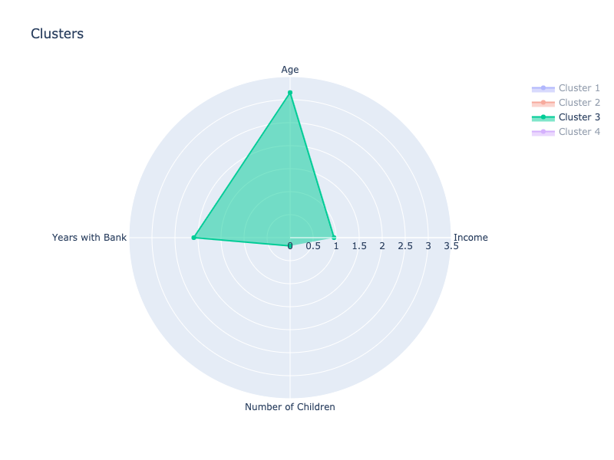
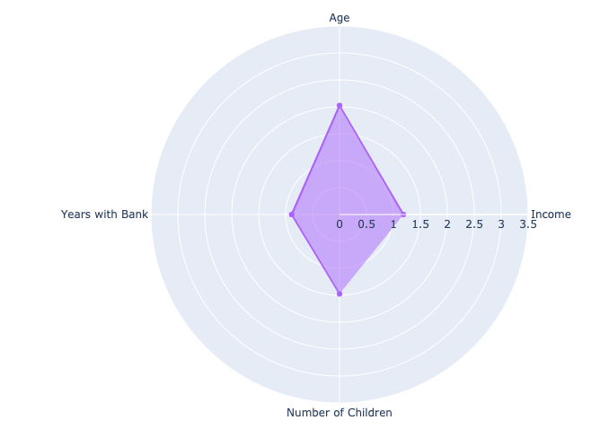
Cluster 1
Cluster 2
Cluster 3
Cluster 4

Slide 7
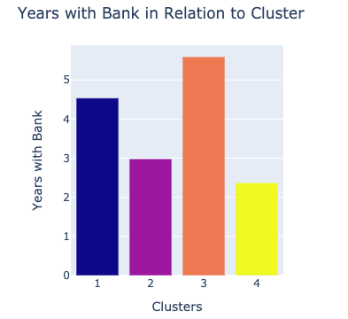
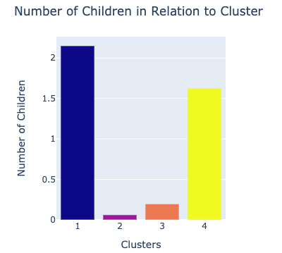
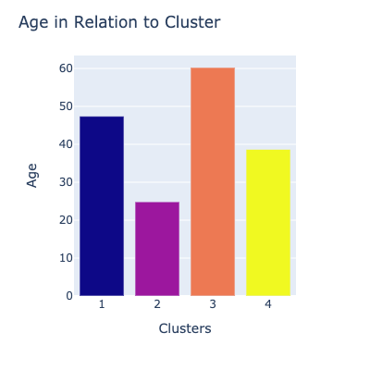
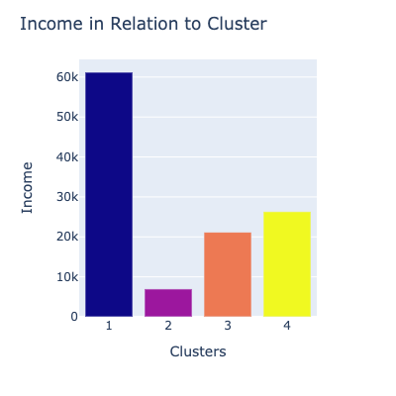

Slide 8
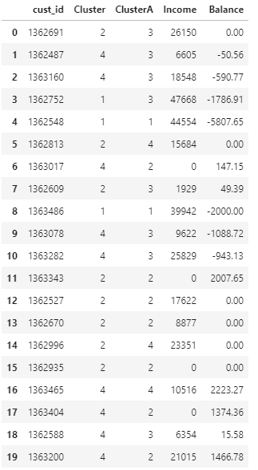
Are clients being grouped the same way by both demographics AND banking information?

Slide 9
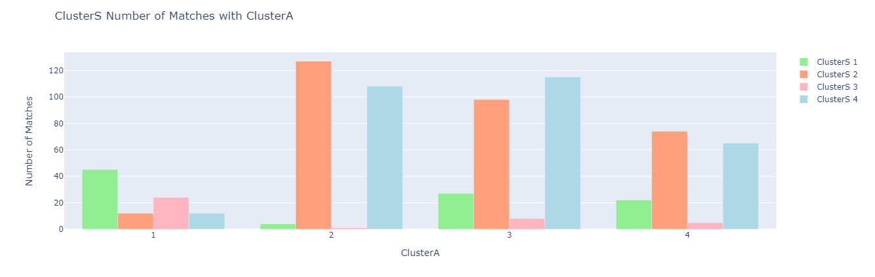
45/93 (48.4%)
127/240 (52.9%)
115/248 (46.4%)
5/166 (3.0%)
292/747 = 39.1% match

