Slide 1
Introduction to the Module
SET08103 Software Engineering Methods
Dr Kevin Sim
k.chalmers@napier.ac.uk

Slide 2
News
Coursework is available now!
Specification is available at https://github.com/kevin-chalmers/set08103/tree/master/assessment
We will do a coursework group forming session in the next lecture.

Slide 3
Learning Environment

Slide 4
Creating a Cooperative Learning Community Environment for the Module
We will use the following to help create our learning environment:
Toyota Improvement Kata.
Ideas from the book A Mind for Numbers.
An industry perspective - Meeting Norms at Skyscanner.
Ideas from Lean and Continuous Improvement.

Slide 5
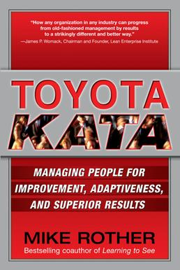
Toyota Improvement Kata
In consideration of the outcomes of your education...
Grasp your current level of knowledge and understanding.
Define what you want to learn next - e.g. the ideas in this module.
Move toward that target level iteratively, which will uncover areas you don't know that need to be worked on.
This Photo by Unknown Author is licensed under CC BY-SA

Slide 6

A Mind for Numbers
Two modes of thinking:
Focused thinking requires active attention, and is conscious, analytical, and serial. Hard as requires effort.
Diffuse thinking requires passive attention, and is subconscious, creative and parallel. Easy.
We require both modes:
Avoid distraction or engagement with multiple attentional things to things, for example using your phone.
Don’t’ fool yourself that following and copying is the same as understanding - related to ego is the enemy.
Focused attention is requires diffuse thinking to make linkages.

Slide 7
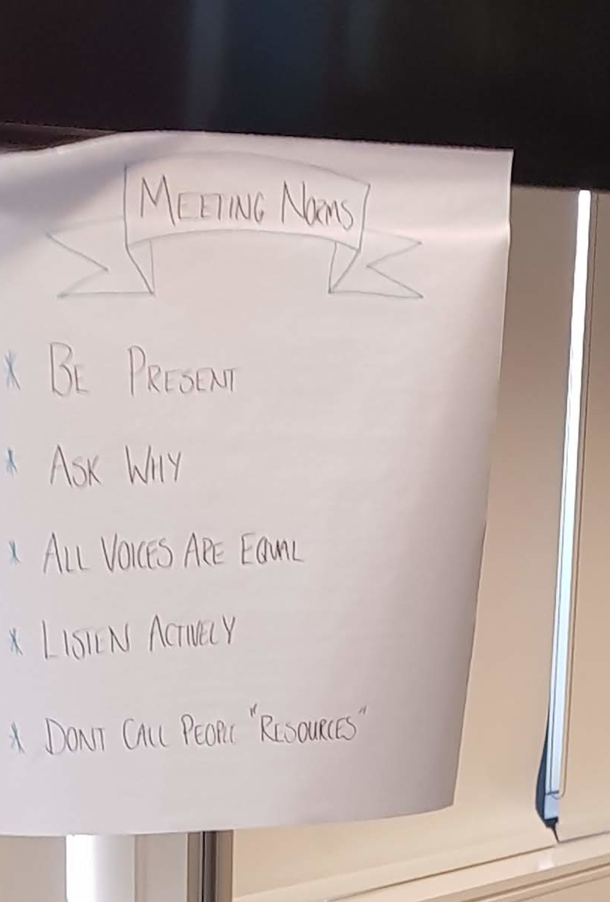
Skyscanner Meeting Norms
Be present both physically and mentally.
Ask why to me and yourself.
All voices are equal.
Listen actively which normally means close your laptop - take written notes instead.
Don't call people resources which is more about the work place than studying, but keep it in mind when working in teams.
And one addition from me - remember that ego is the enemy.

Slide 8
Continuous Improvement
One final point comes from ideas of lean. We have two objectives:
Have respect for people.
Continuously improve.
Education is a form of continuous improvement - you will never stop learning. However, a key concept is this:
Respect for people supports continuous improvement.
Continuous improvement does not in itself support respect for people.
This can be expanded to the class - respect each other, and give each other support, and you can improve yourself and your class mates together.
Education is not a competition.

Slide 9
Behavioural Objectives for the Lecture
Define what a software engineering method is.
List the three Software Development Lifecycle types.
List the four points of the Agile Manifesto.
Define what DevOps is and its five goals.
List the seven parts of a DevOps toolchain.
Define the metrics of lead-time, process-time, and %C/A.

Slide 10
Defining Software Engineering Methods

Slide 11
What is a Software Engineering Method?
Two concepts to define:
Software Engineering
Method
We will start with Software Engineering – from Wikipedia:
Software engineering is the application of engineering to the development of software in a systematic method.

Slide 12
What is Software Development?
Again from Wikipedia:
Software development is the process of conceiving, specifying, designing, programming, documenting, testing, and bug fixing involved in creating and maintaining applications, frameworks, or other software components.
Conceiving or coming up with an idea.
Specifying the requirements.
Designing (we use UML).
Programming.
Documenting is fundamental for reuse.
Testing (we will use unit testing).
Bug fixing in production.

Slide 13
What is Engineering?
From Wikipedia:
Engineering is the creative application of science, mathematical methods, and empirical evidence to the innovation, design, construction, operation and maintenance of structures, machines, materials, devices, systems, processes, and organizations.
Engineering has three strands:
The application of science – computer science underpins software development.
Mathematical methods to model (not in the module). From computer science.
Empirical evidence means that we measure something to gain information (e.g. testing).

Slide 14
So what is Software Engineering?
The working definition for the module:
A collection of techniques (e.g. designing, programming, testing) to develop software using ideas from computer science in a manner that is systematic. We require evidence about our software to determine if it is working as expected.

Slide 15
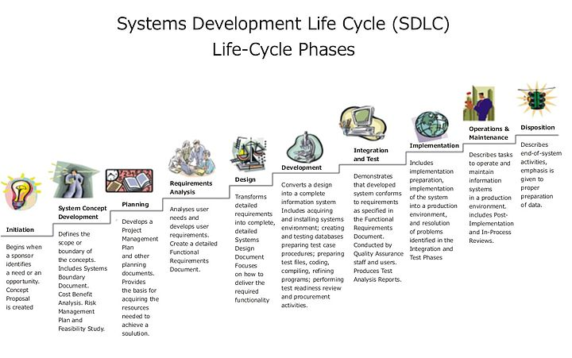
What is a Method?
Effectively, an approach to do something – a series of steps.
Software engineering is underpinned by the Software Development Lifecycle.
Three key methods:
Waterfall.
Spiral or incremental.
Agile.
This Photo by Unknown Author is licensed under CC BY-SA

Slide 16
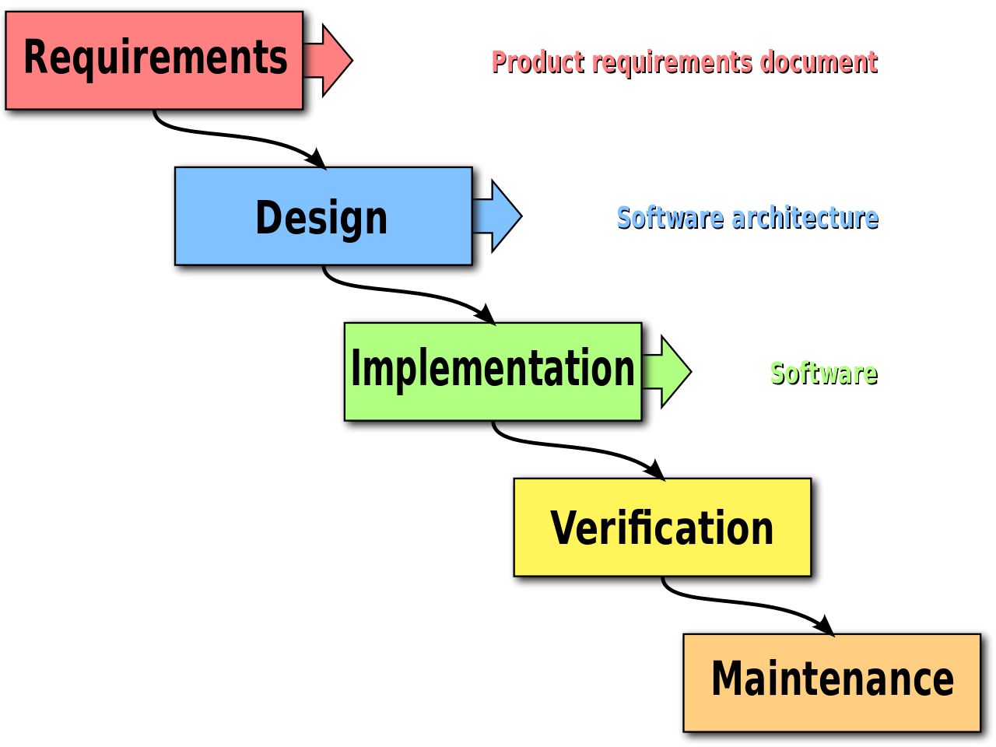
Waterfall Method
Each stage is completed before moving onto the next.
Requirements gathering or defining what is needed in the software.
Analysis of the requirements to define models and rules.
Design to produce the software architecture.
Coding to build the software.
Testing to ensure the software is working as expected.
Operation of the software where needed.
This Photo by Unknown Author is licensed under CC BY-SA

Slide 17
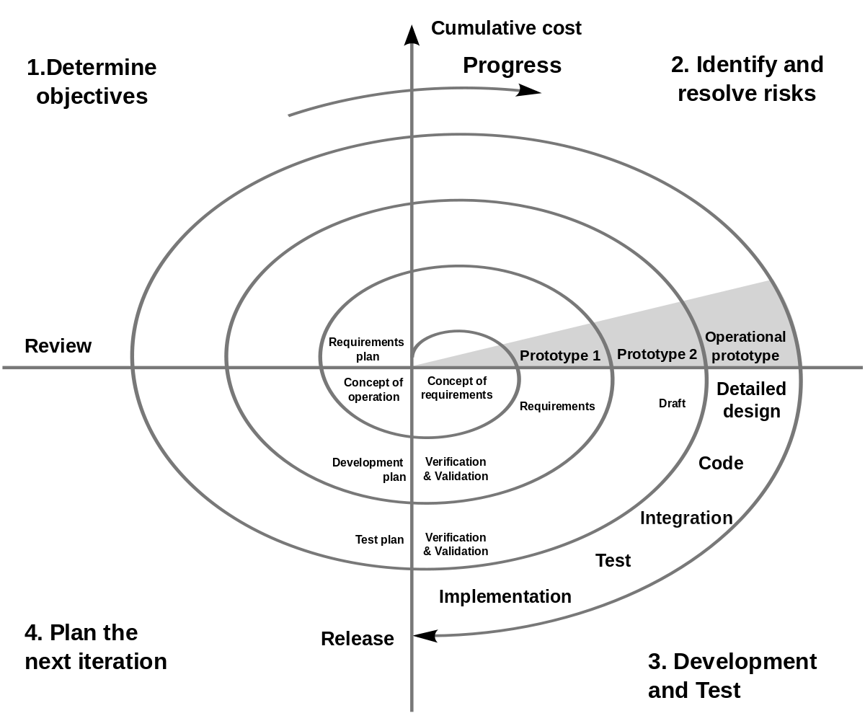
Spiral Method
Software is iteratively developed through four stages to produce better prototypes.
Determine objectives for this iteration.
Identify and resolve risks for this iteration.
Development and test for this iteration.
Plan the next iteration.
This Photo by Unknown Author is licensed under CC BY-SA

Slide 18
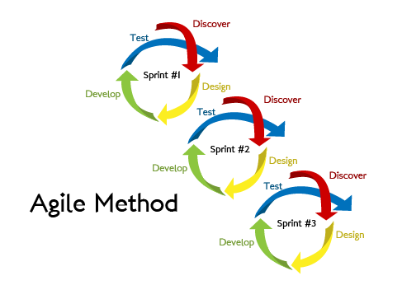
Agile Method
Extend the iterative ideas, but focus on human-centric ideas.
Software is evolved by collaboration between developers and clients.
Teams are self-organising and support multiple parts of the process.
Teams can adapt (be agile) as requirements and challenges evolve.
This Photo by Unknown Author is licensed under CC BY-SA

Slide 19
Linking to Module Learning Outcomes
Demonstrate understanding of a modern software development lifecycle. (coursework)
Explain the different techniques supporting modern software engineering methods. (exam)
Define and analyse systems requirements and needs and specify a system design to deliver these requirements. (coursework)
Apply modern software engineering methods and techniques to a software development project. (coursework)
Explain the role of a computing professional in relation to social, ethical and legal issues surrounding projects. (exam)
Consider information security requirements in the development and delivery of software. (exam)

Slide 20
A Brief History of Software Engineering Methods

Slide 21
History of Software Engineering (part 1)
Pre 1965 work on defining a discipline, but the term Software Engineering.
1965 various letters to the ACM, lectures, and advertisements mention the term Software Engineering.
1965 to 1985 the software crisis - software runs over budget, schedule, causes faults that lead to loss of life. Software quality becomes a key idea.
1970s structured programming - using if, functions, etc.
1980s Structured Systems Analysis and Design Methodology (SSADM).
1985 to 1989 'no silver bullet' idea - no single technology or approach will solve the software crisis.
1990s Object-Oriented Programming (OOP).
1990s Internet becomes dominant technology.

Slide 22
History of Software Engineering (part 2)
1991 Rapid Application Development (RAD) - still common in user-interface design methods.
1994 Dynamic Systems Development Method (DSDM) - the first agile method.
1995 Scrum.
1999 eXtreme Programming (XP).
2000 to today rise of lightweight methods (the focus of this module).
2000s various agile methods defined.
2001 The Manifesto for Agile Software Development.
2008 DevOps (Development Operations) coined.

Slide 23
The Manifesto for Agile Software Development
Signatories state that as developers they value:
Individuals and Interactions over processes and tools.
Working Software over comprehensive documentation.
Customer Collaboration over contract negotiation.
Responding to Change over following a plan.
After class:
Reflect on the Agile Manifesto and analyse what the individual points mean to you.
Read the Wikipedia section on the Agile Manifesto. Reflect how your original analysis is similar and different to that presented on Wikipedia.

Slide 24
Lean Software Development
Eliminate waste – do not do work that does not add value to the customer.
Amplify learning – usually by short iteration cycles with feedback from the client and the team.
Decide as late as possible – wait until all the facts are available before deciding how features are implemented.
Deliver as fast as possible.
Empower the team – “find good people and let them do their own job”.
Build integrity in – keep the system simple to update and modify.
See the whole – “Think big, act small, fail fast; learn rapidly”.

Slide 25
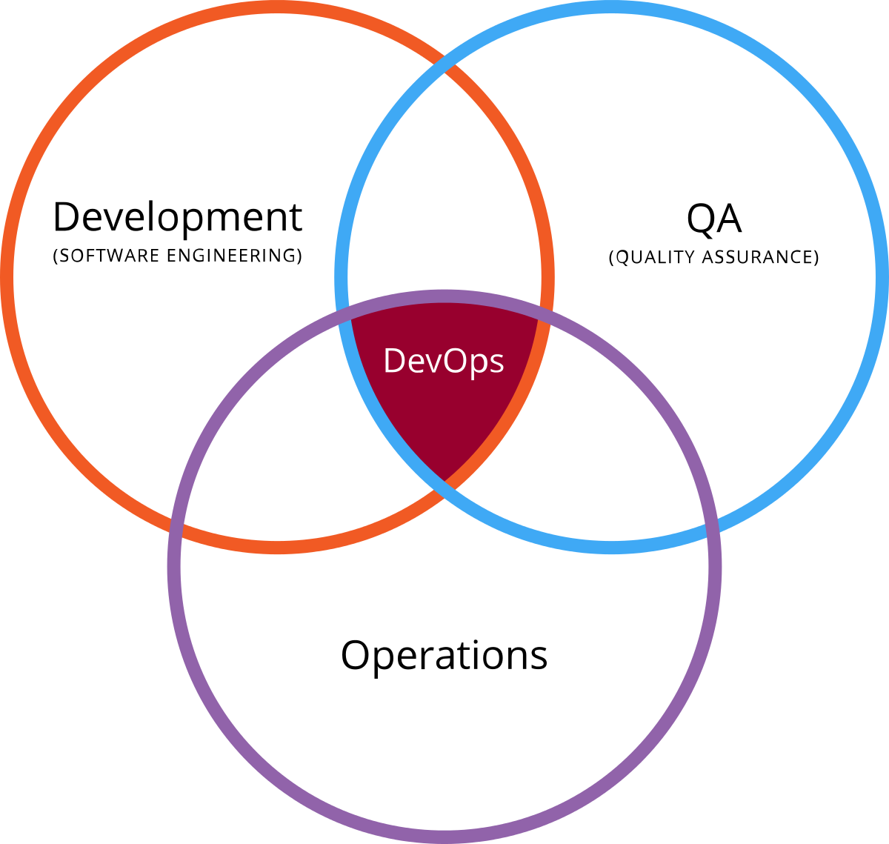
DevOps
Development and Operations work together to deliver the software product.
Intersection of three areas:
Development is the software engineers role.
Operations is the management of systems where software runs.
Quality Assurance to ensure production quality software delivered.
This Photo by Unknown Author is licensed under CC BY-SA

Slide 26
Five Goals of DevOps
Improved deployment frequency.
Faster time to market.
Lower failure rate of new releases.
Shortened lead time between fixes.
Faster mean time to recovery.
The overall goal is to increase the flow of work through the production process.
See the additional video in the lecture notes on deploying multiple times per day.

Slide 27

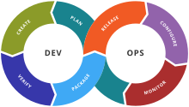
DevOps Toolchain
Stage | Our Tools
Plan | User stories Kanban board (GitHub)
Create | IntelliJ UML Git
Verify | Unit testing Travis CI
Package | Maven
Release | Amazon Web Services
Configure | Docker
Monitor | Amazon Web Services Bug and issue tracking
This Photo by Unknown Author is licensed under CC BY-SA

Slide 28
Some Metrics and Summary

Slide 29
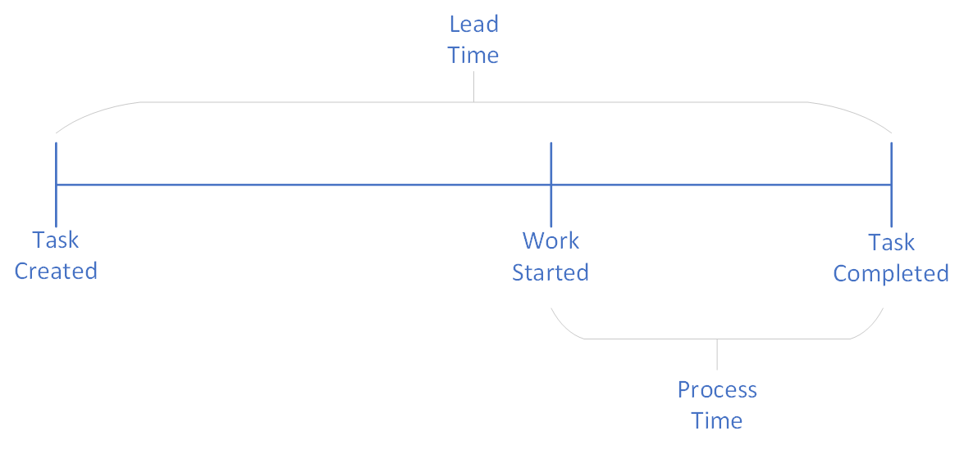
Metrics for Software Development
Lead time is the duration from task creation to task completion – it is the time the customer sees.
Process time is the duration from work initiation to task completion – it is the time the team sees.
%C/A or percentage complete over accurate is a measure of quality – how much completed work can be used as-is?

Slide 30
Summary
The aim of this lecture is to cover the basic concepts underpinning the module. We will examine several of these concepts in more detail as we continue through the module. In summary, we have:
Specified the learning environment for the module.
Defined what a software engineering method is.
Listed the three Software Development Lifecycle types.
Listed the four points of the Agile Manifesto.
Defined what DevOps is and its five goals.
Listed the seven parts of a DevOps toolchain.
Defined the metrics of lead-time, process-time, and %C/A.

