Slide 1
DO NOT UNPACK YOUR STUFF – YOU WILL BE MOVING

Slide 2
Scrum and Team Forming
SET08103 Software Engineering Methods
Dr Kevin Chalmers
k.chalmers@napier.ac.uk

Slide 3
Objective – form a team of four students to work together on the module.

Slide 4
Points to Consider
You need a team that will be able to complete the coursework. Sometimes that means finding new people to work with.
Your team must come to the same lab session for code reviews and weekly lab meetings.
Your team must be four people. Only once all teams are formed will we look at how the numbers work out.
You are a team member. You are committing to the team and working together.

Slide 5
Get into a Team
Get up.
Find your team of four.
Once in a team sit down as close to the front as possible.
Not as close to the front as you want – we are making space for everyone.
Once seated, your team need to do the following:
Define a Code of Conduct
Start reading the notes for Lecture 2.
Decide on a Product Owner.
Decide on a Scrum Master.
Schedule necessary meetings

Slide 6
Code of Conduct
You require rules for your team. For example:
If a team member is late more than twice they have to buy everyone a coffee.
If a team member doesn’t communicate for a week they will be reported at the weekly lab meeting.
etc.
The point of the Code of Conduct is for everyone to agree how they will act as a team. Your Code of Conduct must be added to your GitHub repository. See https://help.github.com/articles/adding-a-code-of-conduct-to-your-project/

Slide 7
Core Concepts of Scrum
See the lecture notes for far more detail

Slide 8
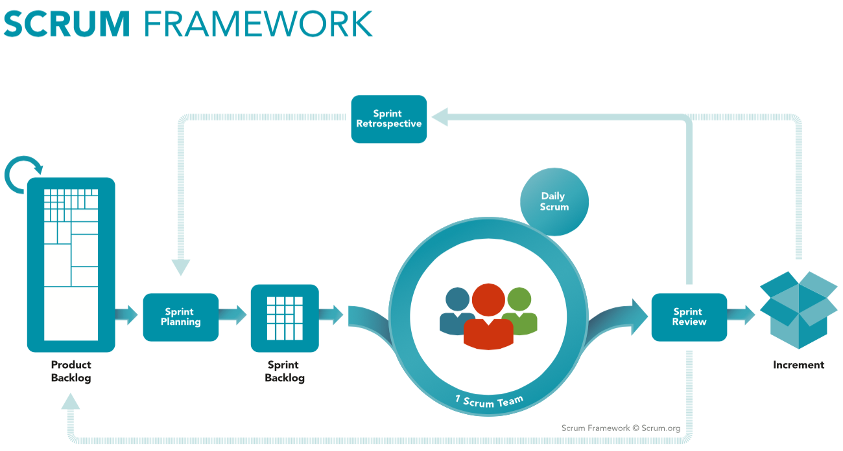

Slide 9
Scrum Process
Create a Product Backlog.
Estimate the Product Backlog.
Plan work to be done in a Sprint.
Start work.
Check-up each day (Daily Scrum).
End of Sprint, review.
End of Sprint, reflect.
Check velocity, return to 2.

Slide 10
Scrum Roles
Product Owner prioritises the Product Backlog and generally maintains it.
Scrum Master encourages the team and gets problems out of their way. They schedule the meetings, but they are not in charge.
Team member does the work. In your teams, everyone is a team member.
The Product Owner and Scrum Master cannot be the same person.

Slide 11
Your Task
READ THE LECTURE NOTES! They provide more information and detail than we can cover today.
Get your team organised and working. Work on everything together. You are a team now and need to support each other.
During next week’s lab we will start team meetings. Be prepared and make sure everything is set-up. Again, see the notes.

