Slide 1
Version Control and Git
SET08103 Software Engineering Methods
Dr Kevin Chalmers
k.chalmers@napier.ac.uk

Slide 2
Overview
Version Control
Git
Gitflow Workflow

Slide 3
Version Control

Slide 4
What is Version Control?
Version control is about the management of changes to documents or collections of documents.
Not just software but any document versioning.
In software development, version control is a component of Software Configuration Management (SCM).

Slide 5
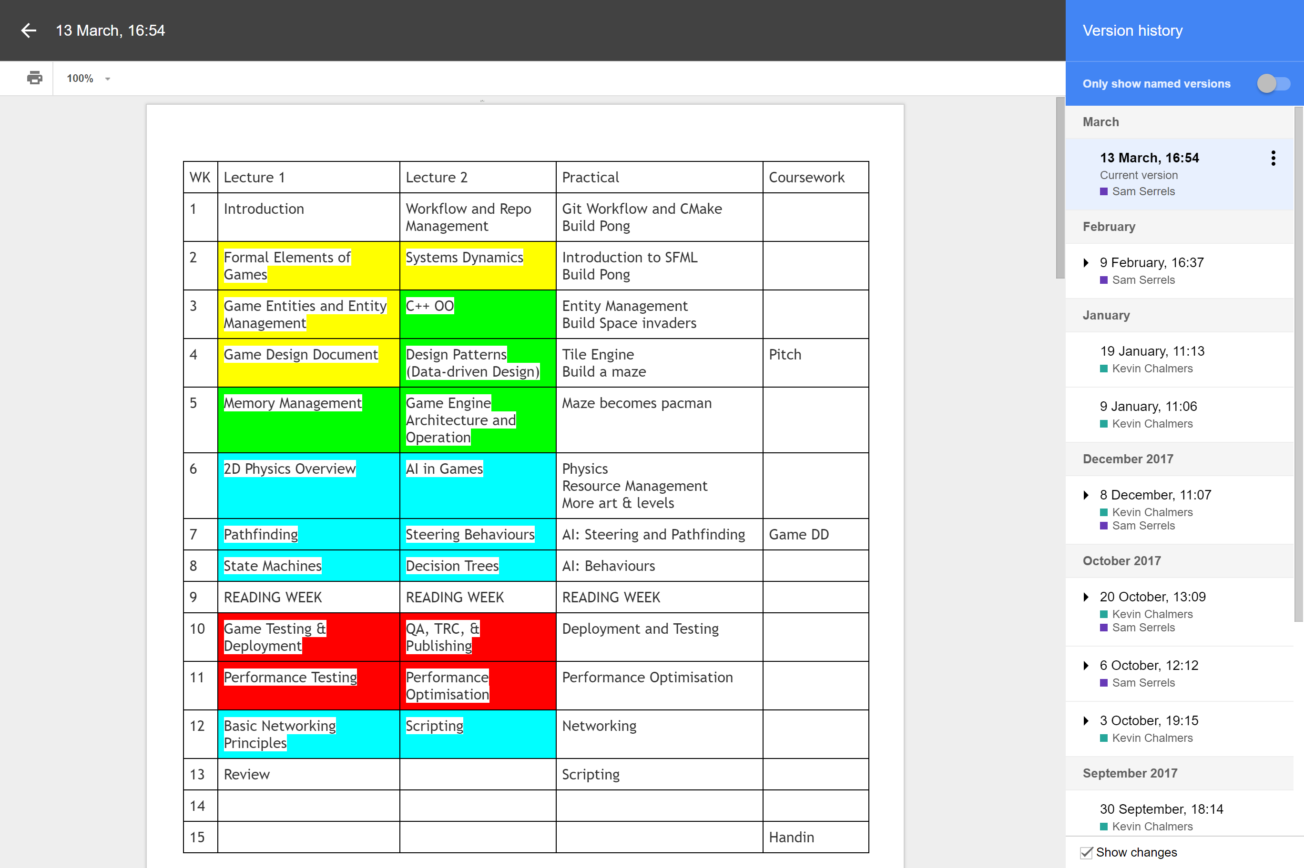

Slide 6
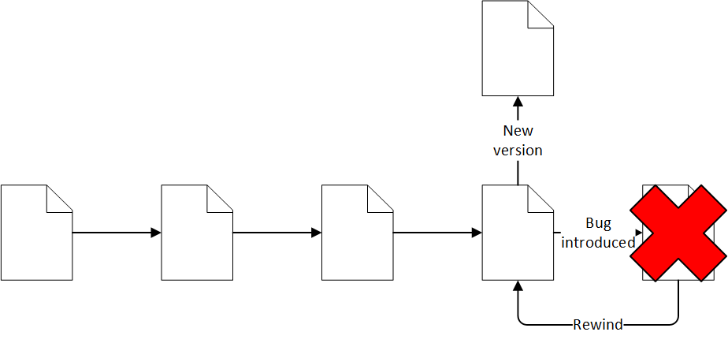
Rewinding Changes
Key feature of a version control system is the ability to go back to a previous version.
Checkpointing changes at functioning points means we can revert to a point before an error was introduced.
Using version control effectively means a complete history of change is maintained.

Slide 7
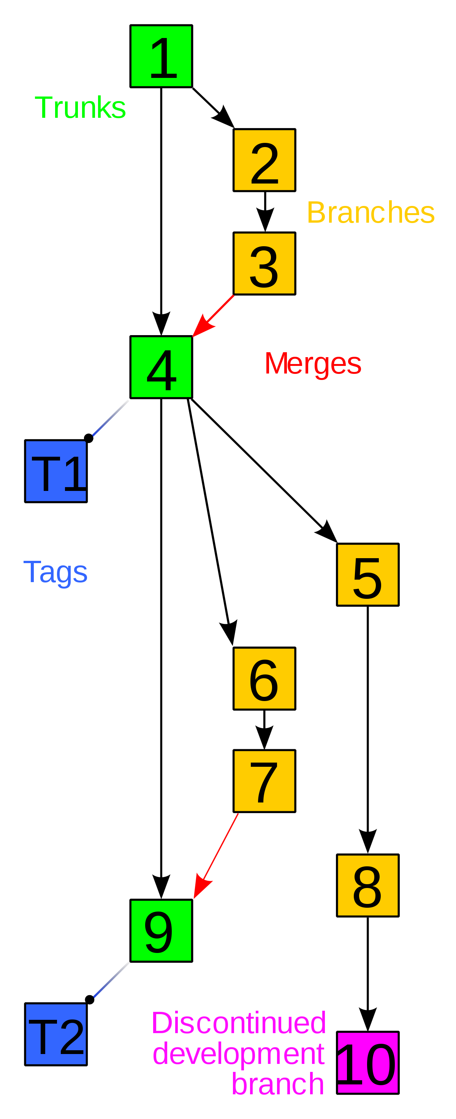
Branching Versions
Version control also allows branching.
A branch is an isolated version of the code base to work on.
Changes made on a branch can be merged into another branch when ready.
This Photo by Unknown Author is licensed under CC BY-SA

Slide 8




Popular Version Control Tools
Git – popular services include GitHub, GitLab and Bitbucket.
Mercurial – a popular alternative to Git.
SVN – Apache tool based on the older CVS.
Visual Studio Team Services – from Microsoft, although recent purchase of GitHub may change this.
This Photo by Unknown Author is licensed under CC BY-SA
This Photo by Unknown Author is licensed under CC BY-SA-NC
This Photo by Unknown Author is licensed under CC BY-SA

Slide 9
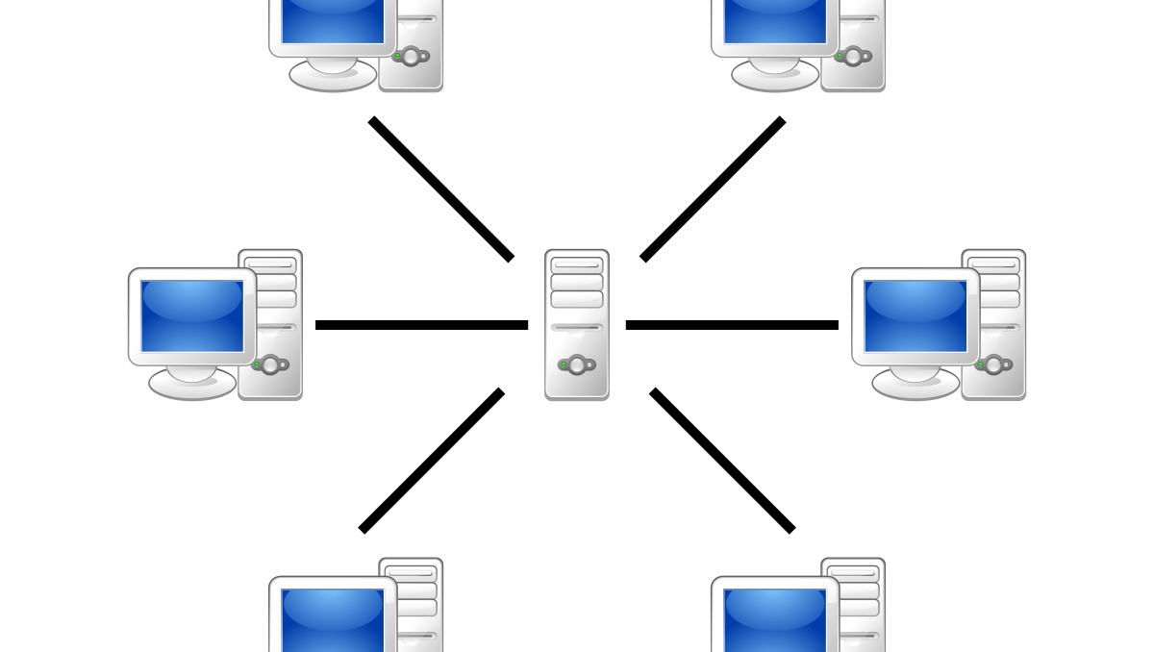
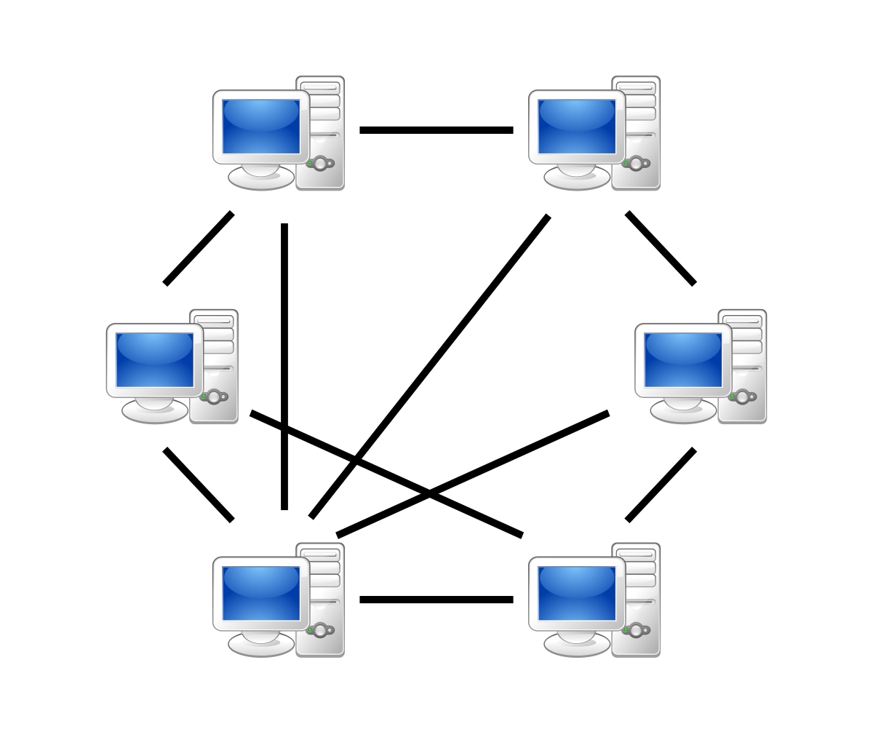
Version Control Approaches
Localised means versions are stored on a single file-system.
Client-server means there is a centralised server for the repository and everyone acts as a client.
Distributed means everyone has their own working copy of the repository.
This Photo by Unknown Author is licensed under CC BY-SA
This Photo by Unknown Author is licensed under CC BY-SA

Slide 10
Terminology
Repository is where code is stored.
Checkout (or clone) is creating a local copy of a code repository.
Working copy is a local copy of the code.
Fetch (or pull) is to get the latest updates of the code.
Push is to update the remote repository with updates to the code.
Commit is to create a code checkpoint.
Tag or label is to attach a name to a specific code commit.
Branch is a new working code version.
Merge is to combine two separate code versions.
Conflict occurs when code versions have changed the same file.

Slide 11
(A Brief) History of Version Control
1972 Source Code Control System developed at Bell Labs.
1990 CVS 1.0 released.
1999 SourceForge launched.
2000 Subversion (SVN) released. BitKeeper launched.
2002 Linux kernel development moved to BitKeeper.
2005 BitKeeper becomes commercially licensed. Git and Mercurial released.
2006 Google Code Project Hosting and Microsoft CodePlex launch.
2008 GitHub launches. Bitbucket launches.
2011 GitLab launches.
2013 Microsoft launches Visual Studio Team Services.
2016 Google Code Project Hosting shuts down.
2017 Microsoft closes CodePlex.
2018 Microsoft buys GitHub .

Slide 12
Git

Slide 13
What is Git?
Git is a distributed VCS.
Linus Torvalds used the following design principles:
See Concurrent Versions System (CVS) as the model of what not to do.
Support a distributed workflow, as in BitKeeper.
Have strong safeguards against corruption.

Slide 14
Working with Repositories
There are two methods to “create” a repository.
We can initialise a directory on the local file system as a repository.
We can clone (copy) an existing repository from a URL.
git init
git clone <url>

Slide 15
Working with Changes
A local Git repository contains all the information of the other Git repositories.
History and other information is maintained in the .git folder.
When you change a file, we have a different local working copy.
To save the current state of the Git repository we perform the following steps:
Add the required changes to the staging area.
Create a new commit from the staging area.

Slide 16
Adding Changes
We can add individual file changes.
Or add a directory that was created.
Adding supports wildcards.
And we can use this to add all changes.
We can also find out what has changed from the previous commit.
git add <filename>
git add <directory>
git add *.java
git add *
git status

Slide 17
Committing Changes
Once suitable changes have been made to the staging area we need to create a commit.
git commit –m “message”
This will create a new checkpoint of your code. It exists as a point in history which changes are measured against.
Best advice – commit often to allow simple rewinding.

Slide 18
Pushing Changes
We can update local changes to the origin remote for the current branch.
We can push changes to a specific remote and branch.
To push all branch updates to all remotes.
git push
git push <remote> <branch>
git push --all

Slide 19
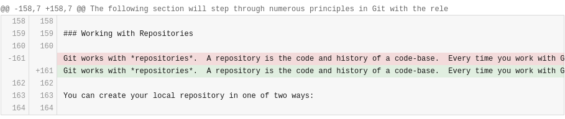
Diffs
Git keeps track of changes between commits, not complete files.
Hence text files are good and binary bad in Git.
The git diff command provides information on changes between commits.

Slide 20
Logs
Git stores a log of all changes.
To access this use the git log command.
This shows the SHA-1 hash of the commit, which is useful for going backwards.
commit e426d2c1b1aa7f732c5b863708de4e3a29da3b52 (HEAD -> feature/lecture03, origin/feature/lecture03)
Author: Kevin Chalmers <k.chalmers@napier.ac.uk>
Date: Wed Aug 15 16:32:59 2018 +0100
Almost completed section on adding changes to lecture 03.
commit b53479816d69a0d6254f9501d636f6b6e75460fb
Author: Kevin Chalmers <k.chalmers@napier.ac.uk>
Date: Thu Aug 9 15:23:16 2018 +0100
Added working with repositories section.
commit b9001d50cc976e70a150d129fe5aeb9e67e8c210
Author: Kevin Chalmers <k.chalmers@napier.ac.uk>
Date: Thu Aug 9 15:11:29 2018 +0100
Spell check.
commit dcbc34b2d990f768317c7e7a684b1de037ac199c
Author: Kevin Chalmers <k.chalmers@napier.ac.uk>
Date: Thu Aug 9 14:31:58 2018 +0100

Slide 21
Going Backwards
Version control allows rewinding through changes.
We can check out a particular commit based on its SHA-1 hash.
We can also check out a particular commit based on its tag/name.
git checkout <hash>
git checkout <tag>

Slide 22
Fetching and Merging Changes
Whenever changes are pushed to a remote we need to be able to retrieve them.
We first retrieve the changes.
And then we merge them into the current branch.
We can perform this operation in one step.
git fetch <remote>
git merge <branch>
git pull

Slide 23
Managing Conflicts
Is hard…. and would take a lot of time to walk through.
Practice is normally the best teacher here.
See this link for advice when you get a merge conflict:
https://help.github.com/articles/resolving-a-merge-conflict-using-the-command-line/

Slide 24
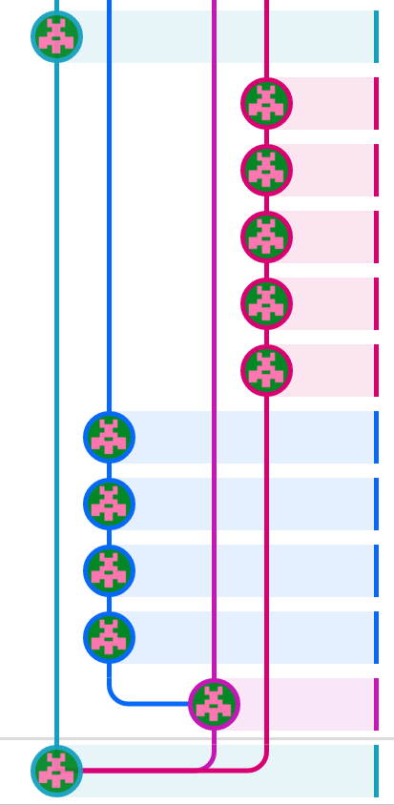
Branching
Branching creates a new local “version” of the code base to work on.
Changes on a branch are independent from another branch.
Branches must be merged to share changes.
Branching is done with the branch command:
git branch <name>

Slide 25
Remotes
A remotes are different servers that can be used to share code.
We can view the current remote.
We can list all remotes.
And we can add a new remote.
git remote
git remote –v
git remote add <name> <url>

Slide 26
Primitive Git Workflow
Basic steps:
Modify files to make a working change.
Add changes to the staging area.
git add
Create a commit from the changes.
git commit
Send the changes to the remote,
git push

Slide 27
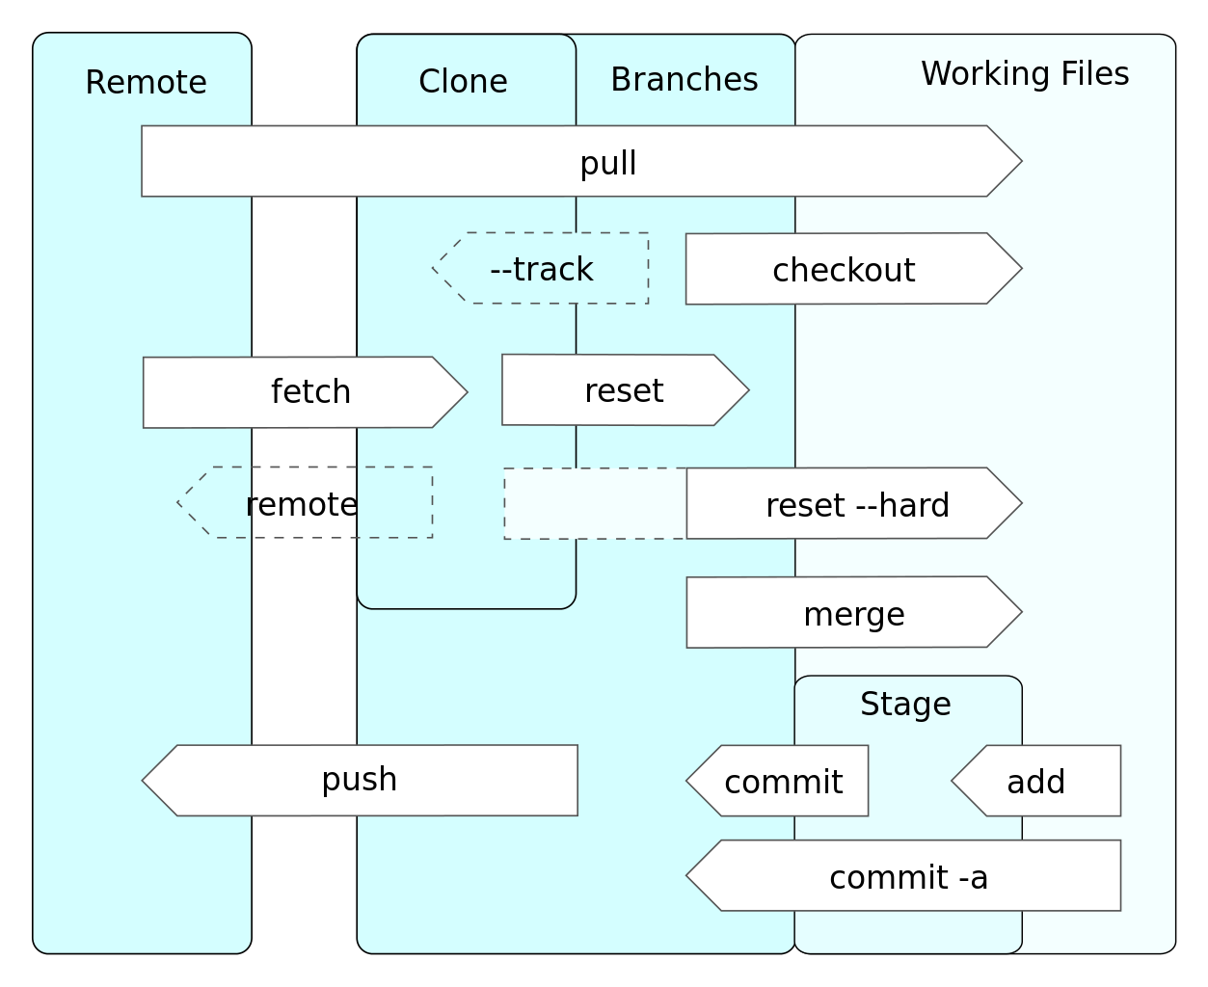
Git Command Summary
This Photo by Unknown Author is licensed under CC BY-SA

Slide 28
Gitflow Workflow

Slide 29
Gitflow Workflow
Common approach to managing a project in general.
Very useful for team-based projects.
Basic idea is:
Work is done in feature branches.
Develop branch merges features.
Release is a set of features.
Master updated on releases.

Slide 30
Gitflow Workflow
Branch | Example | Description
master |  | Main branch.
develop |  | Main development branch. Ongoing work is merged here. Branch initially from master.
feature | feature/add-user | Work to add a feature to the project. Branch from develop.
release |  | Release is a collection of features. Tagged (e.g. v0.1.0). Merged from develop and into master.
hotfix | hotfix/database-disconnect | Fixes to releases. Branch from release and merged into master.

Slide 31
Summary

Slide 32
Summary
We’ve defined what version control is.
We’ve described the key differences between client-server and distributed VCS.
We’ve defined what Git is.
We’ve listed the basic Git commands.
We’ve defined the Gitflow workflow

