Slide 1
Modern Software Architecture
SET08103 Software Engineering Methods
Dr Kevin Chalmers
k.chalmers@napier.ac.uk

Slide 2
Overview
Hardware Eras for Software Development.
Software Platforms for Software Development.
Execution Environments for Software.

Slide 3
Hardware Eras

Slide 4
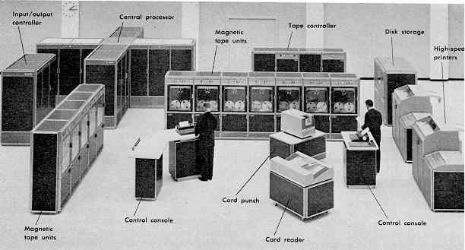
Mainframe
This Photo by Unknown Author is licensed under CC BY-SA

Slide 5
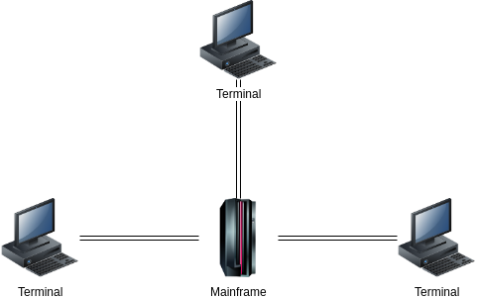
Mainframe Era
Single machine that processed jobs in order.
Collection of dumb terminals connected to the mainframe.
Software and data resided on the mainframe.

Slide 6
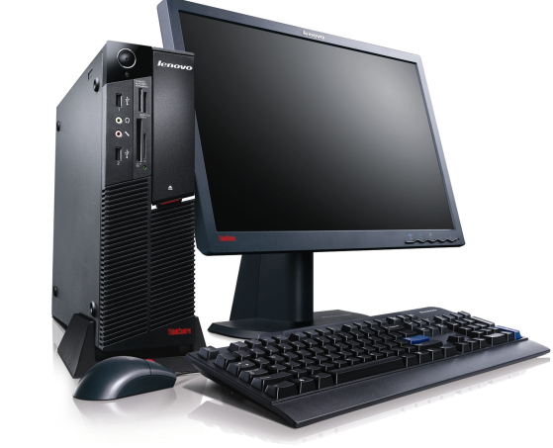
PC Era
Still ongoing to a certain extent.
Single machines for each user.
Rise of home computing.
Transition towards Internet computing.
This Photo by Unknown Author is licensed under CC BY-NC-ND

Slide 7
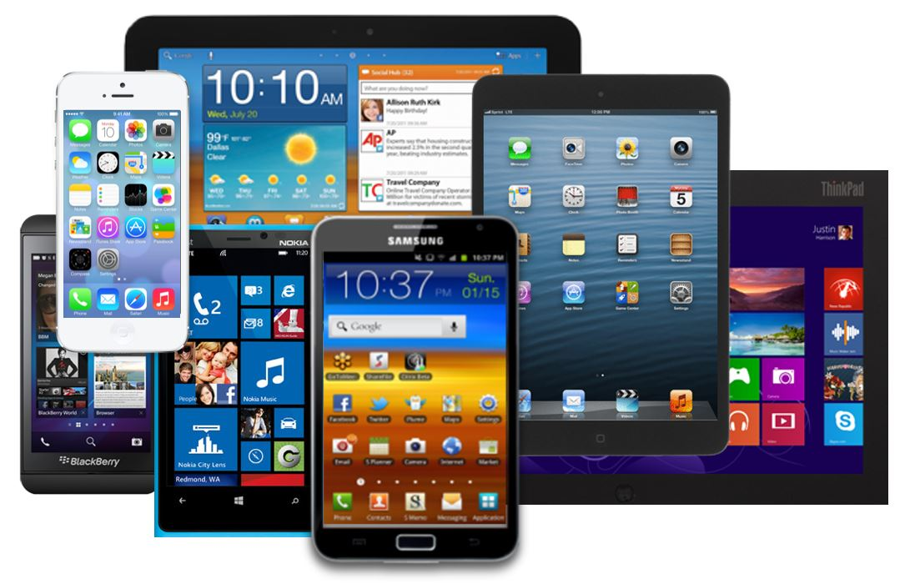
Mobile Era
More “computers” are mobile now.
Software delivered online.
Software becomes more dynamic, integrating various services from around the world.
This Photo by Unknown Author is licensed under CC BY

Slide 8
Software Platforms

Slide 9
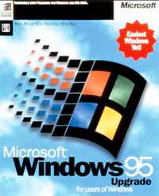
Desktop Applications
Up until fairly recently, boxed applications that were sold and never updated.
Updates for consumers were rare as no delivery mechanism.
Commercial software had maintenance contracts to support in premises, or was developed in house.
This Photo by Unknown Author is licensed under CC BY-SA

Slide 10
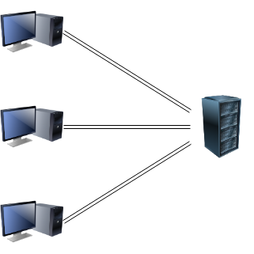
Client-server
Still a core software platform.
Client interacts with the server which contains part of the application, part of the data, or both.
Evolution from the mainframe model.

Slide 11
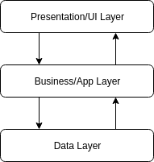
Multitiered and the Three-tier Architecture
Dominant model today.
Seven layer network model.
Operating system design.
Distributed applications.
Idea is to separate application into different layers of functionality.
Layer knows how to communicate only to the next layer – abstraction of communication.

Slide 12
Multitiered and the Three-tier Architecture
Presentation/UI layer responsible for presenting information to the user.
Logic layer controls application functionality.
Data layer manages the data in the system.

Slide 13
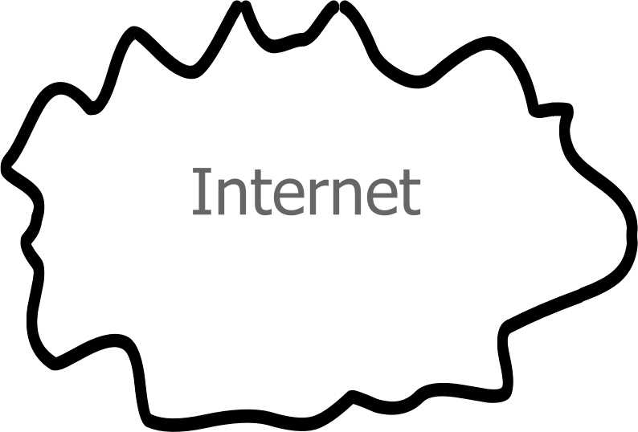
Internet
In the late 1990s to early 2000s the Internet became the dominant software platform.
Data and applications could be delivered via the Internet.
Software became more dynamic as updates could occur easily.

Slide 14
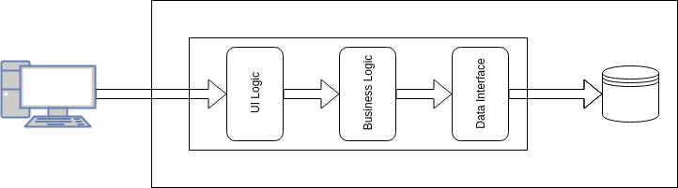
Monolithic Architecture
Monolithic architectures evolved where a single system contained all application behaviour.
Clients interacted with a single point.
Servers became more fragile – a single update could bring down multiple services.

Slide 15
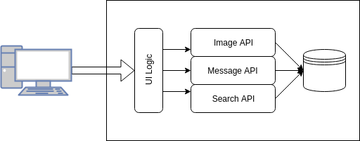
Service Oriented Architectures
SOA mitigates failures by spreading logic across different services (or APIs).
For example, Facebook services:
Messaging.
Images.
Searching.
Posting.

Slide 16
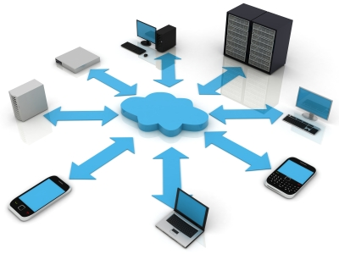
Cloud Computing
Computing-as-a-Service.
The aim of Cloud Computing is to provide computing resource as a utility.
For example, storage is online (e.g., Dropbox) so no need to run an online storage server.
This Photo by Unknown Author is licensed under CC BY-SA-NC

Slide 17
Cloud Computing
Infrastructure-as-a-Service (IaaS) provides machines.
Platform-as-a-Service (PaaS) provides systems and runtimes.
Software-as-a-Service (SaaS) provides applications (e.g., email).
Function-as-a-Service (FaaS) provides processing functions.
This Photo by Unknown Author is licensed under CC BY-SA-NC

Slide 18
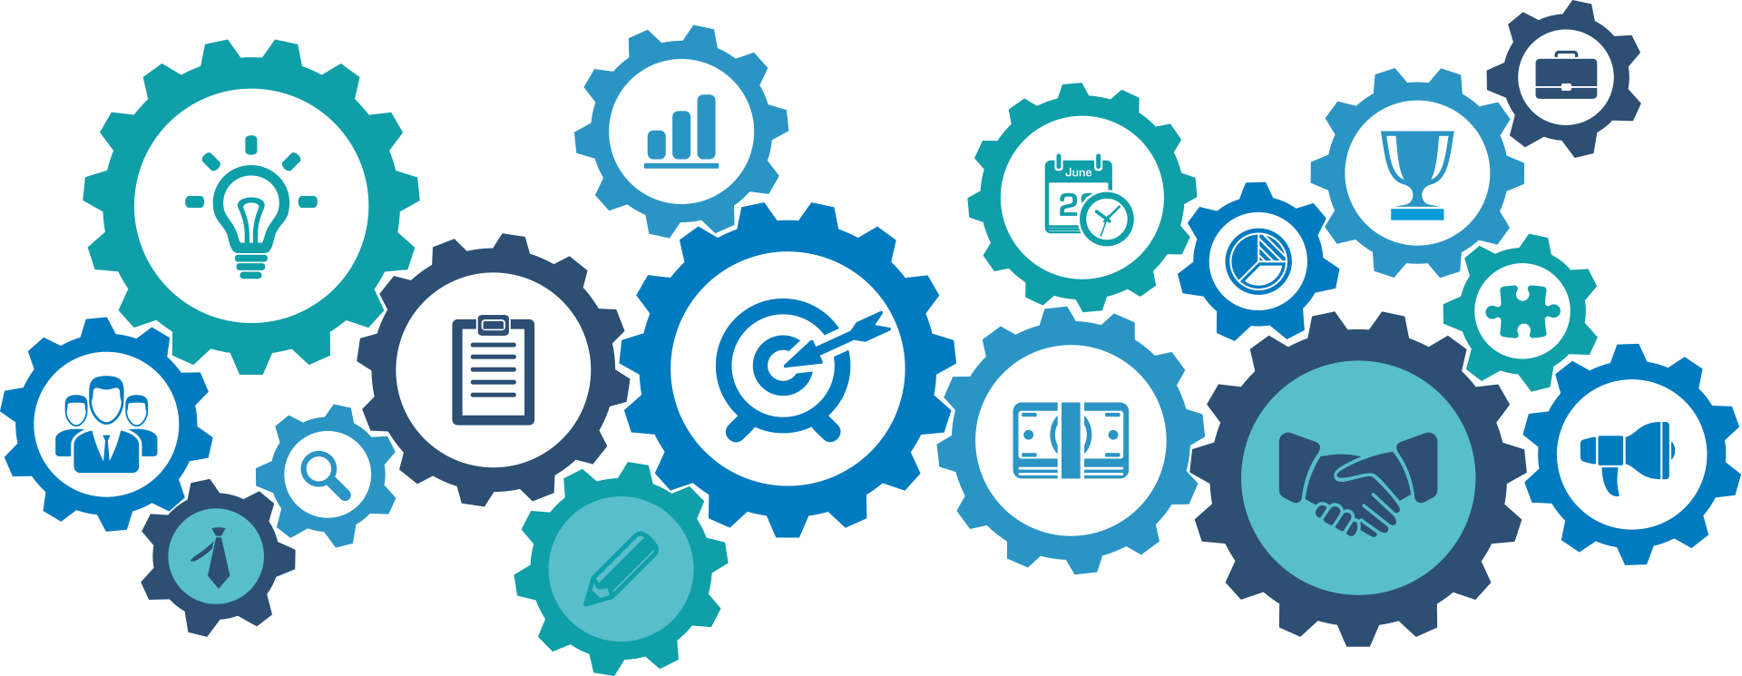
Microservices
This Photo by Unknown Author is licensed under CC BY-SA

Slide 19
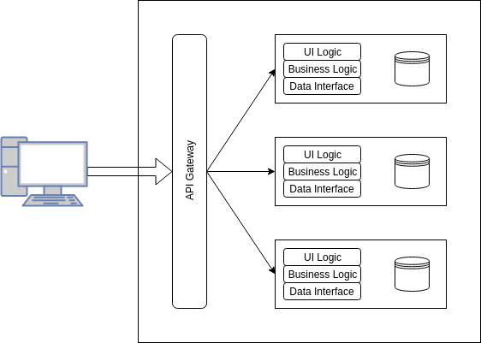
Microservice Architecture
Solves the monolithic problem by dividing applications into a number of smaller services.
Scale instances of a service based on demand.
Can update a service without bringing down entire application.

Slide 20
Execution Environments

Slide 21
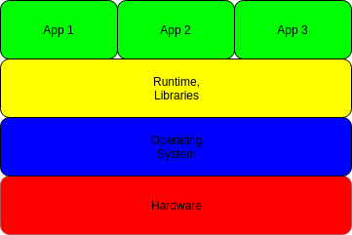
Traditional Applications
Effectively how your desktop applications work.
Problems:
We need the right operating system to run on the hardware.
We need the right operating system for the runtime/libraries.
We need the right runtime and libraries for our apps.

Slide 22
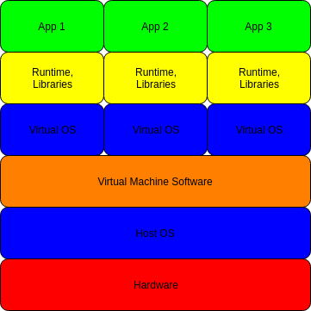
Virtual Machines
Virtualise away the problem of the traditional model.
Hardware is virtualised so can have different operating systems running.
Operating system can be changed to suit the runtime.
Each application can have its own runtime.

Slide 23
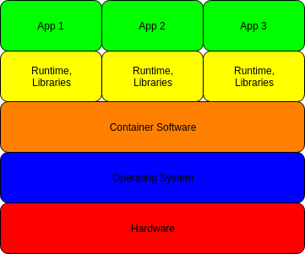
Containers
Virtual machines are resource heavy.
Containers create isolated environments.
Each container has its own runtime and libraries.
Hardware still a problem, but can virtualise in this instance.

Slide 24
Docker

Slide 25
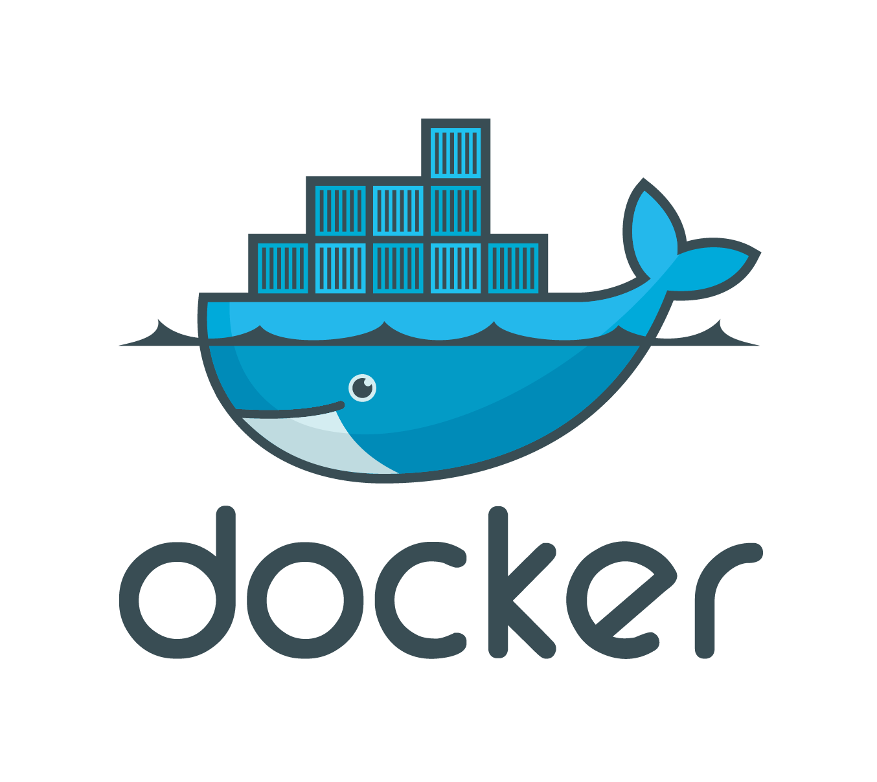
Docker Overview
Docker is a container based system.
It allows creation of execution environment as described in simple text files.
Allows us to package an application with its runtime environment.
This Photo by Unknown Author is licensed under CC BY-SA-NC

Slide 26
Docker System
Docker daemon manages Docker images and containers.
Docker containers are an environment to run an application.
Docker images defines a Docker container.
Docker registry stores Docker images (e.g., Docker Hub or run your own).

Slide 27
So why are we using Docker in the Module?
Docker containers run within cloud systems.
We can deploy software to a cloud engine.
Docker containers provide a microservice architecture.
Container instances can be scaled up and down to meet demand.
Overcomes the “runs on my machine” problem by standardising a runtime environment.

Slide 28
Summary

Slide 29
Summary
We’ve defined the hardware eras for software development, focusing on mainframe, PC, and mobile (as these are still evident today).
We’ve described the software platforms for software development, focusing on architectures still in use today (client-server, tiers, cloud).
We’ve examined the execution environments for software: traditional, virtualised, and containers.

