Slide 1
The Three Ways – Underpinning Principles of DevOps
SET08103 Software Engineering Methods
Dr Kevin Chalmers
k.chalmers@napier.ac.uk

Slide 2
Overview
What is DevOps?
The Three Ways of DevOps
Mapping the Module to DevOps

Slide 3
DevOps

Slide 4
Roots of DevOps
The Lean Movement.
The Agile Manifesto.
Agile Infrastructure and Velocity Movement.
The Continuous Delivery Movement.
The Toyota Kata.

Slide 5
Business Practices in IT
 | 1970s – 1980s | 1990s | 2000s - present
Era | Mainframes | Client/server | Cloud
Technology | COBOL, DB2 | C++, Oracle | Java, MySQL, etc.
Cycle time | 1-5 years | 3-12 months | 2-12 weeks
Cost | $1M-$100M | $100k-$10M | $10k-$1M
At risk | The whole company | Produce line or division | Product feature
Cost of failure | Bankruptcy | Revenue miss | Negligible
Respond to the rapidly changing competitive landscape.
Provide stable, reliable, and secure service to the customer.

Slide 6
Example
Application and infrastructure becomes fragile over time.
Technical debt – quick and easy solutions leading to long-term problems – increases.
Try and compensate for broken promises by making bigger promises, leading to bigger issues.
Everything gets harder and harder over time, until failure is irreversible.

Slide 7
So what is DevOps?
From Wikipedia:
DevOps (a clipped compound of "development" and "operations") is a software development methodology that combines software development (Dev) with information technology operations (Ops). The goal of DevOps is to shorten the systems development life cycle while delivering features, fixes, and updates frequently in close alignment with business objectives.

Slide 8
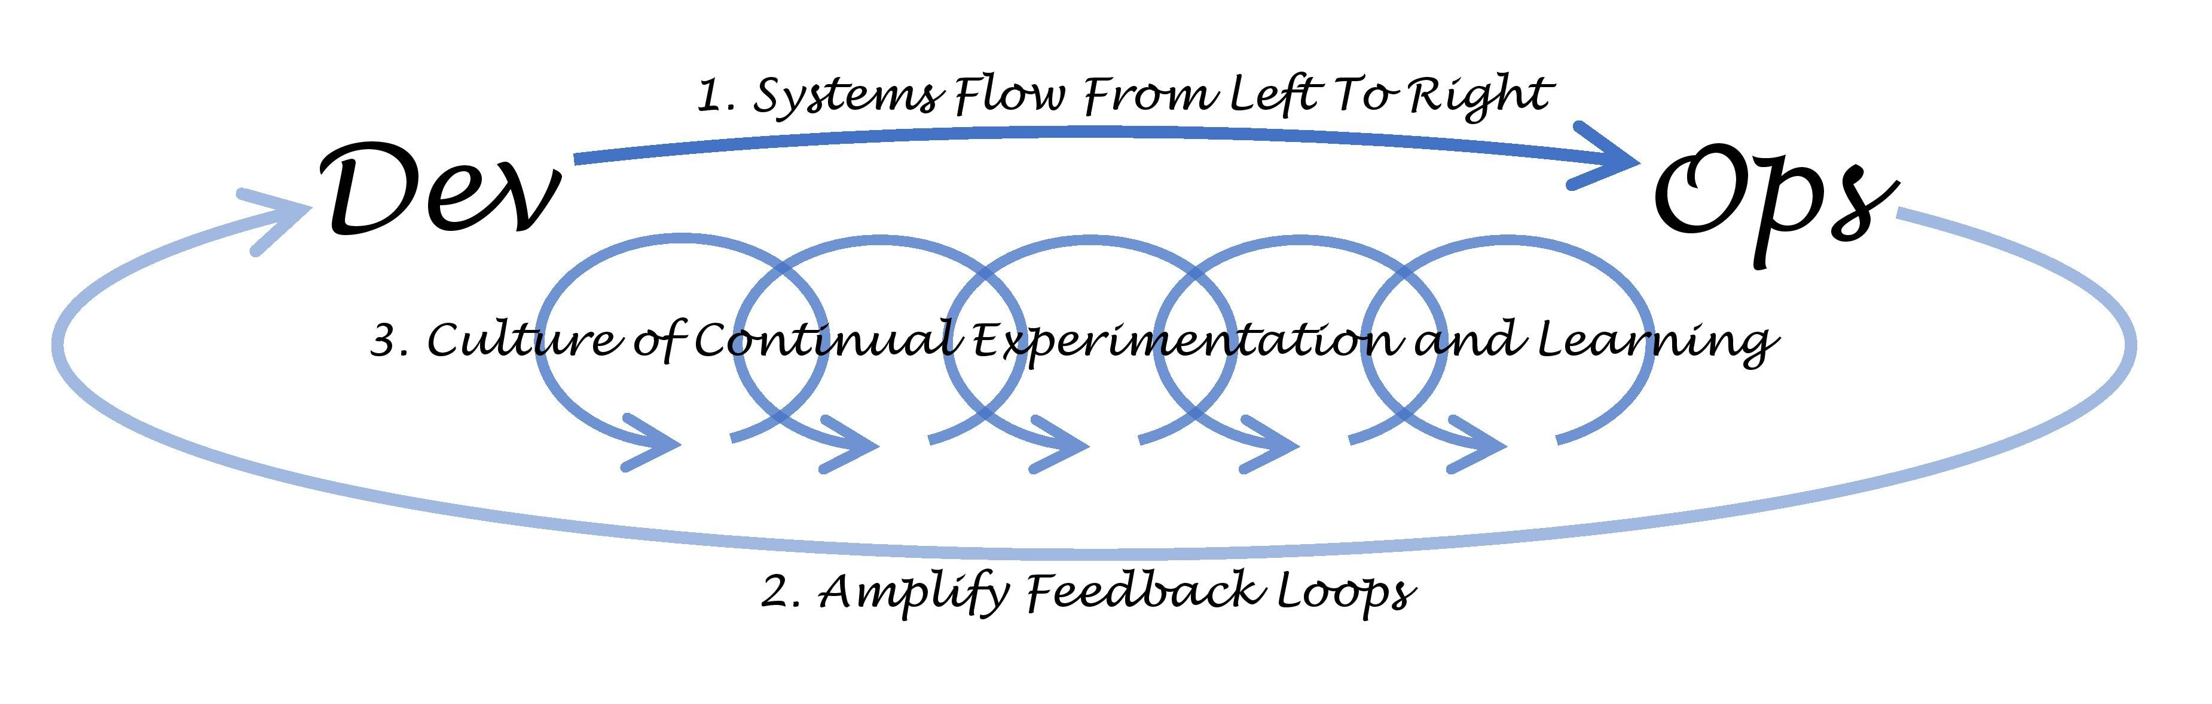
The Three Ways of DevOps

Slide 9
The First Way of DevOps: The Principles of Flow

Slide 10
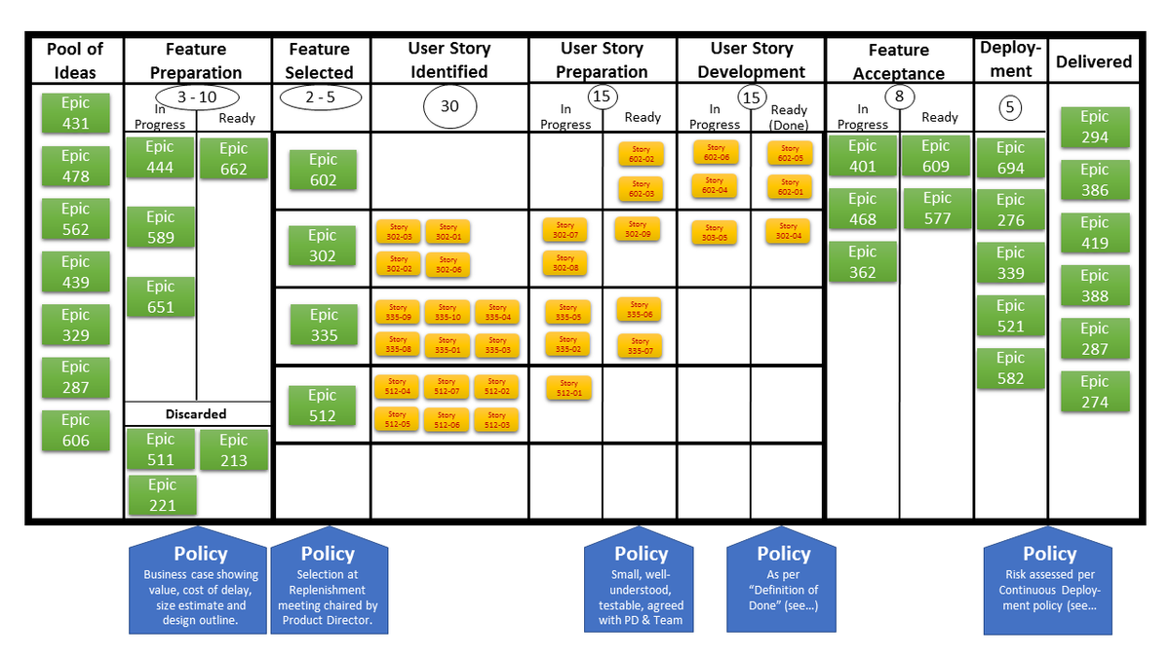
Make Work Visible
This Photo by Unknown Author is licensed under CC BY-SA

Slide 11
Limit Work in Progress (WiP)
People should work on only one task at a time.
No one can multitask – context switch time is an overhead. The more you context switch, the longer a task takes.
Reduce the WiP for the team to ensure focus is on the task at hand. This enables the team to deliver to the customer faster.

Slide 12
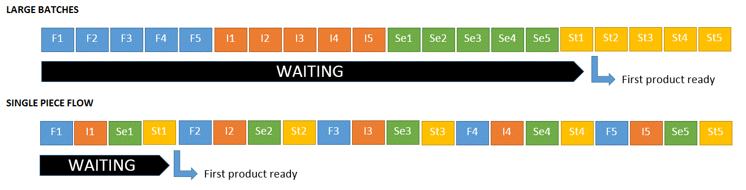
Reduce Batch Sizes

Slide 13
Reduce the Number of Handoffs
Cost for handing off a piece of work.
Receiver loses sight of the point of the task.
Communication required between sender/receiver to understand the handoff.
Team reorganisation and automation can reduce the impact.

Slide 14
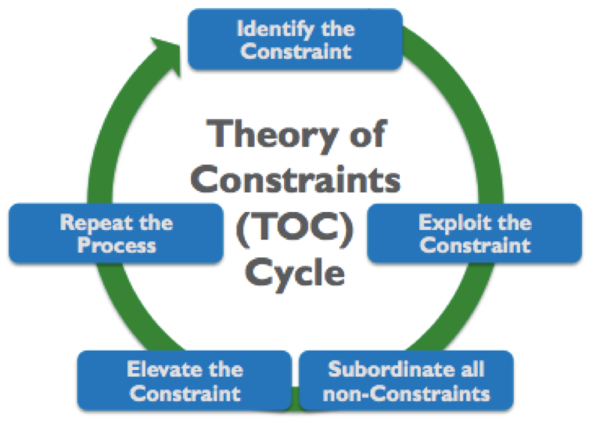
Continually Identify and Elevate Constraints
Theory of Constraints:
Identify the system’s constraints.
Decide how to exploit the system’s constraint.
Subordinate everything else to the above decision.
Elevate the system’s constraints.
If the constraint is broken return to step 1.

Slide 15
Eliminate Waste and Hardship in the Value Stream
Covered in Lean Software Development:
Partially done work.
Extra processes.
Extra features.
Task switching.
Waiting.
Motion.
Defects.
Nonstandard or manual work.
Heroics.

Slide 16
The Second Way of DevOps: The Principles of Feedback

Slide 17
Working Safely with Complex Systems
Complex systems are too big for any one person to know.
Complex systems will not always behave the same way under the same conditions.
Strategies:
Manage complex work so that problems are revealed.
When a problem arises they are swarmed and solved, leading to new learning.
New knowledge is exploited throughout the organisation.
Leaders create other leaders who grow these capabilities.

Slide 18
See Problems as They Occur
Don’t just run tests!
Provide visible output from the tests.
Communicate to the team when tests fail.
Quick and informative feedback allows quick resolution of problems.

Slide 19
Swarm and Solve Problems to Build New Knowledge
Fix the problem now! And the team needs to fix it.
Swarming is necessary as:
It prevents a problem progressing downstream where it becomes more expensive to fix.
It prevents the team starting new work which may introduce further errors.
If the problem is not fixed, it could become recurrent at the next operation, leading to further errors to fix.

Slide 20
Keep Pushing Quality Closer to the Source
More checks and approvals can increase the chance of future failure.
Checks and approvals typically happen away from the team so knowledge has been lost.
Make quality the responsibility of the team.

Slide 21
Enable Optimising for Downstream Work Centres
Basically, recognise where the work goes next.
Optimise for the next stage, not just the end point.

Slide 22
The Third Way of DevOps: The Principles of Continual Learning and Experimentation

Slide 23
Enabling Organisational Learning and a Safety Culture
Pathological | Bureaucratic | Generative
Information is hidden. | Information may be ignored. | Information is actively sought.
Messengers are “shot” | Messengers are tolerated. | Messengers are trained.
Responsibilities are shirked. | Responsibilities are compartmented. | Responsibilities are shared.
Bridging between teams is discouraged. | Bridging between teams is allowed but discouraged. | Bridging between teams is rewarded.
Failure is covered up. | Organisation is just and merciful. | Failure causes inquiry.
New ideas are crushed. | New ideas create problems. | New ideas are welcomed.

Slide 24
Other Principles
Transform local discoveries into global improvements.
Inject resilience patterns into our daily work.
Leaders reinforce a learning culture.

Slide 25
Mapping the Module

Slide 26
The First Way: Flow
Lecture 7: The First Way of DevOps: Flow.
Lecture 8: Kanban.
Lecture 9: Requirements Gathering.
Lecture 10: Use Cases and User Stories.
Lecture 11: UML Diagrams.
Lecture 12: UML Workflow.

Slide 27
The Second Way: Feedback
Lecture 13: The Second Way of DevOps: Feedback.
Lecture 14: Unit Testing and Test Driven Development.
Lecture 15: Continuous Integration.
Lecture 16: Continuous Delivery.
Lecture 17: Deploying Software.
Lecture 18: Monitoring Software.
Lecture 19: Bug Tracking.

Slide 28
Summary

Slide 29
Summary
Defined what we mean by DevOps - a software development methodology built on agile and lean, integrating bot development and operation of software.
Described the Three Ways of DevOps: flow, feedback, and continual experimentation and learning.
Reflected on how the module maps to the Three Ways by listing the lectures in each sub-area.

Slide 30
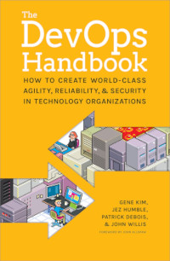

Recommended Reading

