Slide 1
The First Way of DevOps: Flow
SET08103 Software Engineering Methods
Dr Kevin Chalmers
k.chalmers@napier.ac.uk

Slide 2
Overview
Psychology of Flow.
Good Deployment Pipeline Practices.
Good Testing Practices for Flow.
Release Methods to Encourage Flow.

Slide 3
The Psychology of Flow

Slide 4
Flow
Originally defined by Mihály Csíkszentmihályi.
Six characteristics:
Intense and focused concentration on the present moment.
Merging of action and awareness
A loss of reflective self-consciousness
A sense of personal control or agency over the situation or activity
A distortion of temporal experience, one's subjective experience of time is altered
Experience of the activity as intrinsically rewarding.

Slide 5
Flow
Three components:
Receiving immediate feedback.
Feeling that you have the potential to succeed.
Feeling so engrossed in the experience, that other needs become negligible.
DevOps:
Feedback is a way in DevOps.
Learning and risk reduction key in DevOps and lean.
Well, this is up to you. Do you enjoy solving programming problems.

Slide 6
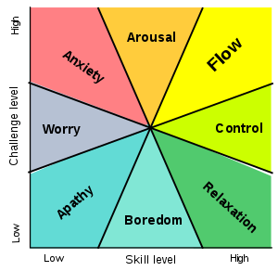
Flow, Skill, and Challenge
Flow state occurs when your perceived skill level and challenge level to complete a task is high.
What state do you feel in right now in the lecture?
Why is that?
This Photo by Unknown Author is licensed under CC BY-SA

Slide 7
Further Conditions of Flow
Knowing what to do.
Knowing how to do it.
Knowing how well you are doing.
Knowing where to go (if navigation is involved).
High perceived challenges.
High perceived skills.
Freedom from distractions.
Understand user story.
Experience and skill.
Feedback from the system (e.g., testing).
Not relevant beyond knowing where the project is going.
Development is complex.
You can solve the problem.
One item at a time.

Slide 8
Create the Foundations of Our Deployment Pipeline

Slide 9
Pipeline Development Steps
Step 1: Enable On-demand Creation of Dev, Test, and Production Environments.
Step 2: Create Our Single Repository of Truth for the Entire System.
Step 3: Make Infrastructure Easier to Rebuild than to Repair.
Step 4: Modify our Definition of Development “Done” to Include Running in Production-like Environments.

Slide 10
Definition of Done
Mentioned initially in Lecture 02 on Scrum.
Definition of Done is when we agree a task is completed.
At this stage, code should be:
Integrated.
Tested.
Working and potentially shippable.
Demonstrated in production-like environment.

Slide 11
Enable Fast and Reliable Automated Testing

Slide 12
Automated Testing
Manual testing does not scale well with code base increases.
New programmers don’t understand code.
Existing programmers know how fragile code is.
2013 Google’s automated testing and integration:
4000 teams of developers.
Changing 50% of code per month.
40,000 commits per day.
50,000 builds per day, up to 90,000.
120,000 automated test suites.
75 million test cases per day.

Slide 13
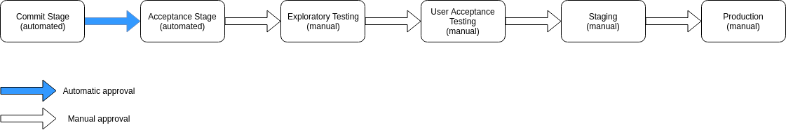
Step 1: Continuously Build, Test, and Integrate our Code and Environments.

Slide 14
Step 1: Continuously Build, Test, and Integrate our Code and Environments.
Three capabilities required:
Comprehensive and reliable set of automated tests to validate that software is deployable.
Culture to stop the entire production line when validation tests fail.
Developers working in small batches on trunk (develop) rather than long-lived feature branches.

Slide 15
Step 2: Build a Fast and Reliable Automated Validation Test Suite
Three types of automated test:
Unit tests.
Acceptance tests.
Integration tests.
We cover unit testing and integration testing later in the module. Acceptance tests are ensuring the functionality is what the customer asked for.

Slide 16
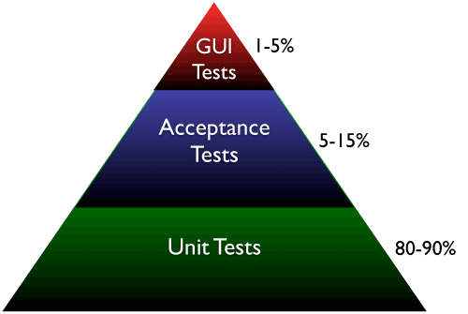
Step 3: Catch Errors as Early in Our Automated Testing as Possible
UI tests are slow and expensive, but test complete systems.
Service tests are midway.
Unit tests are fast but provide least integration.
This Photo by Unknown Author is licensed under CC BY-SA-NC

Slide 17
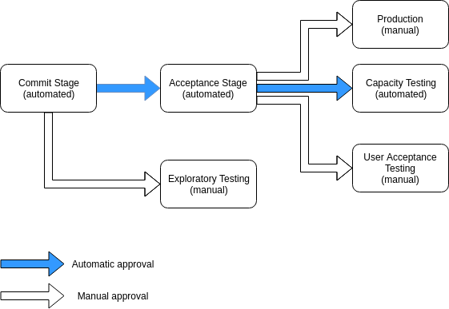
Step 4: Ensure Tests Run Quickly (in Parallel if Necessary)

Slide 18
Step 5: Write Our Automated Tests Before We Write the Code (“Test Driven Development”)
Three steps of Test-Driven Development:
Ensure the test fail. Write a test for the functionality to add. Commit.
Ensure the test passes. Write the code to pass the test. Commit.
Refactor old and new code to make it well structured. Ensure test still passes. Commit.

Slide 19
Other Steps
Step 6: Automate as Many of Our Manual Tests as Possible.
Step 7: Integrate Performance Testing into Our Test Suite.
Step 8: Integrate Non-functional Requirements Testing into Our Test Suite.
Step 9: Pull Our Andon Cord When the Deployment Pipeline Breaks.

Slide 20
Enable and Practice Continuous Integration

Slide 21
Why Practice Continuous Integration?
The longer developers work independently in isolated branches, the more difficult it becomes to merge – also we don’t want people to act as “heroes”.
Practice should be:
Multiple builds per day.
Multiple commits per day.
1000s of new lines of code per day.

Slide 22
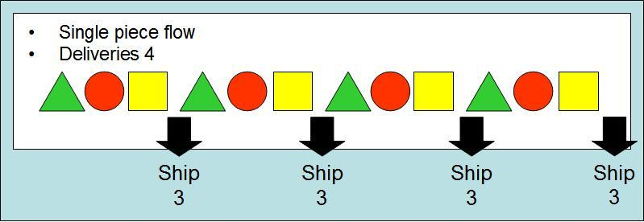
Small Batch Development and What Happens When We Commit Code to Trunk (develop) Infrequently
This Photo by Unknown Author is licensed under CC BY-SA

Slide 23
Adopt Trunk-based Development Practices
Developers commit to develop at least once per-day.
Reduces batch size and merge conflicts.
Gated commits: if the commit breaks deployment reject it.
Definition of Done:
At the end of each development interval, we must have integrated, tested, working, and potentially shippable code, demonstrated in a production-like environment, created from develop using a one-click process, and validated with automated tests.

Slide 24
Automate and Enable Low-risk Releases

Slide 25
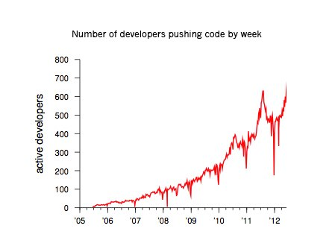
Low-risk Releases
Releasing value quickly to the customer.
Developers need to deploy code to achieve fast, low-risk releases.

Slide 26
Low-risk Release Steps
Step 1: Automate Our Deployment Process.
Step 2: Enable Automated Self-service Deployments.
Step 3: Integrate Code Deployment into the Deployment Pipeline.
Step 4: Decouple Deployments from Releases.

Slide 27
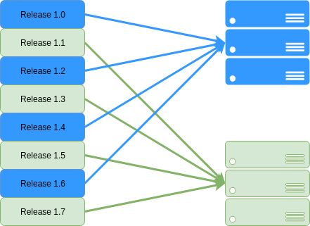
Release Patterns
Blue-green deployment.
Canary pattern.
Feature toggles.
Dark launches.

Slide 28
Summary

Slide 29
Summary
We've explained the psychology of flow, and specifically mapped that back to some of the ideas we have introduced around Scrum, DevOps, and lean/agile.
We've described good deployment pipeline practice, discussing ideas around version control and rebuilding infrastructure.
We've describe good testing practices for flow, focusing on test automation which we cover in more detail later in the module.
We've described release methods to encourage flow, and in particular the difference between deploying and releasing.

Slide 30

Recommended Reading
Part III of The DevOps Handbook goes into more detail on the practices of flow.
This Photo by Unknown Author is licensed under CC BY-SA

