Slide 1
Requirements Gathering
SET08103 Software Engineering Methods
Dr Kevin Chalmers
k.chalmers@napier.ac.uk

Slide 2
Overview
Requirements.
Project Management and Requirements.
Agile and Requirements.
Working with Requirements in Agile.

Slide 3
Requirements

Slide 4
What is a Requirement?
Something that drives a design choice.
Need of a stakeholder that provides value to the stakeholder.
Define what a developer should implement.
System behaviours, properties, attributes, and/or constraints.

Slide 5
IEEE Standard Glossary of Software Engineering Terminology
A requirement is:
A condition or capability needed by a user to solve a problem or achieve an objective.
A condition or capability that must be met or possessed by a system or system component to satisfy a contract, standard, specification, or other formally imposed document.
A documented representation of a condition or capability as in 1 or 2.

Slide 6
Terminology
Term | Definition
Business requirement | A high-level organisation objective.
Business rule | A policy, guideline, standard, or regulation that defines or constrains the business.
Constraint | A restriction on development choices.
External interface requirement | Requirements on how a system interacts with external users, services, and applications.
Feature | Capability required by the customer, defined as a set of functional requirements.
Functional requirement | Behaviour that the system must exhibit.
Nonfunctional requirement | A property of the system.
Quality attribute | A nonfunctional requirement for service or performance levels.
System requirement | Top-level requirement for a large system with multiple components.
User requirement | Goal or task that a user wishes to perform with the system.

Slide 7
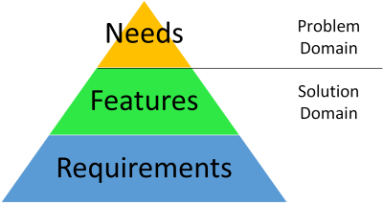
Problem and Solution Domains

Slide 8
Summary – Types of Requirements
Business requirements are why the business is building the system. Recorded in a vision and scope document.
User requirements are goals and tasks the user wants to perform.
Functional requirements specify behaviours the product will perform to enable users to complete tasks.

Slide 9
Project Management and Requirements

Slide 10
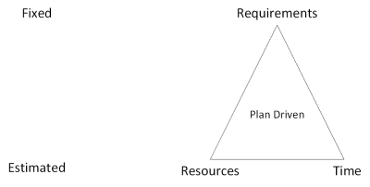
The Iron Triangle
Requirements (or scope) is what we will do in the project.
Resources (or cost) is the budget (including people and materials) for the project.
Time is the duration of the project.

Slide 11
The Iron Triangle Trap
No organisation can provide undefined resources and time for a project.
Requirements change over time based on changing business needs.
The only item developers can change is quality, so that drops to meet actual resource and time demands.

Slide 12
Why are the Iron Triangle and Waterfall Still in Use?
Waterfall aimed to fix the old technique of "code it, fix-it, code-it-some-more-until-it's-quickly-not-maintainable".
The general idea seems sound: understand requirements; design a solution to the requirements; code it; test it.
It works to a point. Lots of software has been built using waterfall. Business processes have been built around this model.
Customers still want fixed delivery time and requirements from suppliers.

Slide 13
Agile and Requirements

Slide 14
Agile Manifesto and Requirements
Agile Manifesto also defines 12 Principles.
Manifesto principle 1 Our highest priority is to satisfy the customer through early and continuous delivery of valuable software.
Manifesto principle 2 Welcome changing requirements, even late in development. Agile processes harness change for the customer’s competitive advantage.

Slide 15
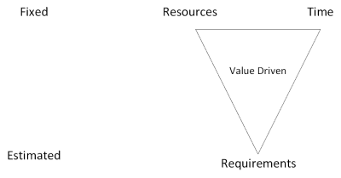
Inverting the Iron Triangle
Time is fixed.
Resources are fixed.
Requirements estimated.
Quality is fixed.

Slide 16
Vision Statement (from the Product Owner)
The Vision answers the big questions for the system, application, or product, including the following:
What problem does this particular solution solve?
What features and benefits does it provide?
For whom does it provide it?
What performance, reliability, and so on, does it deliver?
What platforms, standards, applications, and so on, will it support?

Slide 17
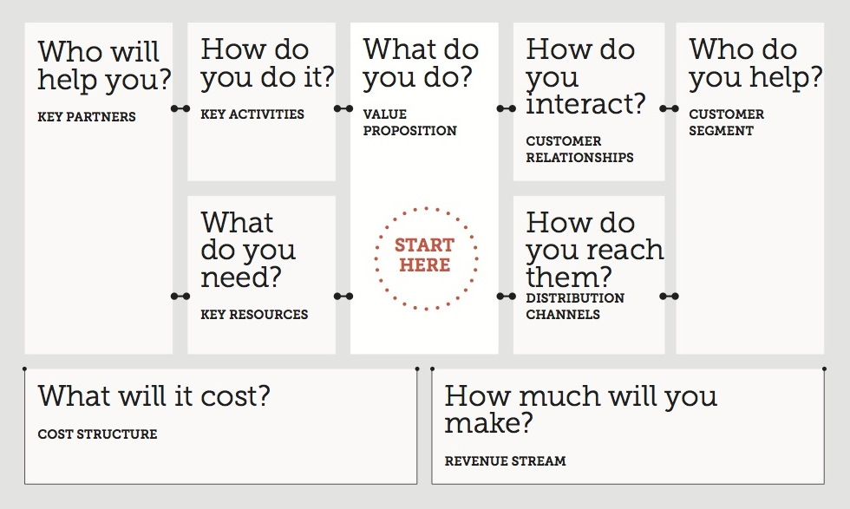
Business Model Canvas
This Photo by Unknown Author is licensed under CC BY-SA-NC

Slide 18
Stakeholders
System Stakeholders
Project Stakeholder
uses the system (the users)
uses the results from the system.
are impacted by the deployment and use of the system
has an interest in the budget and delivery date of the project;
has an interest in how the project is deployed;
will be involved in selling, maintaining, etc. (aftercare) of the project deliverable(s);

Slide 19
Identifying Stakeholders
Who needs to be consulted on the scope of this project?
Who has input to the budget and schedule?
Who ultimately manages the business relationship between the teams and the customer?
Who will determine how and when the system is released to customers?
Who can support or harm this project politically?
What partners are dependent on our system?
Who cares about the process we use to develop the system?

Slide 20
Working with Requirements in Agile

Slide 21
User Stories (more next lecture)
Identified via discovery (see below).
Maintained by the Product Owner working with the team.
Prioritised by the Product Owner, on the product backlog
Scheduled by the team, by pulling them into a Sprint.
Elaborated by the team by asking questions.
Implemented by the team.
Tested by the team (unit test, functional test, acceptance test).
Accepted by the Product Owner as complete, based on the Definition of Done.

Slide 22
Product Owner
Must:
determine requirements by working with product managers, business analysts, customers, and other stakeholders.
maintain the backlog and prioritise based on relative user value.
set iteration objectives.
elaborate stories, participate in progress reviews, and accept new stories.
Sprint Planning Duties:
reviewing the iteration objective.
presenting each backlog item, individually, for discussion.
supporting the team as they discuss each item until it is well enough understood to implement and estimate.

Slide 23
Requirements Discovery
Requirements workshops.
Brainstorming.
Interviews and questionnaires.
User experience mock-ups.
Product council.
Competitive analysis.
Customer change request systems.
Use-case modelling.

Slide 24
Start With Why

Slide 25
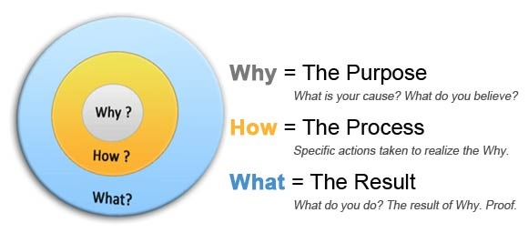
Start With Why
People do not buy what you do, they buy why you do it.
Why you do it (the needs).
How you do it (the features).
What you do (the requirements).
Watch the TEDx talk linked to in the notes.
This Photo by Unknown Author is licensed under CC BY-SA-NC

Slide 26
Summary

Slide 27
Summary
Defined what a software requirement is - something required by a project stakeholder.
Evaluated the problems with traditional project management and requirements - particularly the Iron Triangle Trap.
Discussed requirements in the context of agile software development - examining the role of the Product Owner and team in working with requirements.

Slide 28
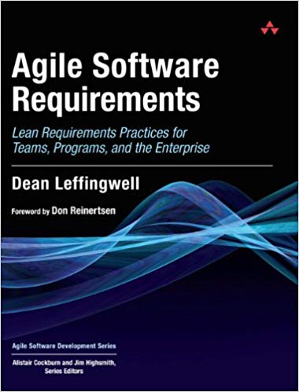
Recommended Reading
Agile Software Requirements by Dean Leffingwell.
Goes in depth from organisational to team level in the use of agile and requirements via user stories.

