Slide 1
User Stories and Use Cases
SET08103 Software Engineering Methods
Dr Kevin Chalmers
k.chalmers@napier.ac.uk

Slide 2
Overview
User stories.
Use cases.

Slide 3
User Stories

Slide 4
What is a User Story?
A requirement represents something that our software will do to meet a business goal.
A user story is a definition of what our software should do for a user.
User stories are a very common technique in modern software development.

Slide 5
Standard Template
As a <user role>, I can <activity> so that <business value>.
User role is who the story involves. It needs to be specific enough to allow a conversation. User is not a legitimate user role.
Activity is the task the user wants or is required to do.
Business value is why the task is important.

Slide 6
Example
As a wheelchair user I want to go into the computer lab so that I can do my assignment on a lab computer.
Compare to:
I want to go into the computer lab so that I can do my assignment on a lab computer.
As a wheelchair user I can do my assignment on a lab computer.
As a wheelchair user I want to go into the computer lab.

Slide 7
Three Cs Formula
Card is a physical token to hold concepts. Physical means a member of the team can take it, it can be used in a meeting, and it can be visualised easily on the wall.
Conversation between stakeholders and the team. The story does not provide enough information for implementation, but allows a conversation to occur to discover the information.
Confirmation means the objectives of the conversation have been reached.

Slide 8
INVEST Criteria
Independent.
Negotiable.
Valuable.
Estimable.
Small.
Testable.

Slide 9
User Stories versus Requirements
They are not detailed requirements specifications (something a system shall do) but are negotiable expressions of intent (it needs to do something about like this) .
They are short, easy to read, and understandable to developers, stakeholders, and users.
They represent small increments of valued functionality that can be developed in a period of days to weeks.
They are relatively easy to estimate, so effort to implement the functionality can be rapidly determined.
They are not carried in large, unwieldy documents but rather organized in lists that can be more easily arranged and rearranged as new information is discovered.
They are not detailed at the outset of the project but are elaborated on a just-in-time basis, thereby avoiding too early specificity, delays in development, requirements inventory, and an over constrained statement of the solution
They need little or no maintenance and can be safely discarded after implementation.
User stories, and the code that is created quickly thereafter, serve as inputs to documentation, which is then developed incrementally as well.

Slide 10
Conditions of Satisfaction
Questions that need to be answered for the user story to be completed.
Defined by the Product Owner.
Conditions that will satisfy the Product Owner that the story is complete.

Slide 11
Example – Wheelchair in the Computer Lab
Is the door to the lab large enough to let in a wheelchair?
Is the door to the lab automatic to allow the wheelchair user access?
Is the button to open the doors at a suitable height for a wheelchair user?
Is their space for a wheelchair user to navigate the lab freely?
Are the desks in the lab at a suitable height for a wheelchair user?
Is the space at each desk enough for a wheelchair user?

Slide 12
Tasks
Stories can be decomposed into tasks.
Tasks are pieces of work that can be completed by an individual team member.
Estimated in hours rather than points (typically 4-8).
May also be stand alone.

Slide 13
Epics
High-level user needs.
“Big stories” but really cover themes, programmes, or initiatives.
Epic has a collection of features, which each have a collection of stories, which have a collection of tasks.

Slide 14
Working with User Stories
A member of the development team takes responsibility for a backlog item (story, task, fix, etc.).
The item is developed to meet the teams Definition of Done, e.g.,:
Refined.
Designed.
Coded.
Integrated.
Tested.
The item is delivered by integrating it into the build.
Signal that the item is developed and ready for acceptance testing.
Get the item accepted by the Product Owner:
Passes acceptance tests.
Meets the Conditions of Satisfaction.

Slide 15
Working with the Product Owner
Definition of the user story – the developer needs to understand by working with the Product Owner.
Building the user story – more information and checking with the Product Owner as time goes on.
Testing the user story – the Product Owner can assist in defining the acceptance test.

Slide 16
Story Acceptance Test
Determines if a story is implemented correctly.
A story can have one or more acceptance tests.
Test functionality, so are different to Conditions of Satisfaction.

Slide 17
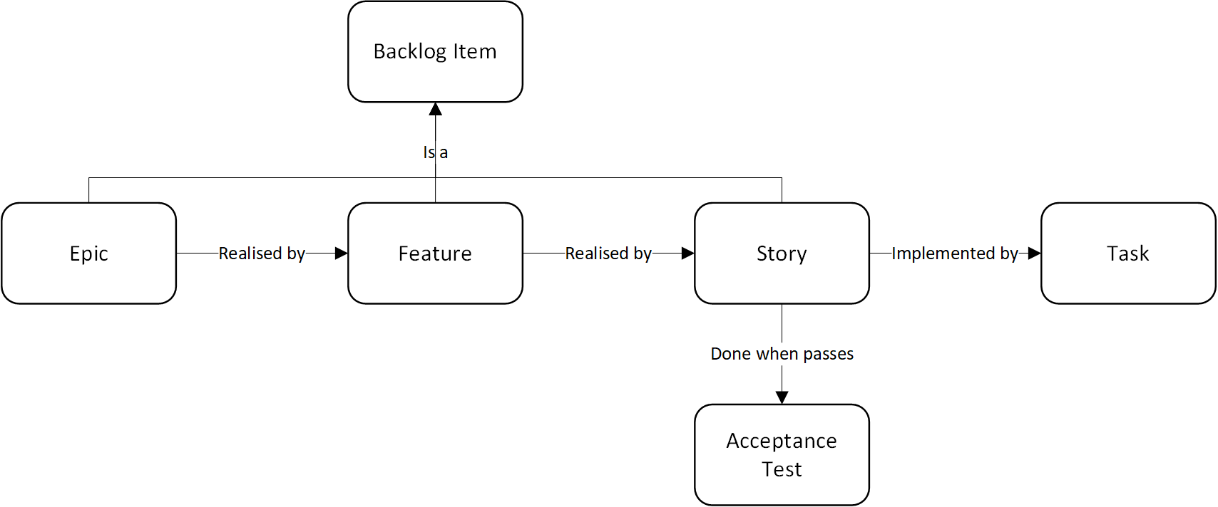
Story-Task Relationship

Slide 18
Use Cases

Slide 19
What is a Use Case?
From Wikipedia:
In software and systems engineering, a use case is a list of actions or event steps typically defining the interactions between a role (known in the Unified Modeling Language (UML) as an actor) and a system to achieve a goal.
We have a user: the actor.
We have what they will do: a series of actions.
We have why the value: the goal.

Slide 20
Use Case Sections
Goal in Context: a longer statement of the goal, if needed.
Scope: what system is considered black-box under design.
Level: one of: Summary, Primary task, subfunction.
Preconditions: what we expect is already the state of the world.

Slide 21
Use Case Sections
Success End Condition: the state of the world upon successful completion.
Failed End Condition: the state of the world if goal abandoned.
Primary Actor: a role name for the primary actor, or description.
Trigger: the action upon the system that starts the use case, may be a time event.
Main Success Scenario: put here the steps of the scenario from trigger to goal delivery, and any cleanup after.

Slide 22
Cockburn’s Use Case Symbols

Slide 23
Scope
Design scope allows us to consider what should be part of our discussion.
Do not add features not required.
Use a simple table.
Topic | In | Out
Invoicing in any form |  | Out
Producing reports about requests | In
Merging requests into one PO | In
Partial deliveries, late deliveries, wrong deliveries | In
All new system services, software | In
All nonsoftware parts of the system |  | Out

Slide 24

Scope Levels
Organisational black box.
Organisational white box.
System black box.
System white box.
Component.
This Photo by Unknown Author is licensed under CC BY-SA

Slide 25

Goal Level
Very high summary.
Summary.
User goal.
Subfunction.
Too low.
This Photo by Unknown Author is licensed under CC BY-SA

Slide 26
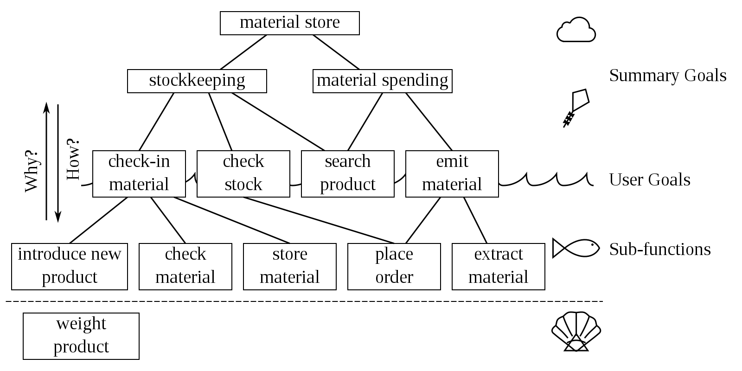
Goal Level Example
This Photo by Unknown Author is licensed under CC BY-SA

Slide 27
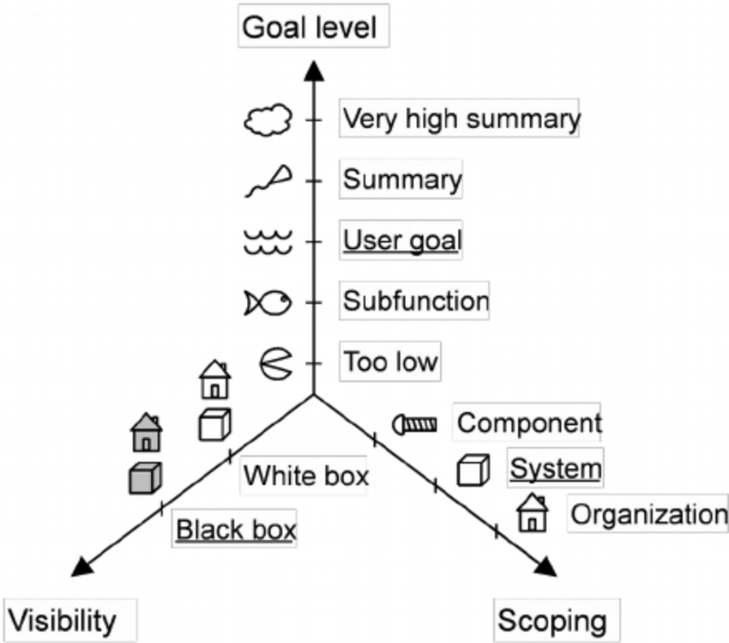
Dimensions of Use Cases

Slide 28
Summary
Defined what a user story is: something our software should do to satisfy a user. We also looked at a basic user story template.
Described the elements of a user story, including Conditions of Satisfaction, acceptance test, and tasks.
Defined what a use case is: a series of actions between a user and system to achieve a goal.
Specified a simple use case, examining features such as scope and goal level.

Slide 29
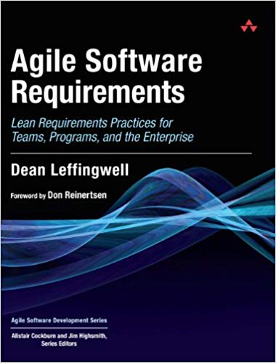
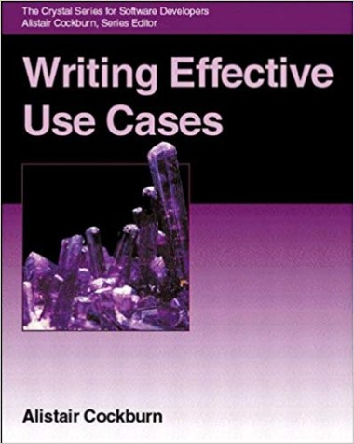
Recommended Reading

