Slide 1
UML Workflow
SET08103 Software Engineering Methods
Dr Kevin Chalmers
k.chalmers@napier.ac.uk

Slide 2
Overview
Using UML in Analysis and Design.
Case Study: Coffee Machine.
UML Tips.

Slide 3
UML in Analysis and Design

Slide 4
Main Advice
Do not try and do full system analysis and design in UML.
Diagrams are not what the customer paid for.
It is not generally recommended.
Use as a standardised diagramming technique to support the main development work.

Slide 5
A Basic UML Workflow
Produce use case diagrams to analyse the use cases needed for the system.
Produce activity diagrams to analyse and design the flow of activity through the system. This should include the use cases defined in step 1.
Produce state diagrams to analyse and design the changes in state that occur as the application occurs. The activities help us define the different state transitions and must all be covered.
Produce a class diagram to design the classes required to meet the activity and state diagram requirements. This takes some skill to divide up the functionality and data into chunks.
Produce a sequence diagram to design how objects interact to solve the use cases. This comes from our activity and state diagrams.

Slide 6
Coffee Machine Case Study

Slide 7
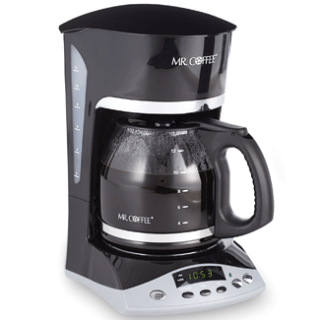
Coffee Machine
The coffee machine can only hold enough coffee to make one cup.
The coffee machine can only hold enough water to make one cup.
Otherwise, it is just a coffee machine.
This Photo by Unknown Author is licensed under CC BY-NC-ND

Slide 8
Use Cases
Think about what you can do with a coffee machine:
Add water to the coffee machine.
Add coffee to the coffee machine.
Switch the coffee machine on.
Pour coffee.
We translate these into use cases:
Add Water.
Add Coffee.
Turn On.
Pour Coffee.

Slide 9
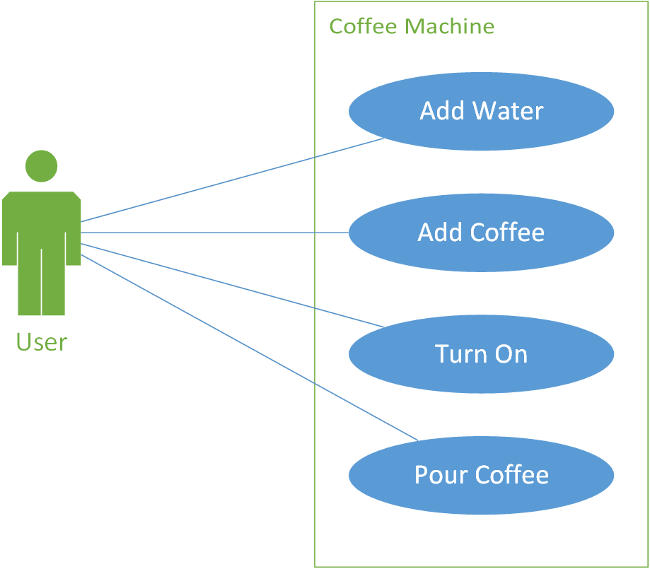
Use Case Diagram

Slide 10
Activity Diagram
We want to capture the flow of activity rather than just a simple set of use cases.
How do we make a coffee in a coffee machine?
Add water and coffee (the order doesn't matter).
Heat coffee.
Pour coffee.

Slide 11
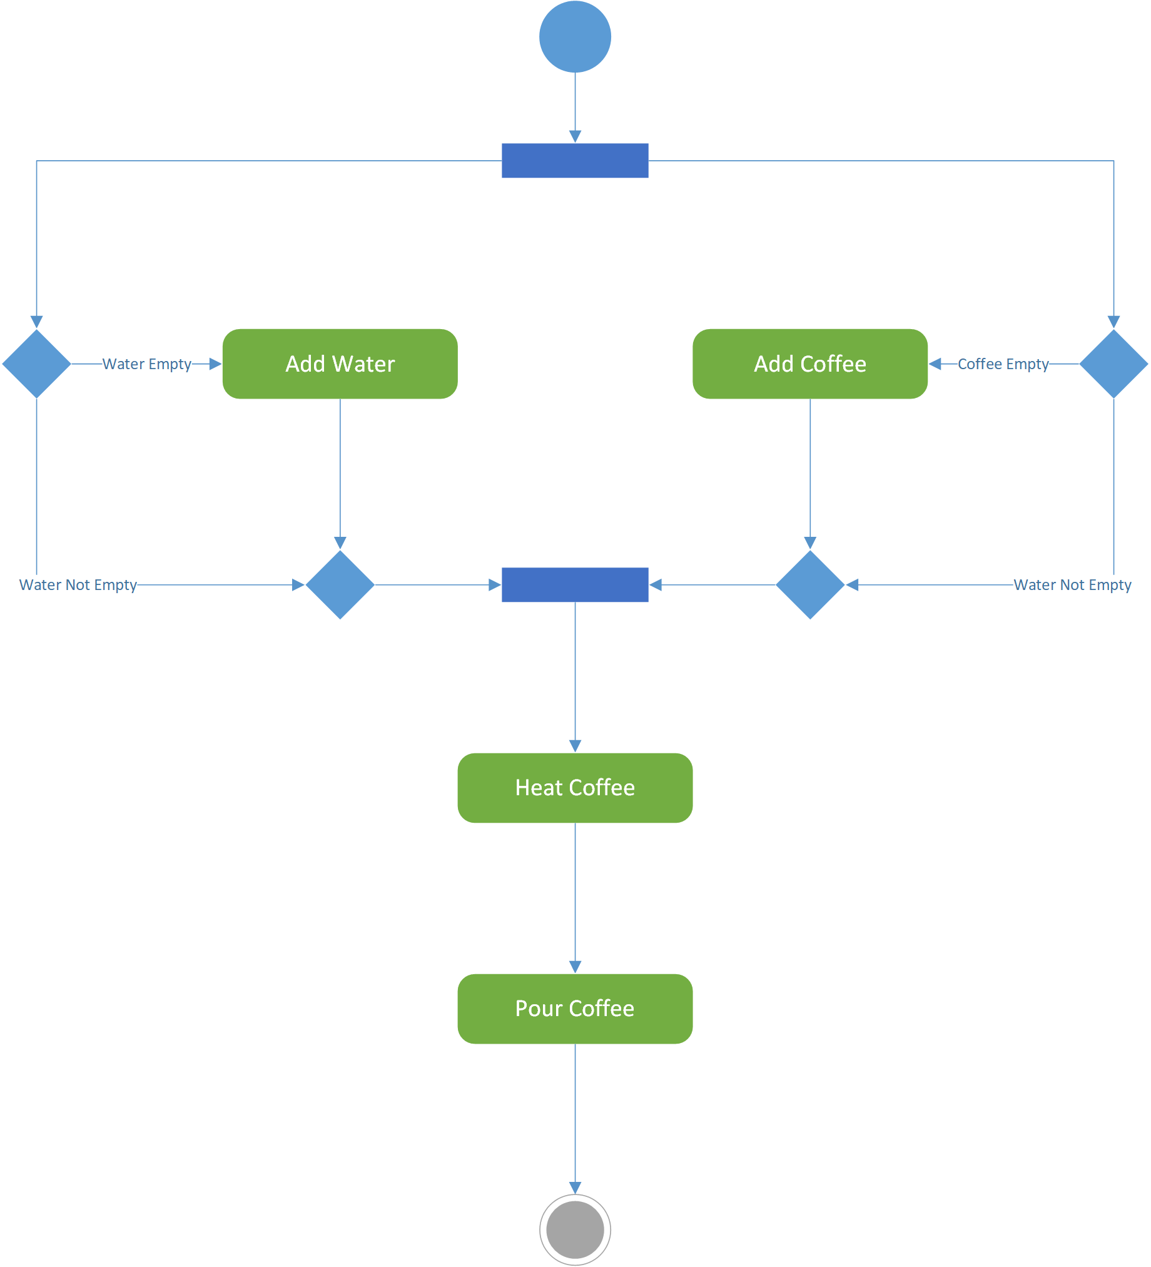
Activity Diagram
Two flows of activity.
One:
IF water IS EMPTY THEN Add Water
IF coffee IS EMPTY THEN Add Coffee
Heat Coffee
Pour Coffee
Two:
IF coffee IS EMPTY THEN Add Coffee
IF water IS EMPTY THEN Add Water
Heat Coffee
Pour Coffee

Slide 12
State Diagram
State transitions (from activity diagram):
Add coffee.
Add water.
Switch on.
Pour coffee.
State transition activity:
When add coffee:
If empty, then coffee full.
If water full, then full.
When add water:
If empty, then water full.
If coffee full, then full.
When switch on then heating.
When pour coffee then empty.

Slide 13
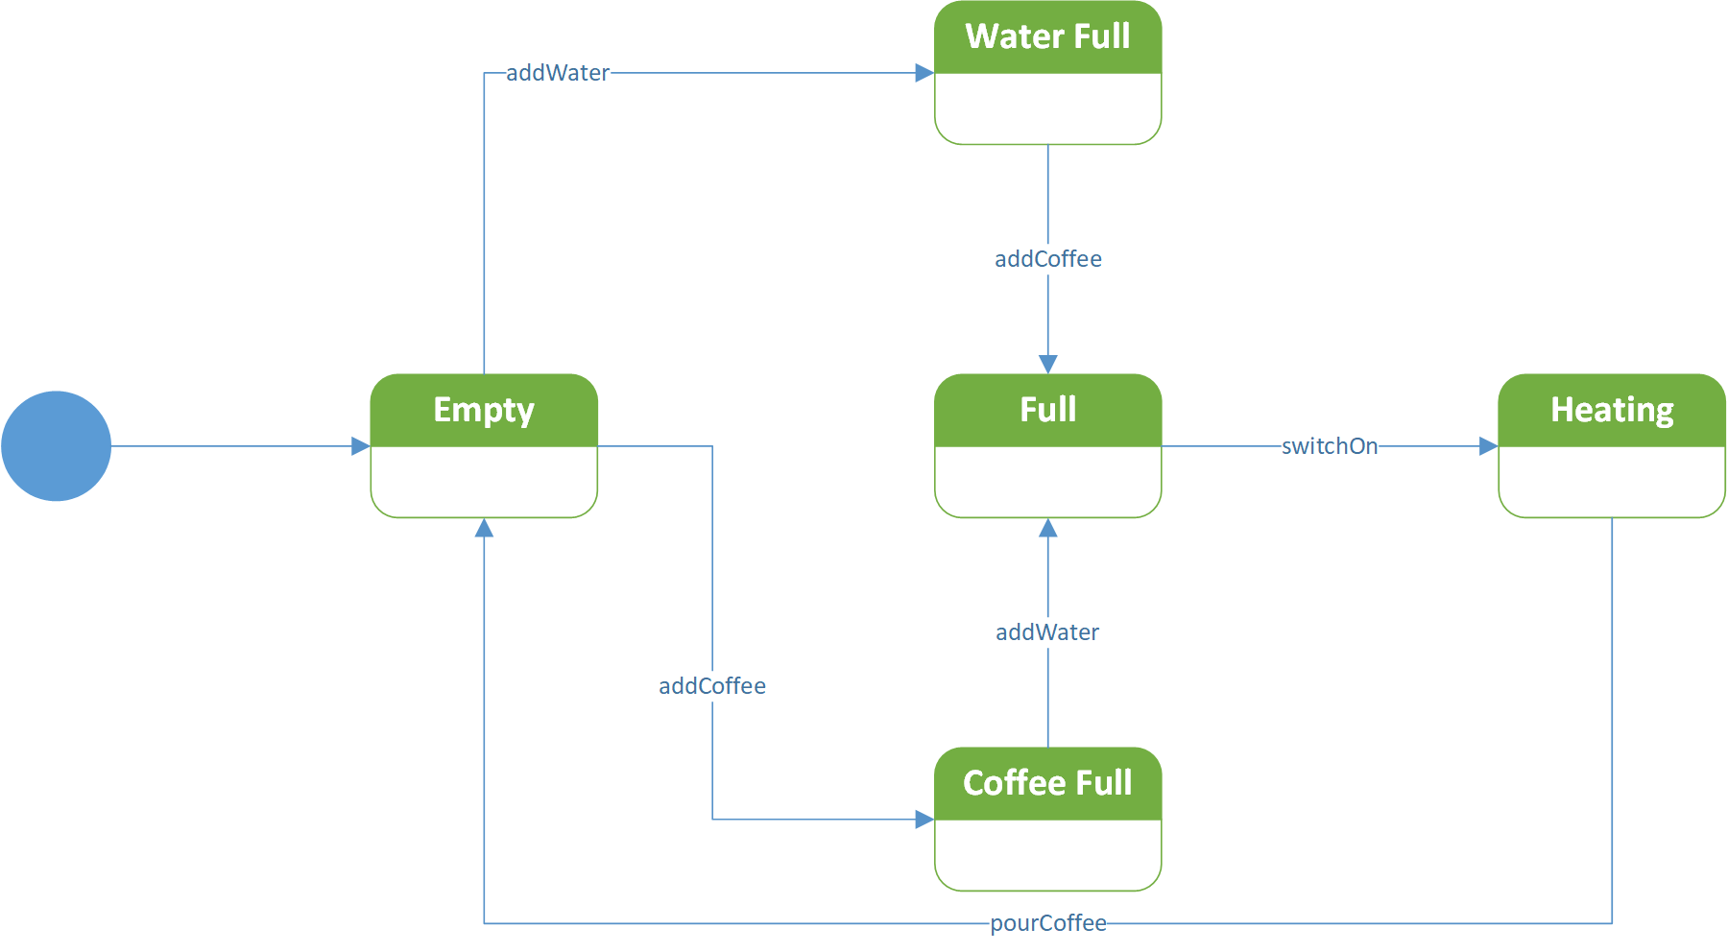
State Diagram

Slide 14
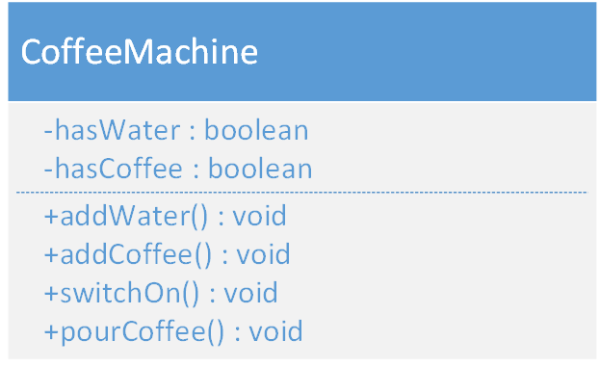
Class Diagram
Two attributes:
hasCoffee
hasWater
Four methods:
addWater
addCoffee
switchOn
pourCoffee

Slide 15
Some UML Tips

Slide 16
UML Tips
Allows you to visualise your code.
Designing software from the ground up in UML not a good idea.
Producing diagrams is not the job of the software engineer.
UML is large – don’t expect to understand it all.

Slide 17
What UML Can Do
Use cases allow communication with stakeholders.
Activity diagrams allow flowchart modelling which allows analysis, design, and communication with stakeholders.
Class diagrams allow the visualisation of software architecture which is necessary when software becomes too complex.

Slide 18
Summary

Slide 19
Summary
Defined how to use UML in analysis and design, providing a possible five-step process to follow.
Described a case study of using UML in analysis and design, examining a coffee machine from use case analysis to class design.

Slide 20

Recommended Reading
Coffee Machine example adapted from UML @ Classroom.
Further UML case study examples available in the book.

