Slide 1
The Second Way of DevOps: Feedback
SET08103 Software Engineering Methods
Dr Kevin Chalmers
k.chalmers@napier.ac.uk

Slide 2
Overview
Telemetry.
Hypothesis-based development.
Peer review.

Slide 3
Create Telemetry to Enable Seeing and Solving Problems

Slide 4
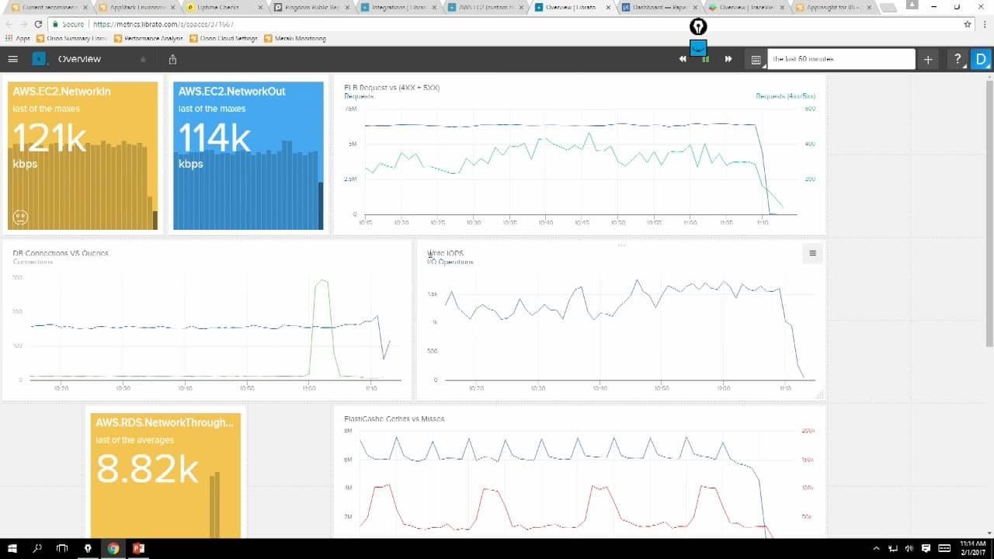
Telemetry
An automated communications process by which measurements and other data are collected at remote points and are subsequently transmitted to receiving equipment for monitoring.
This Photo by Unknown Author is licensed under CC BY-SA

Slide 5
Avoid Blame
When something goes wrong in production, we just reboot the server. If that doesn't work, reboot the server next to it. If that doesn't work, reboot all the servers. If that doesn't work, blame the developers, they're always causing outages.
Higher-service organisations typically reboot servers 20% less often.
Developers add telemetry as part of daily work.

Slide 6
Create Our Centralised Telemetry Infrastructure
More than logs (for developers) and system status (for operations).
Develop sufficient telemetry to understand system behaviour.
Following components:
Data collection at the business logic, application, and environments layer.
An event router responsible for storing our events and metrics.
Statistical: “10 SQL query fails per week” over “SQL query failed.”

Slide 7
Create Application Logging Telemetry That Helps Production
If you’ve built it, you should measure it:
“Every feature should be instrumented: if it was important enough for an engineer to implement, it is certainly important enough to generate enough production telemetry so that we can confirm that it is operating as designed and that the desired outcomes are being achieved.”

Slide 8
Create Application Logging Telemetry That Helps Production
Events to Log
Logging Levels
Authentication/authorization decisions (including logoff).
System and data access.
System and application changes (especially privileged changes).
Data changes, such as adding, editing, or deleting data Invalid input (possible malicious injection, threats, etc.).
Resources (RAM, disk, CPU, bandwidth, or any other resource that has hard or soft limits).
Health and availability.
Start-ups and shutdowns.
Faults and errors.
Circuit breaker trips.
Delays Backup success/failure.
DEBUG: anything that happens in the program.
INFO: actions that are user-driven or system specific.
WARN: conditions that could potentially become an error. Should initiate an alert.
ERROR: error conditions (e.g., API call failures, internal error conditions).
FATAL: when we must terminate (e.g., failed to create network socket).

Slide 9
Use Telemetry to Guide Problem-solving
Questions to ask:
What evidence do we have from our monitoring that a problem is actually occurring?
What are the relevant events and changes in our applications and environments that could have contributed to the problem?
What hypotheses can we formulate to confirm the link between the proposed causes and effects?
How can we prove which of these hypotheses are correct and successfully effect a fix?

Slide 10
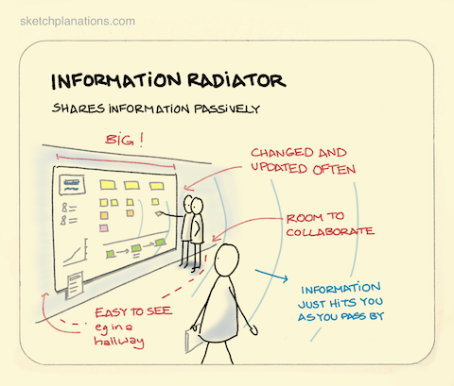
Create Self-service Access to Telemetry and Information Radiators
Information Radiator:
The generic term for any of a number of handwritten, drawn, printed, or electronic displays which a team places in a highly visible location, so that all team members as well as passers - by can see the latest information at a glance: count of automated tests, velocity, incident reports, continuous integration status, and so on.
This Photo by Unknown Author is licensed under CC BY-NC

Slide 11
Find and Fill Any Telemetry Gaps
Business level.
e.g., the number of sales transactions, revenue of sales transactions, user signups, churn rate, A/B testing results, etc.
Application level.
e.g., transaction times, user response times, application faults, etc.
Infrastructure level.
e.g., web server traffic, CPU load, disk usage, etc.
Client software level.
e.g., application errors and crashes, user measured transaction times, etc.
Deployment pipeline level.
e.g., build pipeline status, change deployment lead times, deployment frequencies, test environment promotions, and environment status.

Slide 12
Analyse Telemetry to Better Anticipate Problems and Achieve Goals

Slide 13
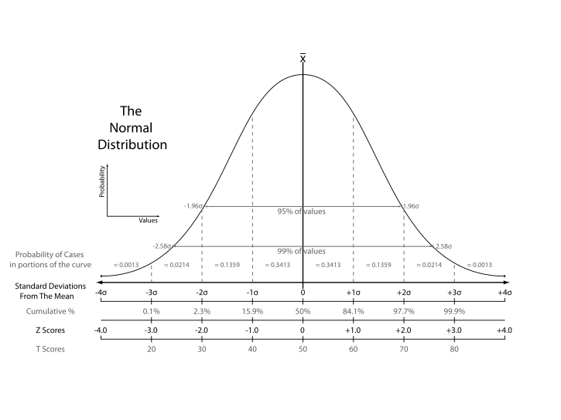
Use Means and Standard Deviations to Detect Potential Problems
Mean – average.
Standard deviation – variation of the data.
Improve signal to noise by only responding to outliers.
This Photo by Unknown Author is licensed under CC BY-SA

Slide 14
Instrument and Alert on Undesired Outcomes
For example, web server incident could be indicated by:
Application level: increasing web page load times, etc.
OS level: server free memory running low, disk space running low, etc.
Database level: database transaction times taking longer than normal, etc.
Network level: number of functioning servers behind the load balancer dropping, etc.
Post-mortems allow faster problem spotting in future, thus improving overall quality of service.

Slide 15
Non-Gaussian (normal) Distribution
We need to use other statistical techniques.
We want to avoid over-reporting as well as under-reporting.
Anomaly detection: the search for items or events which do not conform to an expected pattern.
Data smoothing, Fast Fourier Transforms, and Kolmogorov-Smirnov tests are options – but generally find people with more stats knowledge.

Slide 16
Enable Feedback So Development and Operations Can Safely Deploy

Slide 17
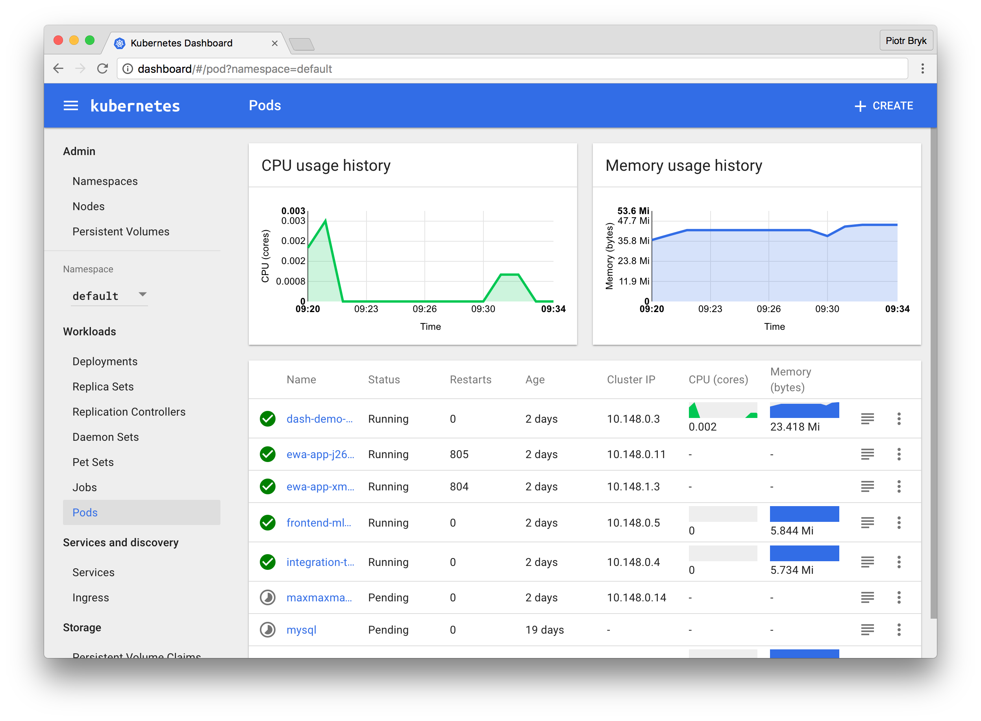
Use Telemetry to Make Deployments Safer
This Photo by Unknown Author is licensed under CC BY-SA

Slide 18
Dev Shares Pager Rotation Duties With Ops
Development shouldn’t just pass work to operations and walk away.
Development should share responsibility for production.
Having developers on pager rotation for production improves quality.
Developers stop seeing “done” as code being written. “Done” means working in production.

Slide 19
Have Developers Follow Work Downstream
Contextual inquiry:
A practice where product teams watch a customer use an application in their natural environment.
Developers should watch customers using the software they build.
This also includes internal customers (e.g., operations) so they understand the problems created by poor working practices.

Slide 20
Have Developers Initially Self-manage Their Production Service
Product launch guidance and requirements for initial development:
Defect counts and severity: Does the application actually perform as designed?
Type/frequency of pager alerts: Is the application generating an unsupportable number of alerts in production?
Monitoring coverage: Is the coverage of monitoring sufficient to restore service when things go wrong?
System architecture: Is the service loosely - coupled enough to support a high rate of changes and deployments in production?
Deployment process: Is there a predictable, deterministic, and sufficiently automated process to deploy code into production?
Production hygiene: Is there evidence of enough good production habits that would allow production support to be managed by anyone else?

Slide 21
Integrate Hypothesis-Driven Development and A/B Testing into Our Daily Work

Slide 22
A/B Testing
Where we provide two different versions of a product to different groups of users. We then analyse how these versions are used and pick which one provides the outcomes we are looking for.
Initially used in direct response marketing.
Used extensively by Amazon and Google.
Used by UK Government for tax collection letters.

Slide 23
Integrate A/B Testing into Our Feature Testing
Visitors randomly being shown either a control (A) or a treatment (B).
Performing statistical analysis on visitor behaviour we can determine if certain features cause different outcomes.
Without user research, we will build features that deliver no, or worse negative, value to the organisation.

Slide 24
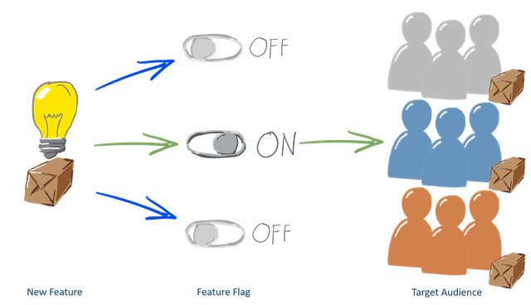
Integrate A/B Testing into Our Release
Feature toggles allow switching on and off features to different users.
We can deliver multiple versions, and test which one had the desired effect.
This Photo by Unknown Author is licensed under CC BY

Slide 25
Integrating A/B Testing into Our Feature Planning
We can add hypotheses to our backlog that we can test.
Written in a similar manner to user stories.
One such template is:
We believe [TYPE OF USER] has a problem [DOING THING]. We can help them with [OUR SOLUTION]. We'll know we're right if [CHANGE IN METRIC].

Slide 26
Create Review and Coordination Processes to Increase Quality of Or Current Work

Slide 27
GitHub Flow for User Review
Pull requests gain votes (+1, +2) or mentions. This is integrated into GitHub’s workflow:
New descriptive branch created from master (e.g., `new-login-feature`).
Commits made to local branch, and regularly pushed the same on the server.
When feedback or help is required, or when the branch is ready to merge, a pull request is opened.
After review and any necessary approval, merge it into master.
Once the code is merged and pushed to master deploy into production.

Slide 28
The Dangers of Change Approval Processes
Knight Capital lost $440 million due to a 15 minute deployment error – or close to $30 million per minute. This resulted in Knight Capital being sold that weekend to stay afloat.
Two counter explanations for failure:
Change control failure.
Testing failure.
Low trust, command-and-control culture are likely to result in problems reoccurring.

Slide 29
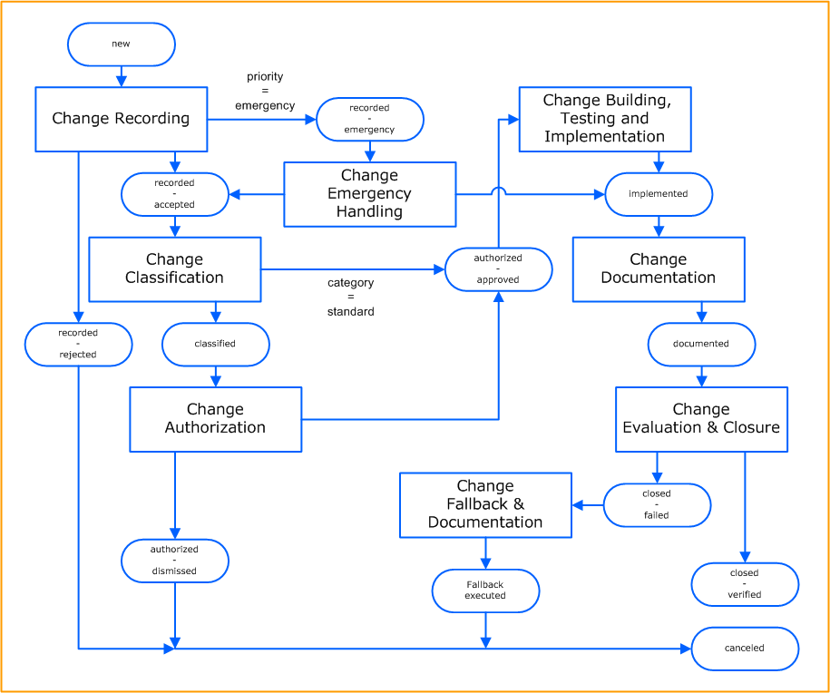
Potential Dangers of "Overly Controlling Changes"
Change control:
adds more questions that need to be answered.
adds more authorisations (e.g., one more level of management approval, more stakeholder approval).
adds time so that changes can be properly evaluated.
Toyota Production System:
People closest to a problem typically know the most about it.
This Photo by Unknown Author is licensed under CC BY-NC-ND

Slide 30
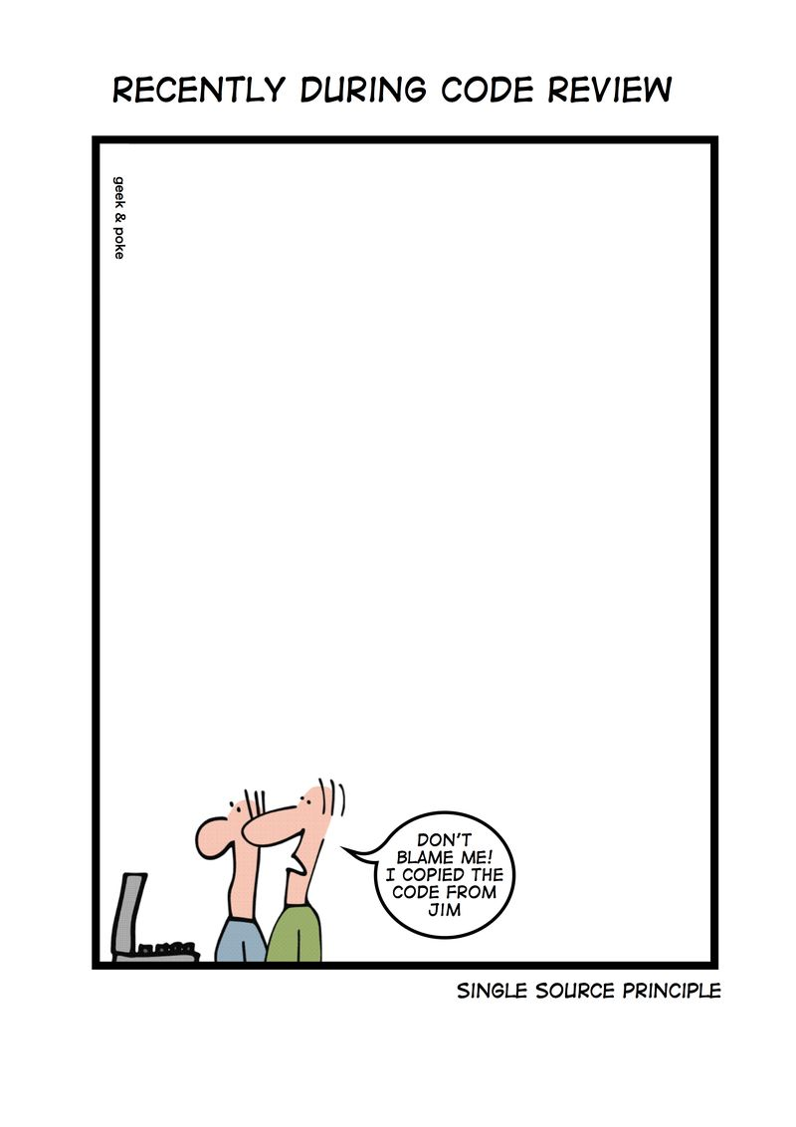
Enable Peer Review of Changes
Guidelines:
Everyone has a reviewer before committing to master.
Everyone monitors commits to identify and review any conflicts.
Define which changes are high risk and require an expert.
Any change to large to understand is split into smaller changes.
This Photo by Unknown Author is licensed under CC BY

Slide 31

Enable Pair Programming to Improve All Our Changes
Two programmers work together.
One as driver (writes code) and one as navigator (review, feedback, strategic thought).
Test-Driven Development – one programmer writes tests, the other writes code to pass test.
This Photo by Unknown Author is licensed under CC BY-NC-ND

Slide 32
Other Review Processes and Optimisations.
Enable Coordination and Scheduling of Changes.
Evaluate the Effectiveness of Pull Request Processes.
Fearlessly Cut Bureaucratic Processes.

Slide 33
Summary

Slide 34
Summary
We defined telemetry in software development - an automated communications process by which measurements and other data are collected at remote points and are subsequently transmitted to receiving equipment for monitoring.
We described how to use telemetry in software development - examining what to measure, how to fill gaps, and the infrastructure to support it.
We described how to use hypothesis-driven development - looking at A/B testing and backlog hypothesis items.
We described peer reviewing for software development - especially the benefits of pair programming.

Slide 35
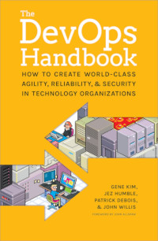
Recommended Reading
Part IV of The DevOps Handbook goes into far greater detail around these practices.

