Slide 1
Test-Driven Development (TDD)
SET08103 Software Engineering Methods
Dr Kevin Chalmers
k.chalmers@napier.ac.uk

Slide 2
Overview
What is Test-Driven Development?
Refactoring.
TDD and XP.
Further Advice from Kent Beck.

Slide 3
What is Test-Driven Development?

Slide 4
Test-Driven Development
Write tests first, then write the code to pass the tests.
Only write new code if an automated test fails.
We eliminate duplication as we only write code to pass a test.

Slide 5
Changing Individual and Group Development Behaviour
Design emerges organically and running code provides feedback.
Programmers write their own tests, rather than waiting for a QA department.
Development environments provide feedback on small batch sizes.
Designs create highly cohesive and loosely coupled components to make testing easy.

Slide 6
TDD Mantra
Red-green-refactor.
Red: write a small test that will fail.
Green: make the test work quickly, not worrying about quality.
Refactor: fix all the bad code created just to pass the test.

Slide 7
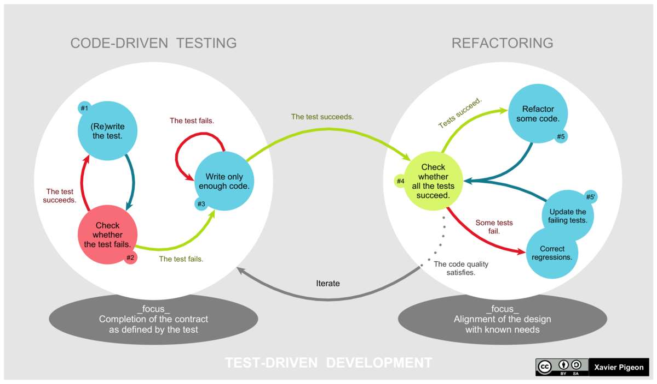
TDD Lifecycle
This Photo by Unknown Author is licensed under CC BY-SA

Slide 8
Why Test First?
No software engineers release even the tiniest change without testing, except the very confident and the very sloppy.
Kent Beck, Test-Driven Development by Example.
Reinforcement feedback loop – TDD stops this loop:
You feel more stressed about your code.
You do less testing because you are stressed.
You make more errors.
Return to step 1.

Slide 9
Benefits of Automated Testing
Fast tests that are run often to build confidence and catch bugs quickly and early.
Reduce cognitive load. Stops the following feedback loop:
As we gain experience, the more we realise needs to be done.
The more that we realise needs to be done, the less attention we pay on what we are doing.
The less attention we have on what we are doing, the less we accomplish.
The less we accomplish, the more we know needs to be done.
Return to step 2.

Slide 10
Change Team Dynamic
Defect density is reduced, thus QA changes to proactive rather than reactive work.
Reduced problems means the Scrum Master can better estimate the velocity and thus completion time.
Software engineers can work collaboratively constantly as they are not spending time fixing defects.
We have potentially shippable software as it has been tested.

Slide 11
Undertaking Test-Driven Development
Getting started:
Start simply.
Write automated tests.
Refactor to add design decisions one at a time.
First test – pick an operation that will do nothing (no side effects):
Where does the operation belong?
What are the correct inputs?
What is the correct output given those inputs?

Slide 12
Which Test to Write Next?
If you have a list, pick the test that will teach you something and you are confident you can implement.
Other test types:
Explanation Test: spread the use of automated testing by asking for and giving automated tests to explain code.
Learning Test: write a test to better understand externally produced software?
Another Test: write tests for ideas generated by technical discussion to ensure you stay on topic.
Regression Test: tests that would have been written originally. When you write a regression test, determine how you could have recognised the need for this test originally.

Slide 13
What to Test?
At what level do you write tests?
Each test introduces just a single line of logic and some refactoring.
Each test introduces hundreds of lines of logic and hours of refactoring.
You should be able to do either, but you will find smaller batch sizes makes sense over time.

Slide 14
What Don’t You Test?
TDD is about reducing fear, so you have to determine this for yourself somewhat.
However, definitely write tests for:
Conditionals.
Loops.
Operations.
Polymorphism.

Slide 15
How Do You Know You Have Good Tests?
Problems to look out for:
Long setup code: if running a test requires 100s of lines of setup code your objects are likely too large and should be split.
Setup duplication: if you cannot reuse setup code between tests your code is too tightly coupled.
Long running tests: if tests take long to run they won't be run often, and indicates a likely design problem. Test suites should only take 10 minutes to run.
Fragile tests: if tests break then we have parts of the application affecting other parts. This will need to be fixed.

Slide 16
Assertions
From Wikipedia:
In computer programming, an assertion is a statement that a predicate (Boolean-valued function, i.e. a true–false expression) is always true at that point in code execution. It can help a programmer read the code, help a compiler compile it, or help the program detect its own defects.
Write assertions first, and tests should allow the passing of assertions.

Slide 17
Refactoring

Slide 18
Refactoring
From Wikipedia:
Code refactoring is the process of restructuring existing computer code - changing the factoring - without changing its external behavior. Refactoring is intended to improve nonfunctional attributes of the software. Advantages include improved code readability and reduced complexity; these can improve source-code maintainability and create a more expressive internal architecture or object model to improve extensibility.

Slide 19
What to Refactor?
TDD allows refactoring to change behaviour as we care more about tests passing than maintaining semantics.
Some points to consider:
Two pieces of similar code? Bring them closer and unify when identical. This works at different scales:
Loops.
Conditional branches.
Methods.
Classes.
Change long methods into smaller ones by calling the new method. Tools can normally help you do this.

Slide 20
TDD and Extreme Programming (XP)

Slide 21
What is Extreme Programming?
From Wikipedia:
Extreme programming (XP) is a software development methodology which is intended to improve software quality and responsiveness to changing customer requirements. As a type of agile software development, it advocates frequent "releases" in short development cycles, which is intended to improve productivity and introduce checkpoints at which new customer requirements can be adopted.

Slide 22
XP Practices in TDD
Pairing: tests can be written by one programmer and the code to pass it by another.
Work fresh: XP advises to work when you are fresh and stop when you are tired. Having tests mean we can safely return to work by walking away.
Continuous integration: we will cover more explicitly in Lecture 15. Testing is at the heart of CI.
Simple design: as code emerges from tests, design is simple to allow such evolution.
Refactoring: we have already covered.
Continuous delivery: we will cover more explicitly in Lecture 16. CD requires working software, which TDD provides.

Slide 23
Further Advice from Kent Beck

Slide 24
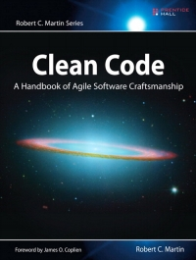
Clean Code
“Clean code that works”. TDD supports this as:
It is a predictable way to develop. You know when you are finished, without having to worry about a long bug trail.
It gives you a chance to learn all of the lessons that the code has to teach you. If you only slap together the first thing you think of, then you never have time to think of a second, better thing.
It improves the lives of the users of your software.
It lets your teammates count on you, and you on them.
It feels good to write it.
This Photo by Unknown Author is licensed under CC BY-SA

Slide 25
Courage
Side-effects of Fear
Mitigation in TDD
It makes you tentative.
It makes you want to communicate less.
It makes you shy away from feedback.
It makes you grumpy.
We learn quickly through experimentation.
We communicate better.
We seek feedback.
Grumpiness you'll have to resolve yourself.

Slide 26
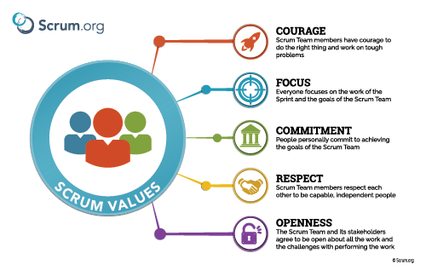
Scrum Values

Slide 27
Taking Breaks
Keep a water bottle at your keyboard so you take regular breaks.
Have commitments after regular work hours to stop you working late.
Weekend commitments help you get your head out of work thinking.
Holidays ensure you will refresh yourself. Three-to-four week breaks are considered the most effective.

Slide 28
Summary

Slide 29
Summary
Specifically, we have:
Defined Test-Driven Development (TDD) as a process where we write tests first.
Described the TDD lifecycle - red-green-refactor.
Described the advantages of TDD, focusing mainly on improved code quality, feedback, and working practices.

Slide 30

Recommended Reading
Test-Driven Development by Example by Kent Beck provides case studies and code samples examining TDD in practice.

