Slide 1
Continuous Integration
SET08103 Software Engineering
Dr Kevin Chalmers
k.chalmers@napier.ac.uk

Slide 2
Overview
What is Continuous Integration?
Continuous Integration Workflow.
Building a Continuous Integration System.
Risk.

Slide 3
What is Continuous Integration?

Slide 4
Continuous Integration
A software development practice where members of a team integrate their work frequently, usually each person integrates at least daily - leading to multiple integrations per day. Each integration is verified by an automated build (including test) to detect integration errors as quickly as possible.
Martin Fowler
CI is the practice of performing integration upon every commit to version control.

Slide 5
Integration and Integration Testing
Integration is the process of combining software components:
For performing integration tests.
To deploy software.
Integration testing:
Integration testing (sometimes called integration and testing, abbreviated I&T) is the phase in software testing in which individual software modules are combined and tested as a group. It occurs after unit testing and before validation testing.

Slide 6
Value of Continuous Integration
It reduces risk.
It reduces the number of repetitive manual processes.
It allows us to create deployable software at any point - or be potentially shippable.
It makes the project output more visible.
It creates greater confidence in the product being developed.

Slide 7
Continuous Integration Principles
Developers commit their code to a centralised version control at least once per day.
A separate build machine performs integration builds several times per day.
100% of tests must pass for every build.
A deployable product is created for functional testing.
If the build breaks then the highest priority is to fix it.
Developers review reports generated by the build system such as coding standards and dependency analysis looking for improvement.

Slide 8
Continuous Integration Practices
Commit code frequently.
Don’t commit broken code.
Fix broken builds immediately.
Write automated developer tests.
All tests and inspections must pass.
Run private builds.
Avoid getting broken code.

Slide 9
Continuous Integration Workflow

Slide 10
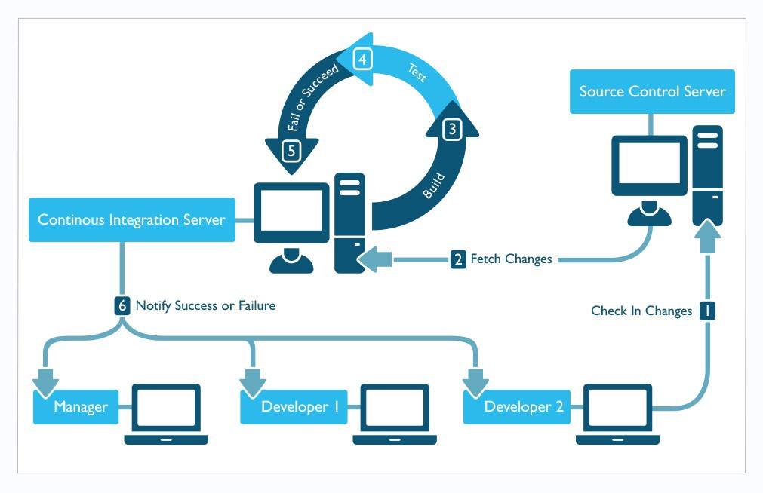
Continuous Integration Workflow
This Photo by Unknown Author is licensed under CC BY-SA

Slide 11
Steps in the Continuous Integration Workflow
The developer commits changes to source control.
The CI server polls for and receives the changes.
The CI server builds the software.
The CI server runs automated tests on the build.
The build and tests either succeed or fail.
The team are notified about the status of the build and tests.

Slide 12
Feedback from Continuous Integration
Do all the software components work together?
What is my code complexity?
Is the team adhering to the established coding standards?
How much code is covered by automated tests?
Were all the tests successful after the latest change?
Does my application still meet the performance requirements?
Were there any problems with the last deployment?

Slide 13
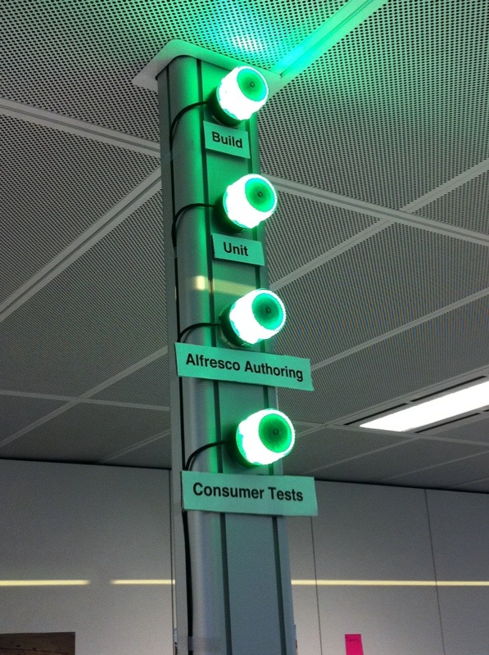
Build Status Indication
The team must be informed on the status of the build.
Normally email or other messaging.
Physical emitters also possible.
This Photo by Unknown Author is licensed under CC BY-SA

Slide 14
Building a Continuous Integration System

Slide 15
Getting Started
Requires developers to change practice to frequent commits, prioritise broken builds, and automate build and test.
Start with lower frequency builds (e.g., daily).
CI system features:
A connection to a version control repository.
A build script (e.g., we use Maven and Travis).
Some sort of feedback mechanism (such as e-mail).
A process for integrating the source code changes (manual or CI server).

Slide 16
Maintaining a Good Continuous Integration Workflow
Identify a process that requires automation (e.g., compilation, test, inspection, deployment, database integration, etc.).
Build a script to support the automation making it repeatable and consistent.
Share via version control so others can use the scripts.
Make it continuous by running the script with every change applied.

Slide 17
Improving Continuous Integration
Ask the following questions:
How much code coverage do you have with your tests?
How long does it take to run your builds?
What is your average code complexity?
How much code duplication do you have?
Are you labelling your builds in your version control repository?
Where do you store your deployed software?

Slide 18
Building
A build acts as the process for putting source code together and verifying that the software works as a cohesive unit.
This is the first stage after changes are fetched from version control.
The definition of a build depends on the team – but it needs to be quick enough to get feedback.

Slide 19
Build Script
Decouple from the IDE – allows the CI server to run without intervention.
Basic build script:
Clean.
Compile source code.
Integrate database.
Run tests.
Run inspections.
Deploy software.

Slide 20
Running Private Builds
Developer Private Build
Gitflow Workflow
Check out code from version control.
Make changes to that code.
Get the latest changes from version control.
Build, including unit tests.
Commit changes to version control.
Create a new feature branch from develop.
Implement the feature.
Merge any changes in develop into feature.
Build, including unit tests.
Merge feature into develop.

Slide 21
Integration and Release Builds
Integration build occurs on code being committed. It includes all the components of the system. The aim is to check all the components work together.
Release build can happen at the end of milestone, can include performance (nonfunctional) tests, and must include any acceptance tests. The aim is to create installation media and prepare for full QA testing.

Slide 22
Risk

Slide 23
Risk
Risk is the potential for a problem to occur. When a risk occurs it becomes a problem.
We focus on the high-priority risks (most damaging) that are most likely to occur.
Agile reduces risk by small iterations and feedback from users.

Slide 24
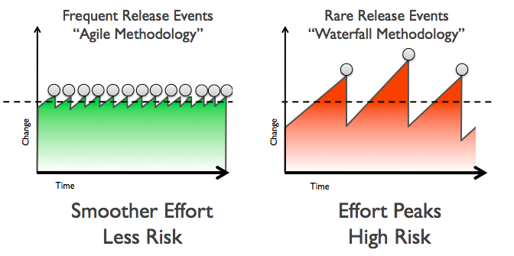
Risk in Agile Projects
This Photo by Unknown Author is licensed under CC BY-SA-NC

Slide 25
Lack of Deployable Software
Continuous Integration reduces this risk by:
Decoupling the IDE from the build process.
Placing all database artefacts in version control.
Rebuilding the database from the build script.
Testing and inspecting the database.
Automating the build process to reduce wasted time and effort.

Slide 26
Late Discovery of Defects
Writing test code for all source code.
Running tests in the build script.
Running tests continuously at any change committed to version control

Slide 27
Other Risks
Lack of Project Visibility
Continuous Integration system provides telemetry so we know the state of the build.
Low-Quality Software
Run automated tests that measure quality metrics. For example:
Complexity.
Dependency analysis.
Code duplication.

Slide 28
Summary

Slide 29
Summary
Defined Continuous Integration as the process of performing integration building and testing on each change committed to version control.
Explained why Continuous Integration is useful, focusing on risk reduction and workflow.
Described the Continuous Integration workflow, looking at the steps and CI system setup.
Described risk in software development and how this is managed via Continuous Integration, focusing on lack of deployable software, late discovery of defects, lack of project visibility, and low-quality software.

Slide 30
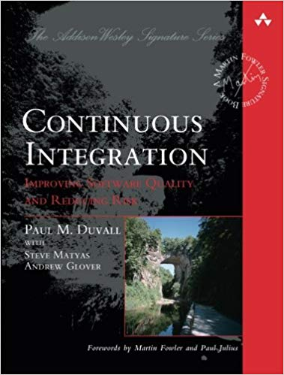
Recommended Reading
Continuous Integration: Improving Software Quality and Reducing Risk by Paul M. Duvall is the go to book on Continuous Integration practice.

