Slide 1
Continuous Delivery
SET08103 Software Engineering Methods
Dr Kevin Chalmers
k.chalmers@napier.ac.uk

Slide 2
Overview
Continuous Delivery.
Implementing Continuous Delivery.
Continuous Delivery Project Lifecycle.
Risk Management in Continuous Delivery.

Slide 3
Continuous Delivery

Slide 4
What is Continuous Delivery?
Continuous delivery (CD or CDE) is a software engineering approach in which teams produce software in short cycles, ensuring that the software can be reliably released at any time and, when releasing the software, doing so manually.
Extension of Continuous Integration:
Continuous Integration automates testing and integration.
Continuous Delivery extends Continuous Integration by ensuring we can release at any time.
Continuous Deployment extends Continuous Delivery by automating deployments.

Slide 5
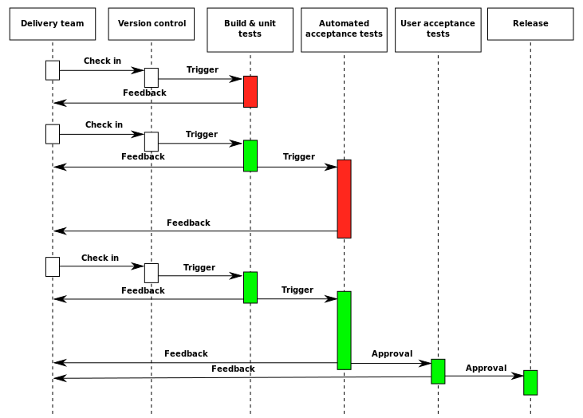
Deployment Pipeline
This Photo by Unknown Author is licensed under CC BY-SA

Slide 6
Aims of Continuous Delivery
Deliver software as quickly as possible.
Deliver software whenever we want.
Reduce fear of doing a release – do releases so frequently that we reduce the pain.

Slide 7
Principles of Continuous Delivery
Create a repeatable, reliable process for releasing software.
Automate almost everything.
Keep everything in version control.
Build quality in.
Done means released.
Everybody is responsible for the delivery process.
Continuous improvement.

Slide 8
Problems Overcome via Continuous Delivery
Deploying software manually: deployments will tend towards automation over time, with humans only selecting the version and pressing deploy.
Running to a production-like environment only on deployment: testing, deployment, and release is integrated into normal development.
Manual configuration management of production environments: configuration is stored in version control and used in the automated processes.

Slide 9
Implementing Continuous Delivery

Slide 10

Software Components
Executable code.
We package via Maven.
Configuration.
We use Docker.
Host environment.
We use Docker to make this neutral.
Data.
We use MySQL.
This Photo by Unknown Author is licensed under CC BY-SA

Slide 11
Pre-deployment Feedback
The build works showing the syntax of the code is correct.
The unit tests pass.
Software quality metrics are met (e.g., code coverage of tests).
Acceptance tests pass ensuring the business value of the product.
Nonfunctional tests pass.
Exploratory testing and demonstration to the customer.

Slide 12
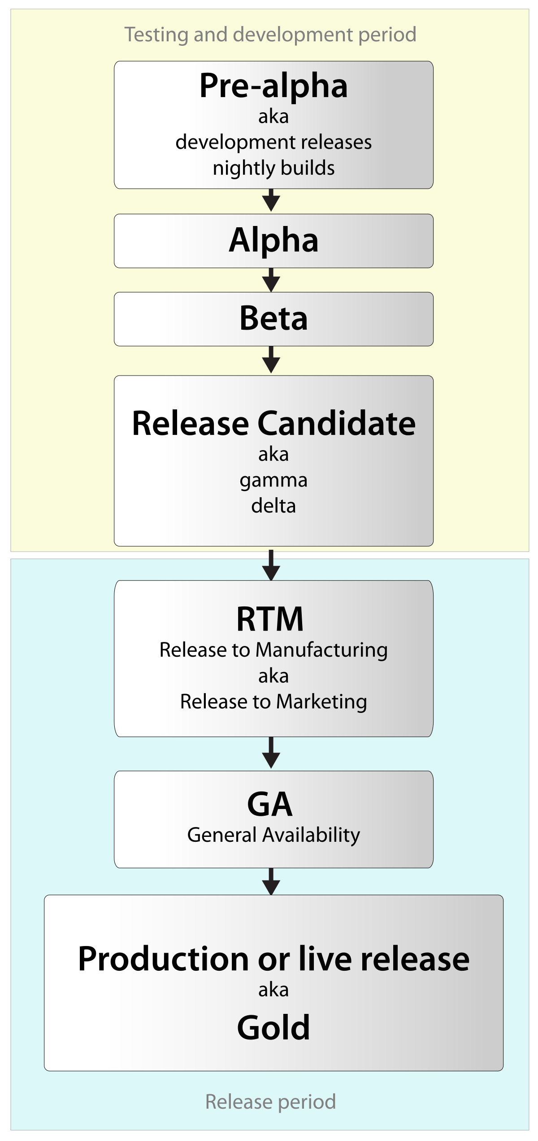
Release Lifecycle
Traditional “big-bang” release lifecycle:
Pre-alpha.
Alpha.
Beta.
Release Candidate.
Gold.
Continuous Delivery doesn’t use this – any commit can be a release.
This Photo by Unknown Author is licensed under CC BY-SA

Slide 13
Configuration Management
Can I exactly reproduce any of my environments, including the version of the operating system, its patch level, the network configuration, the software stack, the applications deployed into it, and their configuration?
Can I easily make an incremental change to any of these individual items and deploy the change to any, and all, of my environments?
Can I easily see each change that occurred to a particular environment and trace it back to see exactly what the change was, who made it, and when they made it?
Can I satisfy all of the compliance regulations that I am subject to?
Is it easy for every member of the team to get the information they need, and to make the changes they need to make? Or does the strategy get in the way of efficient delivery, leading to increased cycle time and reduced feedback?

Slide 14

Smoke Test
Deployments should be smoke tested.
A smoke test is an automated script to test the system is up and running.
Can be as simple as checking the main web page loads.
This Photo by Unknown Author is licensed under CC BY-SA-NC

Slide 15

Business Change
Conflict in business:
A business wants to release software fast to gain value.
A business wants to avoid risk from such problems as violation of regulations.
That is a business wants performance and conformance.
This Photo by Unknown Author is licensed under CC BY

Slide 16
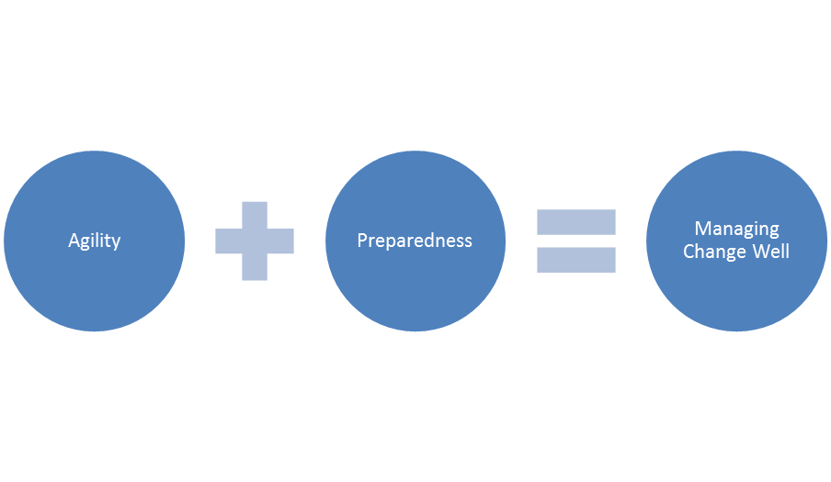
Business Change
Lean, Agile, and Continuous Delivery allow us to manage change.
Reduce cycle time.
Reduce defects so less time is spent on support.
Increase predictability.
Adaption to new regulations quickly.
Determine and manage the risks.
Reduce costs due to improved risk management and delivery process.
This Photo by Unknown Author is licensed under CC BY-NC-ND

Slide 17
Continuous Delivery Project Lifecycle

Slide 18
Continuous Delivery Project Lifecycle
Identification: based on business objectives.
Inception.
Initiation.
Development and deployment.
Operation.

Slide 19
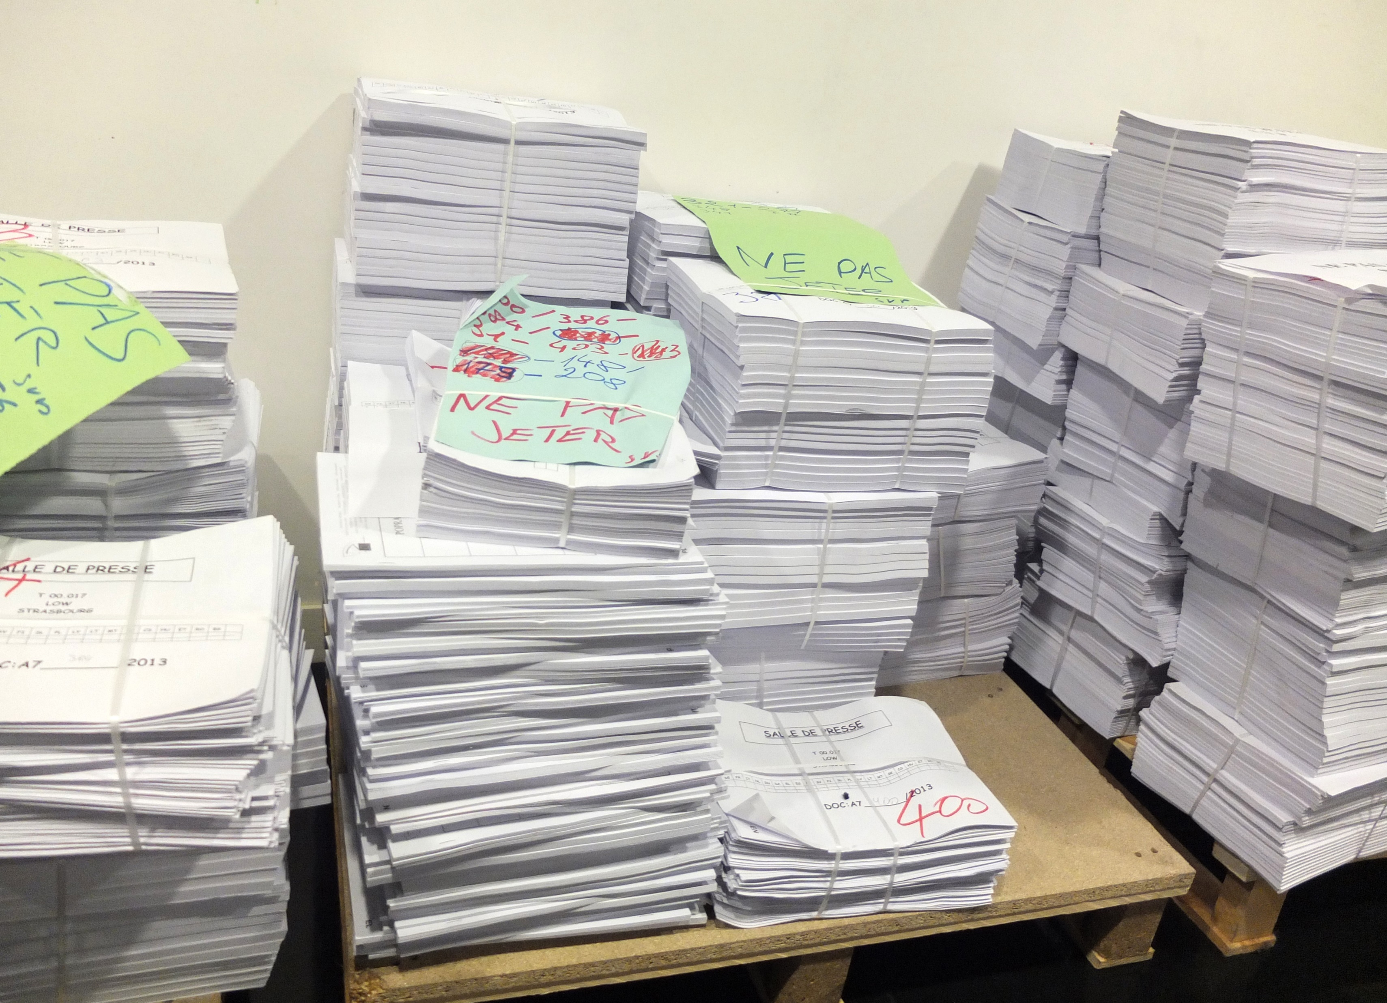
Inception
A business case.
A list of high-level functional and nonfunctional requirements to estimate the work.
A release plan which includes a schedule of work and the cost associated with the project.
A testing strategy.
A release strategy.
An architectural evaluation, leading to a decision on the platform and frameworks to use.
A risk and issue log.
A description of the development lifecycle.
A description of the plan to execute this list.
This Photo by Unknown Author is licensed under CC BY-SA

Slide 20
Initiation
Making sure that the team has the hardware and software that they need to begin work.
Making sure that basic infrastructure is in place - such as an Internet connection, a whiteboard, paper and pens, a printer, food, and drinks.
Creating email accounts and assigning people permissions to access resources.
Setting up version control.
Setting up a basic continuous integration environment.
Agreeing upon roles, responsibilities, working hours, and meeting times.
Preparing the work for the first week and agreeing on targets (not deadlines).
Creating a simple test environment and test data.
A slightly more detailed look at the intended system design: exploring the possibilities is really the aim at this stage.
Identify and mitigate any analysis, development, and testing risks by doing spikes.
Developing the story or requirement backlog.
Setting up the project structure and using the simplest possible story, including a build script and some tests to get continuous integration under way.

Slide 21

Develop and Release
Following basic conditions:
Software is always working
Working software is deployed at each iteration.
Iterations are no longer than two weeks.
Iterative process:
We get feedback.
Things are done when the customer signs them off and this is done during regular showcases.
The software works at all times.
Software is production ready at all times.

Slide 22
Risk Management in Continuous Delivery

Slide 23
Risk Management Process
Main project risks are identified.
Risk mitigation strategies have been put in place.
Risks are continuously identified and managed throughout the project.
A standard structure for project teams to report status.
Regular updates on progress.
Information radiators and dashboards to allow tracking of status.
Regular audits from someone outside the team.

Slide 24
Doing Risk Management in Continuous Delivery
Ask questions, such as:
How are you tracking progress?
How are you preventing defects?
How are you discovering defects?
How are you tracking defects?
How do you know a story is finished?
How are you managing your environments?
See the notes for a fuller set of questions.

Slide 25
Common Delivery Problems
Infrequent or buggy deployments.
Poor application quality.
Poorly managed Continuous Integration process.
Poor configuration management.
Compliance and auditing.
Automation over documentation.
Enforcing traceability.
Working in silos.
Change management.

Slide 26
Compliance and Auditing
Version control informs us of what and who for a change.
Further regulation enforcement:
Locking access to certain environments.
Having an effective and efficient change management process.
Requiring approvals from management before deployments can be performed.
Requiring every process be documented.
Creating authorization barriers to disable parts of the automated process.
Requiring every deployment to be audited.

Slide 27
Change Management
Create a Change Advisory Board with representatives from your development team, operations team, security team, change management team, and the business.
Decide which environments fall under the purview of the change management process. Ensure that these environments are access-controlled so that changes can only be made through this process.
Establish an automated change request management system that can be used to raise a change request and manage approvals. Anyone should be able to see the status of each change request and who has approved it.
Any time anybody wants to make a change to an environment, whether deploying a new version of an application, creating a new virtual environment, or making a configuration change, it must be done through a change request.
Require a remediation strategy, such as the ability to back out, for every change.
Have acceptance criteria for the success of a change. Ideally, create an automated test that now fails but will pass once the change is successful. Put an indicator on your operations management dashboard with the status of the test.
Have an automated process for applying changes, so that whenever the change is approved, it can be performed by pressing a button.

Slide 28
Summary

Slide 29
Summary
Defined Continuous Delivery as an extension to Continuous Integration that incorporates release building.
Described how to implement Continuous Delivery examining items such as configuration management and business change.
Evaluated Continuous Delivery in the software project lifecycle, discussing how it meets different stages of the lifecycle.
Described risk within the context of Continuous Delivery, examining risk management, and conformance.

Slide 30
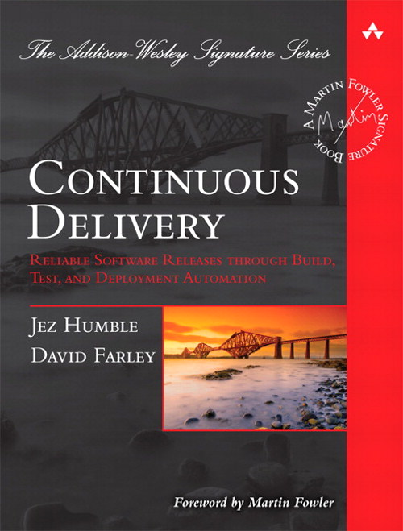
Recommended Reading
Continuous Delivery: Reliable Software Releases through Build, Test, and Deployment Automation provides a complete overview of CD and how it can be integrated into an organisation.

