Slide 1
Monitoring Software
SET08103 Software Engineering Methods
Dr Kevin Chalmers
k.chalmers@napier.ac.uk

Slide 2
Overview
Information Visualisation.
Monitoring Systems.
Monitoring Culture.
A Monitoring Framework.

Slide 3
Information Visualisation

Slide 4
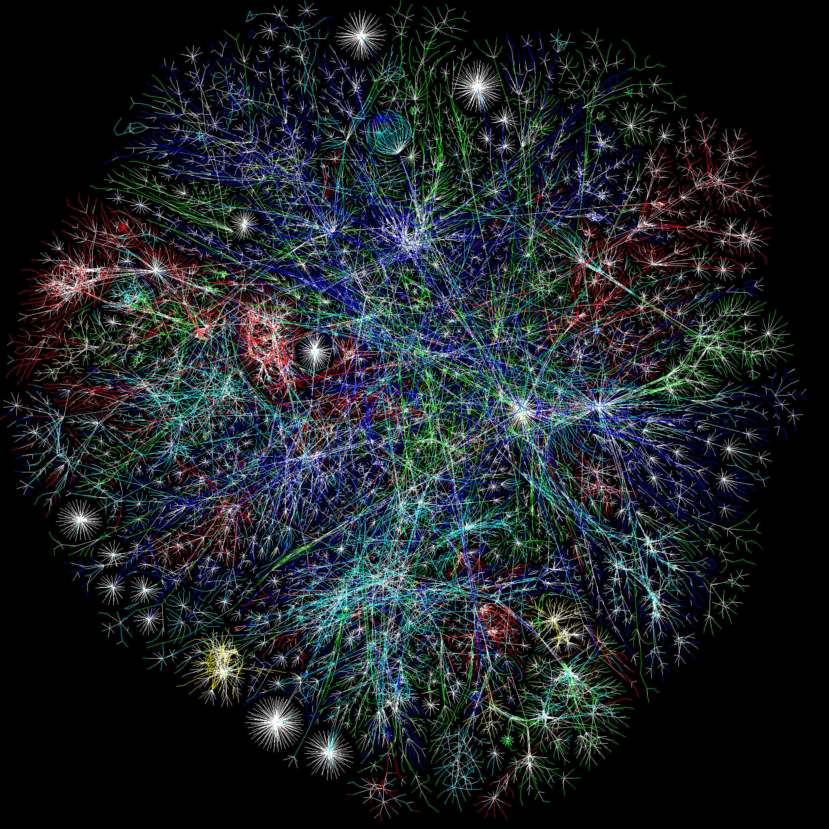
Information Visualisation
From Wikipedia:
Information visualization or information visualisation is the study of (interactive) visual representations of abstract data to reinforce human cognition.
This Photo by Unknown Author is licensed under CC BY-SA

Slide 5
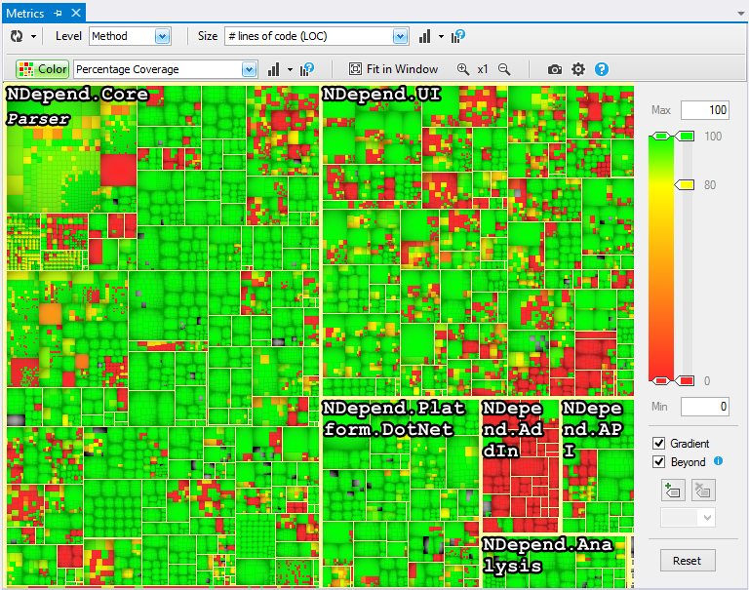
Software Visualisation
A field of information visualisation focused on the visual representation of software data.
This is a code coverage map:
The size of the square is the LoC per method, class, or namespace.
The colour represents the code coverage %.

Slide 6
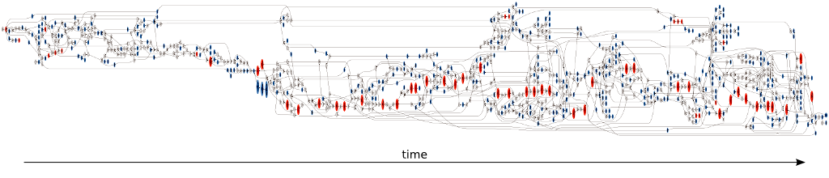
Git Branches Visualisation

Slide 7
Quicksort Animation
This Photo by Unknown Author is licensed under CC BY-SA

Slide 8
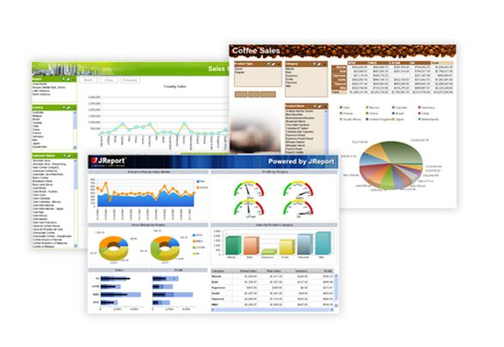
Business Dashboard
From Wikipedia:
Dashboards often provide at-a-glance views of key performance indicators (KPIs) relevant to a particular objective or business process. In the other, "dashboard" has another name for "progress report" or "report."
This Photo by Unknown Author is licensed under CC BY-SA

Slide 9
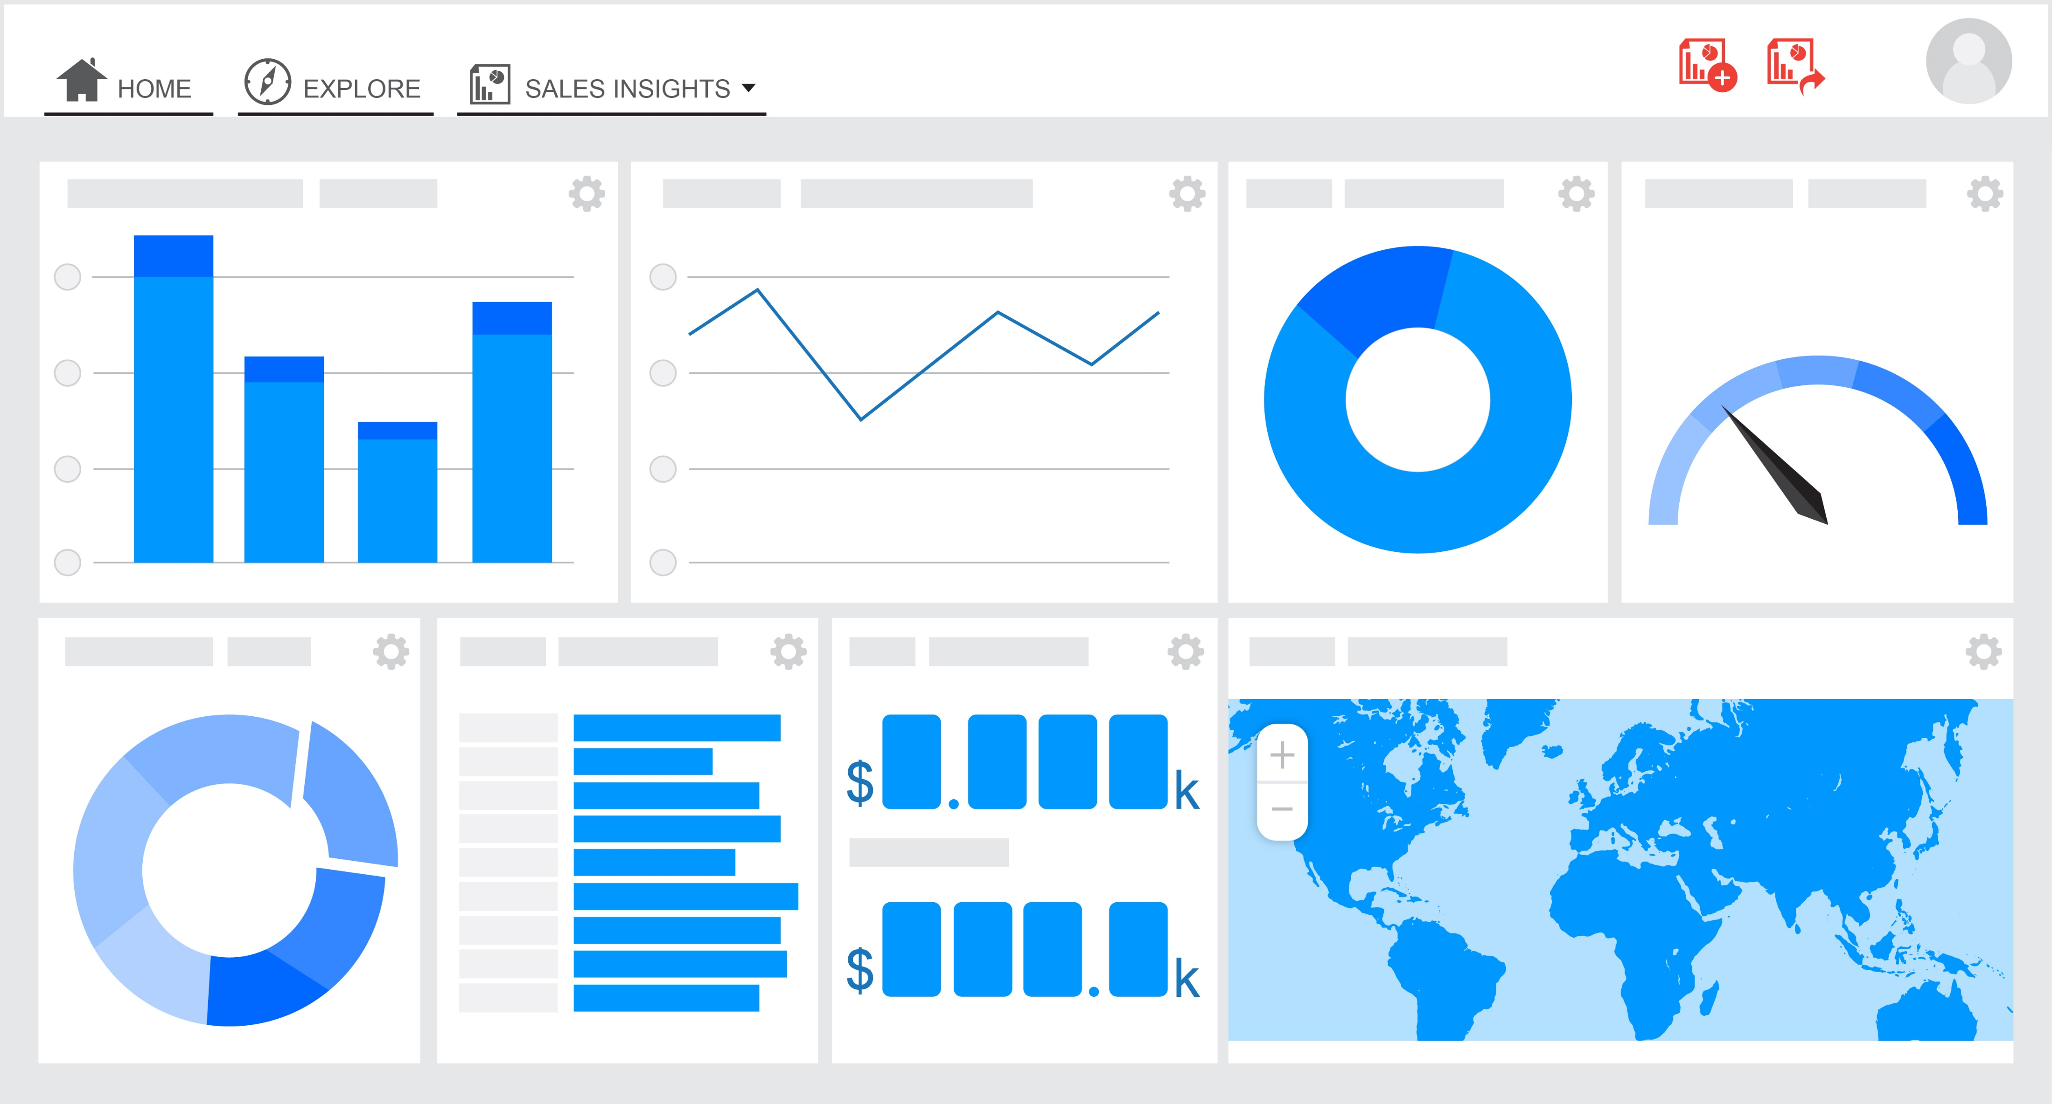
Business Dashboard
This Photo by Unknown Author is licensed under CC BY-SA

Slide 10
Monitoring Systems

Slide 11
Monitoring Systems
We use monitoring to:
Detect faults.
Diagnose faults.
Resolve faults.
Monitoring also provides data to support the business, such as:
user experience data.
where to make product and technology investments.

Slide 12
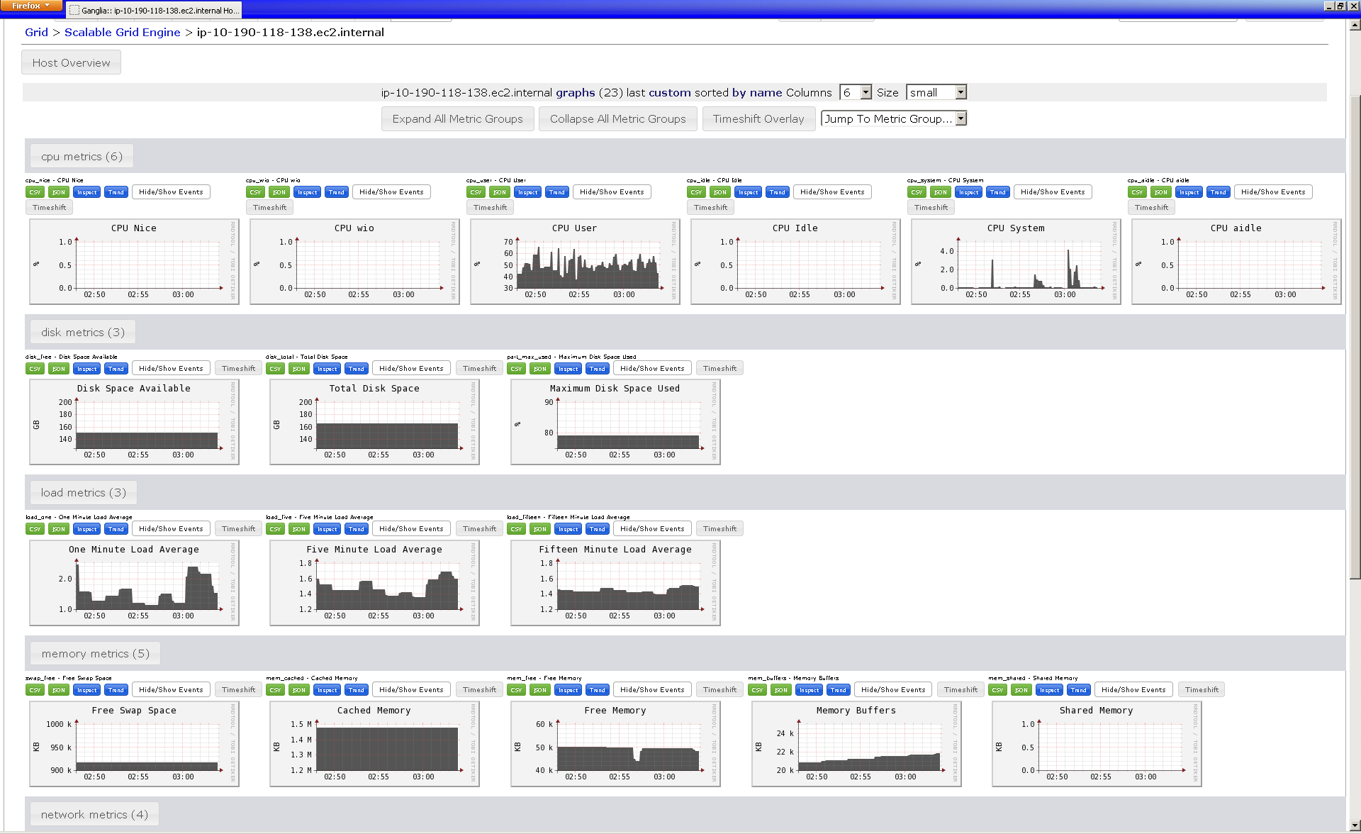
System Dashboard
This Photo by Unknown Author is licensed under CC BY-SA

Slide 13
System Monitoring
Technically the tools and processes for measure and manage IT systems.
Monitoring goes beyond this, providing business metrics such as user experience.
Should not be seen as an addon – part of the role of the software engineer. You are an engineer, not a cowboy.

Slide 14
Operational Risk form Not Monitoring
An inability to identify or diagnose faults.
An inability to measure the operational performance of your application.
An inability to measure the business performance and success of an application or a component, like tracking sales figures or the value of transactions.

Slide 15
Monitoring Culture

Slide 16
Manual Monitoring or None
Person driven (if it exists).
Checklist following, simple script, or other non-automated approach.
Aim is to manage assets and avoid downtime.
Little information to justify investment.

Slide 17
Reactive Monitoring
Automates most of the processes.
Tooling deployed, but still works on availability and asset management.
New monitoring driven by system incidents.
Operations team are the focus of the metrics.

Slide 18
Proactive Monitoring
Supports infrastructure and the business.
Metrics include business performance and quality of service.
Operations manage monitoring, but development must build-in monitoring to their applications (part of definition of done).
Information gathered justifies investment in IT infrastructure.

Slide 19
A Monitoring Framework

Slide 20
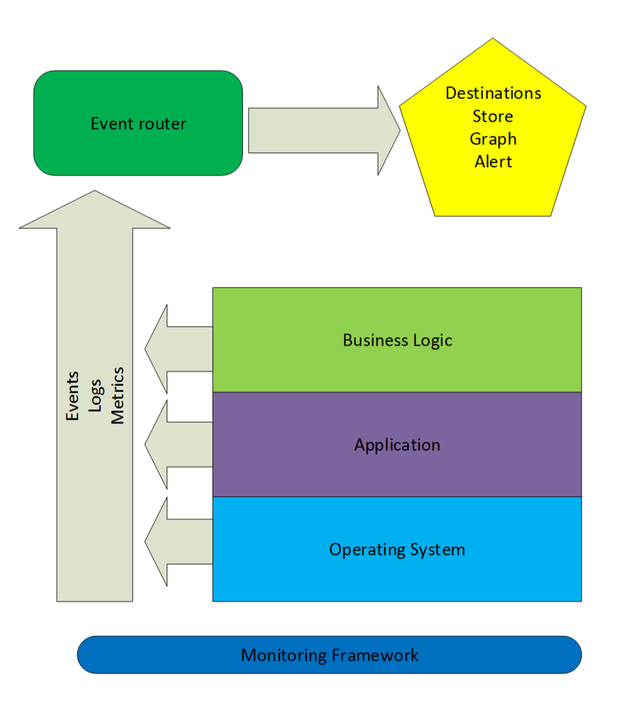
Monitoring Framework

Slide 21
Emitters
Systems and components emit data so information is pushed to the collector.
If data is emitted the system is available. If it doesn’t, it isn’t.
Moves focus from availability to information that can be emitted by the system/component.

Slide 22
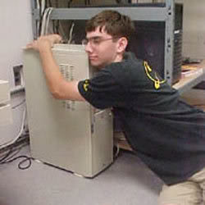
Previous Approach
Operations team saw systems as pets, constantly nursed back to health.
Checks only involved what had been done in the past, or response to incidents.
This Photo by Unknown Author is licensed under CC BY

Slide 23
Monitoring Systems
Via Docker and cloud infrastructure we now tear down and rebuild systems. We just rebuild what we need.
Monitoring applications requires three approaches:
Emitting metrics by instrumenting code.
Generating structured or semantic log events.
Building health checks and endpoints.

Slide 24
Types of Data to Gather
Resource information, like consumption of CPU or memory
Performance information, like latency and application throughput
Business and user-experience metrics, like volumes or the amounts of transactions or numbers of failed logins
Log data from hosts, services, and applications

Slide 25
Categories of Data
Events: changes and occurrences in our environment.
Logs: a subset of events most useful for fault diagnosis and investigation.
Metrics: most useful to help us understand what's going on in our environment.

Slide 26
Notifications
Basics:
Who to tell about a problem.
How to tell them.
How often to tell them.
When to stop telling them, do something else, or escalate to someone else.
Good notification system:
Make notifications actionable, clear, and articulate.
Add context to notifications.
Align notifications with the business needs of the service being monitored.

Slide 27
Application Monitoring
Measure and log requests and responses.
Measure and log all calls to external services and APIs.
Measure and log job scheduling, execution, and other periodic events.
Measure significant business and functional events.
Measure methods and functions that read and write from databases and caches.

Slide 28
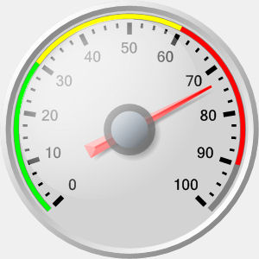
Metric Types and Visual Approaches
Gauges show a number that will change over time (e.g., CPU usage). We want to see the metric at a given point in time.
Counters increase over time, such as uptime and sales. Useful for mapping rates of change.
Timers are used to determine how long something took, for example a request.
Summaries combine metrics into a more useful statistic. For example, means, medians, percentages, etc.
This Photo by Unknown Author is licensed under CC BY-SA

Slide 29
Summary

Slide 30
Summary
Defined information visualisation as the graphical representation of data in a manner that helps people understand what the data means.
Described system monitoring, looking at what to monitor and the culture required.
Defined the requirements for a system monitoring framework, including emitters and notifications.
Defined application monitoring approaches, looking at what to monitor and how to present this.

Slide 31
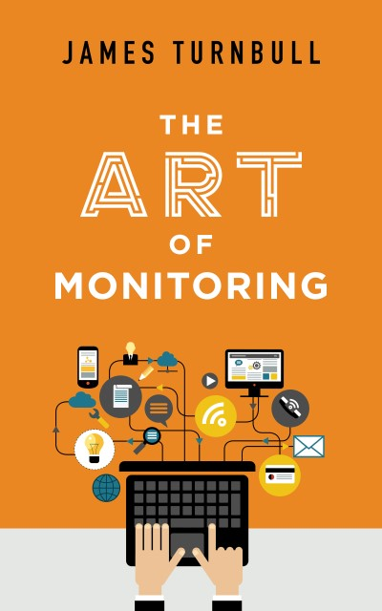
Recommended Reading
The Art of Monitoring by James Turnbull covers both the principles of monitoring and how to build a monitoring system. If you want to build a monitoring feedback this is a good starting point.

