Slide 1
Bug Tracking
SET08103 Software Engineering Methods
Dr Kevin Chalmers
k.chalmers@napier.ac.uk

Slide 2
Overview
Bugs, smells, and technical debt.
Bug tracking systems.
Bug tracking workflow.
Bug tracking best practices.
Bug reporting.

Slide 3
Bugs, Smells, and Technical Debt

Slide 4
Software Bug
Software Bug (Wikipedia):
A software bug is an error, flaw, failure or fault in a computer program or system that causes it to produce an incorrect or unexpected result, or to behave in unintended ways.
A bug is a defect that we have to resolve.
The challenge is finding bugs.

Slide 5
Code Smell
Code Smell (from Wikipedia):
In programming, a code smell is a characteristic in the code that shows a deeper problem.
A code smell is a poor implementation, caused by lazy or rushed programmers.
A code smell isn’t a defect, but may lead to other defects or more work.

Slide 6
Technical Debt
Technical Debt (Wikipedia):
Technical debt (also known as design debt or code debt) is a concept in software development that reflects the implied cost of additional rework caused by choosing an easy solution now instead of using a better approach that would take longer.
Bugs and code smells are forms of technical debt. We need to pay down technical debt before it builds interest.

Slide 7
Bug Tracking Systems

Slide 8
Bug Tracking System
Bug Tracking System (Wikipedia):
A bug tracking system or defect tracking system is a software application that keeps track of reported software bugs in software development projects.
This tells us nothing.
A bug tracking system is a database for tracking bugs and managing their lifecycle.

Slide 9
Bug Tracking and Issue Tracking
Issue Tracking System (from Wikipedia):
An issue tracking system (also ITS, trouble ticket system, support ticket, request management or incident ticket system) is a computer software package that manages and maintains lists of issues.
Wikipedia’s definition again provides little information.
Issues are more general than bugs. Indeed, we use GitHub issues to track feature work.

Slide 10
The Problem with Spreadsheets
Lack of communication: hard to discuss the bug.
Lack of visibility: bug discussion is via emails not seen by the full team.
Lack of real-time updates: no notifications on bug progress or new bugs.
Lack of fluid properties: challenging to manage bug priority.
Lack of a central repository: no one location to store description, screenshots, progress and feedback.
Lack of insights: difficult to see patterns and trends.
Lack of integration with other work: bug tracking exists separate to the rest of our work, which goes against the single repository of truth paradigm.

Slide 11
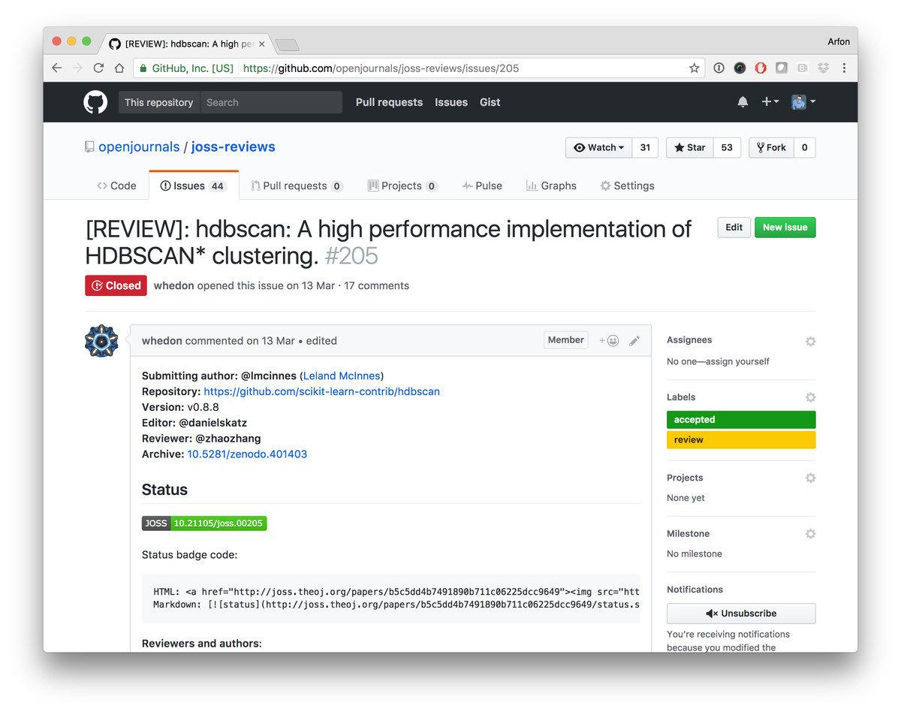
GitHub Issues
This Photo by Unknown Author is licensed under CC BY

Slide 12
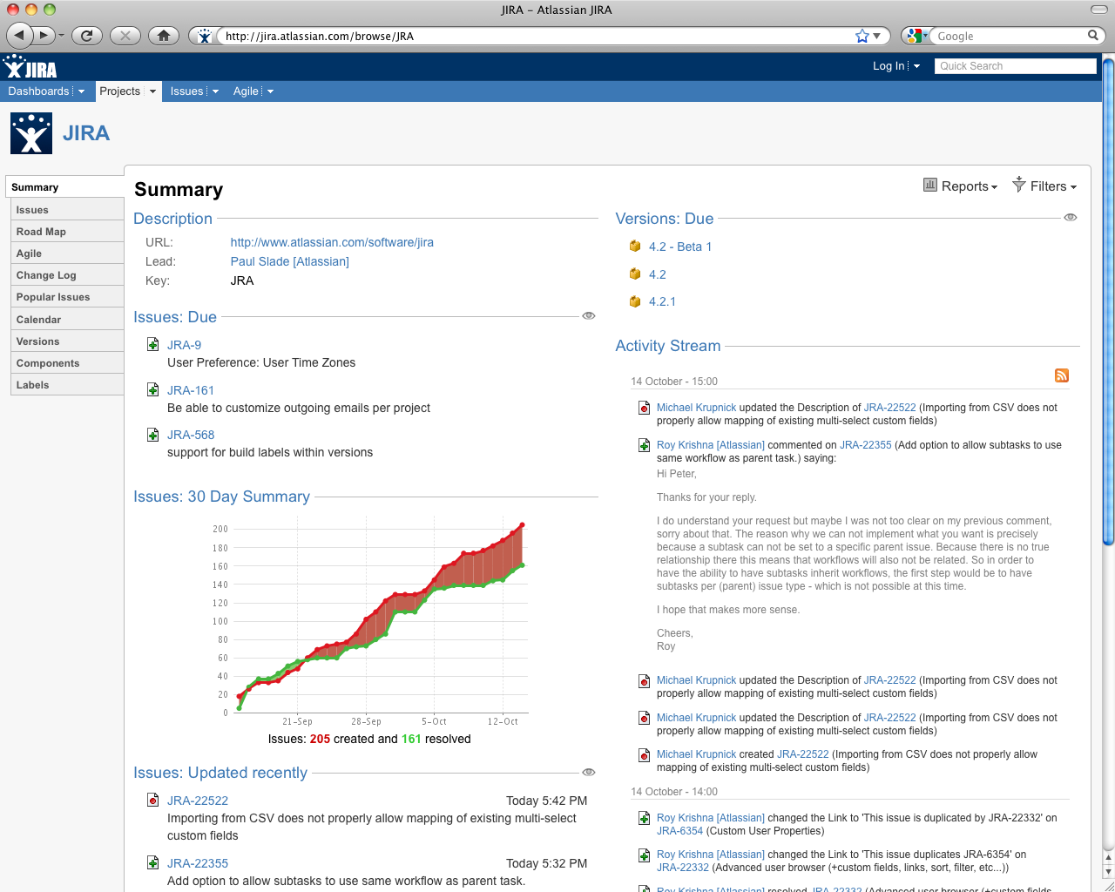
Jira
This Photo by Unknown Author is licensed under CC BY-SA

Slide 13
Bug Tracking Workflow

Slide 14
Four Stages of Bug Tracking
Capturing: where QA or users discover bugs.
Prioritising: where the team sort the bugs into a work order.
Tracking: where the team fix bugs and update their status.
Releasing: where customers receive bug fixes.

Slide 15
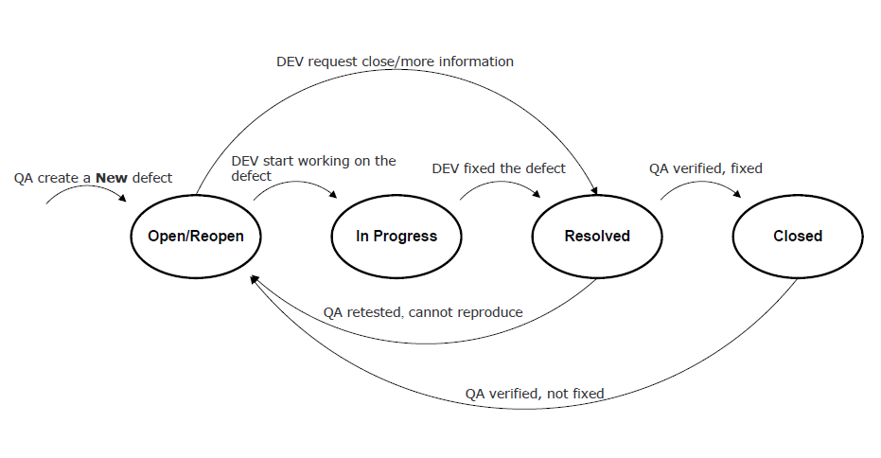
Basic Bug Tracking Lifecycle
open/reopen: when someone reports the bug, or QA marks the bug as not fixed.
in progress: when development work on fixing the bug.
resolved: when development submits the fix and is awaiting a QA review.
closed: when QA make sure the bug fix passes inspection.

Slide 16
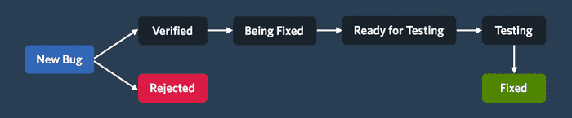
Another Bug Tracking Lifecycle

Slide 17
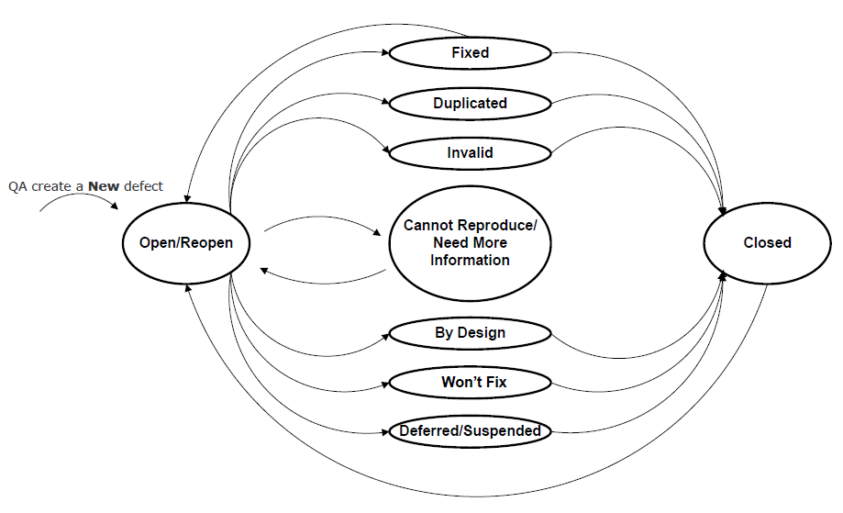
Bug State

Slide 18
Bug Tracking in the Backlog
Treat bugs as cards/issues in the backlog.
Integrates bug work into our workflow:
We can check for duplicate bugs in the backlog.
We create a new defect as a card in the backlog.
We can prioritise and assign bugs.
When we fix the bug, it moves to the done column.

Slide 19
Bug Tracking Best Practices

Slide 20
Best Practices
Be thorough. The more information presented on the bug, its cause, and its fix, the better for the team.
Make sure a bug is valid.
Make sure we have complete information on the bug; e.g., title, description, screenshots, etc.
Make sure people only report bugs once.
Make sure people give details to reproduce a bug.
Think through the bug.
Always look for new bugs: no program is bug-free.

Slide 21
A Good Bug Report
Steps required to reproduce the bug.
What was the expected result?
What was the actual result?

Slide 22
Bug Communication
A description of what happens. What is the observed defect?
A description of when it happens. What are the causes of the defect?
If the defect always occurs. Is the bug intermittent?
A description of how the bug occurs at present. Maybe the circumstances under which the bug occurs have changed.
What are the steps required to reproduce the bug?

Slide 23
Bug Reporting

Slide 24
Bug Reporting
I’m going to use examples from teaching.
I get these queries a lot, and have for many years, so don’t worry if you’ve communicated like this. No example is about any one individual but a collection of examples.
From now, try and improve how you communicate the problems you have.

Slide 25
Be Specific
“I ran the code, and it’s not working.”
What does run mean? In this module:
You selected run within IntelliJ.
You ran the Docker container for the application.
You pushed your container to Google Cloud.
Be specific about what you tried.

Slide 26
Be Verbose
“Lab 3 doesn’t work.”
OK, why does lab 3 not work? “The program doesn’t run.”
OK, what part of the lab are you doing? “The part with Docker.”
Be verbose. Spend time describing the problem. Your rush to respond is actually slowing things down. We can ignore irrelevant information.

Slide 27
Watch Your Pronouns
“It doesn’t work.”
What is “it”?
Be careful with pronouns and related words (e.g., it, he, she, they, this, etc.).

Slide 28
Inform What Else You’ve Done
“I cannot connect to the database container.”
We do some digging around and cannot find out why.
“Oh, I installed MySQL on my machine. Is that a problem?”
Yes it is.
Inform what else you’ve done that might be causing a conflict.

Slide 29
Don't Use Anecdotal Evidence or Perform Confirmation Bias
“Lab 7 isn’t working, and everyone I’ve spoken to says they have the same problem.”
Give the developer some credit. This doesn’t help as:
The other person may have a different problem.
The other person may have a different configuration.
You’ve performed confirmation bias. You don’t know who has a working system. You are trying to justify your problem. If a legitimate problem, you need not to justify it.

Slide 30
Proof Read
Always review and edit text you send to others.
Rushing means:
You might not make sense.
You might miss important information.
You might cause offense.
This just slows down the process overall.
If submitting coursework like this you will lose marks.

Slide 31
Summary

Slide 32
Summary
Defined software bugs (defects), smells (poor implementation), and technical debt in how they relate.
Described a bug tracking system as essentially a database which holds facts on a defect and allows bug lifecycle management.
Described a bug tracking lifecycle, from open to fixing to closed.
Evaluated good bug reporting practice, particularly focusing on good communication.

