Slide 1
Computer Security
SET08103 Software Engineering Methods
Dr Kevin Chalmers
k.chalmers@napier.ac.uk

Slide 2
Overview
Roles.
Ethics.
McCumber Cube.
Attacks.

Slide 3
What is Computer Security?
From Wikipedia:
Computer security, cybersecurity or information technology security (IT security) is the protection of computer systems from theft or damage to their hardware, software or electronic data, as well as from disruption or misdirection of the services they provide.
From Security for Software Engineers:
Computer security can be defined as providing confidentiality, integrity, and availability (C.I.A.) assurances to users or clients of information systems.

Slide 4
Roles

Slide 5
Two Main Roles
Users:
The aim is to defend users of IT systems from attacks. Computer security is therefore defined in terms of user needs and not the attack or technology.
“Hackers”:
Blacks hats – the bad guys.
White hats – the good guys

Slide 6

Black Hats
Break system security without permission.
1st generation: curiosity and pride.
2nd generation: financial gain.
3rd generation: ethical, moral, or political.
Grey hats: find vulnerabilities without permission and report them.

Slide 7

White Hats
Various roles.
Share two common principles:
Ethics.
Defence of users.
White hats uphold the law.
All IT professionals should be white hats.

Slide 8
Software Engineers
Write code that is resistant to attack.
Be familiar with potential security issues.
Minimise vulnerabilities:
Write code that lacks vulnerabilities.
Locate and fix vulnerabilities in an existing codebase.
Integrate security features (e.g., authentication, encryption).

Slide 9
Ethics

Slide 10
Ethics
Computer security often referred to as cyber warfare.
Ethics of warfare well established.
Some argue that ethics should not be a concern when undertaking cyber warfare – just win.
White hats generally agree on (ISC)² Code of Ethics.

Slide 11

(ISC)²
International Information System Security Certification Consortium.
Certification and training:
CSSLP – Certified Secure Software Lifecycle Professional.
CISSP – Certified Information Systems Security Professional.
And many others.
This Photo by Unknown Author is licensed under CC BY-SA

Slide 12
(ISC)² Code of Ethics
Protect: white hats have a responsibility to:
Protect society from threats.
Protect computer systems from attacks.
Teach people how to protect against attacks.
Act honourably: white hats must be honest and inform employers what they are doing.
Provide service: white hats should give advice and treat everyone fairly.
Advance the profession: white hats should respect the authority given to them and only work in their areas of competence. Avoiding conflicts of interest is essential.

Slide 13
Protect society, the common good, necessary public trust and confidence, and the infrastructure
Promote and preserve public trust and confidence in information and systems.
Promote the understanding and acceptance of prudent information security measures.
Preserve and strengthen the integrity of the public infrastructure.
Discourage unsafe practice.

Slide 14
Act honorably, honestly, justly, responsibly, and legally
Tell the truth; make all stakeholders aware of your actions on a timely basis.
Observe all contracts and agreements, express or implied.
Treat all members fairly. In resolving conflicts, consider public safety and duties to principals, individuals, and the profession in that order.
Give prudent advice; avoid raising unnecessary alarm or giving unwarranted comfort. Take care to be truthful, objective, cautious, and within your competence.
When resolving differing laws in different jurisdictions, give preference to the laws of the jurisdiction in which you render your service.

Slide 15
Provide diligent and competent service to principals
Preserve the value of their systems, applications, and information.
Respect their trust and privileges that they grant you.
Avoid conflicts of interest or the appearance thereof.
Render only those services for which you are fully competent and qualified.

Slide 16
Advance and protect the profession
Sponsor for professional advancement those best qualified. All other things equal, prefer those who are certified and who adhere to these canons. Avoid professional association with those whose practices or reputation might diminish the profession.
Take care not to injure the reputation of other professionals through malice or indifference.
Maintain your competence; keep your skills and knowledge current. Give generously of your time and knowledge in training others.

Slide 17
Hacker’s Manifesto
Short extract (see notes for rest):
This is our world now... the world of the electron and the switch, the beauty of the baud. We make use of a service already existing without paying for what could be dirt-cheap if it wasn't run by profiteering gluttons, and you call us criminals. We explore... and you call us criminals. We seek after knowledge... and you call us criminals. We exist without skin color, without nationality, without religious bias... and you call us criminals.
You build atomic bombs, you wage wars, you murder, cheat, and lie to us and try to make us believe it's for our own good, yet we're the criminals.

Slide 18
McCumber Cube

Slide 19
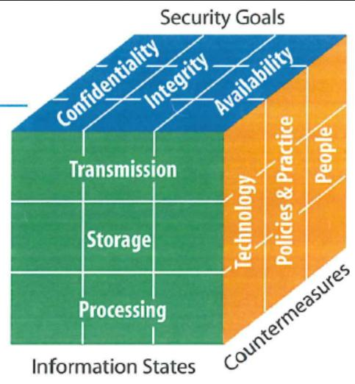
McCumber Cube
CIA: Confidentiality, Integrity, and Availability.
Asset state: where information is.
Safeguards: protections.
This Photo by Unknown Author is licensed under CC BY-NC-ND

Slide 20
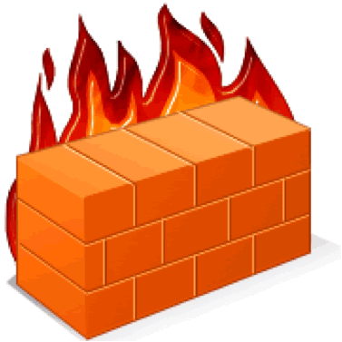
Safeguards
Outside the scope of the module.
Policy and practices: controls an organisation puts in place.
Human factors: for example training.
Technology: software and hardware solutions.
This Photo by Unknown Author is licensed under CC BY-NC-ND

Slide 21
Confidentiality, Integrity, and Availability
Confidentiality is the assurance that our systems keep user's data private.
Integrity is the assurance that a system preserves data.
Availability is the assurance that users can access resources.

Slide 22
Asset State
Storage is Data at Rest. Data in a hard drive, memory, or an external device (e.g., SD card) is at rest. Stored data usually is easiest to protect but is usually the most valuable.
Transmission is when a system moves data from one location to another. Network security targets this state.
The processing state occurs when data is in use. Most vulnerabilities occur in this state as a program is working on the data and is therefore open to modification and access.

Slide 23
Attacks

Slide 24
Some Terminology
Asset: something of value that a defender wishes to protect, e.g., passwords, bandwidth, CPU use, reputation, or simple credit card information.
Threat: a potential event causing an asset to lose value or an attacker taking possession of the data, e.g., transfer of ownership, destruction, disclosure, or corruption.
Vulnerability: a weakness in a system allowing a threat to occur. A white hat's role is to minimise vulnerabilities.
Risk: a vulnerability paired with a threat, meaning a comprise exists with insufficient protection leading to a possible attack.
Attack: a realised risk when an attacker performs an exploit.
Mitigation: the process of reducing risks be either reducing vulnerabilities or devaluing assets.

Slide 25
Attack Vector
Path an attacker takes to access an asset. Software engineers must understand attack vectors and mitigate against them.
Scenario: a malicious student wishes to change their grade on the records system.
Asset: the grade.
Threat: damage the integrity of the grade by altering it.
Vulnerability: for example, an administrator could have an unsafe password written on a piece of paper.
Risk: the student obtains the password, logs in as the administrator, and changes the grade.
Mitigation: a policy that no passwords are written down.

Slide 26
Threat Modelling
Threats are the starting point.
Threat modelling is the process of analysing a system for vulnerabilities.
Best done during specification and design work.
Agile:
Add user stories.
Add tests.
Dedicate Sprints to improving security.

Slide 27
Disclosure, Alteration, and Denial
Disclosure attacks are attacks on confidentiality. If an asset is viewed contrary to the wish of the owner, then a confidentiality breach or disclosure attach has occurred.
Alteration attacks are attacks on integrity. When an attacker makes unauthorised changes to a user's data, they have compromised system integrity and performed an alteration attack.
Denial attacks are attacks on availability. Denial of service attacks disrupts the user's access to systems, impacting the availability of that system.

Slide 28
STRIDE
Spoofing is pretending to be someone else, such as using another person's login details.
Tampering involves changing data in some manner such as deleting or modifying data.
Repudiation is disavowing an action or put simply hiding your tracks.
Information disclosure is the exposure of a user's confidential data against their wishes.
Denial of Service (DoS) attacks target service availability.
Elevation of privilege is finding a method of performing tasks the attacker is not authorised to do.

Slide 29
Summary

Slide 30
Summary
Defined the roles in computer security, looking at users, black hats, and white hats.
Described the ethics of white hats, presenting the (ISC)² Code of Ethics.
Defined the terms in the McCumber Cube including CIA, asset state, and safeguards.
Described computer security attacks and related terminology, such as STRIDE.

Slide 31
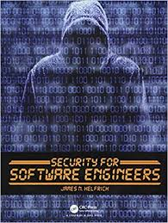
Recommended Reading
Security for Software Engineers by James Helfrich provides further depth to the areas we have covered in this lecture.

