Slide 1
Review
SET08103 Software Engineering Methods

Slide 2
Module Learning Outcomes
Bold ones are assessed by the exam.
LO1: Demonstrate understanding of a modern software development lifecycle.
LO2: Explain the different techniques supporting modern software engineering methods.
LO3: Define and analyse systems requirements and needs and specify a system design to deliver these requirements.
LO4: Apply modern software engineering methods and techniques to a software development project.
LO5: Explain the role of a computing professional in relation to social, ethical and legal issues surrounding projects.
LO6: Consider information security requirements in the development and delivery of software.

Slide 3
Exam
Three questions.
20 marks per question.
Must answer all three questions.
Q1 = LO2
Q2 = LO5
Q3 = LO6

Slide 4
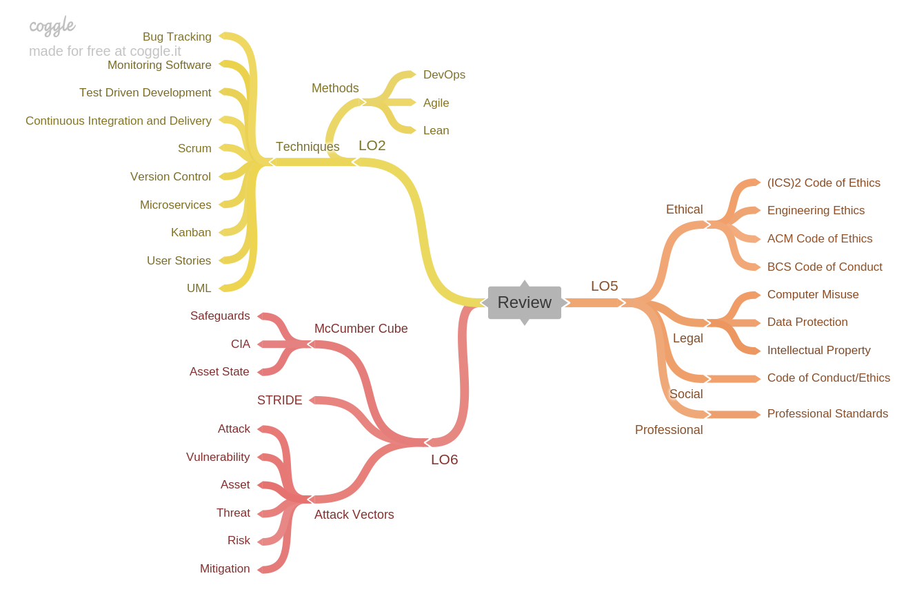
Module Map

Slide 5
LO2 Explain the different techniques supporting modern software engineering methods.
Techniques:
Scrum.
Version Control.
Kanban.
User Stories.
UML.
Microservices.
Test Driven Development.
Continuous Integration and Delivery.
Monitoring Software.
Bug Tracking.
Methods:
Agile.
Lean.
DevOps.

Slide 6
LO2 – Questions to Ask Yourself
Can I explain the different techniques?
Can I explain the four values of the Agile Manifesto?
Can I explain the seven key principles of Lean Software Development?
Can I explain the three ways of DevOps?
How do the different techniques support Agile?
How do the different techniques support Lean Software Development?
How do the different techniques support DevOps?

Slide 7
LO5 Explain the role of a computing professional in relation to social, ethical and legal issues surrounding projects.
Social:
Code of Conduct and ethics.
Ethical:
Engineering ethics.
ACM Code of Ethics.
BCS Code of Conduct.
(ISC)² Code of Ethics
Legal:
Computer misuse.
Data protection.
Intellectual property.

Slide 8
LO5 – Questions to Ask Yourself
Can I explain the three principles of engineering ethics?
Can I explain the four principles of the ACM Code of Ethics?
Can I explain the four principles of the BCS Code of Conduct?
Can I explain the four principles of the (ISC)² Code of Ethics?
How do the ACM/BCS/(ISC)² compare to engineering ethics?
How does the ACM compare to the BCS?
How does the ACM compare to (ISC)²?
How doe the BCS compare to (ISC)²?
Can I explain the three core offences set out in the Computer Misuse Act?
Can I explain the eight principles of Data Protection?
Can I explain the difference between copyright and patents?
Can I explain the different legal areas covered by Computer Misuse, Data Protection, and Intellectual Property Rights?

Slide 9
LO6: Consider information security requirements in the development and delivery of software.
McCumber Cube:
CIA.
Asset State.
Safeguards.
Attacks:
Attack vectors.
Asset.
Threat.
Vulnerability.
Risk.
Attack.
Mitigation.
STRIDE

Slide 10
LO6 – Questions to Ask Yourself
Can I explain the different sides of the McCumber Cube?
Can I explain the different attacks on CIA assurances?
Can I explain what an attack vector is?
Can I provide an example of an attack vector?
Can I explain the different terminology surrounding an attack?
Can I explain the different attacks defined in STRIDE?

