Slide 1


Slide 2




What’s Apache Cassandra ?
Apache Cassandra is an open source, noSQL, distributed database management system that is used for handling big data.
It’s focused on availability, speed and scalability.
Since Cassandra is able to store massive amount of data and handle thousands of writes per second, it’s widely used by big companies.

Slide 3
Distributed ?
NODE
Leaderless P2P - Any node can do what others can do.
GOSSIP - The protocol nodes use to transfer information about each other.
No Single Point Failure - (High Availability)
Geographic Distribution
NODE
NODE
DATACENTER
NODE
NODE

Slide 4
How ?
Course Code | Lecturer | Score
ACM111 | Tamer Karalı | 9.6
ACM111 | Manu Dube | 3.5
ACM112 | Erhan Tümsa | 10 <3
ACM112 | Can Kara | 7
ACM113 | Cemre Deve | 4.8
ACM113 | Şeyma Subaşı | 0.1
ACM113 | Cristiano Ronaldo | 9.9
Partition Key

Slide 5
ACM111 | Tamer Karalı | 9.6
ACM111 | Manu Dube | 3.5
ACM112 | Erhan Tümsa | 10
ACM112 | Can Kara | 7
ACM113 | Şeyma Subaşı | 0.1
ACM113 | Ronaldo | 9.9

Slide 6
Replication in Cassandra
Partition Key
0
hash( PK )
10
5
Partition token

Slide 7
ACM111 | Tamer Karalı | 9.6
hash( ACM111 )
8
0
8
ACM111 | Tamer Karalı | 9.6
10
5

Slide 8
Replication Factor = RF = 1
0
8
ACM111 | … | …
10
5

Slide 9
Replication Factor = RF = 2
8
ACM111 | … | …
0
8
ACM111 | … | …
10
5

Slide 10
Replication Factor = RF = 3
8
ACM111 | … | …
0
8
ACM111 | … | …
10
5
8
ACM111 | … | …

Slide 11
What about INSERT ?
6
RF = 3
ACM999 | … | …
0
6
6
ACM999 | … | …
ACM999 | … | …
10
5
Coordinator Node

Slide 12
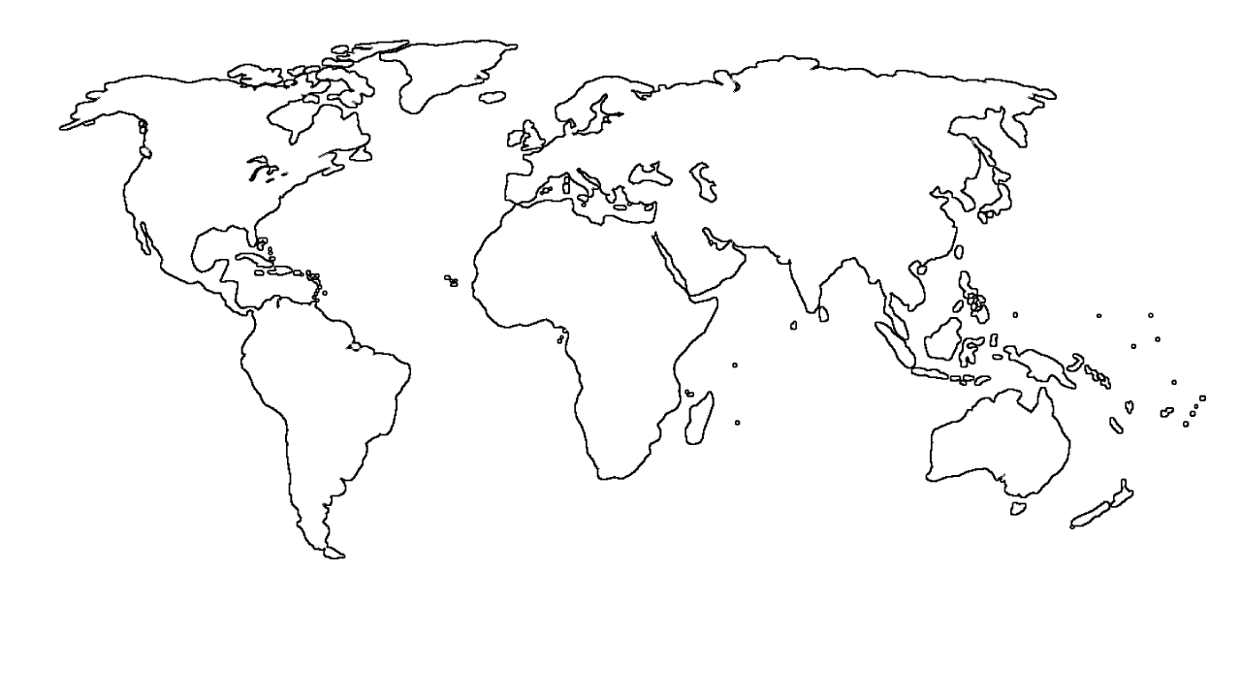
Why Cassandra ?
1 - Scalability
2 - Availability

Slide 13

Why Cassandra ?
3 - Fault Tolerance
4 - Performance

Slide 14

Let’s See Cassandra

