Slide 1


HACKATHON 2024
WebGPT
AI-Powered Web Scraping and Content Generation
LNRS HACKATHON 2024
1
Notes:
1

Slide 2

ABOUT ME
Name: Boobalamurugan S
Email Id: 2k21aids07@kiot.ac.in
Contact No: 8072229191
Github Account: Boobalamurugan
Repo Link: https://shorturl.at/URcvH
Topic: Gen AI context / QnA using Website
College: Knowledge Institute Of Technology
Student Id: 2k21AI07
Notes:
2

Slide 3

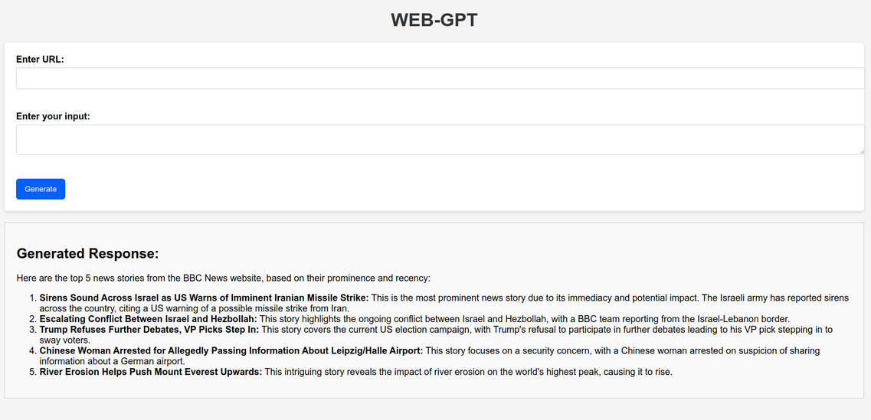
Overview
WebGPT is an advanced Flask-based web application designed to make web scraping and content generation seamless. It scrapes content from a specified URL, processes it with BeautifulSoup, and uses the Gemini API for AI-powered content generation.
This solution provides an intuitive web interface that allows users to input a URL, add comments, and receive both extracted content and AI-generated insights.
webGPT Interface image
LNRS HACKATHON 2024
7

Slide 4
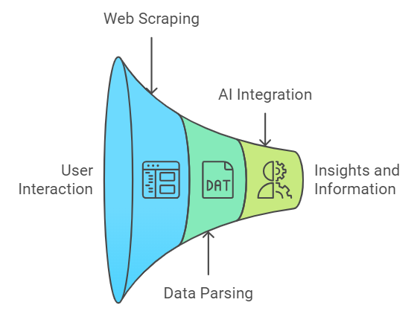
How WebGPT Functions: A Step-by-Step Overview
1. User Input
User provides a URL and asks a question or comment about the content.
2. Web Scraping
Scrape the webpage to extract relevant content using tools like requests and BeautifulSoup.
3. Data Parsing
Clean and structure the extracted data for processing.
4. AI Integration
Use an AI model to analyze the data and generate responses (e.g., summaries, answers).
5. Output
Display the AI-generated response to the user.
LNRS HACKATHON 2024
4

Slide 5

Innovative Features of WebGPT
Innovative Aspects of WebGPT
AI-Powered Insights: Combines traditional web scraping with advanced AI to provide tailored responses.
Real-Time Processing: Quickly retrieves and analyzes content for immediate feedback.
User-Centric Design: Intuitive interface that simplifies complex operations for non-technical users.
Versatile Applications: Can be adapted for various domains (education, marketing, research).
LNRS HACKATHON 2024
5

Slide 6
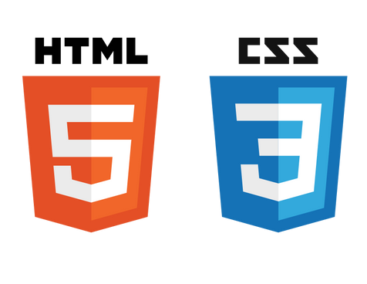




Technical Implementation of WebGPT
Architecture Overview
Frontend:
Built with HTML/CSS, Flask for routing and rendering.
Backend:
Requests: For HTTP requests to fetch webpage content.
BeautifulSoup: For parsing HTML and extracting relevant data.
Gemini API: Integration for generating AI responses.
LNRS HACKATHON 2024
6

Slide 7

Utilizing WebGPT: Practical Applications
Real-Time Summarization: Users can input URLs from news websites like BBC, and WebGPT will extract key information, summarize it, and offer AI-powered insights.
Technical Support for Developers: Instant AI-generated answers to coding questions, frameworks, and libraries, with references to documentation.
Legal Consultation: Tailored responses to legal queries, summarizing laws and regulations, utilizing legal databases for accuracy.
Healthcare Information: Reliable answers about medical conditions and treatments, extracting content from reputable medical sources.
LNRS HACKATHON 2024
9

Slide 8
WebGPT 2.0: Next Steps in Development
Web App Development as a Client Chatbot:
Develop a dedicated web application that integrates WebGPT as a chatbot for client interaction, allowing customers to easily find product information, ask questions, and receive instant responses, enhancing customer engagement and satisfaction.
Browser Extension and API Development:
Create a browser extension and a public API to allow users to access WebGPT functionalities directly from any webpage, increasing usability and accessibility.
E-commerce Integration:
Develop capabilities to scrape product details from e-commerce sites, providing recommendations and comparisons to enhance the shopping experience.
Full RAG Capabilities:
Develop Retrieval-Augmented Generation features to combine web-sourced data with internal knowledge bases, ensuring accurate and relevant answers.
LNRS HACKATHON 2024
10

Slide 9

Understanding the Limitations of WebGPT
Content Relevance: The AI-generated response may depend on the quality and relevance of the scraped content.
Webpage Structure: Webpages with complex or dynamic content may not be fully processed.
API Dependency: The functionality of AI content generation depends on the availability and performance of the Gemini API.
NOTE: But we can overcome this limitation in WebGPT 2.0
LNRS HACKATHON 2024
8

Slide 10
THANK YOU
LNRS HACKATHON 2024

