Slide 1
PROBLEM STATEMENT TITLE : DARK PATTERN IN ECOMMERCE SITES PROBLEM CODE : 06 TEAM LEADER NAME : BOOBATHI RAJA K M TEAM ID : KEC_1052 TEAM MEMBERS : BOOBATHI RAJA K M (22ECR034) DHARSHAN S (22ECR046) DHIVYA V (22ECR048) ELANGO S (22ECR053) GOWTHAM M S (22ECR061)
KONGU ENGINEERING COLLEGE, PERUNDURAI KEC HACKATHON 2024 - SOFTWARE EDITION

Slide 2


IDEA DESCRIPTION
Identify Dark patterns and Fake offers on the e-commerce platform.
Scraping product data from e-commerce platform based on provided URLs.
Compares scraped data with the Actual data from the official product site.
Determines deviations in prices and discounts to ascertain whether a dark pattern is present.
Enhance transparency and protect consumers from deceptive practices in online shopping.

Slide 3
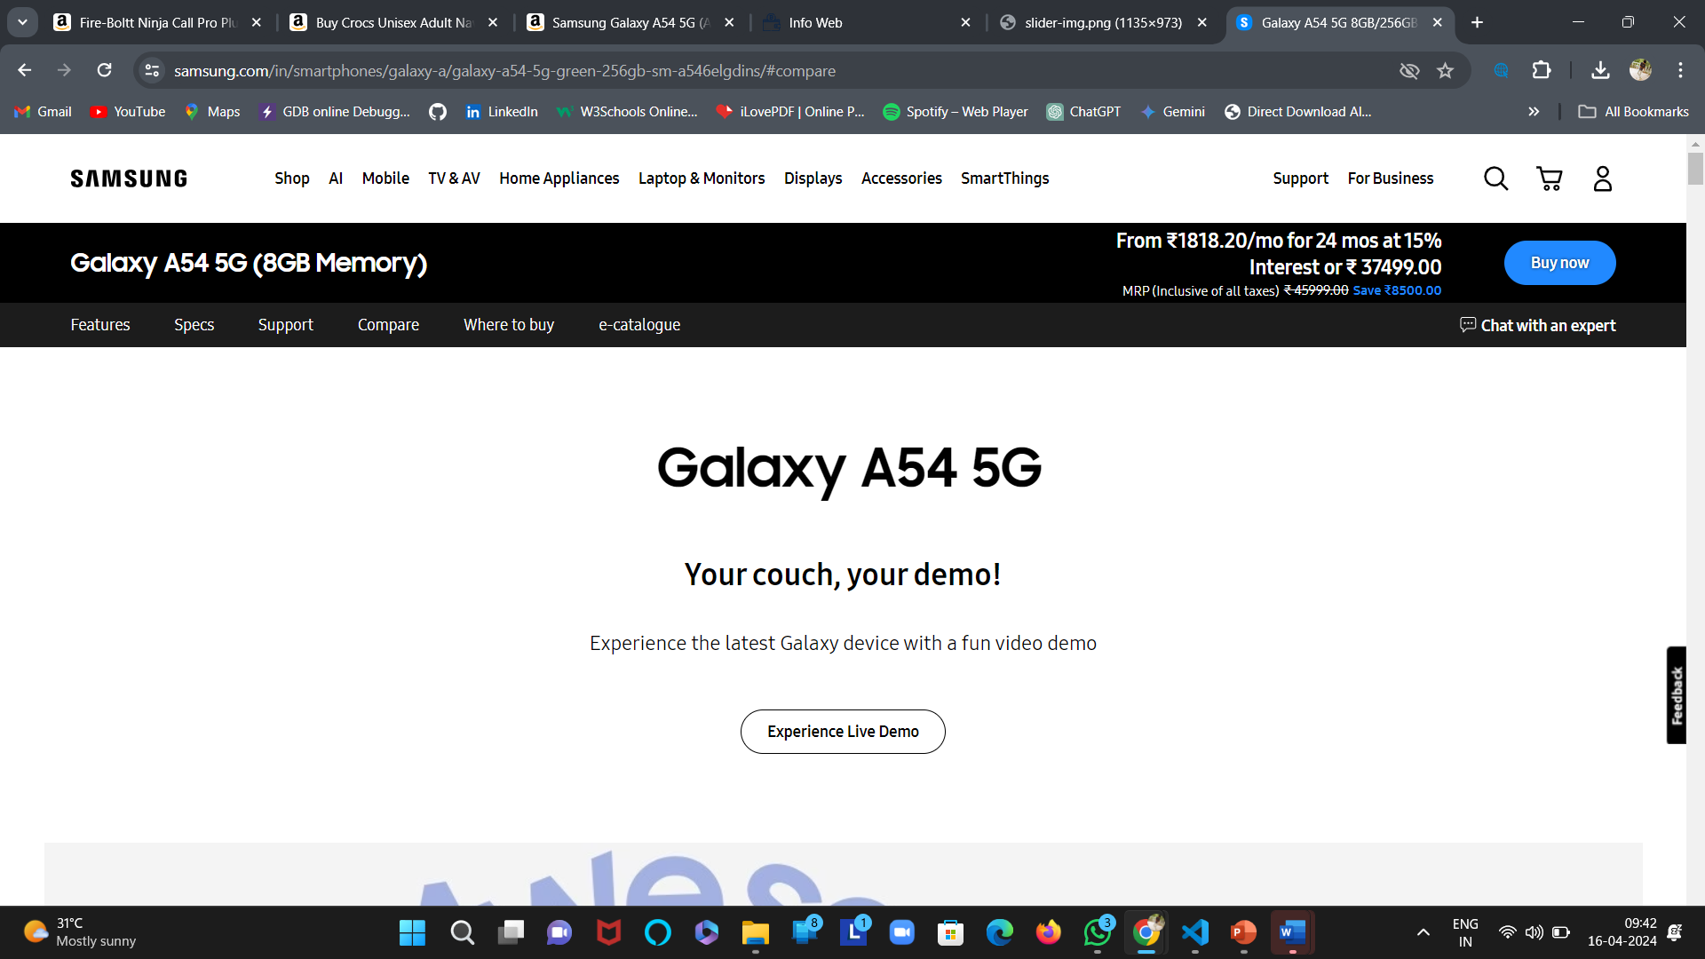
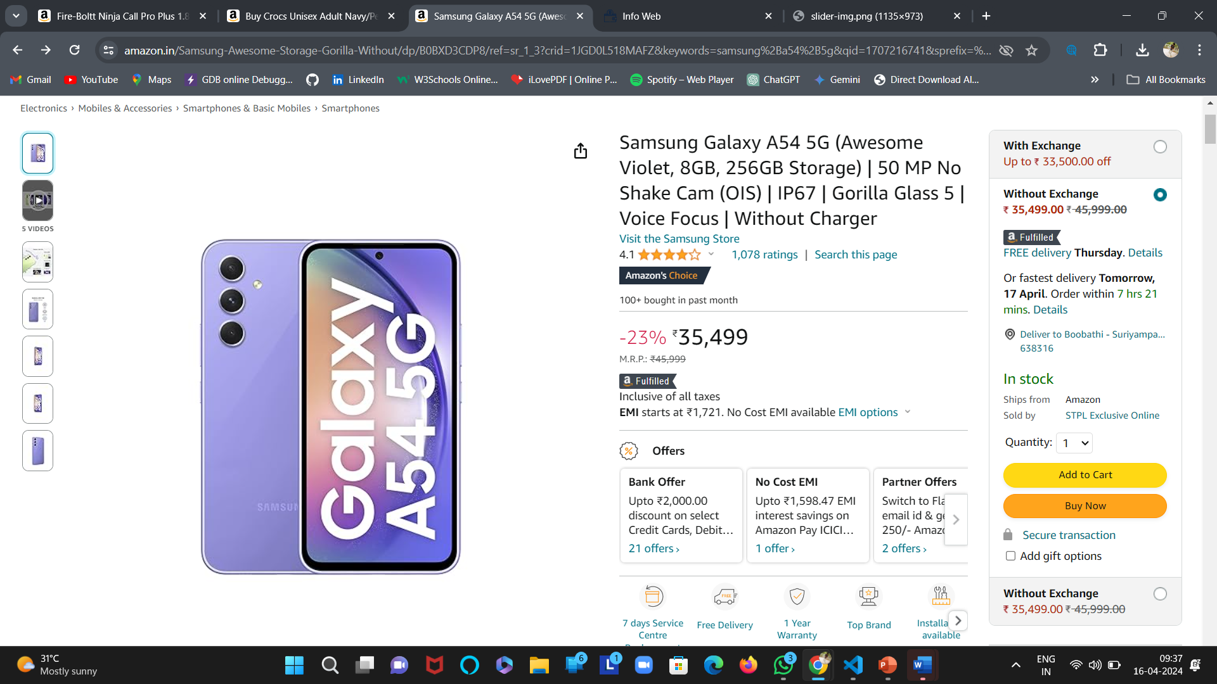
DEVIATION IN DISCOUNTS FROM THE OFFICIAL SITES
Tab URL

Slide 4
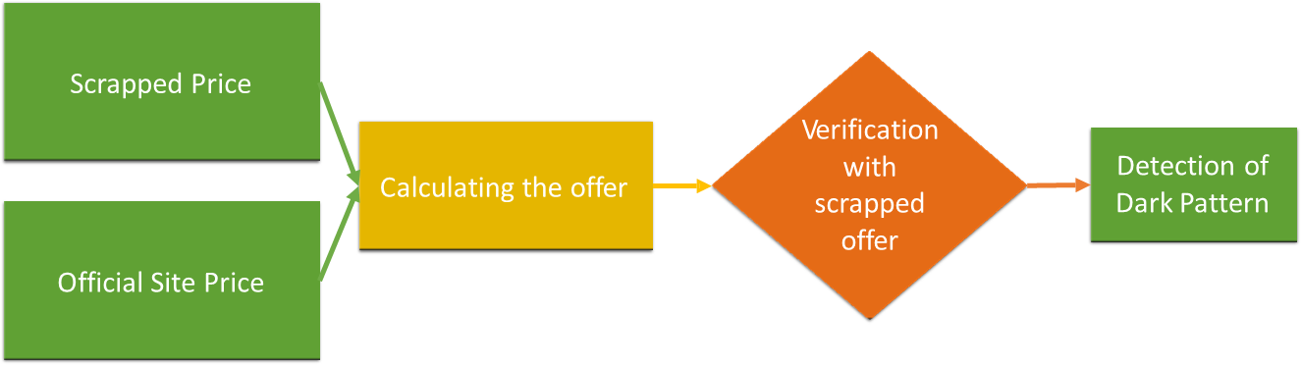
ALGORITHM :
TECHNOLOGIES USED :
HTML and CSS | Java Script | Python – Flask,Cors |Scrapy Framework
Tab URL

Slide 5
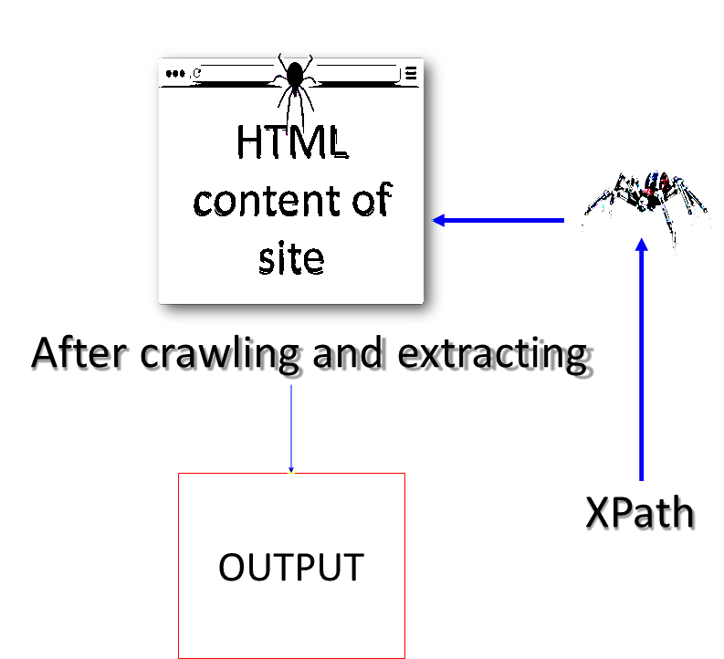
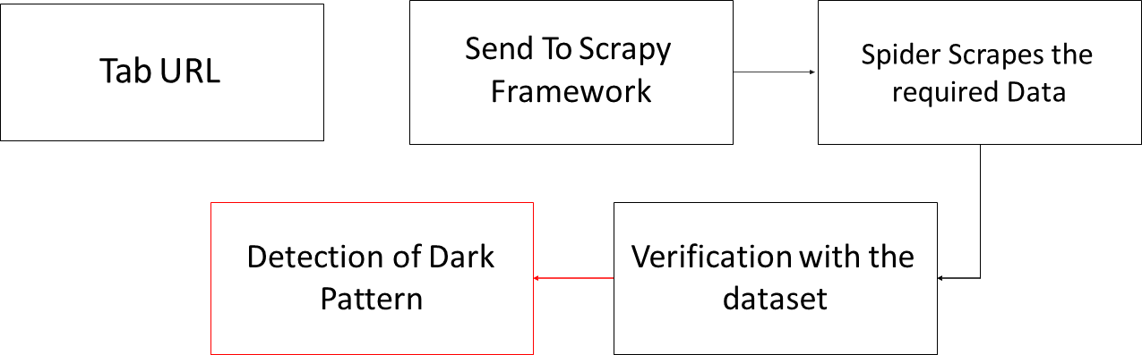
BACK - END SCRAPPING
SCRAPY FRAMEWORK :
In Scrapy, a spider is a class that defines how a website will be scraped, specifying the rules for navigating and extracting data.
FLOW CHART :
Tab URL

